Slide 1
Growth and Demographic Trends
Presented to the
Redistricting Task Force
By Mark McAvoy
Director, Planning and Data Analytics
October 22, 2020

Slide 2















Population
Rank 2017 | City | 2018 Population | Percent Change 2010 - 2018 | Population per Square Mile
1 | New York | 8,398,748 | 2.74% | 27,961
2 | Los Angeles | 3,990,456 | 5.22% | 8,515
3 | Chicago | 2,705,994 | 0.39% | 11,901
4 | Houston | 2,325,502 | 10.77% | 3,651
5 | Phoenix | 1,660,272 | 14.85% | 3,207
6 | Philadelphia | 1,584,138 | 3.81% | 11,801
7 | San Antonio | 1,532,233 | 15.43% | 3,162
8 | San Diego | 1,425,976 | 9.07% | 4,380
9 | Dallas | 1,345,047 | 12.29% | 3,960
10 | San Jose | 1,030,119 | 8.90% | 5,817
11 | Austin | 964,254 | 22.00% | 3,237
12 | Jacksonville | 903,889 | 9.99% | 1,210
13 | Fort Worth | 895,008 | 20.75% | 2,517
14 | Columbus | 892,533 | 13.40% | 4,110
15 | San Francisco | 883,305 | 9.70% | 18,846
16 | Charlotte | 872,498 | 19.29% | 2,931
17 | Indianapolis | 867,125 | 5.69% | 2,399
18 | Seattle | 744,955 | 22.39% | 8,875
19 | Denver | 716,492 | 19.38% | 4,683
20 | Washington, DC | 702,455 | 16.74% | 11,506
Fort Worth ranks…
3rd in growth rate
13th in population
40th in density out of top 50 cities
Source: U.S. Census Bureau, 7/1/2019 estimate, Fort Worth Planning & Data Analytics, 2020
Notes:
18th lowest density out of top 20 cities.
Out of the top 50 cities, Fort Worth ranks #40 in terms of population density. The remaining cities’ land area is based on 2010 Census data, and as such has likely changed since.

Slide 3
Population Growth, 1950-2045
Fort Worth, Dallas, and Arlington
1,316,000
1,125,000
909,585
Source: U.S. Census Bureau estimate for July 1, 2019; NCTCOG

Slide 4
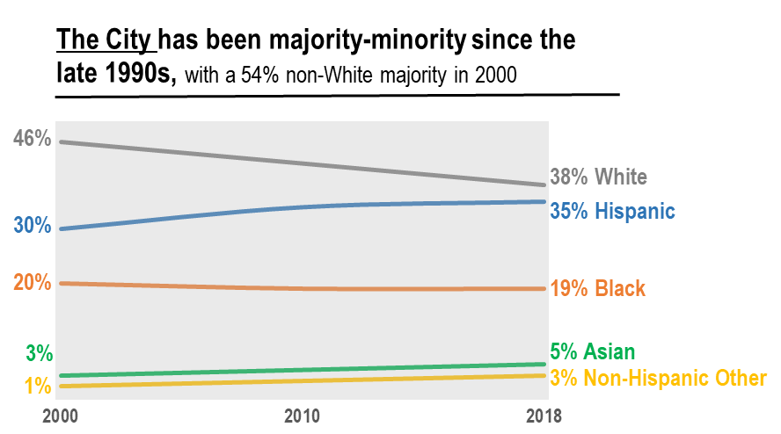
Source: US Census Bureau,2018 American Community Survey 1-Year Estimates
Notes:
You saw this graph in Dana’s presentation this morning, showing the closing gap between the % of white and Hispanic citizens in Fort Worth

Slide 5
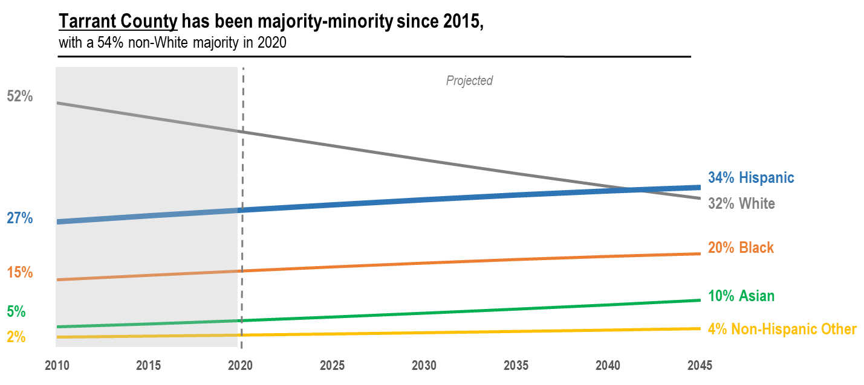
Source: Texas Demographic Center, Tarrant County Population
Notes:
We do not perform demographic projections by race at the City level, so to look forward we use the Texas Demographic Center’s projections. When we look at their projections in Tarrant County through 2045, Whites are steadily declining, while Hispanic, Black and Asian populations are all increasing. In 2010, the White population in Tarrant County was 52% , but declined to 49% in 2015 resulting in a majority-minority around that time. In 2020, the non-White population was 54%.
Here you can see that Hispanics will become the largest population in the County in the early 2040s, just outside our 20-year look-ahead window.
In 2045 Hispanics will make up 34% of Tarrant County’s population while Whites will make up 32%.
2020 %s:
46% White/54% non-white made up of:
29% Hispanic
16% black
6% Asian
3 % NH Other
You can see by the Texas Demographic Center’s projections,

Slide 6
Generations
75 ­­and over
Fort Worth's population is comparatively young
55 – 74
Percent Age Under 18
United States | Texas | DFW | Fort Worth
25.2% | 28.7% | 28.6% | 30.3%
35 – 54
19 – 34
age 18 and under
Source: U.S. Census, 2018 ACS 1-Year Estimates

Slide 7
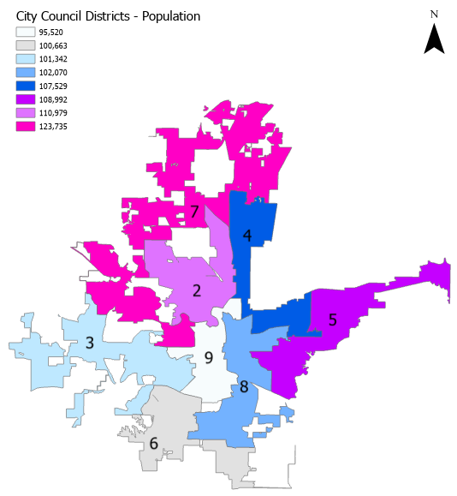
Population per Council District
Source: U.S. Census Bureau, 2014-2018 American Community Survey 5-Year Estimates

Slide 8
Race/Ethnicity, 2000 - 2018
2000
2010
2018
Fastest growing category from 2000 to 2018 = Hispanic
Sources: U.S. Census, 2000, 2010, 2014-2018 ACS 5-year estimates

Slide 9
Voter Statistics
Total Population
by Race and Ethnicity: 909,585
Voting Age Population**
by Race and Ethnicity: 633,980
Total Registered Voters*
by Race/Ethnicity: 388,643
Sources: U.S. Census 2014-2018 ACS 5-year estimates
*obtained from the Elections Division, Texas Secretary of State, 2015
**Generation Z (18 and under) comprises 30.3% of Fort Worth’s Population

Slide 10
Voter Participation – General Municipal and Bond Elections
Average Turnout 7.6%
Source: City Secretary’s Office, City of Fort Worth
Notes:
Combine with next slide

Slide 11
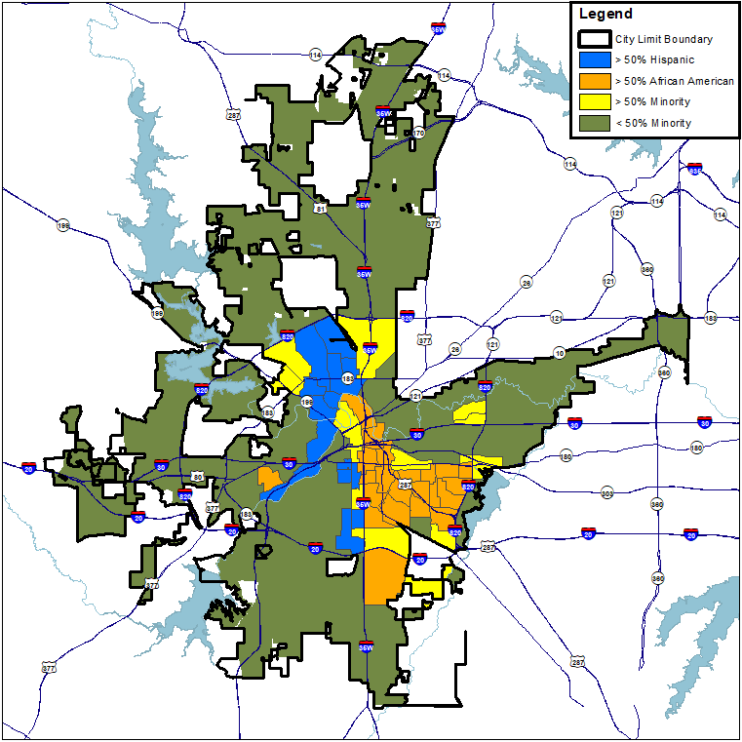
Population Breakdown, 1990
Source: US Census 1990

Slide 12
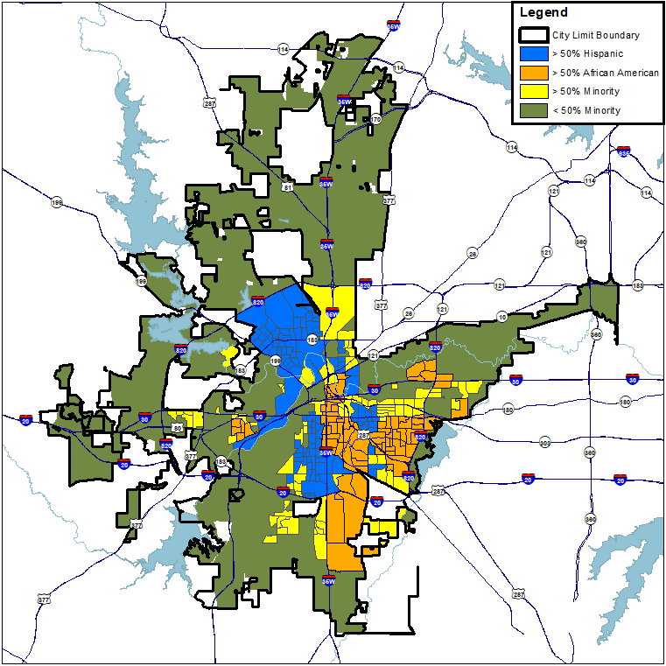
Population Breakdown, 2000
Source: US Census 2000

Slide 13
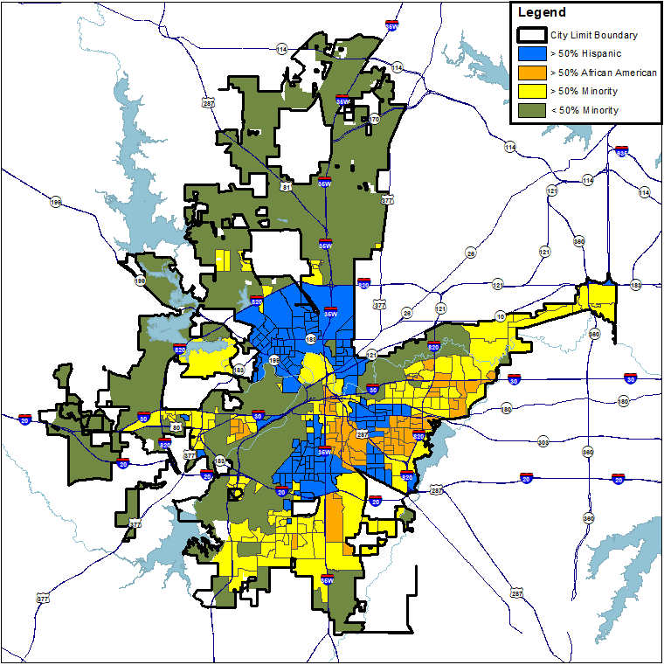
Population Breakdown, 2010
More diverse and
less segregated
Source: US Census 2010

Slide 14
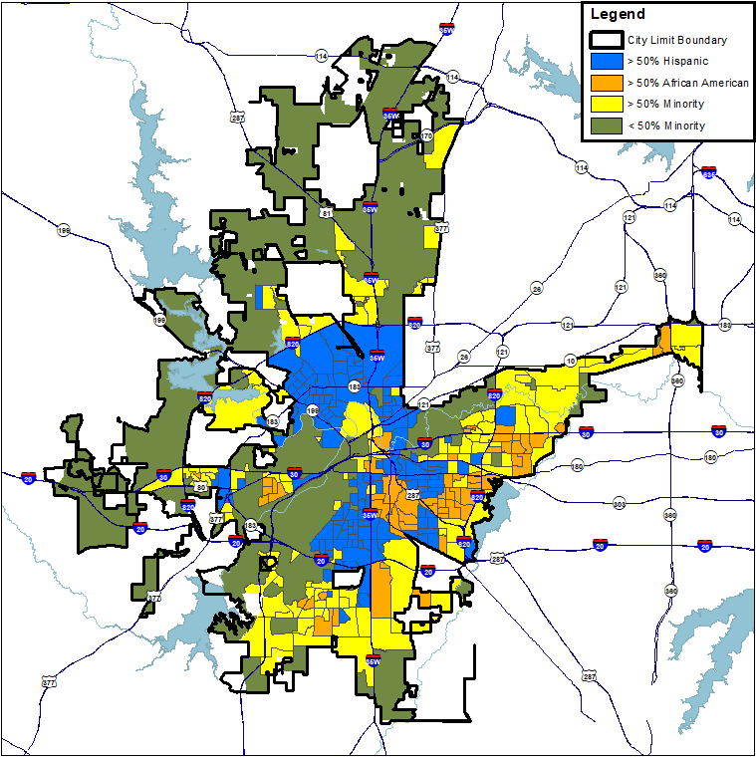
Population Breakdown, 2015
Continuing to grow more diverse and
less segregated
Source: US Census 2015

Slide 15
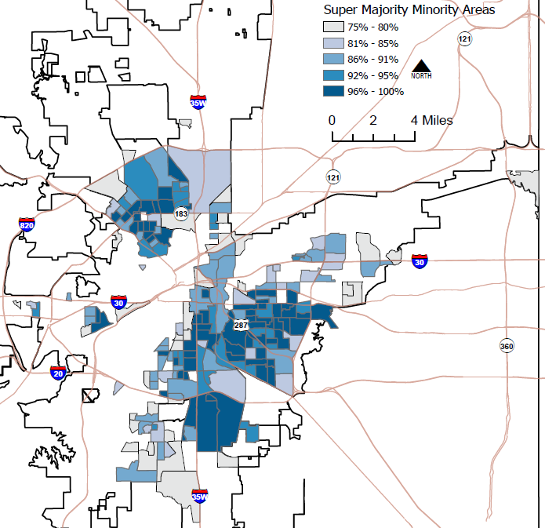
Super Majority Minority Areas, 2020
Minority populations (non-White) making up 75% or more of the total population. Concentrated in Northside, Central, South, Southeast
Source: City of Fort Worth, Planning & Data Analytics

