Slide 1
Growth and Demographic Trends
Presented to the
Redistricting Task Force
By Mark McAvoy
Director, Planning and Data Analytics
November 19, 2020

Slide 2
909K
+23% over 2010 Census

Slide 3
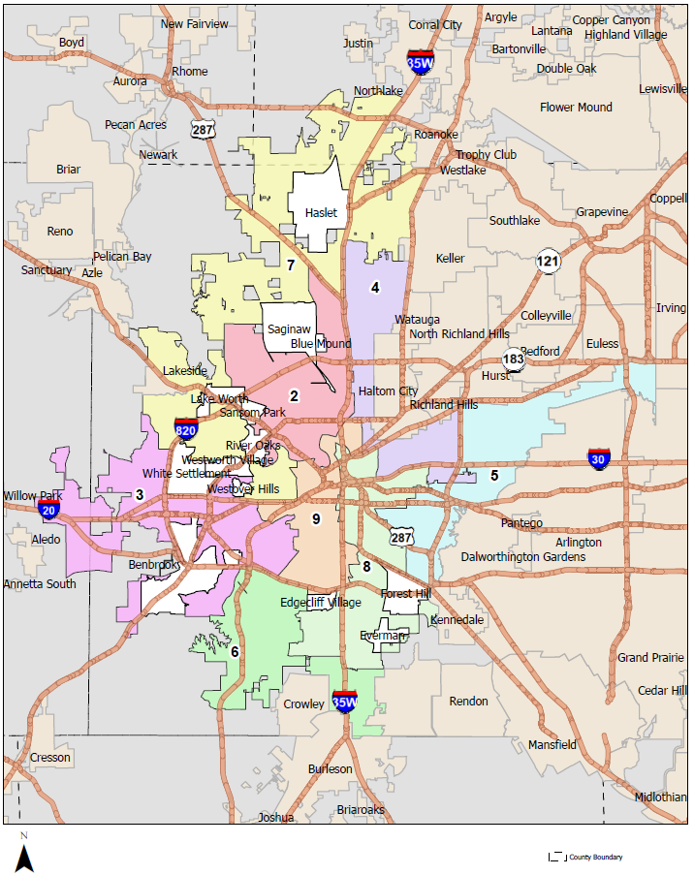
Council District Boundaries, 2020

Slide 4
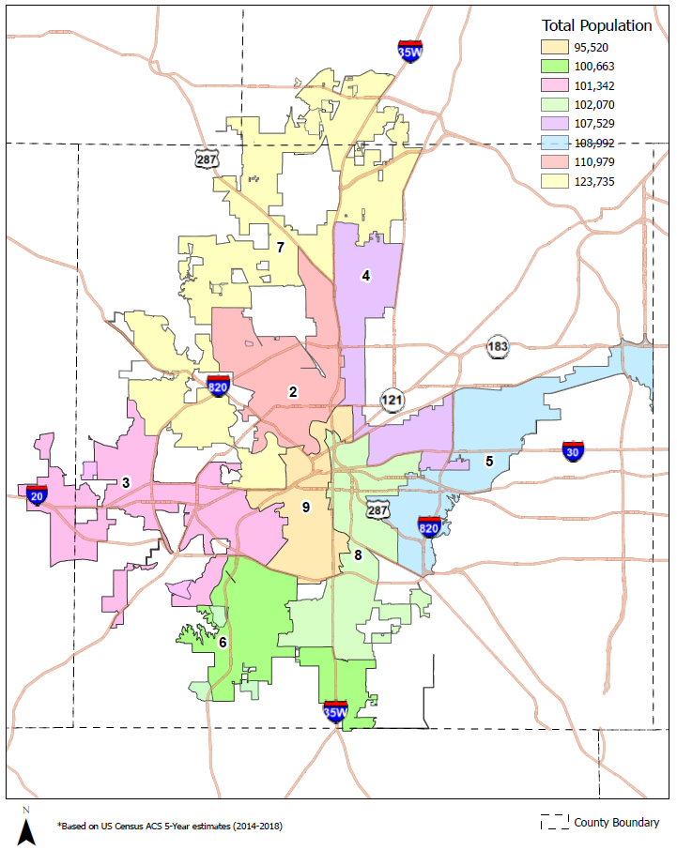
Population by Council District, 2018
Total = 850,830
Average = 106,354
Source: US Census ACS 5-Year estimates (2014 – 2018)

Slide 5
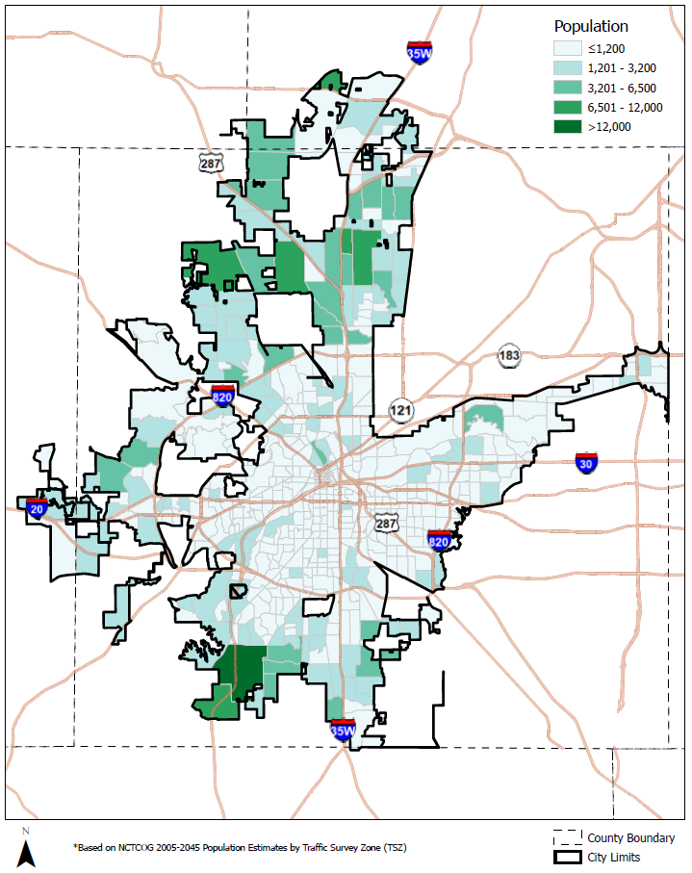
Projected Population, 2020
Traffic Survey Zone (TSZ) is a unit of geography most commonly used in transportation planning models.
Source: NCTCOG 2005 -2045 Population Estimates by Traffic Survey Zone

Slide 6
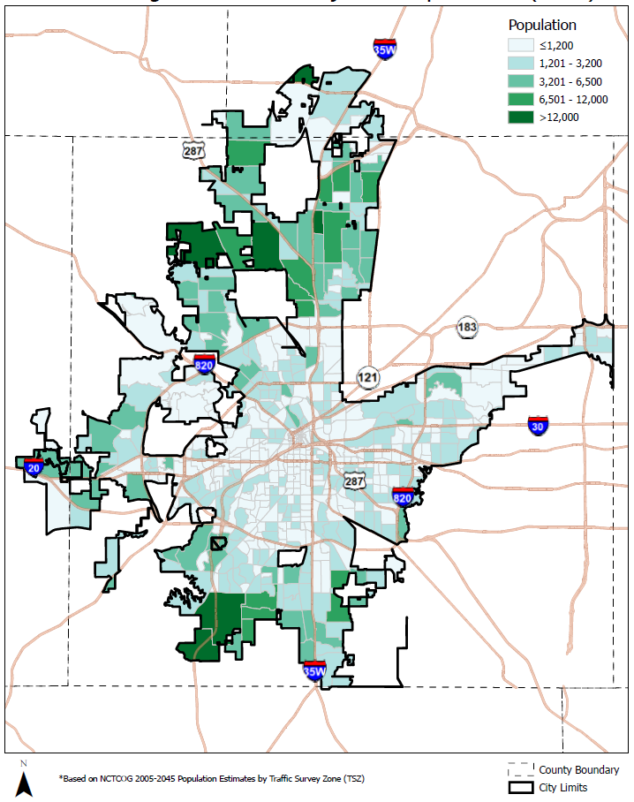
Projected Population, 2030
Traffic Survey Zone (TSZ) is a unit of geography most commonly used in transportation planning models.
Source: NCTCOG 2005 -2045 Population Estimates by Traffic Survey Zone

Slide 7
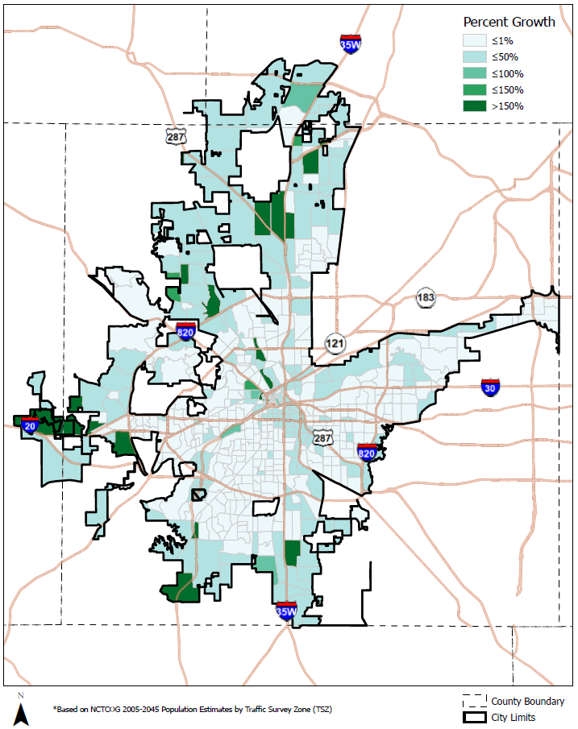
Projected Growth Rate, 2020 - 2030
Traffic Survey Zone (TSZ) is a unit of geography most commonly used in transportation planning models.
Source: NCTCOG 2005 -2045 Population Estimates by Traffic Survey Zone

Slide 8
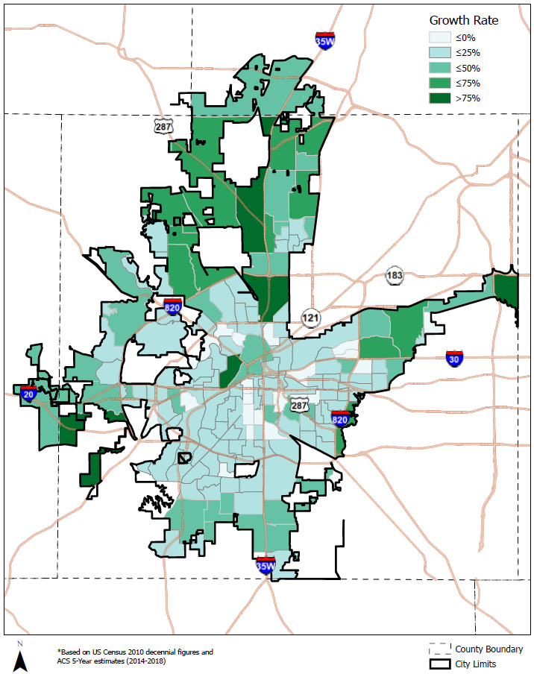
Population Growth Rate, 2010- 2018
Census Tract is a unit of geography defined for the purpose of taking a census.
Source: US Census 2010 decennial figures; ACS 5-year estimates (2014-2018)

Slide 9
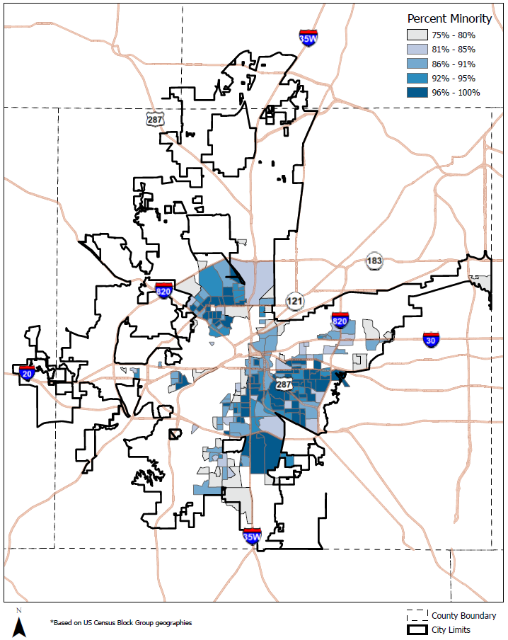
Super Majority Minority Areas, 2020
Census Block Group is a subdivision of a Census Tract.
Source: US Census Block Group geographies

