Slide 1
PRELIMINARY FINDINGS OF THE REDISTRICTING TASK FORCE
November 19, 2020

Slide 2

Redistricting Task Force
Place 1: Lorraine Miller (Chair)
Place 2: Salvador Espino
Place 3: Graham Norris
Place 4: Craig Allen
Place 5: Bert Williams
Place 6: Linda Kennedy
Place 7: Tony DeVito
Place 8: Tracy Scott
Place 9: Kent Bradshaw
Place 10: Bill Schur
Place 11: Teresa Ayala

Slide 3
Task Force Schedule, August – December 2020
Month | Activity
August | City Council adopts resolution appointing Redistricting Task Force.
September | Staff presents informational briefings. Task force charge Open Meetings Act training Redistricting history and schedule Legal basis for redistricting Demonstration of redistricting software
October | Task force interviews representatives from Austin and San Antonio. Staff presents additional informational briefings. Voting Rights Act Local demographic trends
November | Staff provides task force with additional demographic data. Task force discusses preliminary findings. Task force discusses arrangements for Redistricting 101 seminar and public meetings.
December | Task force presents interim report to City Council.

Slide 4
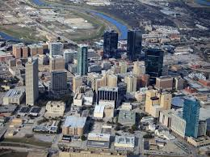
Recent History
2011 After release of 2010 census results, City Council adopts redistricting criteria and redraws district lines accordingly.
2013 U.S. Supreme Court invalidates coverage provisions of Voting Rights Act.
Voters amend City Charter to increase number of single-member districts from eight to ten.
Task Force on Race and Culture recommends appointment of Charter Review Task Force to “study and make recommendation(s) concerning an independent redistricting commission.”
City Manager recommends, and City Council approves, focusing on criteria and procedures, with a goal to “create districts that, when drawn, provide the best opportunities to elect City Council members who reflect the diverse population of the City.”
2020 COVID-19 strikes United States, causing seven-month delay in census and subsequent redistricting.
2020 City Council appoints Redistricting Task Force.

Slide 5

Local Demographic Trends
Fort Worth’s population has been growing rapidly and will continue to do so.
Most of the fastest growing neighborhoods are located north of Loop 820.
Hispanics represent the fastest growing demographic group, though their proportion of voting-age population, voter registration rates, and voter participation rates tend to be relatively low.
African-American and Hispanic populations are increasingly less concentrated and more widely dispersed throughout the city, thereby making it somewhat more difficult to create “opportunity districts” but also more difficult to dilute minority voting strength through “packing and cracking.”

Slide 6
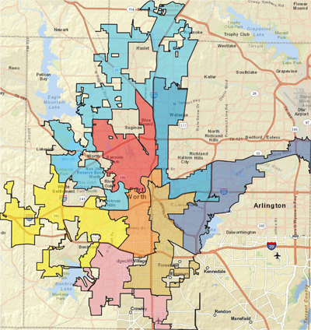
2011 Redistricting Criteria
Per Resolution No. 3998-06-2011, Adopted June 14, 2011
Approximately equal size: Population of largest district < 10 percent more than population of smallest district.
No fragmentation of minority communities or packing of minority voters
No retrogression in ability of minorities to participate in electoral process
Compact and contiguous territory
Identifiable geographic boundaries
Containing communities of interest in single districts
Including areas inside Loop 820 and areas outside Loop 820, if possible, within each Council district
Containing whole voting precincts
Containing whole census blocks or block groups
Preserving incumbent-constituent relations

Slide 7
Comments on 2011 Redistricting Criteria
Criterion | Comments
1. Approximately equal size: Population of largest district < 10 percent more than population of smallest district | Retain
2. No fragmentation of minority communities or packing of minority voters | Retain, but establish objective standards for packing and cracking
3. No retrogression in ability of minorities to participate in electoral process | Retain, though no longer required by Voting Rights Act
4. Compact and contiguous territory | Retain, but establish objective standard for compactness
5. Identifiable geographic boundaries | Retain
6. Containing communities of interest in single districts | Retain, but define “communities of interest”
7. Including areas inside Loop 820 and areas outside Loop 820, if possible, within each Council district | Retain? Delete?
8. Containing whole voting precincts | Retain
9. Containing whole census blocks or block groups | Retain
10. Preserving incumbent-constituent relations | Retain? Delete?

Slide 8
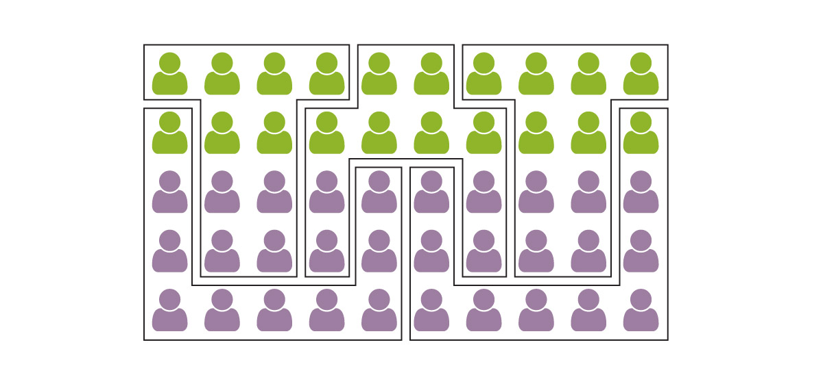
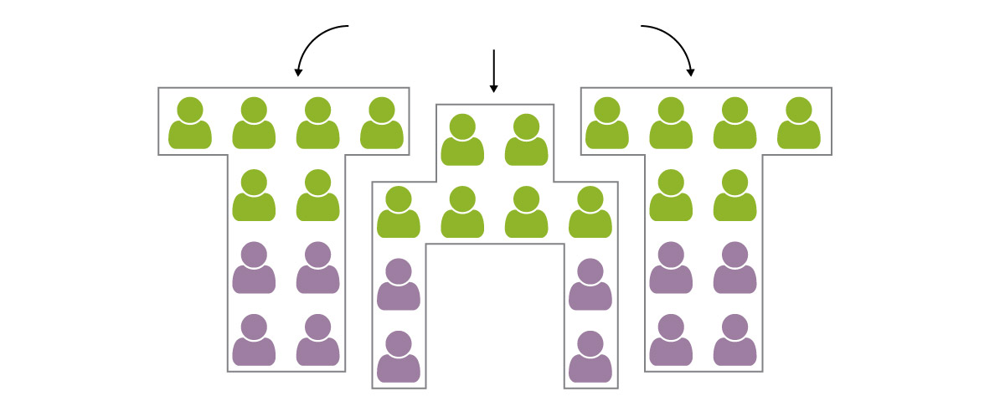
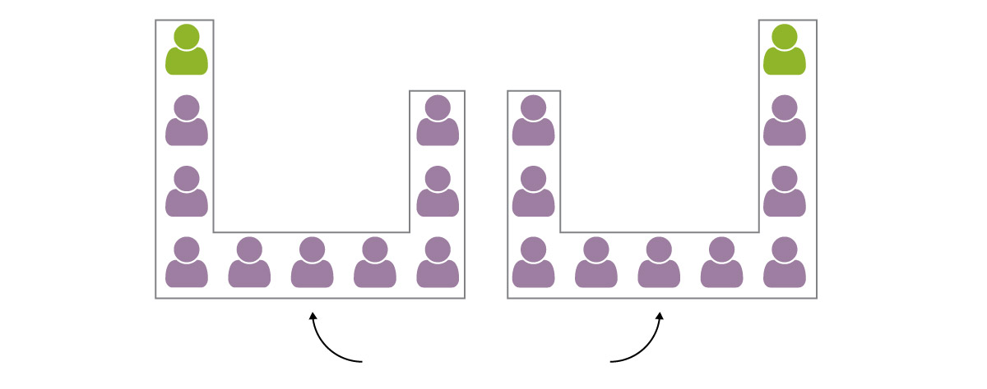
Packing and Cracking
In this example, minorities (in purple) comprise 60 percent of voters.
If voting patterns follow racial and ethnic lines, however, then minorities are likely to elect only two of five representatives.
3 Cracked Districts
2 Packed Districts
Graphics from WashingtonPost.com

Slide 9
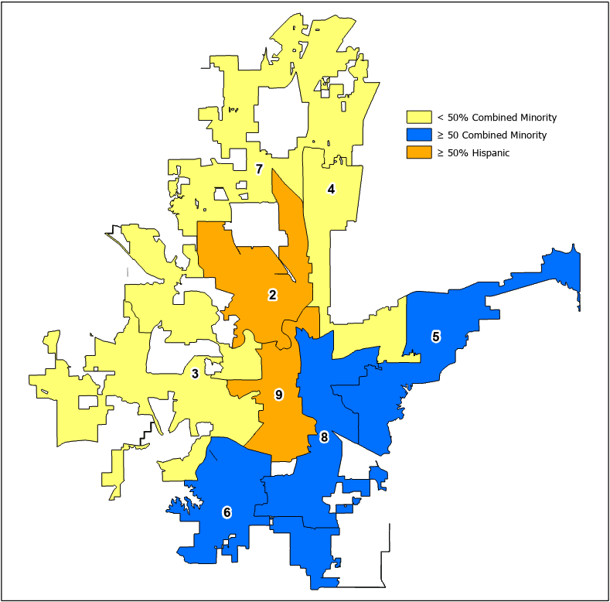
Packing and Cracking
To prevent packing, create districts with proportion of combined minority population < 90 percent.
To prevent cracking, create a minimum number of minority opportunity districts, with combined minority population > 50 percent, in proportion to the City’s combined minority population.
< 50% combined minority: Districts 3, 4, and 7
> 50% combined minority = minority opportunity districts: Districts 5, 6, and 8
> 50% Hispanic = Hispanic opportunity districts:
Districts 2 and 9
Note: 2012 map contains no African-American opportunity districts and no packed districts.
Proportion of minority voters by Council district based upon 2010 population

Slide 10
Minority Opportunity Districts
District | White | Black | Hispanic | Asian | Other | Raw Pop
2 | 27 | 6 | 62 | 3 | 0 | 93,845
3 | 64 | 11 | 21 | 2 | 0 | 93,218
4 | 53 | 14 | 23 | 7 | 0 | 96,603
5 | 24 | 42 | 27 | 4 | 0 | 91,625
6 | 46 | 26 | 22 | 4 | 0 | 90,366
7 | 71 | 6 | 17 | 3 | 1 | 96,237
8 | 16 | 36 | 43 | 3 | 0 | 92,155
9 | 33 | 6 | 58 | 2 | 0 | 89,777
Minority Opportunity District
Hispanic Opportunity District

Slide 11

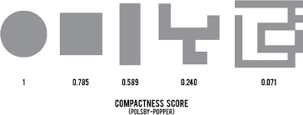
Compactness
To promote compactness, create districts with compactness scores > 0.050?

Slide 12
Compactness Scores of Current Council Districts

Slide 13

Communities of Interest
A local population with shared socio-economic characteristics and political institutions that would benefit from unified representation.

Slide 14

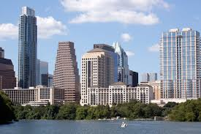
Austin Post-2010 Redistricting Criteria
Comply with U.S. Constitution: Each district’s population = average +/- 5%
Comply with Voting Rights Act and other laws
Geographically contiguous
Respect geographic integrity of communities of interest
Geographically compact
Use boundaries of existing election precincts
Geographically identifiable boundaries
Do not consider place of residence of incumbents or potential candidates

Slide 15

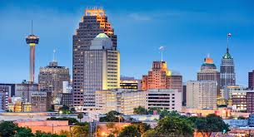
San Antonio Post-2010 Redistricting Criteria
Districts of relatively equal population: Deviation < 10%
Readily identifiable boundaries
Maintain communities of interest and neighborhoods
Use whole voting precincts
Base plan upon existing districts
Keep incumbents in their districts
Districts are compact and contiguous
Minimize retrogression of majority-minority districts
Narrowly tailored to comply with Voting Rights Act

Slide 16

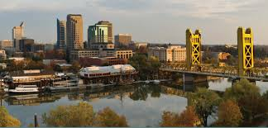
Sacramento, California, Post-2010 Redistricting Criteria
Districts are substantially equal in population
Map complies with U.S. Constitution, Voting Rights Act, California Constitution, and other applicable laws
Each district is geographically contiguous
Additional criteria in order of priority
  Existing neighborhoods and community boundaries
  Communities of interest
  Integrity and compactness of territory
  Geography and topography
  Natural and artificial barriers and boundaries
  Preservation of population cores consistently associated with each district
  Other commission-adopted criteria
Do not consider place of residence of any individual, including any incumbent or political candidate
6. Number each council district such that, for as many residents as possible, the number of the council district they reside in remains the same.

Slide 17


2012 Redistricting Procedures
Late January | City notifies public of redistricting plan process.
February | City Council and staff host public workshops including software training.
March 30 | Redistricting plans and other comments due to City Secretary’s Office.
April | Staff prepares analysis of plans submitted and briefs City Council.
May – June | City Council and staff conduct public meetings and City Council conducts work sessions on plan options.
July | City Council conducts public hearing(s), approves plan and submits it to U.S. Department of Justice (DOJ).
August - November | DOJ reviews plan.

Slide 18
Comments on 2012 Redistricting Procedures
Continue to…
  Host public workshops and provide software training for interested residents.
  Prepare analysis of plans submitted and brief City Council.
  No longer required to secure pre-clearance from U.S. Department of Justice.
  Provide greater transparency in redistricting.

Slide 19
Task Force Schedule, January – March 2021
Month | Activity
January | Task force chair and staff present Redistricting 101 seminar. Task force conducts series of public hearings, each with virtual and in-person options. North East South West
February | Task force discusses comments from public meetings, agrees on final recommendations.
March | Task force presents final report to City Council. City Council adopts resolution accepting final report.

Slide 20
Redistricting Schedule, May 2021 – May 2023
Month | Activity
May 2021 | City conducts 2021 election.
End of July | Census Bureau releases block-level census data for state and local redistricting.
August | City Council and Redistricting Task Force hold joint work session.
August to December | City Council conducts redistricting process in accordance with approved criteria and procedures.
December | Tarrant County Voter Registrar prints voter registration cards with information about new Council districts.
Mid-July 2022: 180 days before qualifying begins for May 2023 municipal election | Deadline for candidates to establish residency within Council districts that they wish to represent.
Mid-January to mid-February 2023 | Candidates qualify for 2023 municipal election.
May 2023 | City conducts 2023 election.

Slide 21
Potential Redistricting Criteria
1. Approximately equal size: Population of largest district < 10 percent more than population of smallest district
2. No packing: Proportion of combined minority population of each district < 90 percent
3. Minimum number of minority opportunity districts, with combined minority population > 50 percent, in proportion to City’s combined minority population
4. No retrogression in ability of minorities to participate in electoral process
5. Compact districts with Polsby-Popper ratio > 0.050
6. Contiguous territory
7. Identifiable geographic boundaries
8. Contain communities of interest in single districts
9. Include areas inside Loop 820 and areas outside Loop 820, if possible, within each Council district
10. Contain whole voting precincts
11. Contain whole census blocks or block groups
12. Do not consider place of residence of incumbents or potential candidates

Slide 22
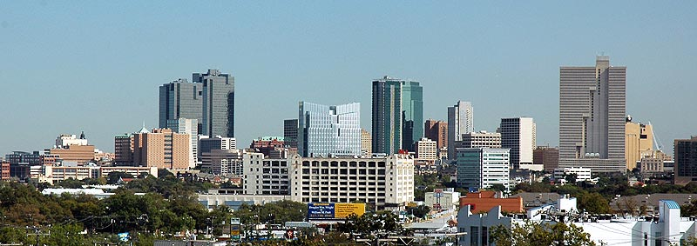
Questions?

