Slide 1
Legal Basis for Redistricting
Redistricting Task Force Meeting
September 17, 2020
Leann Guzman
Deputy City Attorney

Slide 2
Why are we here?
Fort Worth has single member districts
Districts must be balanced – 1 person, 1 vote
Census updates the population information for the City, showing need to redo the districts to balance them
The City is going from 8 single member districts to 10 single member districts
DOJ Preclearance - no longer required

Slide 3
The Balanced District
Equal in population to other districts
1 person, 1 vote (Equal Protection Clause, 14th Amendment, Baker v. Carr (1962))
Boundaries drawn so that “as nearly as practicable” there is “equal representation for equal numbers of people.” (Wesberry v. Sanders, 376 U.S. 1 (1964))
Total Population, not voter population (Evenwel v. Abbott, 136 S. Ct. 1120 (2016))
10% rule (Gaffney v. Cummings, 412 U.S. 735 (1973))
The difference in size between smallest and largest districts should be ≤ 10%
Discrimination can still occur within the 10% rule (Larios v. Cox, 300 F. Supp. 2d 1320 (N.D. Ga. 2004), aff’d, 542 U.S. 947, 2004 (mem.))

Slide 4
Population Deviations Allowed
Population deviations are allowed if they’re based on justifiable, legitimate reasons that effect good policy (Reynolds v. Sims, 377 U.S. 533 (1964), Karcher v. Daggett, 462 U.S. 725 (1983))
Courts call these reasons “traditional redistricting principles”

Slide 5
The Balanced District
No Discrimination
Not packed: Doesn’t push minority voters into few super-concentrated districts to dilute voice
Example: Shaw v. Reno (1993) - First Congressional District in NC was already predominantly African American before 2010, then redrawn to include additional nearby concentrations of African American voters.
Not cracked: Doesn’t split minorities into small pieces across several districts to dilute voice
Example: Rucho v. Common Cause (2019) – NC drew a heavily partisan-gerrymandered map that cracked Democrats into districts where they were in the minority.

Slide 6
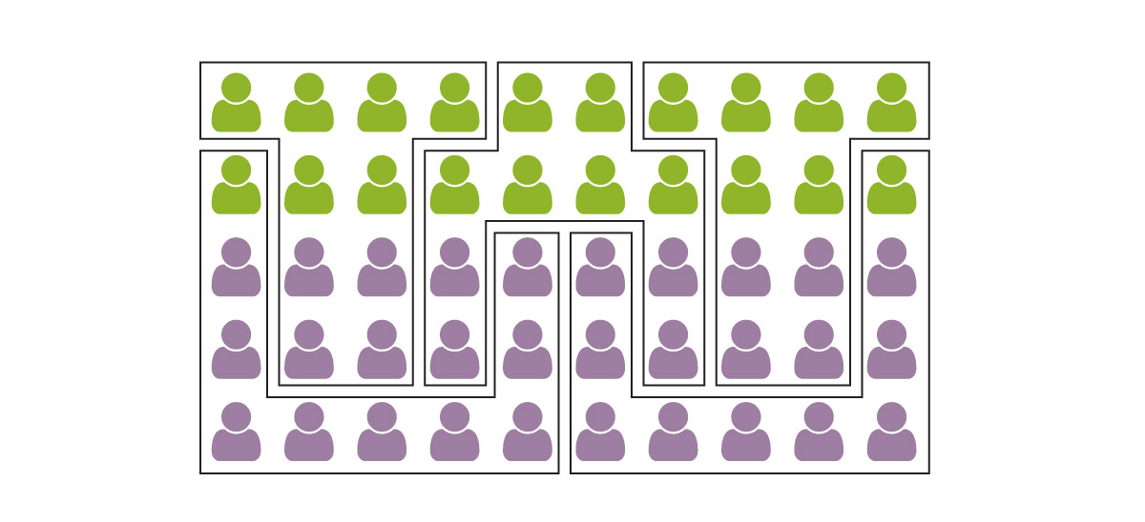
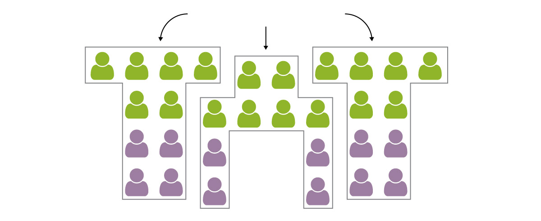
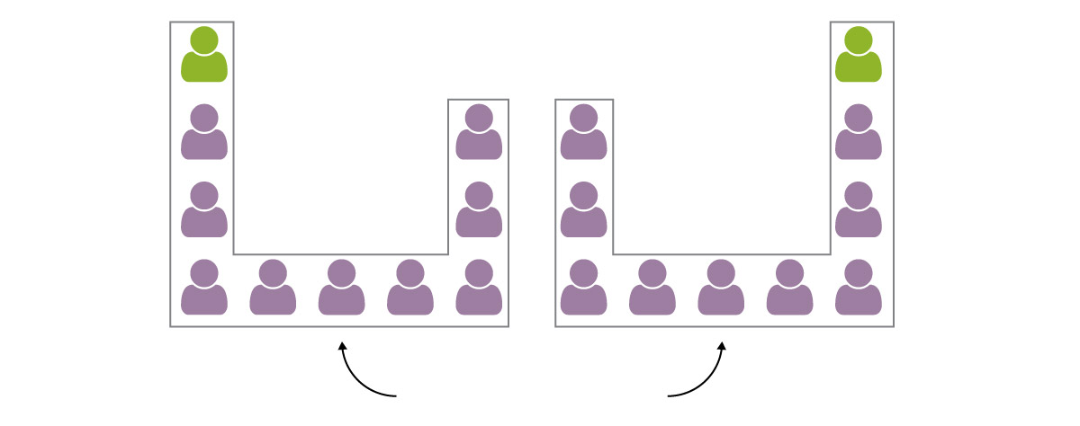
Packing and Cracking
3 Cracked Districts
2 Packed Districts
Graphics from WashingtonPost.com

Slide 7
Impermissible Redistricting Factors
Using race as a predominant factor
Exception: If there is racially polarized voting, a minority opportunity district may be needed to prevent vote dilution
Gingles Test:
Is the minority group sufficiently numerous and compact to be able to form a majority?
Does the group tend to vote similarly?
Does the majority vote differently from the minority, usually to defeat minority’s candidate?
Using partisan reasons as a proxy for race

Slide 8
Example: Impermissible Redistricting
Use of Race for District Boundaries
Cannot be the predominant reason for a district’s shape
Example: HD90, Abbott v. Perez (2018)
2011 – Legislature increased the district’s Latino population in an effort to make it a Latino opportunity district. It also moved Como, which is predominantly African-American, out of the district.
Como residents and their House rep objected
Legislature moved Como back, decreasing Latino population
Legislature moved more Latinos into the district
State argued use of race as predominant factor was permissible because it had “good reasons to believe” that this was necessary to satisfy the Voting Rights Act
Supreme Court found Texas did not satisfy its burden to prove the action was narrowly tailored

Slide 9
Permissible Factors
Traditional Redistricting Principles:
Equal population (Constitutional mandate)
Compact and contiguous
Respecting certain boundaries – voting precincts, neighborhoods, communities of interest (social, cultural, ethnic, economic)
Preserving core of prior districts
Preservation of incumbents
Must be consistently applied and non-discriminatory
Must be specifically justifiable (for the ordinance)

Slide 10
2011 Redistricting Factors
Establishing districts that are relatively equal in size
Ensuring that geographically compact minority neighborhoods are not fragmented and minority voters not packed into districts so as to create liability under Section 2 of the VRA
Avoid retrogression under Section 5 of the VRA (no longer applicable)
Compact and contiguous districts
When appropriate, dividing districts by easily identifiable geographic districts
When appropriate, recognizing neighborhoods and communities of interest
When appropriate, establishing districts that include areas located both inside Loop 820 and outside Loop 820
When appropriate, establishing districts composed of whole census blocks and whole voting precincts
Preserving incumbent/constituent relationship

Slide 11
QUESTIONS

