Slide 1

Redistricting Task Force
Voting Rights Act Compliance
Bruce Miller
October 22, 2020

Slide 2

2012 Criteria for Drawing
City Council Boundaries
Equal Size (+/- 5%)
Voting Rights Act Compliance
Conform To Voting Precincts
Preserve Neighborhoods & Communities of Interest
Census Block Groups & Blocks
Compact and Contiguous Areas
Identifiable Geographic Features
Areas In & Out of Loop I-820
Protect Incumbent Residence

Slide 3
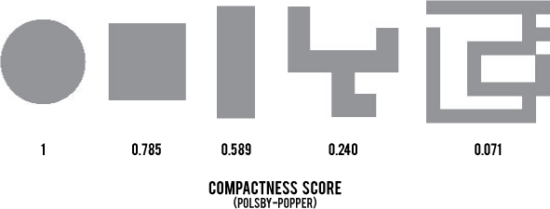
Minority Opportunity District Balances Proportion & Compactness
Opportunity
District
Packed
District
0% Minority
50%
100%
Majority-Minority
District
Voting Rights Act, Section 2
How Compact Is The District?
Gingles Test (Thornburg v. Gingles, 1986)
Is minority district compact?
Is minority vote politically cohesive?
Is majority bloc sufficient to defeat minority?

Slide 4
Voting Rights Act Compliance
May Call For Specific Criteria
Minimum number of minority opportunity districts
Proportion of minority voters > 50% target for an opportunity district
Proportion of minority voters < 75%-80% to prevent packing
Compactness test range > .500
Ranges are better than hard targets
Redistricting Task Force Participation in Drawing Council Districts Offers an Opportunity to Test These Criteria for Soundness and Practicality

Slide 5
BACKGROUND CHARTS

Slide 6
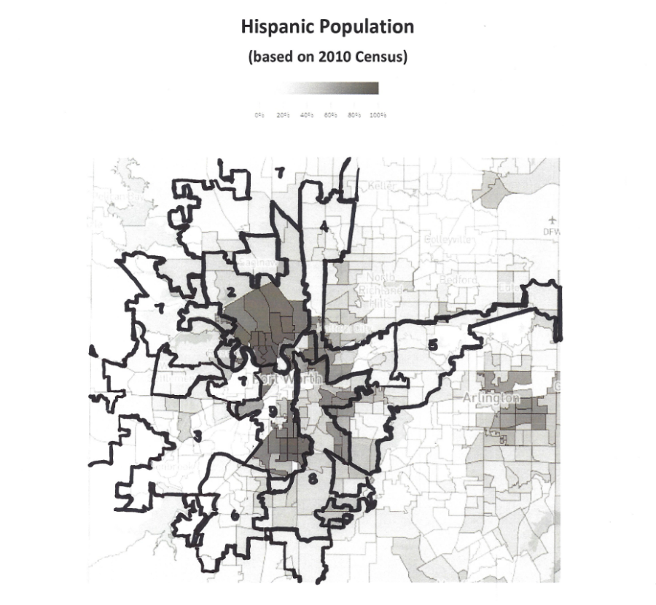
Fort Worth Demographics
Fort Worth City Council Districts (Current)
Hand-drawn district boundaries are approximate

Slide 7
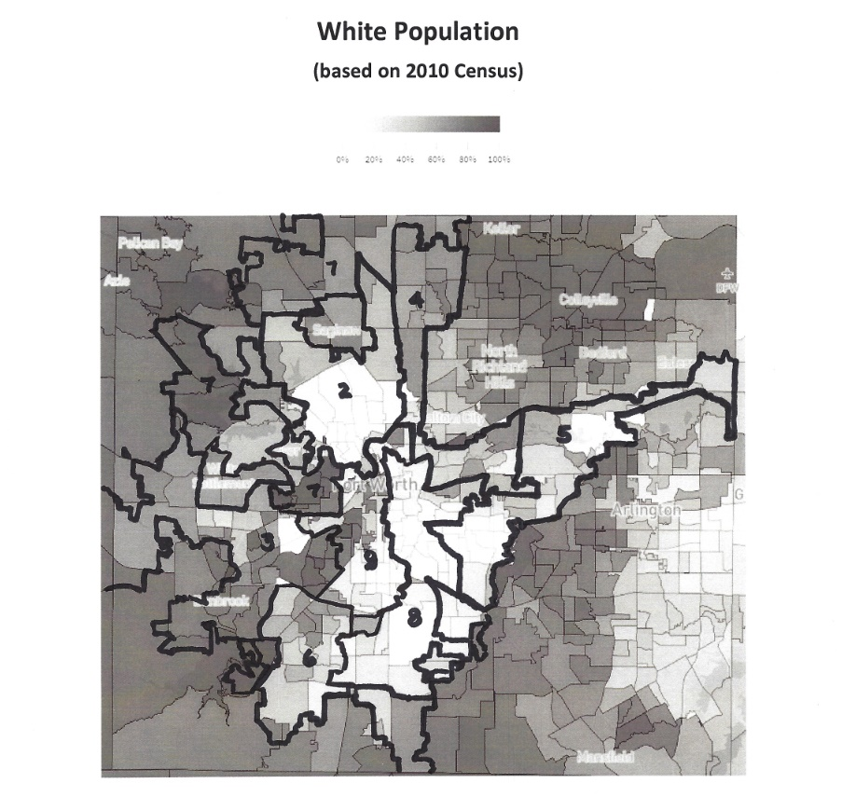
Fort Worth Demographics
Fort Worth City Council Districts (Current)
Hand-drawn district boundaries are approximate

Slide 8
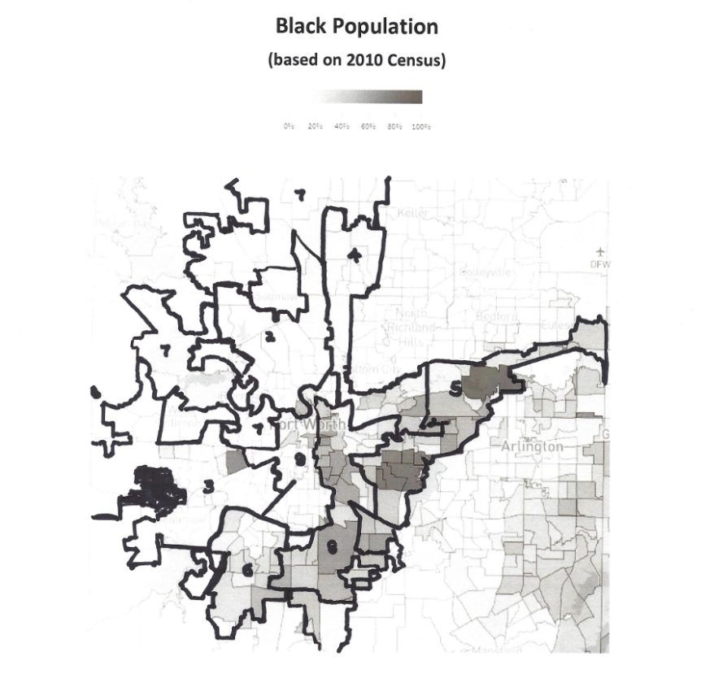
Fort Worth Demographics
Fort Worth City Council Districts (Current)
Hand-drawn district boundaries are approximate

