Slide 1
Welcome
The Presentation will begin at 6:05pm
Please Note: We ask that you mute your microphones during the presentation. We will answer all questions at the end. If you have a question please post it in the chat, the chat button is located in the lower right side of WebEx screen. The presentation will be recorded.
Thank you.

Slide 2

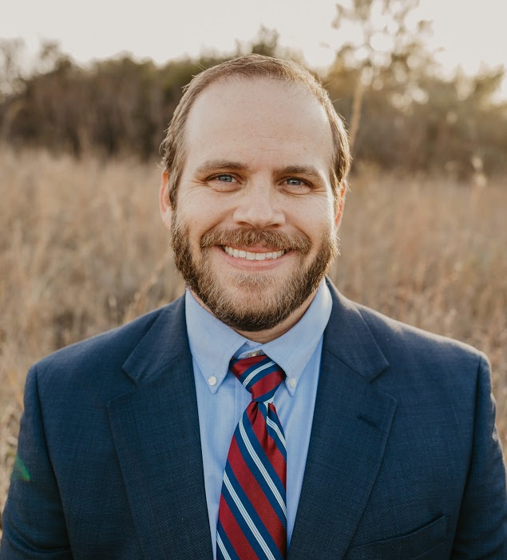
Stop Six/Poly Oversight and Echo Heights Street Improvements
2022 Bond Year 1 –Contract 4
CPN 102930
Presented by
Greg Robbins
Project Manager
City of Fort Worth
Transportation & Public Works Department
February 20th, 2023

Slide 3
Meeting Purpose
Provide overview of the project scope and proposed improvements and provide information regarding the upcoming construction and schedule.

Slide 4
Agenda
Project Overview
Summary of Improvements
Construction Information
Proposed Construction Schedule
Questions and Comments

Slide 5
Project Overview

Slide 6
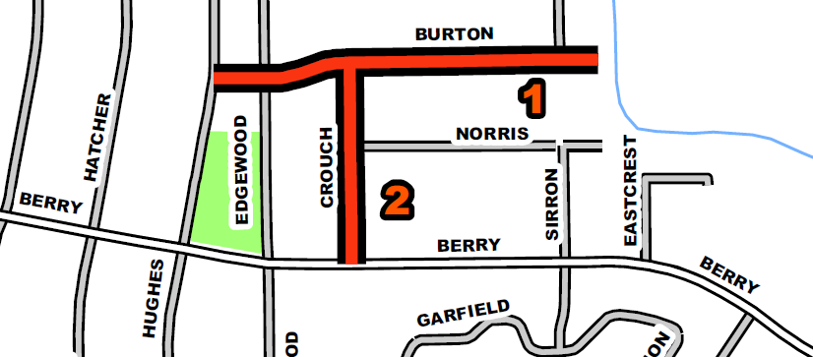
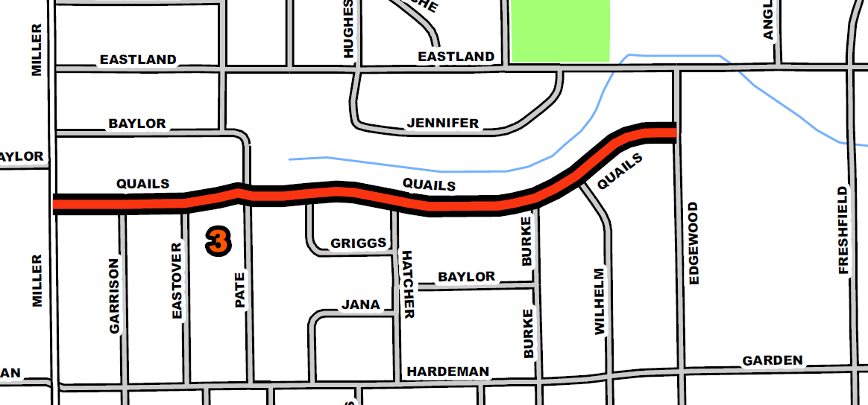
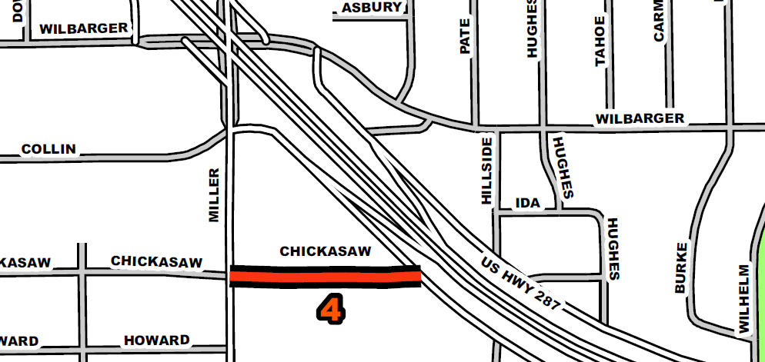
Project Limits
Burton Avenue from South Hughes to E. Dead End (1)
Crouch Street from Burton Avenue to E. Berry Street (2)
Quails Lane from Miller Avenue to S. Edgewood Terrace (3)
Chickasaw Avenue from Miller Avenue to MLK Freeway (4)

Slide 7
Project Funding
2022 Bond Funded Streets
Burton Avenue (S. Hughes Avenue to E. Dead End)
Crouch Street (Burton Avenue to E. Berry Street)
Quails Lane (Miller Avenue to S. Edgewood Terrace)
Chickasaw Avenue (Miller Avenue to MLK Freeway)

Slide 8
Summary of Improvements

Slide 9
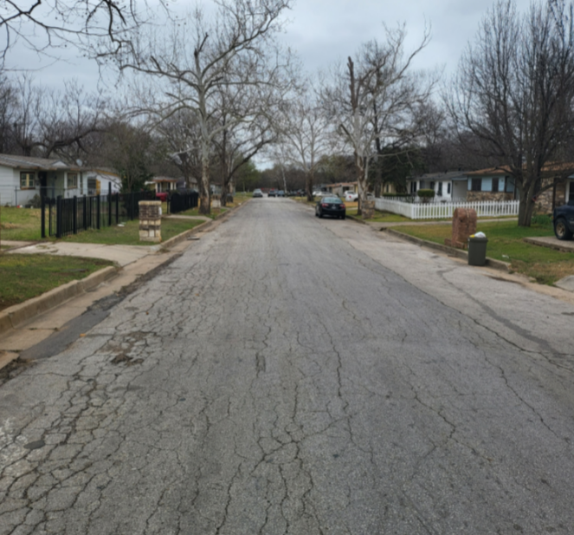
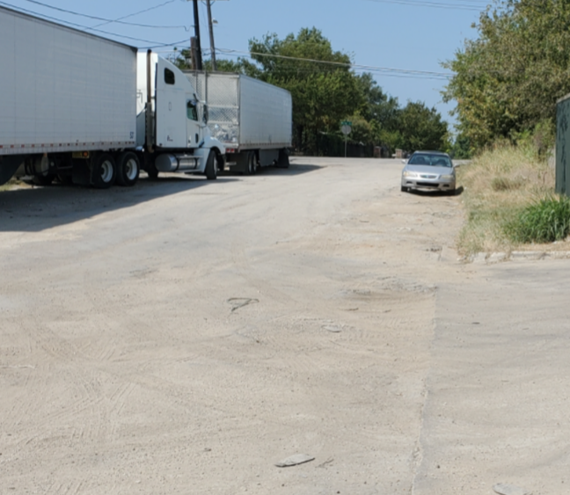
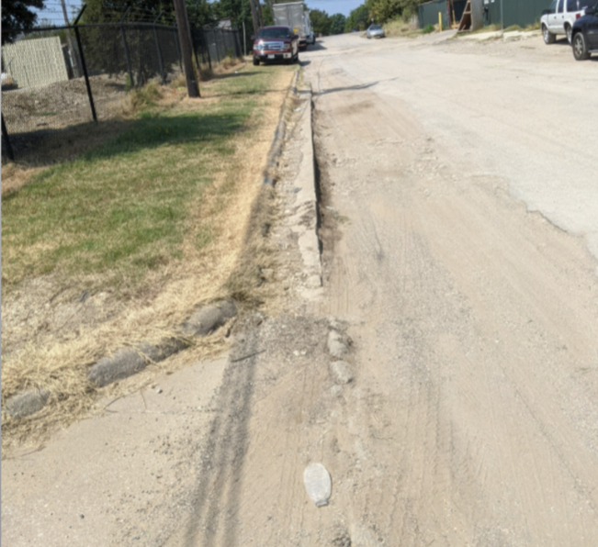
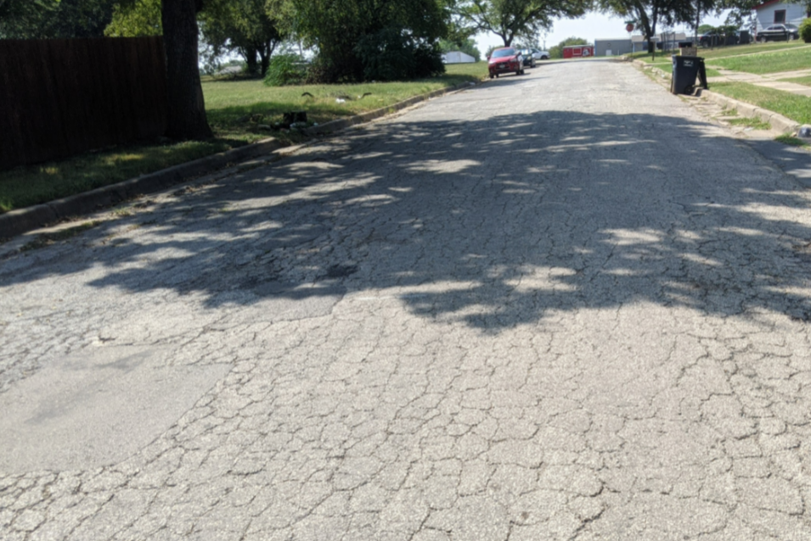
Existing Conditions
Damaged Asphalt Paving
Damaged Asphalt Paving, damaged curb and gutter

Slide 10
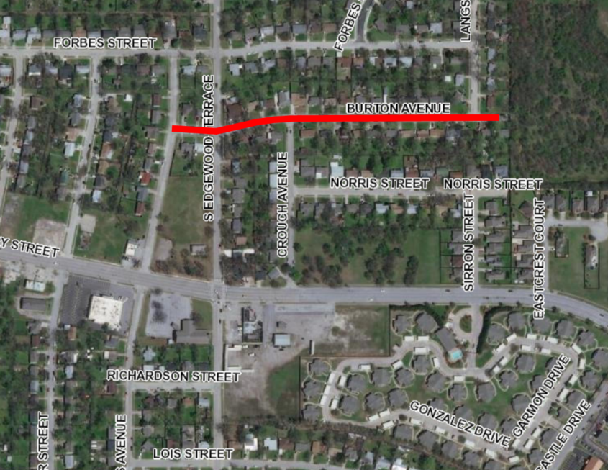
Summary of Improvements
Burton Avenue
Water and Sewer Improvements
  Replacing existing 8” water
  Upgrading existing 6” sewer to 8”
Paving Improvements
  New concrete pavement with concrete curbs
  New concrete driveways with 11’ minimum width (or match existing width).
  New 5’ sidewalk one side of street (alternates)

Slide 11
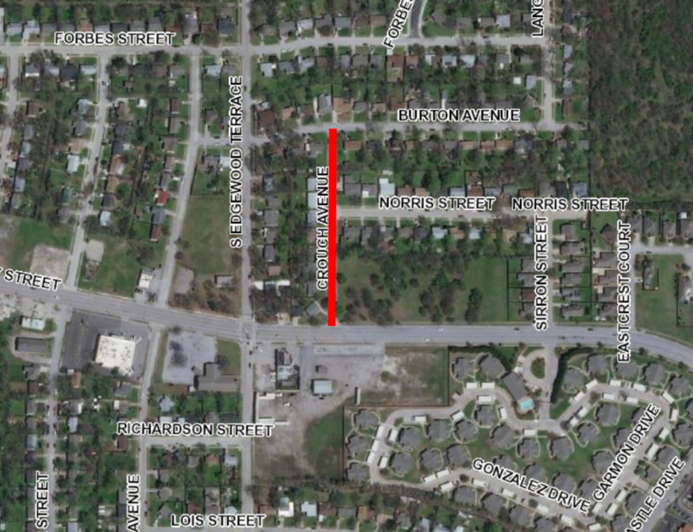
Summary of Improvements
Crouch Avenue
Water and Sewer Improvements
  Replacing existing 8” water
Paving Improvements
  New concrete pavement with concrete curbs
  New concrete driveways with 11’ minimum width (or match existing width).
  New 5’ sidewalk on west side of street and portions of the east side

Slide 12
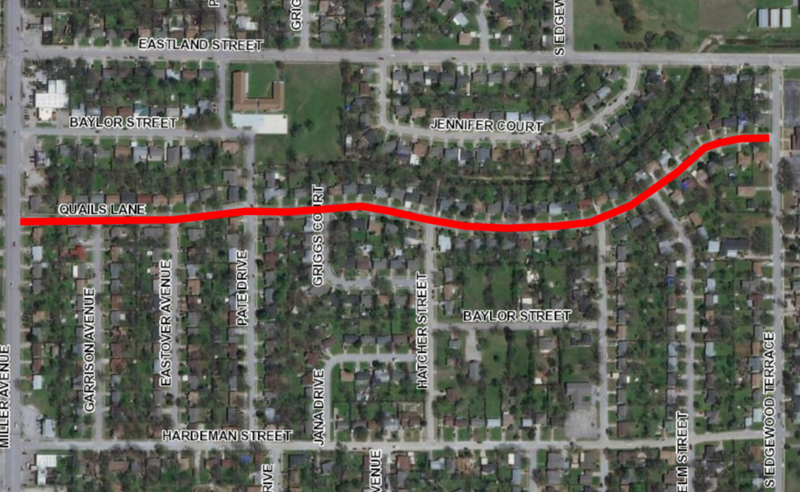
Summary of Improvements
Quails Lane
Water and Sewer Improvements
  Replacing portions of 8” and 16” water
  Replacing existing 8” and 10” sewer
Paving Improvements
  New concrete pavement with concrete curbs
  New concrete driveways with 11’ minimum width (or match existing width).
  New 5’ concrete sidewalk both sides of street

Slide 13
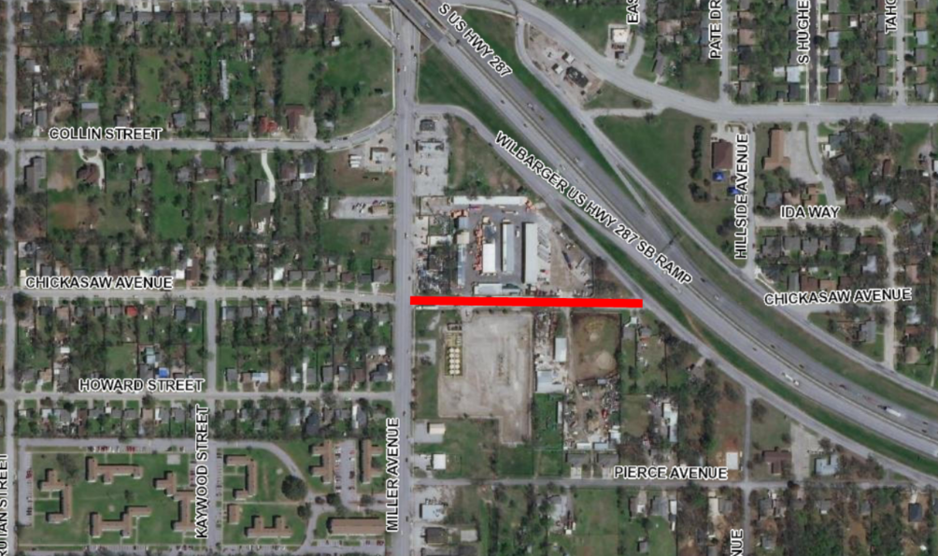
Summary of Improvements
Chickasaw Avenue
Water and Sewer Improvements
  Replacing existing 8” water
  Upgrading existing 6” sewer to 8”
Paving Improvements
  New concrete pavement with concrete curbs
  New concrete driveways with 11’ minimum width (or match existing width).
  New 5’ concrete sidewalk on one side of the street (south)

Slide 14
Construction Information

Slide 15
Why are we doing this project?
In May of 2022, the residents of Fort Worth voted to pass a bond program which would fund street reconstruction projects such as this one, which would target locations in the city most in need of improvements.
When the 2022 Bond streets were identified, Transportation and Public Works partnered with the Fort Worth Water Department to replace underground utilities also in need of improvements.

Slide 16
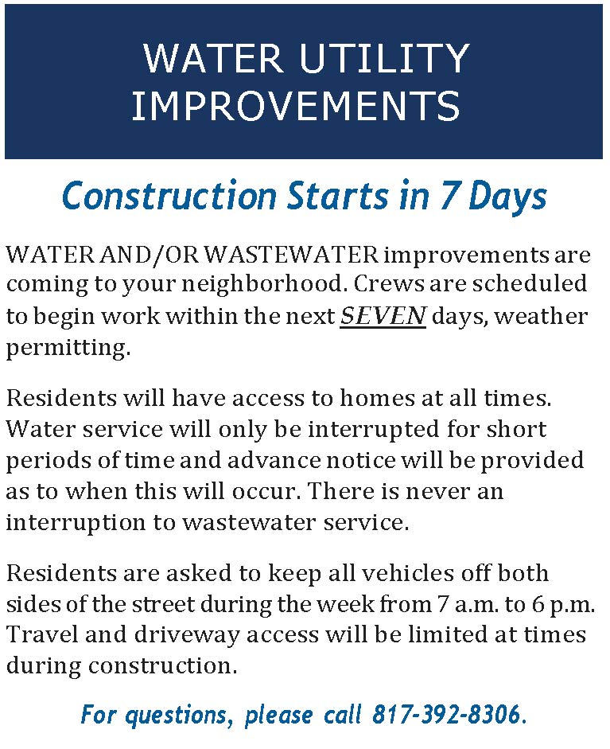
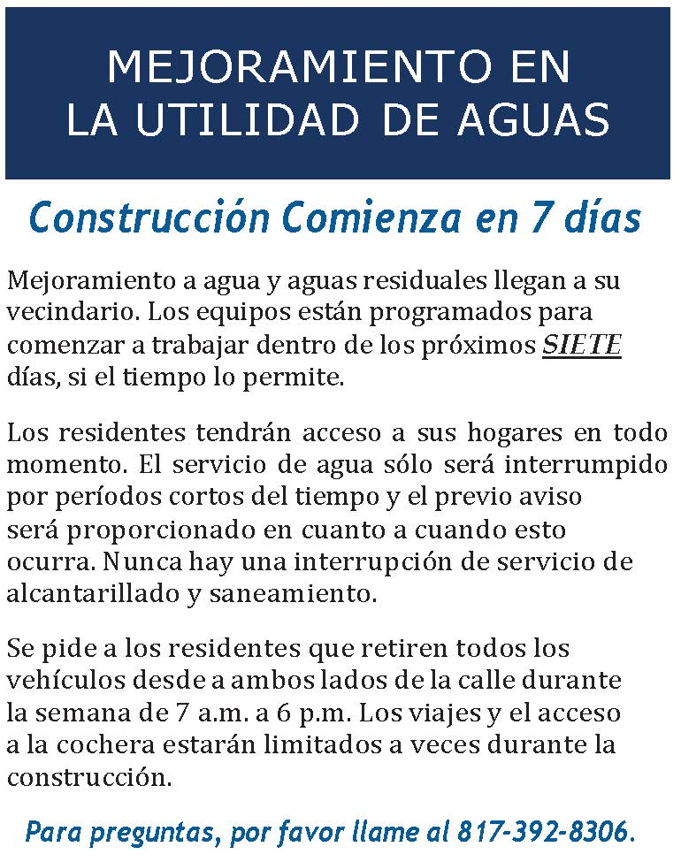
How will we know construction is starting?
Keep an eye on your front door for a door hanger from the City of Fort Worth.
You will receive two door hangers.
The first one says “Construction Starts in 7 days.”

Slide 17
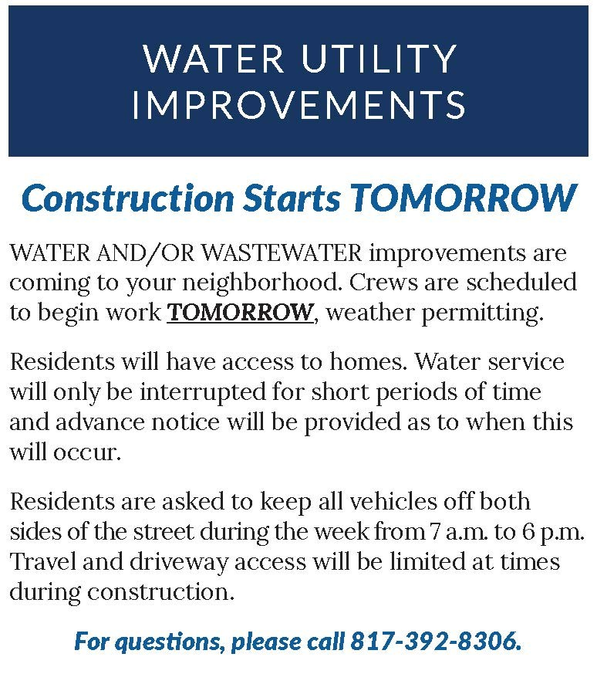
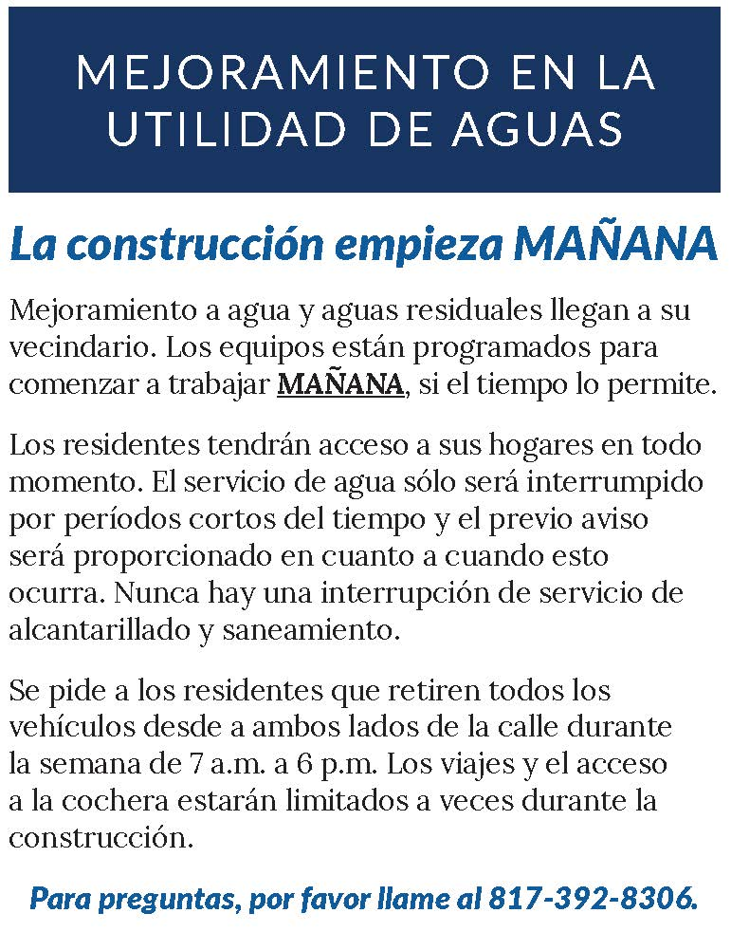
How will we know construction is starting?
The second door hanger says “Construction Starts Tomorrow.”
The inspector will include his/her business card and contact information on the door hanger.

Slide 18
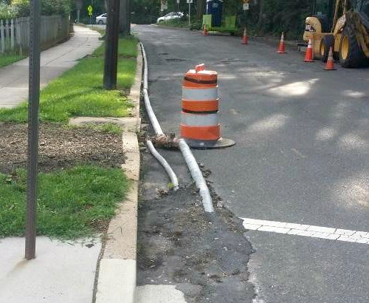
Will our water be turned off?
Water will be turned off for a few hours when service is transferred from the existing line to a temporary water line, and when the service is transferred from the temporary to the new line. These switchovers are done during the day.
The contractor will knock on the door and let customers know when the water will be turned off.

Slide 19
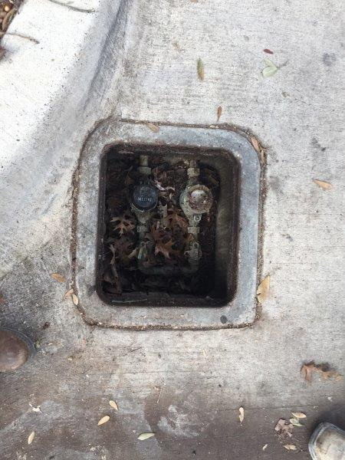
Do you replace the water service line up to my house?
We replace the City-owned service line to the property line. We also replace the water meter and meter box and will repair impacted areas on your property. We do not replace the water line from the water meter to your home or business.
The service line from the water meter to your home or business is considered private plumbing and, in the event of a leak, repairs need to be done by a licensed plumber at the homeowners expense.

Slide 20
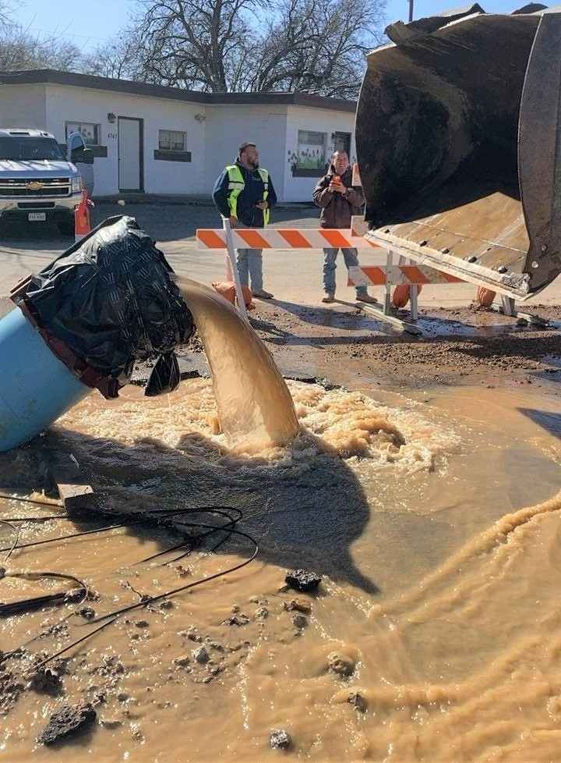
If you see water running down the street, don’t turn it off
Before we can connect your services to the new water line we have to flush the line.
The water flow – from flushing the line – will be continuous until the inspector gets the samples for that day. You will be connected to the new water main after two consecutive samples pass the bacteriological test.
When it is time to sample the water flowing through the new water main, the contractor will place traffic cones around the valve to prevent anyone from parking over the valve. Don’t move the cones, don’t park over the cones and don’t turn off the water valve.

Slide 21
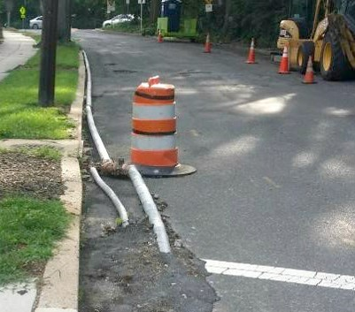
How does the temporary line impact my home & water bill?
The temporary water line insures that you are not without water during construction.
In the summer months the continuous flow keeps the water from becoming stagnant in the above-ground line.
During the winter months, water must be continually flowing through the temporary line to keep the line from freezing. Customers should also keep their faucets dripping.
The bill for your water usage while you are on the temporary line is based on an average of the previous months’ usage.

Slide 22
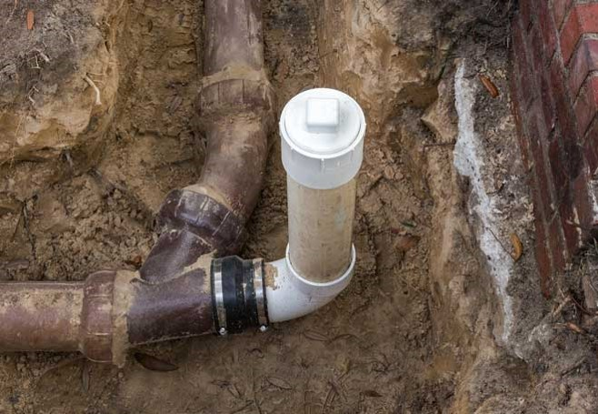
Will you need access to our property?
This construction is in the street. If Fort Worth Water needs access to your property we will contact you.
Will our sewer service be disrupted?
Sanitary sewer service will not be interrupted. New sewer cleanouts will be installed at the property line. The sewer cleanout provides crews easy access if a backup or blockage occurs. The sewer line from the cleanout to the house is the owner’s responsibility to maintain.

Slide 23
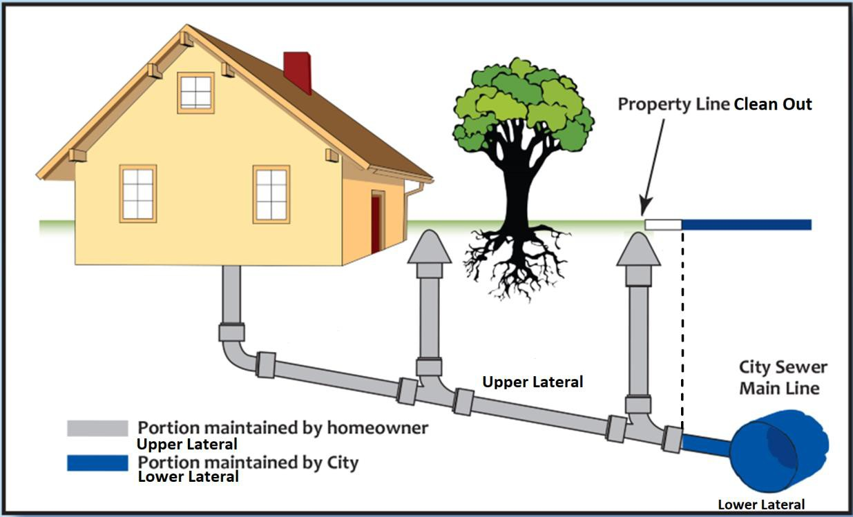
What part of the sewer line are customers responsible for?
The City side of the line starts at the main in the street and goes to the customer’s sewer cleanout.
The customer’s side of the service line goes from the sewer cleanout to the house and includes all plumbing inside the house.

Slide 24
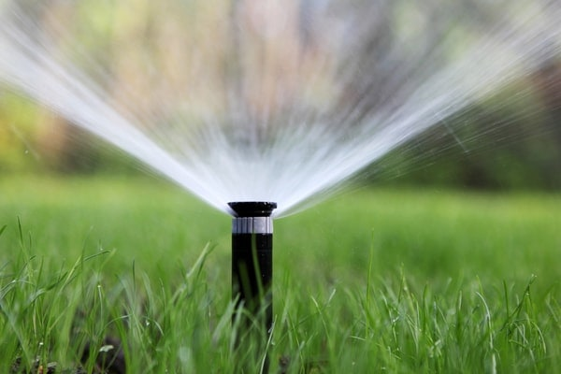
Will the construction affect my irrigation?
The contractor has to cap irrigation lines before construction starts.
The contractor may ask property owners to turn on their irrigation systems so the sprinkler heads can be located and flagged.
The contractor will replace capped or damaged irrigation systems.

Slide 25
Are we getting new curb, gutter and sidewalks?
Concrete curbs will replaced on all streets within the project.
The City will only replace the part of the driveway that is in the City right-of-way, which we refer to as the “apron” or “driveway approach.” The City does not replace the driveway from the street to your garage.
New concrete sidewalks are also included on a majority of streets.

Slide 26
Will I be able to access my driveway?
During pavement construction, there will be times when you are unable to access your driveway.
You will not have access to your driveway
When pavement is being placed directly in front of your property
When your driveway itself is being replaced.
The inspector and contractor will contact you prior to construction start so that you can make arrangements to park elsewhere.

Slide 27
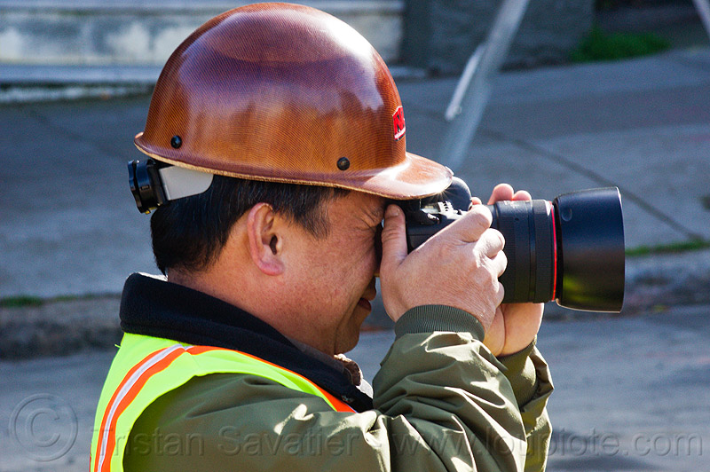
What happens if my property is damaged?
The contractor will take pictures and video of the property before breaking ground. We also encourage property owners to take pictures and video of their property before construction commences.
Damage resulting from the contractor’s activities during construction is the responsibility of the contractor.

Slide 28
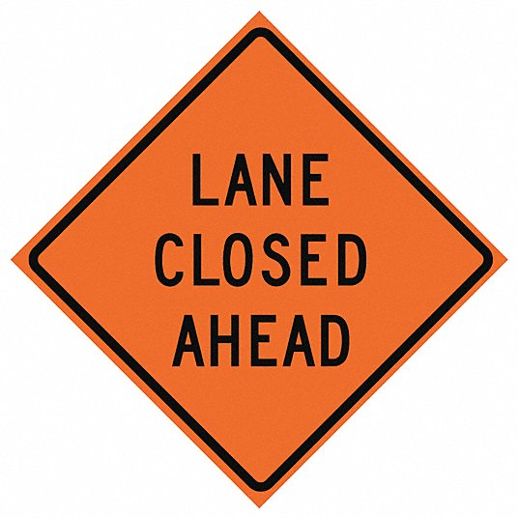
Will there be lane closures during construction?
There will be lane closures when the contractor is installing the water and sewer lines and during street subgrade preparation and paving. Signs will be posted to alert motorists.
The hours of construction are 7 a.m. to 6 p.m., Monday-Friday and, if requested by the contractor, 9 a.m. to 5 p.m. on Saturdays.

Slide 29
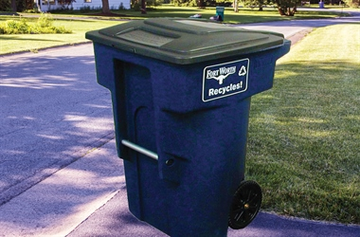
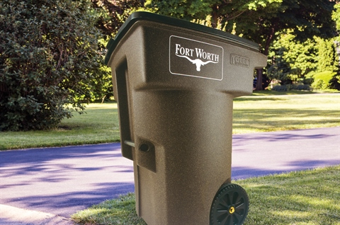

Will the city’s trash truck be able to pick up my trash and recycling during construction?
If your side of the street is closed on your scheduled trash collection day, the contractor will take your trash and recycling carts to the opposite side of the street so the trash collection vehicle can pick it up.

Slide 30
Construction Phasing and Schedule

Slide 31
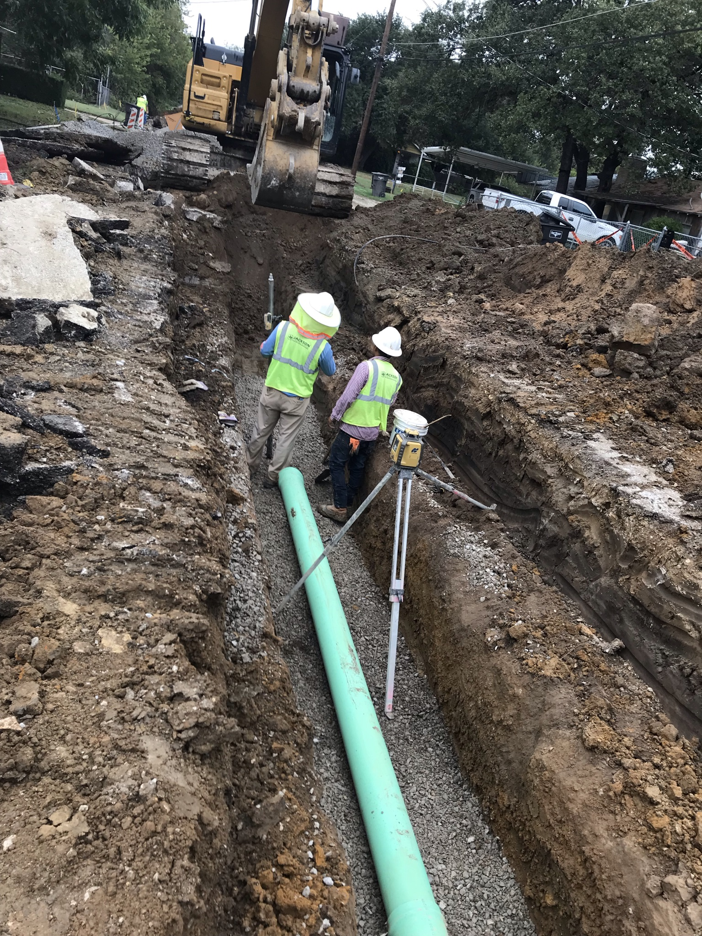
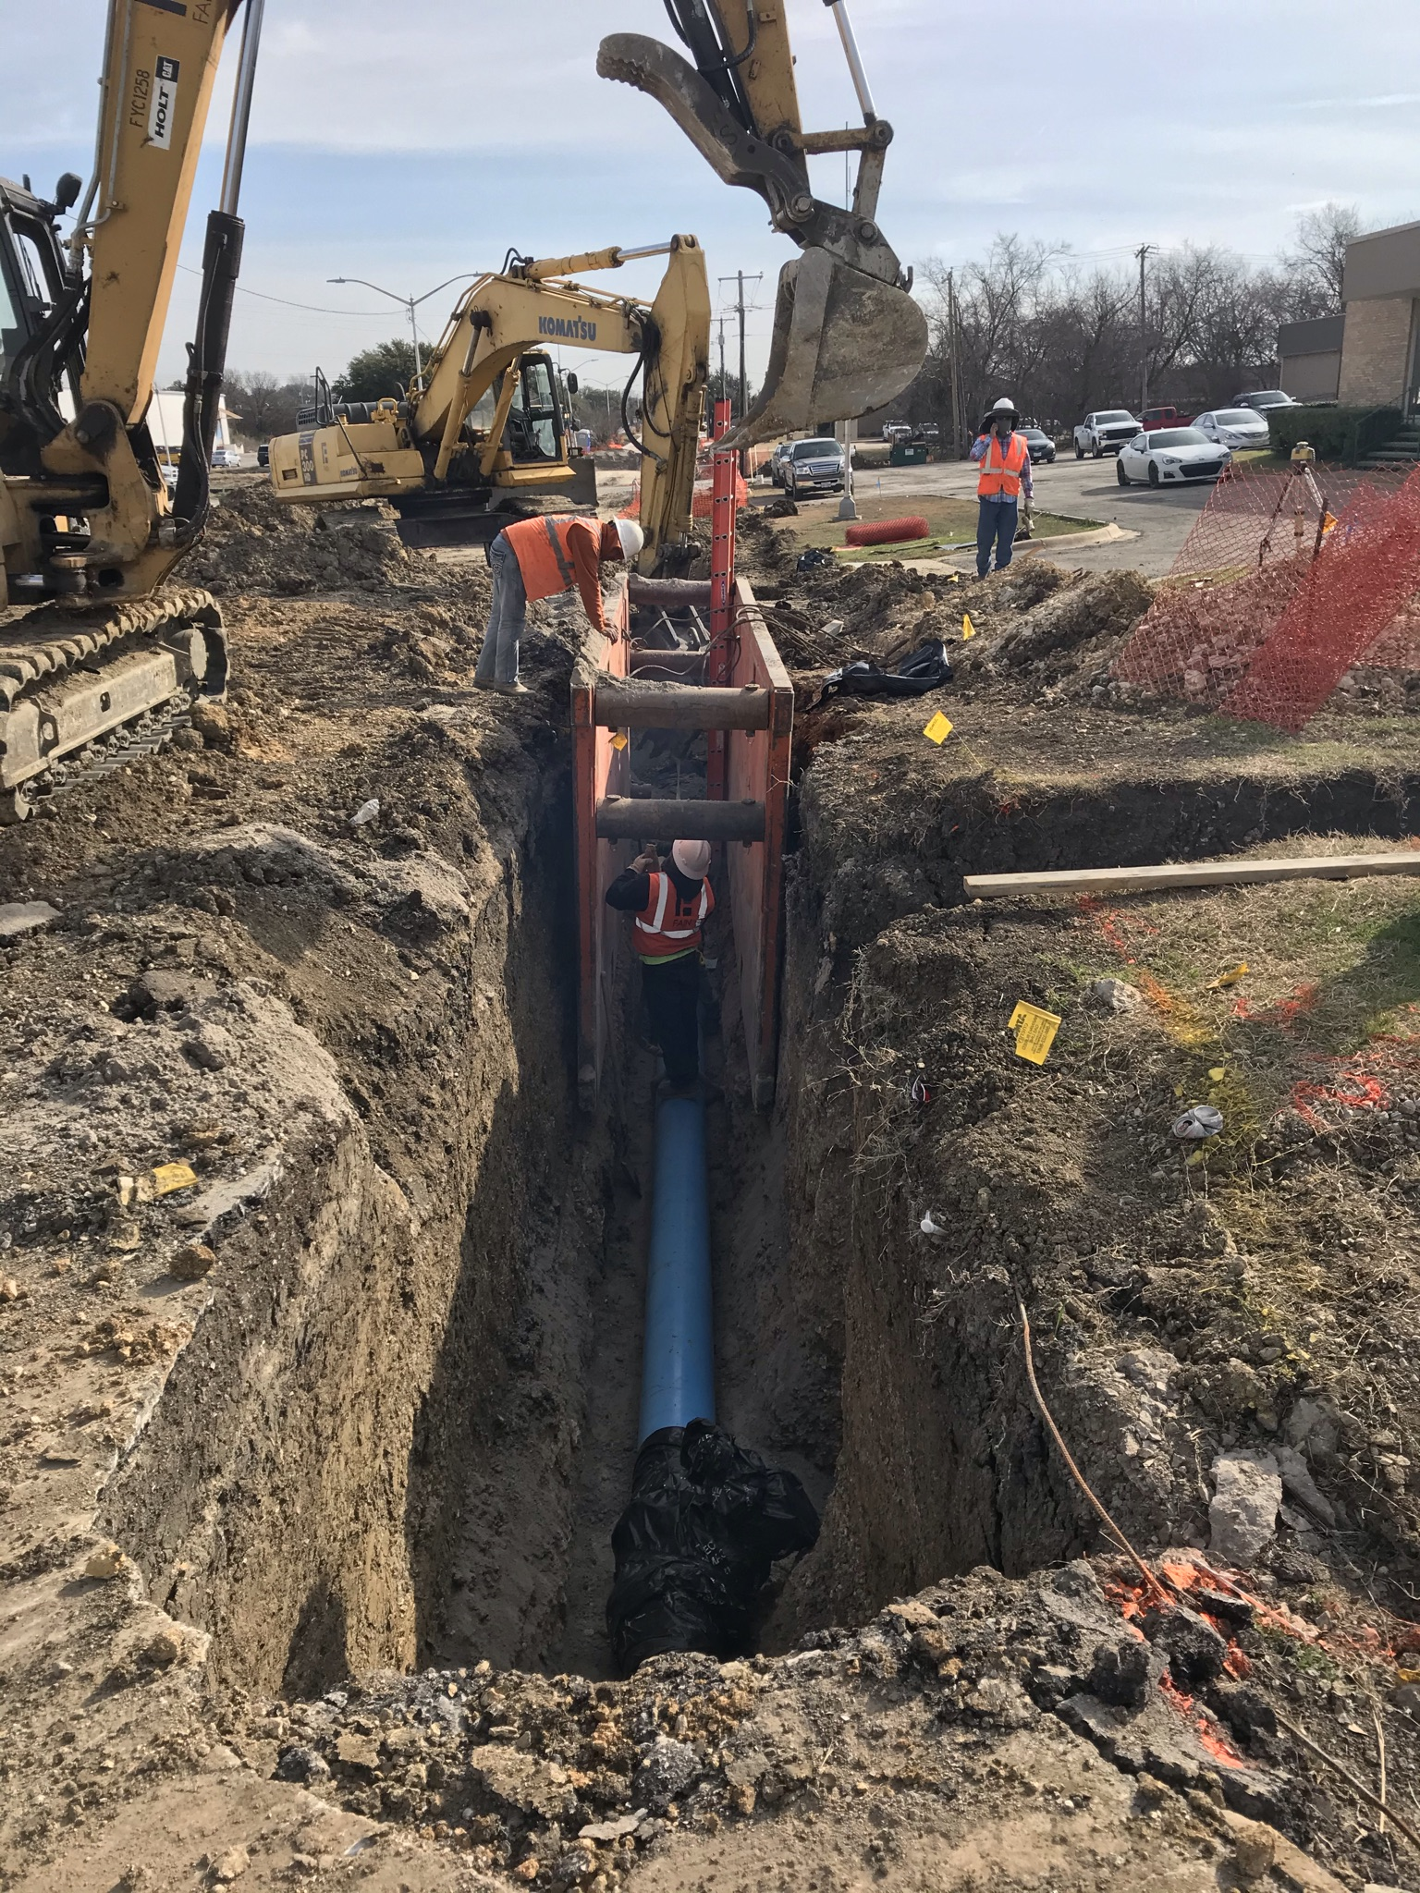
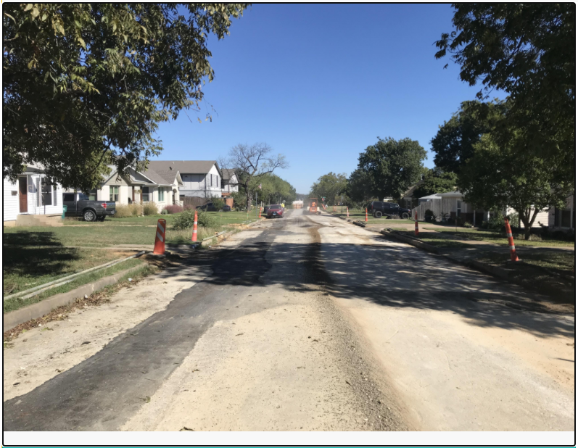
Typical Construction Process
When completed, temporary pavement repair is put in place
Utilities are installed first, along with new service connections to each lot

Slide 32
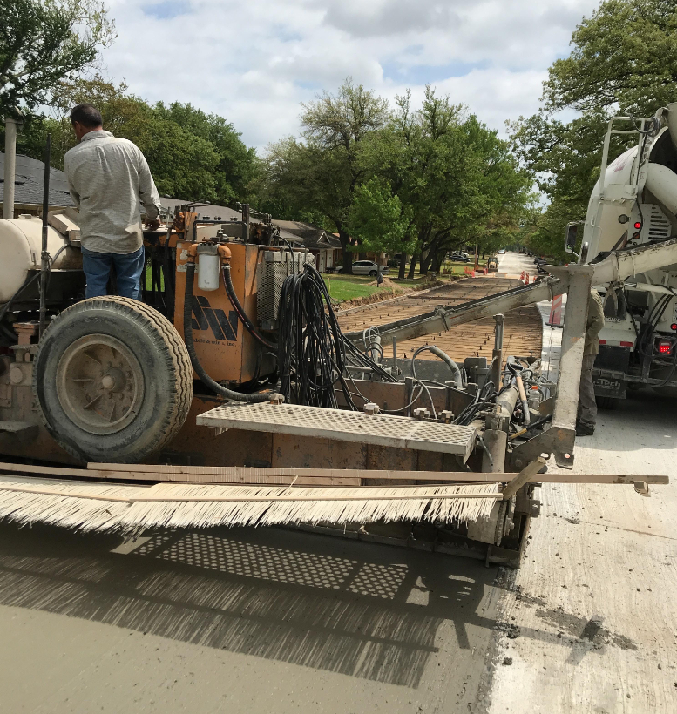
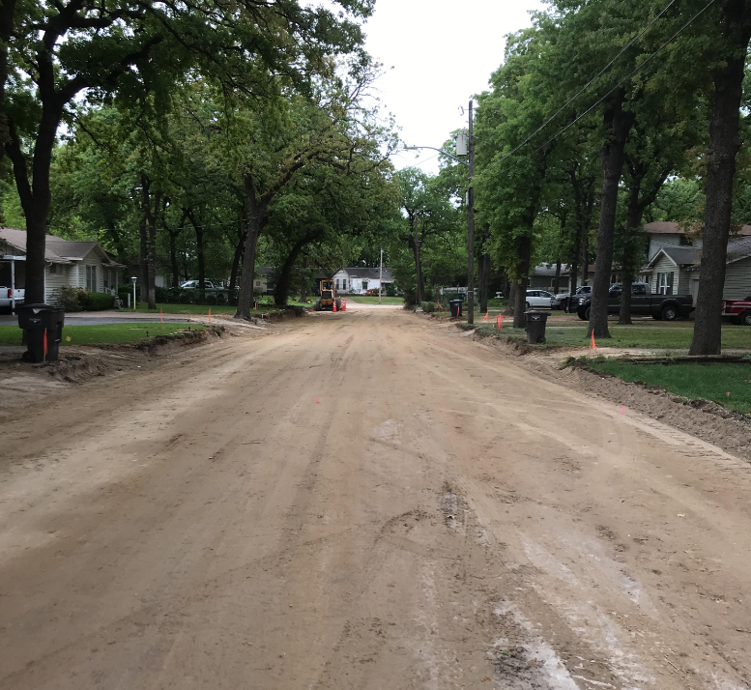
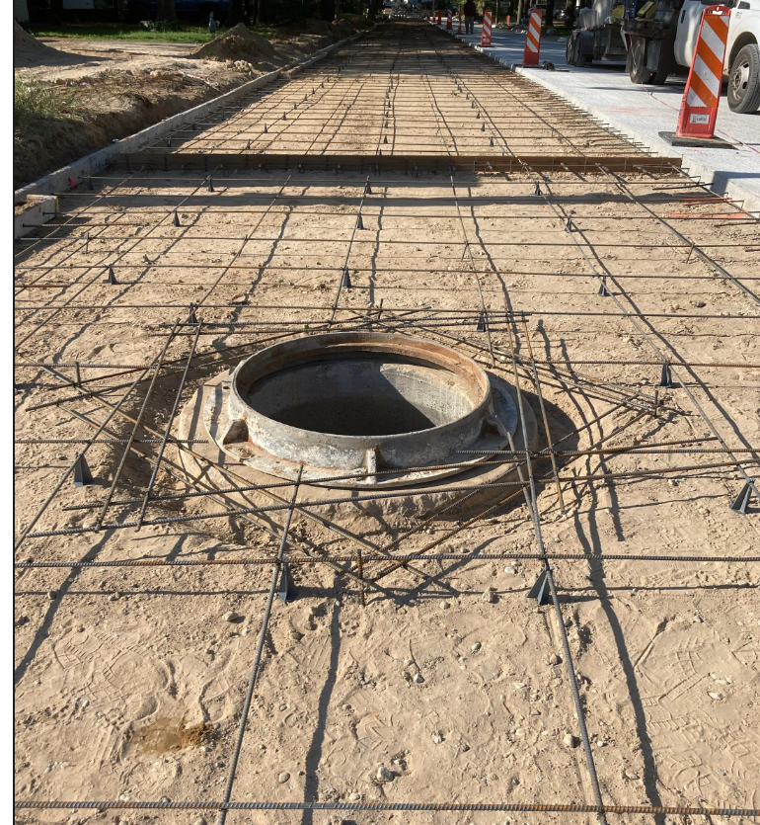
Typical Concrete Construction Process
Existing curb, driveways, and pavement are removed. Then the pavement and curb and installed together. Finally, driveways are installed.

Slide 33
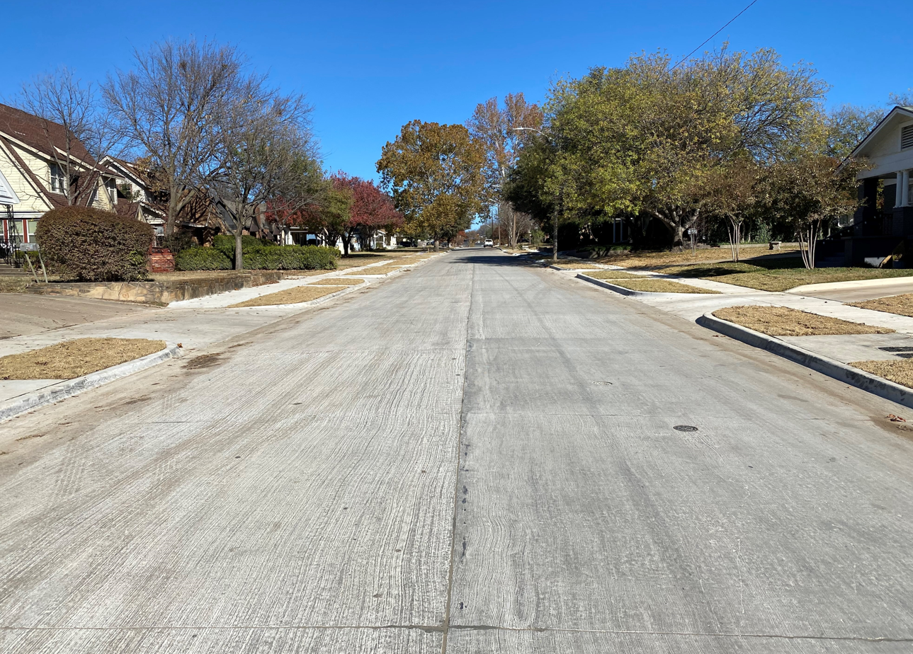
Proposed Improvement
New Concrete Paving, Concrete Curb and Driveways

Slide 34
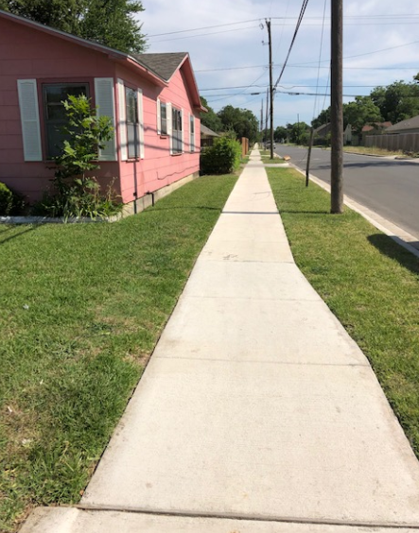
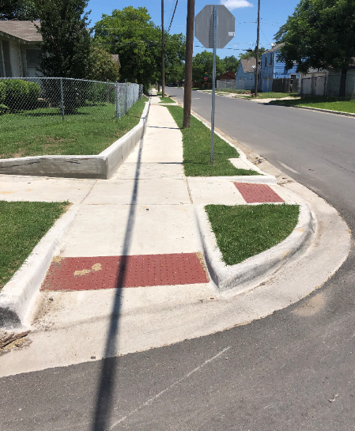
Proposed Improvement
New ADA Ramps
New Concrete Sidewalk

Slide 35
Construction Schedule
Event | Date
Construction Start | March 27, 2023
Chickasaw Avenue | March 2023 – July 2023
Burton Avenue | April 2023 – October 2023
Crouch Street | June 2023 – October 2023
Quails Lane | June 2023 – April 2024
Construction End | April 20, 2024

Slide 36
Questions and Comments

Slide 37
Where can I get more information?
Progress will be updated on the City of Fort Worth website at https://www.fortworthtexas.gov/projects/cfw-stopsix-echoheights-streets
You can also go to www.FortWorthTexas.gov and enter “102930” in the search bar on the home page.
The link to this meeting video, the project map, and the project summary/frequently asked questions will be linked to this project page.

Slide 38

Project Manager, T/PW
Greg Robbins, PE
817.392.2333
gregory.robbins@fortworthtexas.gov
Construction Inspector
Cody Horton
817.475.6903
Cody.Horton@fortworthtexas.gov
Thank you!

Slide 39
Summary of Improvements
Elmwood And Uvalde
Water and Sewer Improvements
  Installing new 8” water
  Installing new 8” sewer (Uvalde)
Paving Improvements
  New concrete pavement with concrete curbs
  New concrete driveways with 11’ minimum width (or match existing width).
  New 5’ sidewalk both sides of street (Uvalde)

Slide 40
Summary of Improvements
Ash Crescent, Avenue C, and Avenue D
Water and Sewer Improvements
  Installing new 8” water
Paving Improvements
  New concrete pavement with concrete curbs
  New concrete driveways with 11’ minimum width (or match existing width).
  New 5’ sidewalk both sides of street

Slide 41
Summary of Improvements
Avenue B, Ann Street, and Belzise Terrace
Water and Sewer Improvements
  Replace existing 8” water
Paving Improvements
  New asphalt pavement with concrete curbs
  New concrete driveways with 11’ minimum width (or match existing width).

Slide 42
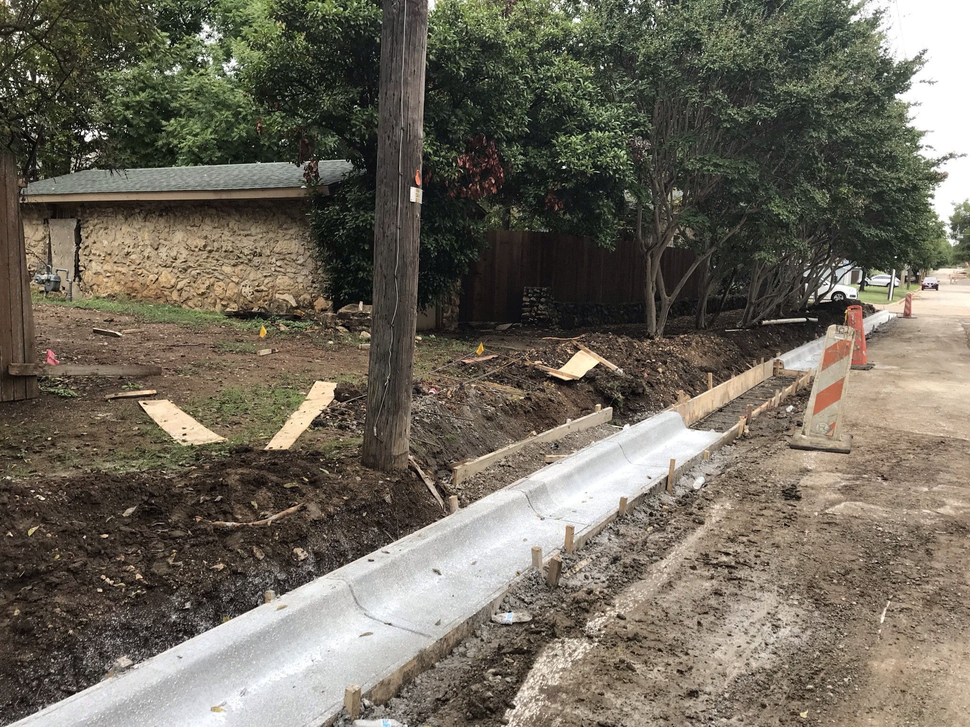
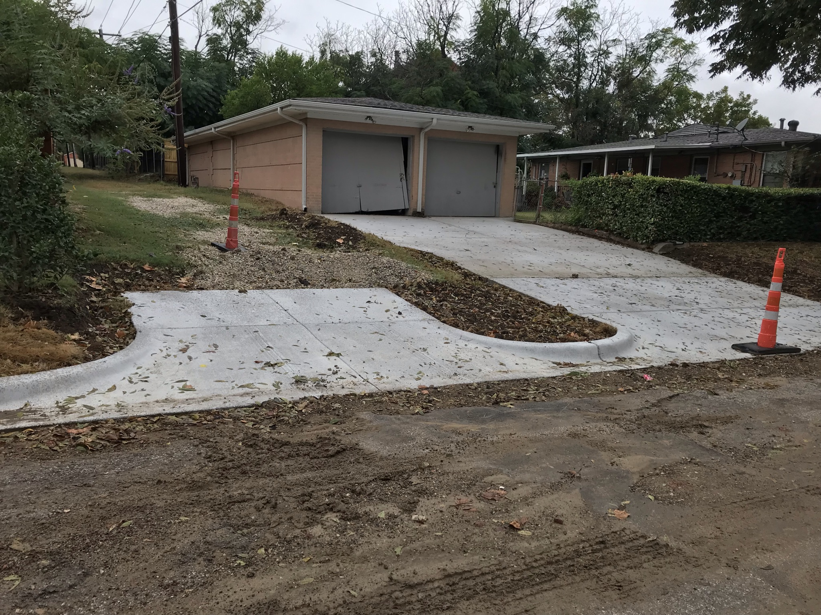
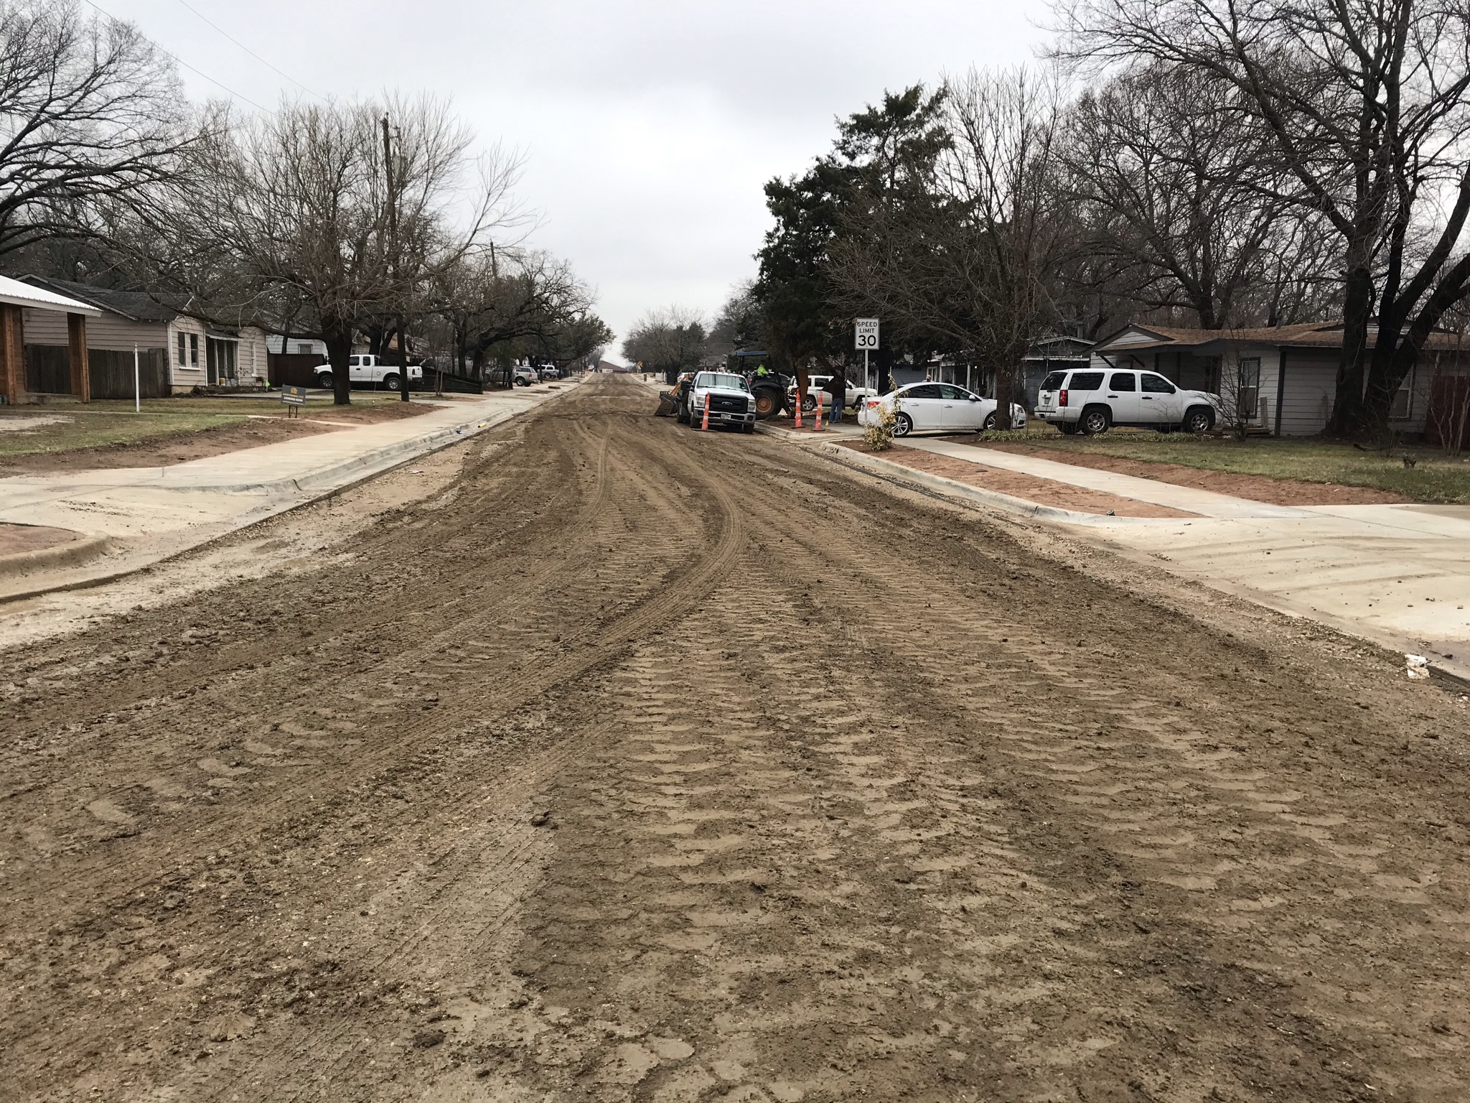
Typical Asphalt Construction Process
Existing curb, and driveways are removed and replaced, then the existing street is demoed

Slide 43
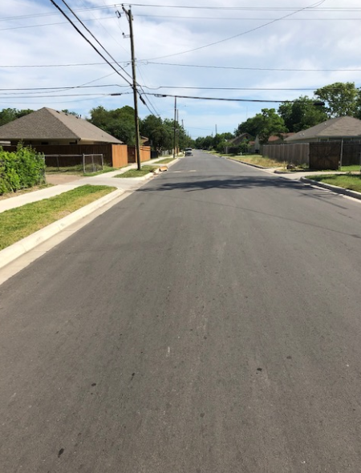
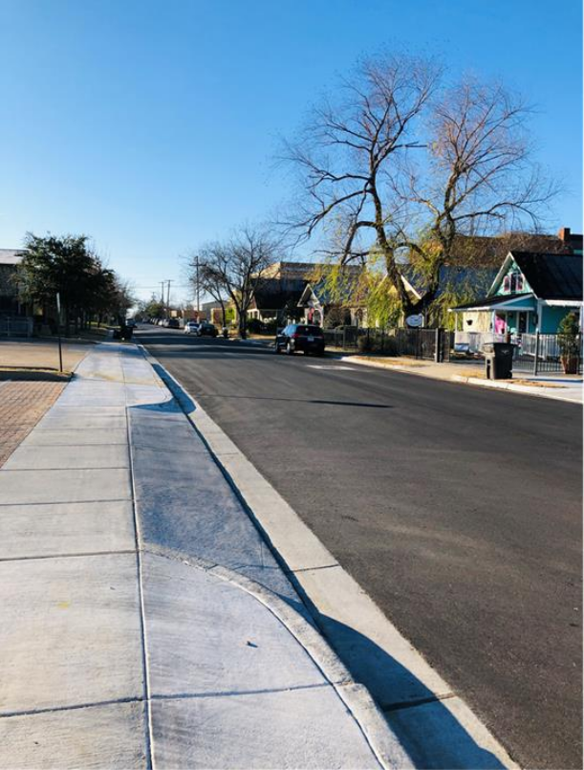
Proposed Improvement
New Asphalt Paving and Concrete Curb & Gutter
New Concrete Driveways

Slide 44
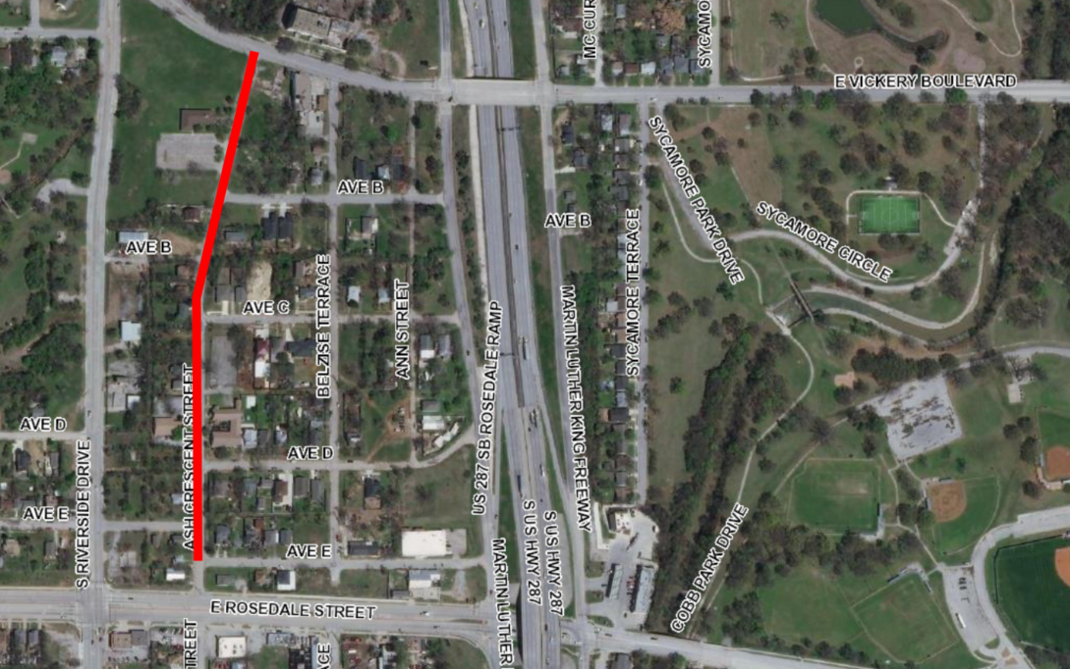
Summary of Improvements
Ash Crescent Street
Water and Sewer Improvements
  Replace existing 8” water
Paving Improvements
  New concrete pavement with concrete curbs
  New concrete driveways with 11’ minimum width (or match existing width).
  New 5’ sidewalk both sides of street

Slide 45
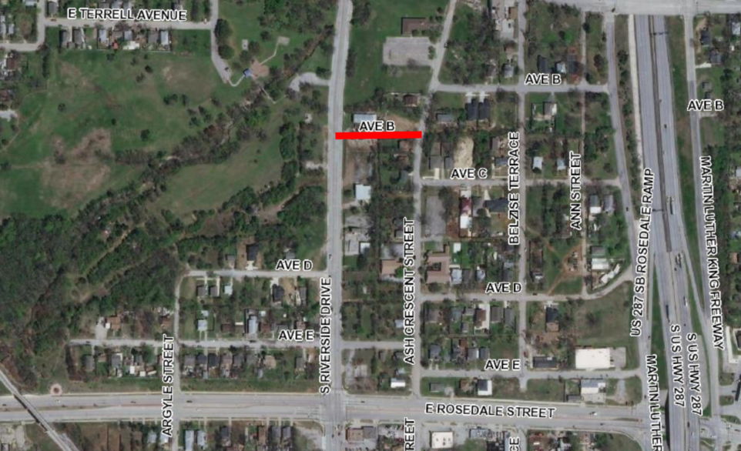
Summary of Improvements
Avenue B
Water and Sewer Improvements
  Upgrading existing 6” water to 8”
Paving Improvements
  New asphalt pavement with concrete curbs
  New concrete driveways with 11’ minimum width (or match existing width).

Slide 46
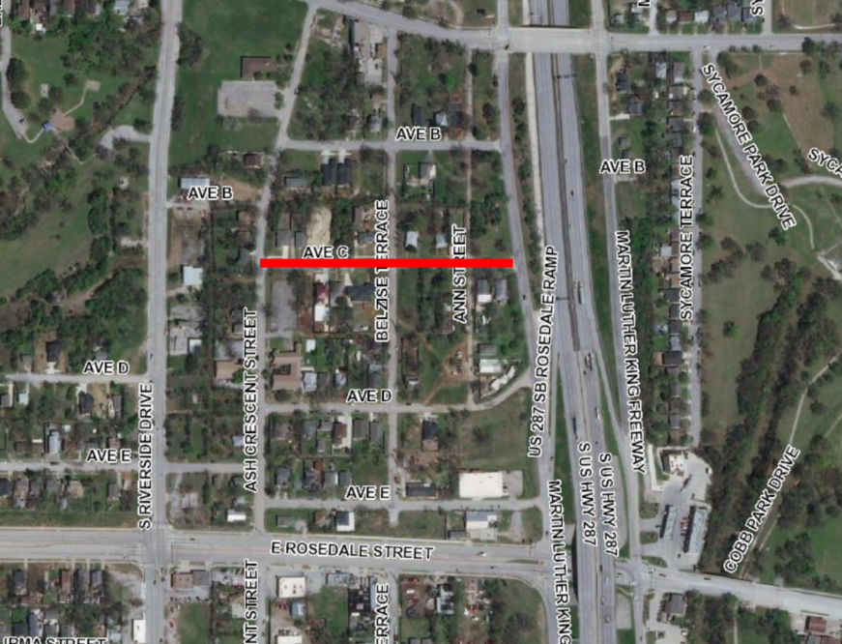
Summary of Improvements
Avenue C
Water and Sewer Improvements
  Upgrading existing 6” water to 8”
Paving Improvements
  New concrete pavement with concrete curbs
  New concrete driveways with 11’ minimum width (or match existing width).
  New 5’ concrete sidewalk both sides of street

Slide 47
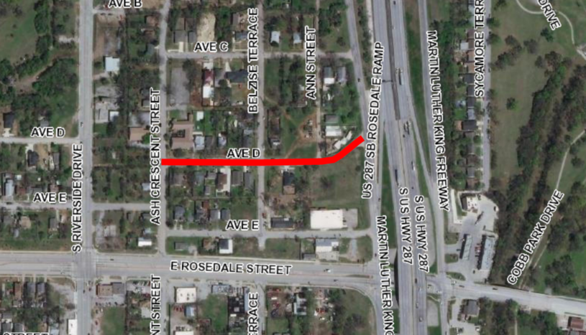
Summary of Improvements
Avenue D
Water and Sewer Improvements
  Upsize existing 6” water to 8”
Paving Improvements
  New concrete pavement with concrete curbs
  New concrete driveways with 11’ minimum width (or match existing width).
  New 5’ concrete sidewalk both sides of street (Ash Crescent to Belzise)
  New 5’ sidewalk on south side of road (Belzise to MLK FWY)

Slide 48
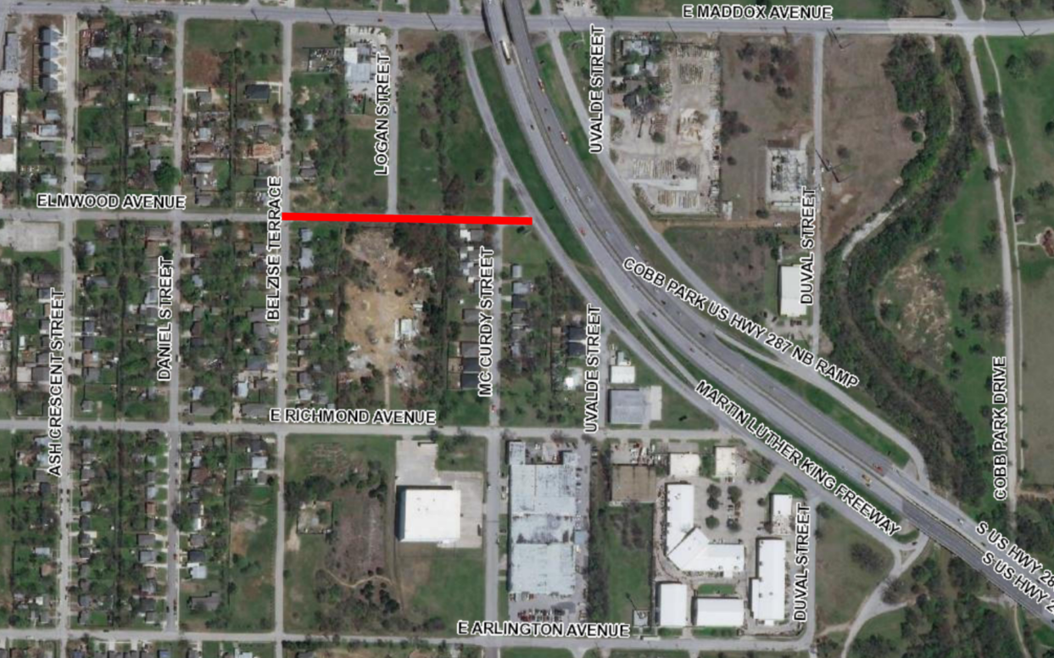
Summary of Improvements
Elmwood Avenue
Water and Sewer Improvements
  Install new 8” water
Paving Improvements
  New concrete pavement with concrete curbs
  New concrete driveways with 11’ minimum width (or match existing width).

Slide 49
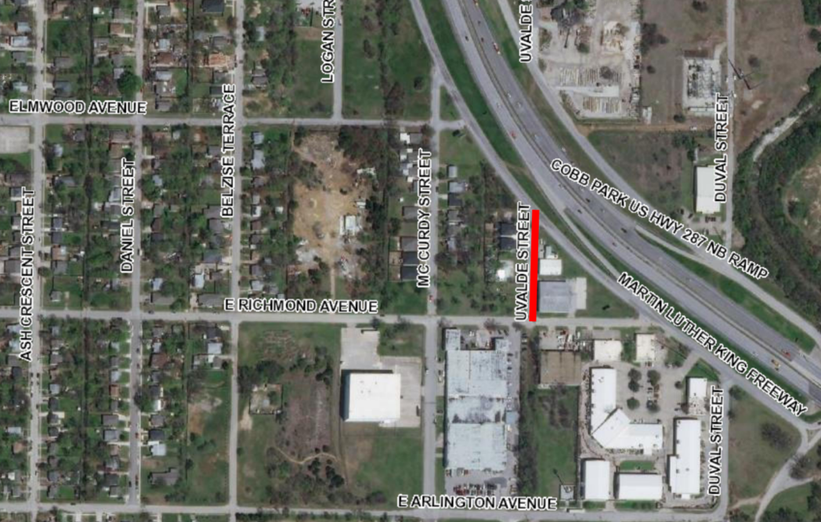
Summary of Improvements
Uvalde Street
Water and Sewer Improvements
  Upsize existing 6” water to 8”
  Replacing existing 8” sewer
Paving Improvements
  New concrete pavement with concrete curbs
  New concrete driveways with 11’ minimum width (or match existing width).
  New 5’ concrete sidewalk both sides of street

Slide 50
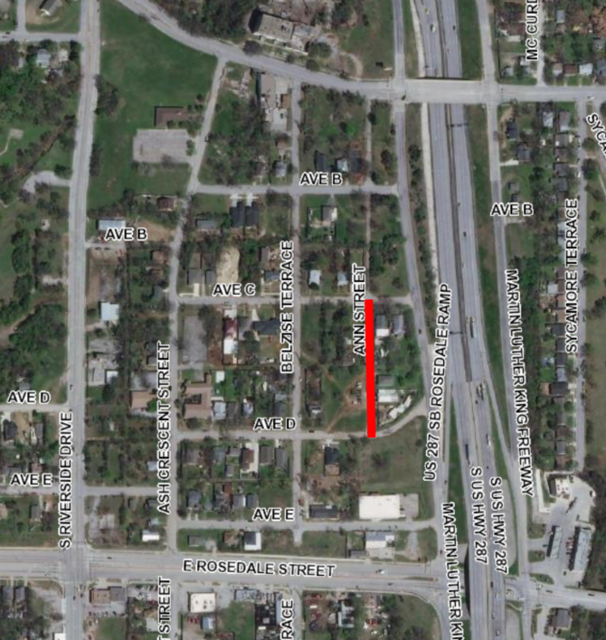
Summary of Improvements
Ann Street
Water and Sewer Improvements
  Upgrading existing 6” water to 8”
Paving Improvements
  New asphalt pavement with concrete curbs
  New concrete driveways with 11’ minimum width (or match existing width).
  Water Department funding this street

Slide 51
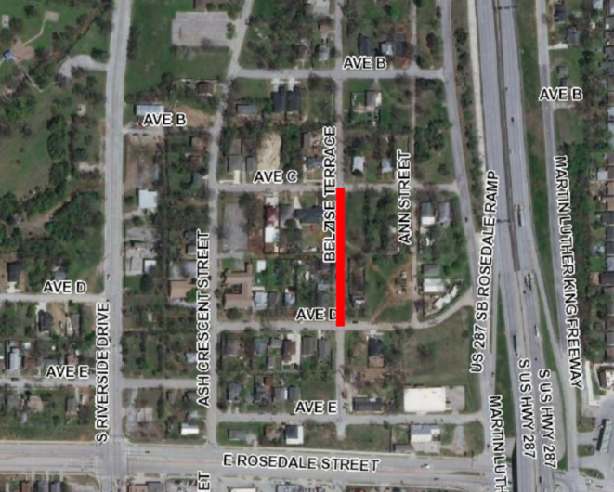
Summary of Improvements
Belzise Terrace
Water and Sewer Improvements
  Upgrading existing 6” water to 8”
Paving Improvements
  New asphalt pavement with concrete curbs
  New concrete driveways with 11’ minimum width (or match existing width).
  Partial sidewalk replacement on west side of street
  Water department is funding this street

