Slide 1
Community Meeting on Design plans South Hulen Street and West Risinger Road
City Project Number 103312 _Project Manager: Fanta Kaba
Project Engineers: Quiddity Engineering
August 24, 2023

Slide 2
Good evening. Thank you for joining this DESIGN PLAN discussion. Design means no final construction is in play and your input is being considered.
We will wait until 6:05PM to start for any still logging in.
Please mute yourselves to avoid echo/ disturbance during the meeting
You may ask questions using the chat box as shown in picture below. Or at the end during the Q/A
This meeting will be recorded and available online at the City’s website.
Note: To mute please press the speaker symbol on the screen

Slide 3
Agenda
Provide details about the status of this project: DESIGN PHASE
Our Design Process: 30% - 60% - 90%
Project Details
Project Schedule
Project Contact Information

Slide 4
DESIGN PHASE
30% Submittal: Conceptual Design
Traffic Study
60% Submittal: Preliminary Design
Constructability Walk Through
Utilities
ROW
90% Submittal: Final Design
Construction plans

Slide 5
Why this Project
Found a need to improve traffic flow at the intersection during peak hours, reduce delays, and improve overall safety for all users
Improve pedestrian safety at the intersection by installing pedestrian actuated signals with push buttons
Improve pedestrian access elements such as ADA compliant curb ramps
Project funded by 2022 Bond

Slide 6
Traffic Operations Study
Purpose:
Evaluate improvements to increase capacity, improve mobility, and improve operation.
Background:
Intersection is heavily trafficked with an approximate Average Daily Traffic (ADT) = 30,000 vehicles per day.
Heavy westbound (WB) and southbound (SB) left turn movements.
North Crowley High School located south on S Hulen Street
I-35 and Crowley Middle School located east on W Risinger Road

Slide 7
Traffic Operations Study
Analysis:
The existing intersection has a high crash rate of 18.8 crashes per year from 2018-2022.
The existing left turn queue exceeds available turn lane storage for all approaches except northbound (NB) S Hulen Street.
Intersection Level of Service analyzed for 5 improvement alternatives in 3 analysis years (2026, 2031, and 2046)

Slide 8
Traffic Operations Study
Recommendations:
Reconstruct all Left Turn Lanes (LTLs) to provide positive offset.
Reconstruct WB LTL to provide dual WB LTLs.
Install NB channelized right with yield operation.
Total LTL lengths be extended the maximum length to maintain existing adjacent median opening spacing.

Slide 9
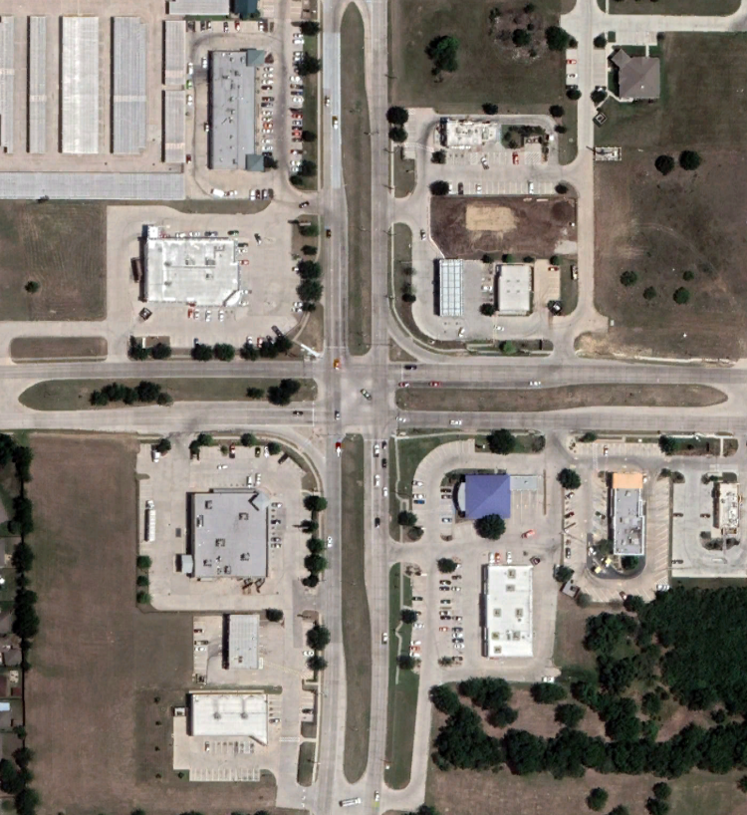
Project Location
N
S Hulen St
CVS
Gas
Station
W Risinger Rd
Chase
Bank
Walgreens
AutoZone

Slide 10
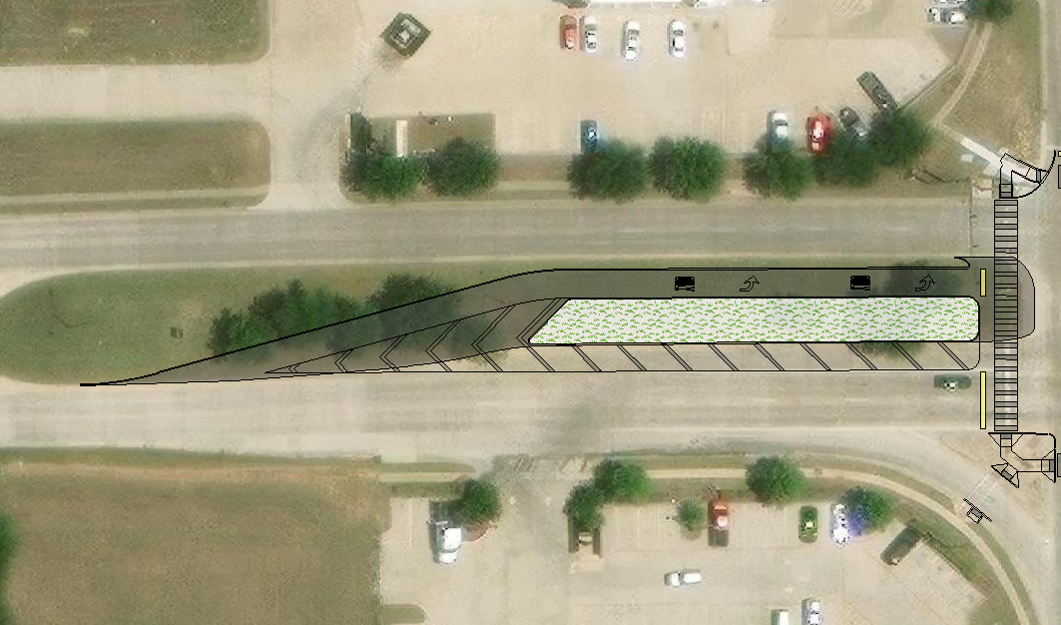
Preliminary Design
CVS
N
S Hulen St
N
S Hulen St
W Risinger Rd
W Risinger Rd
Key Map
Walgreens

Slide 11
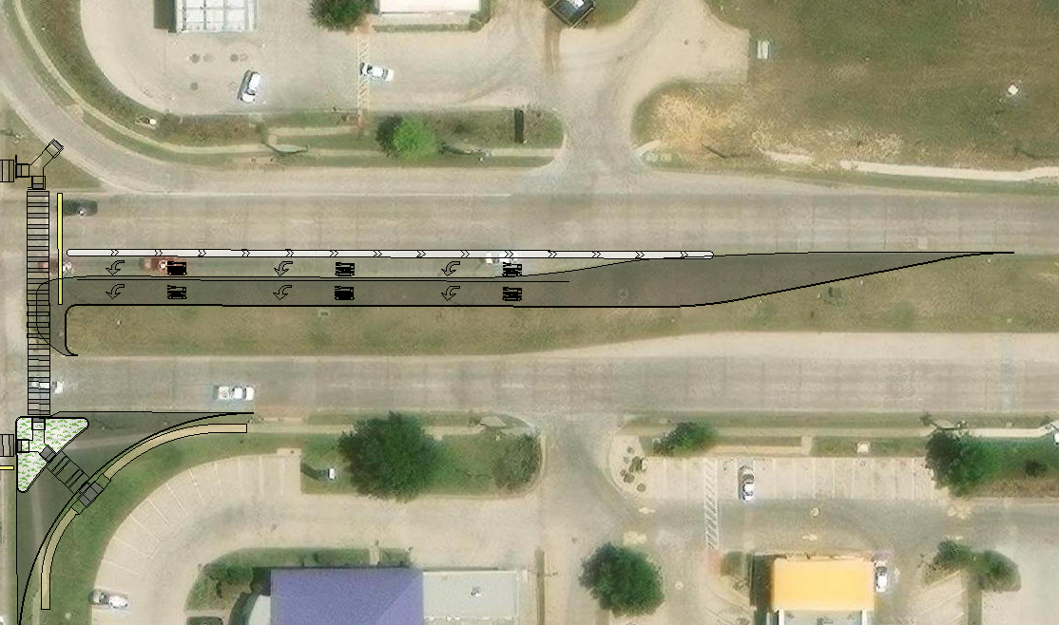
Preliminary Design
Gas
Station
N
S Hulen St
N
S Hulen St
W Risinger Rd
W Risinger Rd
Key Map
Chase
Bank
McDonald’s
Golden
Chick

Slide 12
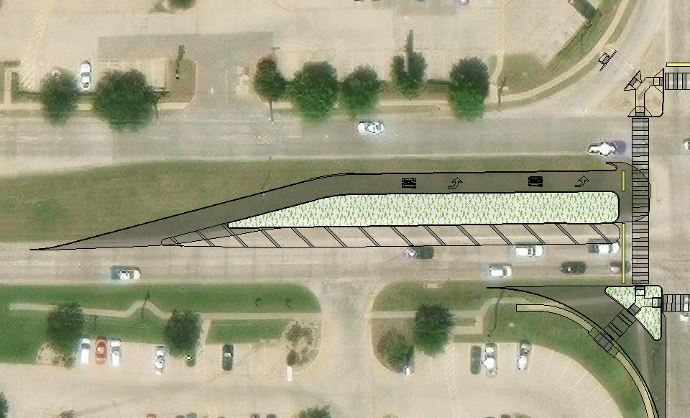
Preliminary Design
Take 5
Oil Change
Walgreens
N
N
S Hulen St
W Risinger Rd
S Hulen St
Key Map
W Risinger Rd
Chase
Bank

Slide 13
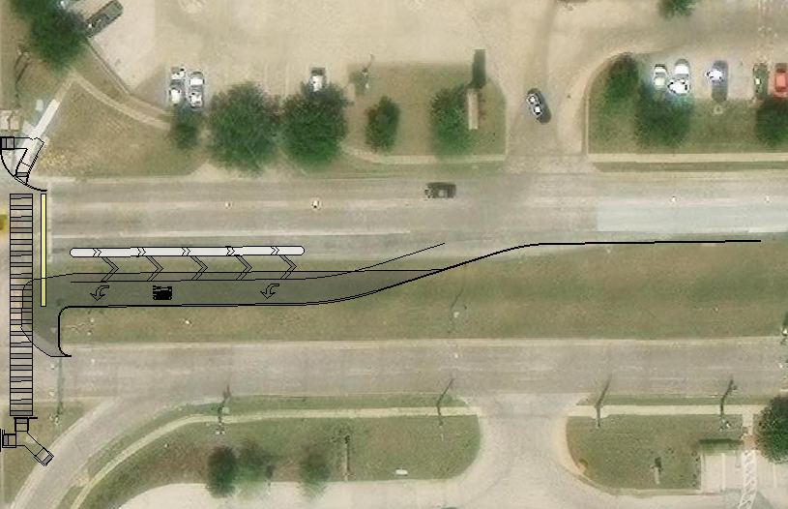
Preliminary Design
CVS
N
W Risinger Rd
N
S Hulen St
W Risinger Rd
S Hulen St
Key Map
Gas
Station
Jack in
The Box

Slide 14
Project Schedule
Currently in design phase
No ROW acquisition is anticipated
Coordination with existing utilities is ongoing
Contract execution for construction – Summer 2024
Estimated construction start – Fall 2024
Estimated construction duration – 12 months
Estimated construction cost - $2,223,585.00

Slide 15
Please Contact Us
Design Engineer:
David Leslie, PE
Quiddity Engineering
972-265-7192
dleslie@quiddity.com
City of Fort Worth Project Manager:
Fanta Kaba, PE
Professional Engineer, Transportation Public Works
817-682-3181
Fanta.Kaba@fortworthtexas.gov

Slide 16
Service Requests (MyFortWorth)
MyFW App for Apple:
https://apps.apple.com/us/app/myfw/id1463082731
MyFW App for Google:
https://play.google.com/store/apps/details?id=gov.fortworthtexas.service&hl=en_US
Text HELLO to 817-835-MYFW (6939).
City Call Center: 817-392-1234
Chat Box on City of Fort Worth Website

Slide 17
Thank you!

