Slide 1
Project Coordination and Cast Iron Pipe Replacement Process
September 23, 2025

Slide 2
Cast Iron Program
Why Cut New Pavement?
TPW and Water Projects
Project Initiation Process
Transportation and Public Works Initiated
Scope of Work and Funding Breakdown
Water Department Initiated
Capital Project Coordination
Agenda

Slide 3
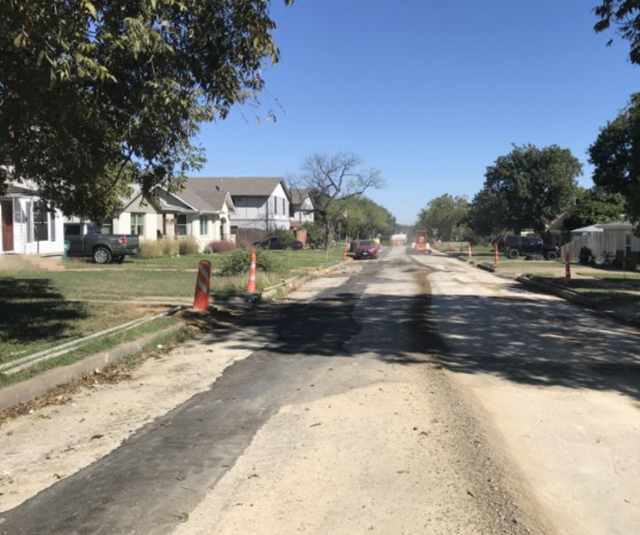
Project Initiation Process

Slide 4
Water Department Initiated Projects
Water Department develops projects based on:
Break history
Maintenance records
Age of the line
Pipe material
Capacity issues (Master Plan Analysis, Hydraulic Studies)
Dead-end lines
Necessary relocations
Regulatory compliance with TCEQ Sanitary Sewer Overflow Initiative (Applicable to Sewer Projects Only)
Water Department shares list of proposed projects

Slide 5
Transportation and Public Works Initiated Projects
TPW develops projects based on:
Pavement Condition Index
Type of water line
PVC – Maintenance Program Eligible
Cast Iron – 50/50 and Bond Program Eligible
Curb and gutter condition
Good – Maintenance and 50/50 Program Eligible
Failed – Bond Program Eligible
Maintenance records
Community Input
Refer to June 6, 2025, Budget Work Session Presentation for additional details
TPW shares list of proposed projects

Slide 6
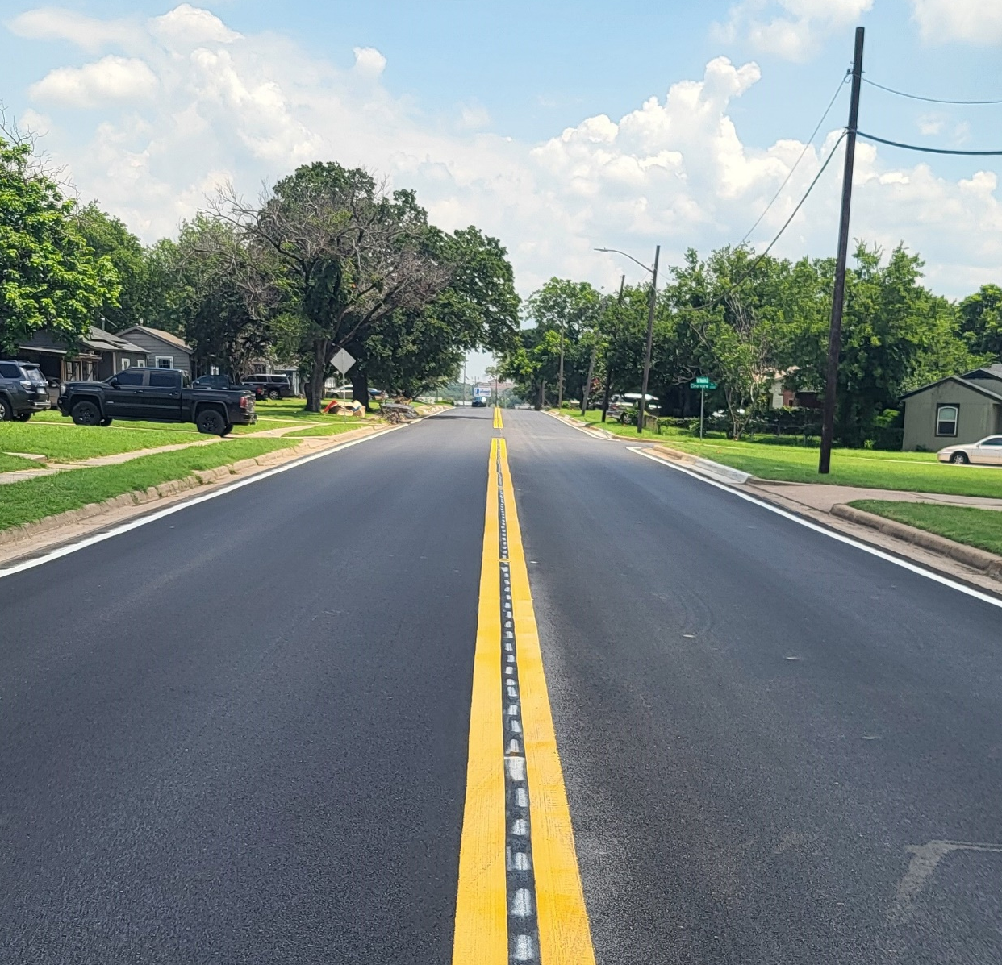
Scope of work and funding breakdown

Slide 7
TPW Initiated Projects:
Maintenance program project
TPW: 100% of pavement preservation or rehabilitation
Minimal curb, gutter, driveways, and sidewalks
Inside bond program project limits
TPW: 100% pavement reconstruction, curb, gutter, driveways, and sidewalks
Water Dept: 100% water & sewer improvements
Outside bond program project limits
Water Dept: 100% water, sewer, and street rehabilitation only
Excludes: curb, gutter, driveways, and sidewalks
Water Department Initiated Projects:
Water Dept: 100% water & sewer improvements
TPW: 50% paving cost (up to $3.5M/year)
After TPW $3.5M is Exhausted:
Water Dept may fund full paving
Excludes: curb, gutter, driveways, and sidewalks
Scope of work and funding breakdown
Notes:
Mention what pavement preservation (crack sealing, surface coat) and rehabilitation/paving (MOL and POL) is and annual budget
Discuss how reconstruction is different from rehabilitiation

Slide 8
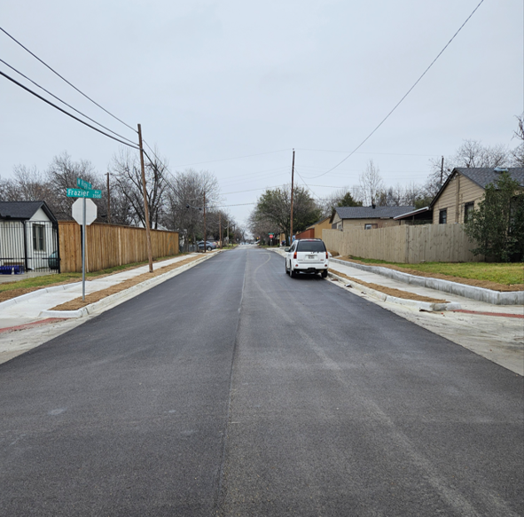
Capital project coordination

Slide 9
Capital Project Coordination
Collaboration & Planning
Shared project list: Water, TPW, PARD, and Development Services
Design reviews at 30%, 60%, and 90% milestones
Early conflict resolution and design alignment
Tools & Integration
Cross-departmental coordination checklist
Projects mapped in GIS
Scopes consolidated when priorities align
Streamlined Delivery
One engineering agreement
One construction contract

Slide 10
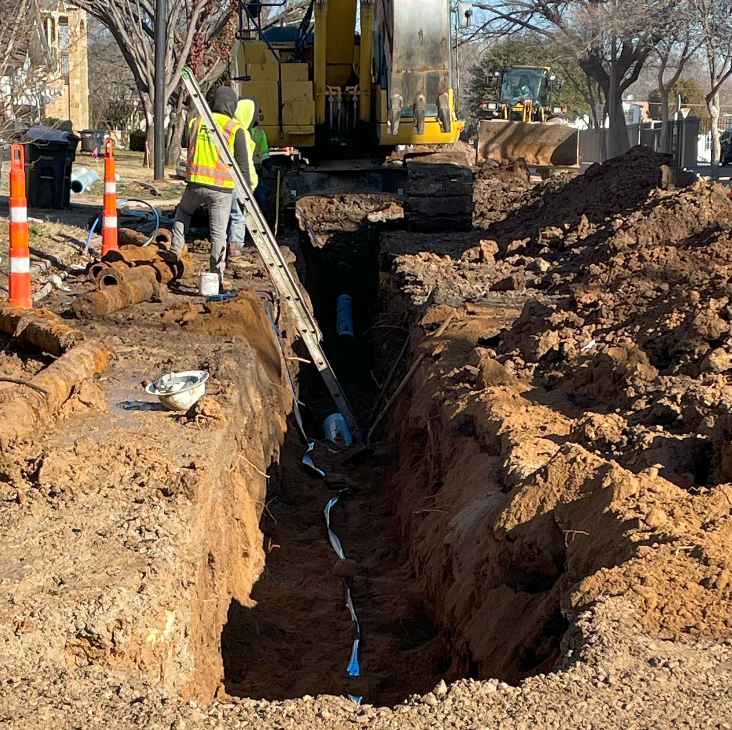
Cast iron program

Slide 11
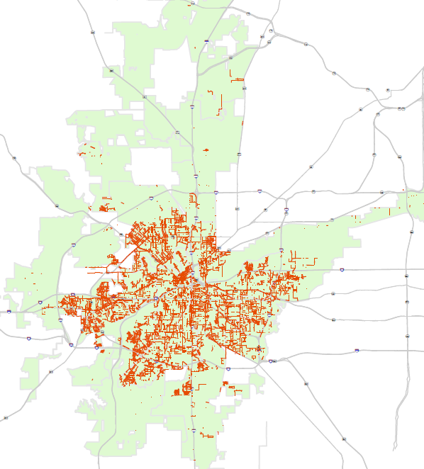

Cast Iron Pipe Locations
Total 4059 miles of Water Main in the City
There are 730 miles of cast iron pipe (18%) in the system
Large Diameter: 58 miles
Small Diameter: 672 miles
Historically, 85% of water system breaks occur on cast iron pipe

Slide 12
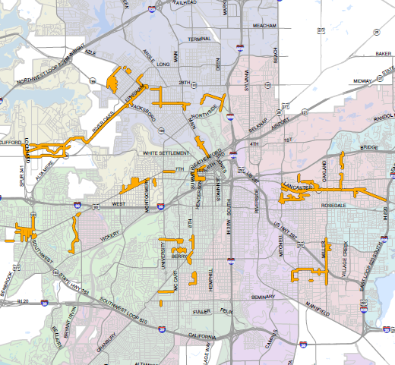
Cast Iron Large Diameter Pipe Projects
 | Existing Cast Iron (miles) | Design/ Construction (miles) | Remaining in System (miles)
Large Diameter (16” or Greater) | 58 | 25 | 33
FY2020
to FY2030
18 Large Diameter Projects
Pipe Size Diameter | Percent Reduction (By 2030)
16” | 28%
20” | 56%
24” | 56%
30” | 65%
36” | 63%

Slide 13
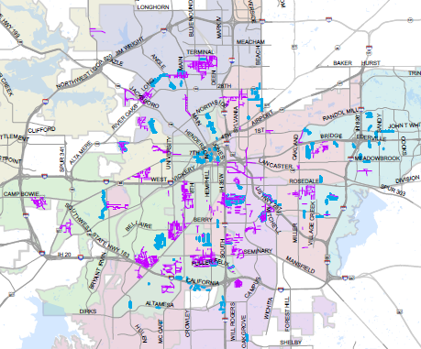
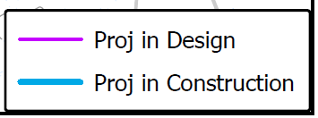
Cast Iron Small Diameter Pipe Projects
 | Existing Cast Iron (miles) | Design/ Construction (miles) | Remaining in System (miles)
Small Diameter (12” or Smaller) | 672 | 180 | 492
FY2020
to FY2030

Slide 14
Large and Small Diameter Cast Iron Pipe Summary
 | Existing Cast Iron (miles) | Design/ Construction (miles) | Remaining in System (miles)
Large Diameter (16” or Greater) | 58 | 25 | 33
Small Diameter (12” or Smaller) | 672 | 180 | 492
Total | 730 | 205 | 525
FY2020
to FY2030

Slide 15
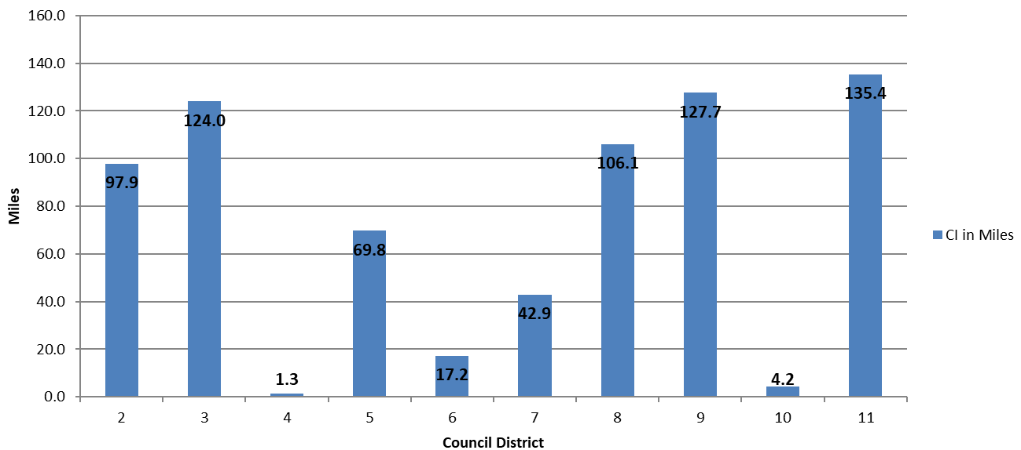
Total Miles of Water Cast Iron Pipe per Council District
19%
17%
18%
14%
15%
10%
6%
2%
0.2%
1%

Slide 16
Cast Iron Program Initiative
The big storm in winter 2021 caused over 700 cast iron pipe breaks
Water Department established the Cast Iron replacement program with a goal of 20 miles a year
Lancaster/Collier 30” transmission main break highlighted the risk to the water system from a cast iron transmission main break

Slide 17
Why Cut New Pavement?
Developer / Redeveloper Needs (taps, service lines, water demand, CFA requirements, redevelopment)
Maintenance Needs (field operation repairs of breaks and leaks)
Waterline relocation to the street due to franchise utility conflicts
Water Dept previously cleared TPW Pavement Projects prior to 2021 Cast Iron Program initiated after 2021 Winter Storm
7th St, Hemphill and Downtown
Lancaster 30" Transmission Main Break

Slide 18
Thank you!

