Slide 1
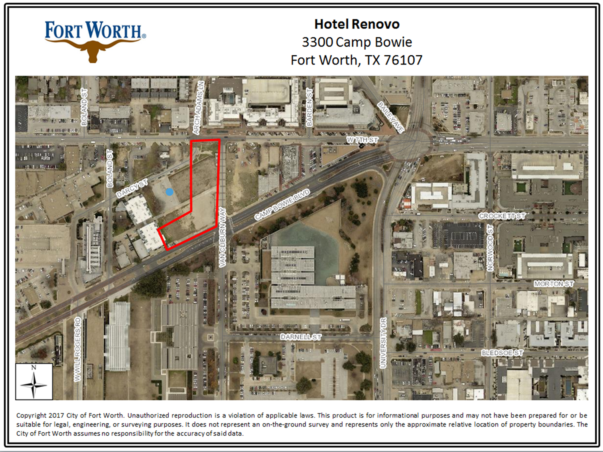
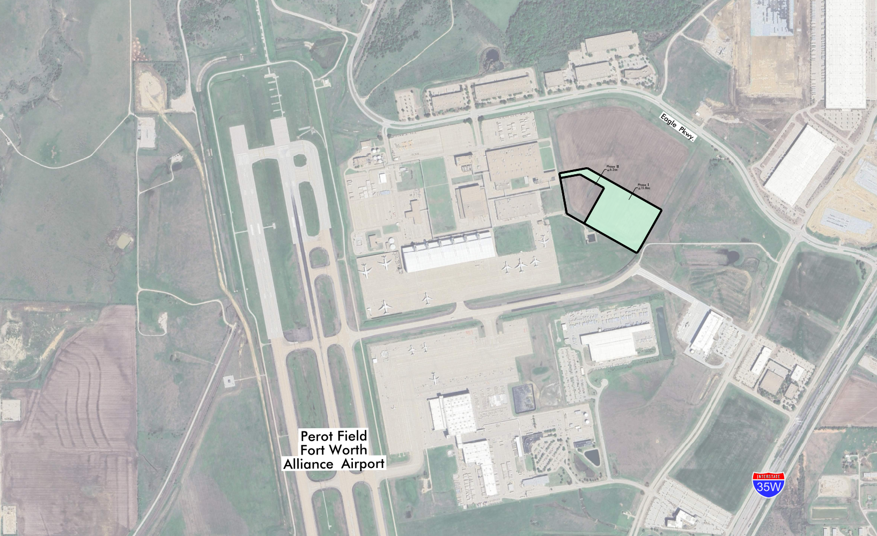
Tax Abatement Reinvestment Zone No. 111
Greenfield Site - 22 acres at Alliance Center (outlined below)
Fort Worth TX 76177 “Exhibit A”
Copyright 2023 City of Fort Worth. Unauthorized reproduction is a violation of applicable laws. This product is for informational purposes and may not have been prepared for or be suitable for legal engineering or surveying purposes. It does not represent an on-the-ground survey and represents only the appropriate relative location of property boundaries. The City of Fort Worth assumes no responsibility for the accuracy of said data.

