Slide 1
Homeless System Overview
Tara Perez, Homeless Strategies Manager, City of Fort Worth
Mayor’s Community Engagement Workshop
March 7, 2026

Slide 2
Agenda
Point in Time Count
System Overview
City Approach
Cross-Departmental Work
Homeless Strategies
City Funding
Reporting Camps

Slide 3
Fort Worth Homeless Population: 2007-2025
Sheltered only, no unsheltered count in 2022
Source for CoC count: 2007-2025 PIT Counts by CoC (Department of Housing and Urban Development), State of the Homeless Report 2024 (Tarrant County Homeless Coalition). City of Fort Worth numbers were estimated at 85% of the CoC numbers based on geographic breakdown for 2007 - 2017 and 2022. Actual City of Fort Worth numbers used for 2018 – 2021 and 2023 - 2025. 2022 is a sheltered only count.

Slide 4


2020-2025 Point in Time Count
2,404
2,289
119
2,065
142
1,882
148
1,193
149
1,266
1,025
Transitional Housing
Safe Haven
1,089
1,001
Emergency Shelter
83
540
999
Unsheltered
872
934
712
446
2020
2021
2023
2024
2025

Slide 5
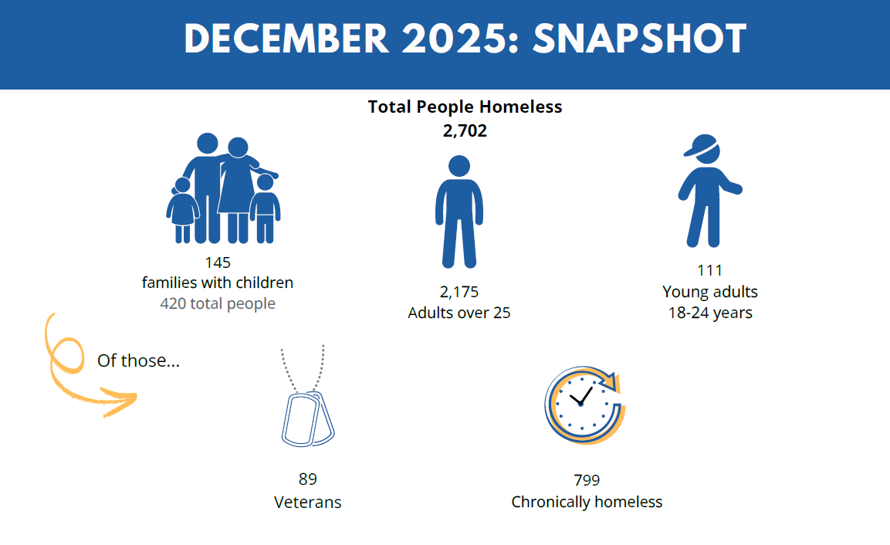

Slide 6
Homeless Strategies
Balance of compassion and enforcement
Enforcement space
State Laws
City Ordinances
Solutions space
Investing in long-term solutions
Able to use flexible local dollars to innovate, supplement other homeless funding

Slide 7
Cross-Departmental Work
Homeless Strategies (CMO)
Environmental Services
HOPE FIRE
HOPE Police
Municipal Court
Park & Recreation
Neighborhood Services
Camp Cleanup
Medical, Outreach
Enforcement, Outreach
Community Court
Grants, Housing
Camp Cleanup
System Support, Housing, Outreach
Enforcement Workgroup
Align on enforcement, improve camp cleanup process
Services Workgroup
Align funding for programs, services, and housing efforts

Slide 8
Homeless Strategies
Two person unit in the City Manager’s Office
Oversees $6.5 million in general funds, state grants
Supports directed investments into homeless housing solutions
In the past 5 years, the City has invested nearly $40M to support the build of 456 PSH units (144 of those units opened in October) and 55 homeless family units.
Works cross-departmentally on problem solving

Slide 9
2024 Stakeholder Input
City
Community
Homeless System
Lived Experience
Met with 276 stakeholders in 4 months through 61 meetings
City Councilmembers​
City Departments Leadership & Staff​
People with Lived Experience​
Homeless System Providers​
Community Partners: Neighborhoods, Churches, Businesses, Public Agencies​

Slide 10
Category | FY26 | % of Total
High Impact | $2,178,303 | 35%
Rapid Exit | $1,556,746 | 25%
Case Management for PSH Clients | $1,175,977 | 19%
Direct Client Service Fund | $500,000 | 8%
Outreach | $457,316 | 7%
Cold Weather Sheltering Operations | $200,000 | 3%
Critical Document Services | $150,000 | 2%
 | $6,301,728

Slide 11
Program Highlight: Rapid Exit
Partner: Presbyterian Night Shelter
$1,556,746 in FY26
How it works
Focuses on employed households or enough income to sustain
One-time funding (rental fees, deposit, 1-3 months rent)
Outcomes
Assisted 410 households in FY25
95% of households assisted in FY24 did not return to homelessness in FY25

Slide 12
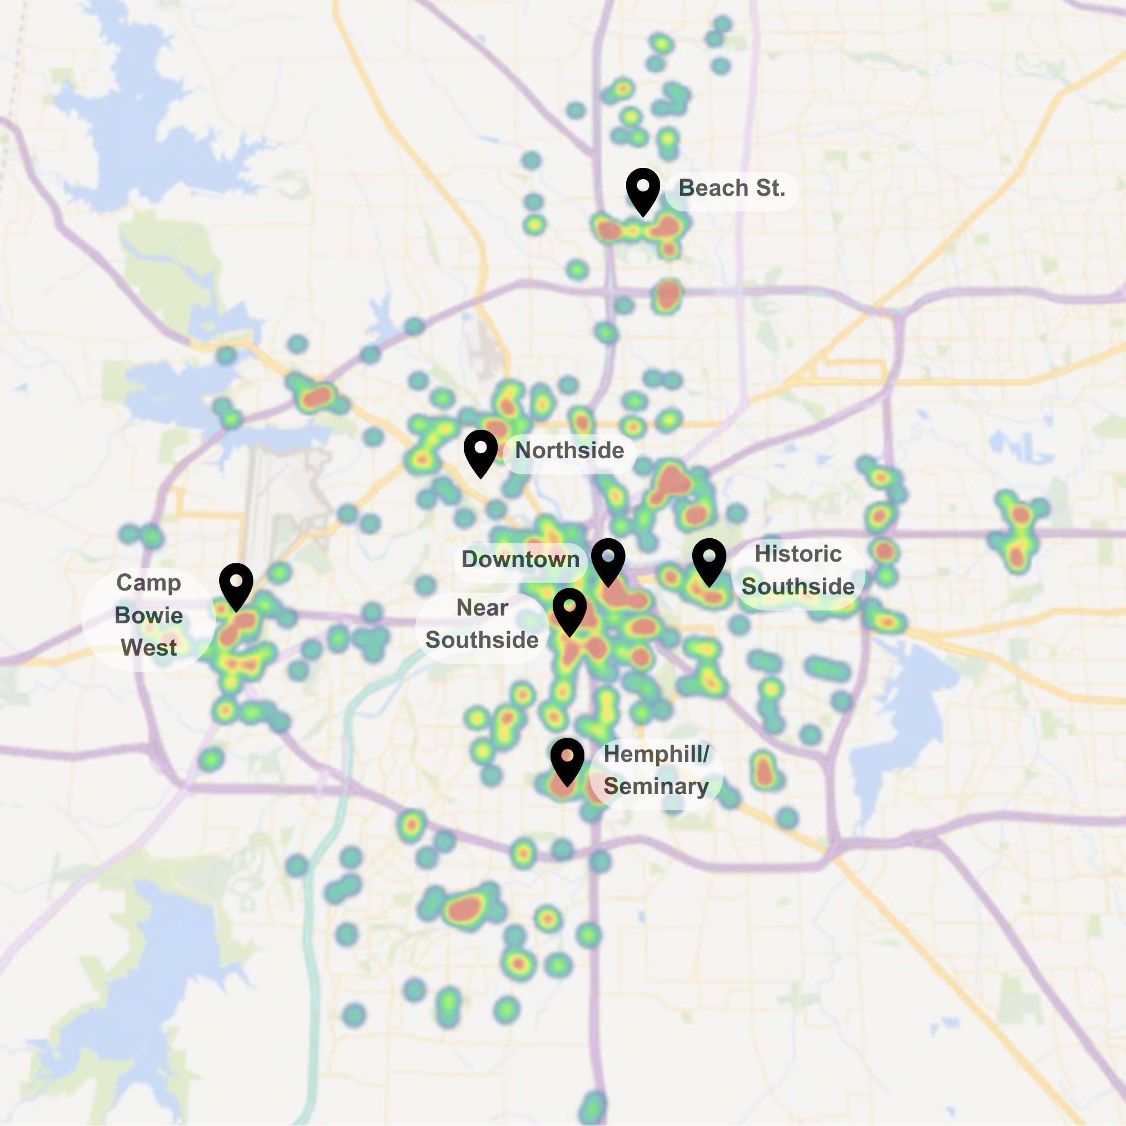
Program Highlight: High ImpACT
Goal
Reduce homelessness in 7 severely affected areas by adding targeted mental health and housing resources
Target Areas
Camp Bowie West/Las Vegas Trail (CD 3)
Seminary/Hemphill (CD 9 and 11)
Downtown (CD 9)
Near Southside (CD 9)
Historic Southside/Near Eastside (CD 8)
Northside/Stockyards (CD 2)
Beach Street intersections – from E. Lancaster to N. Tarrant Parkway (CD 2, 4, 8 and 11)
Referrals
70% from Neighborhood Patrol Officers

Slide 13
Program Highlight: High ImpACT
May 1, 2024 – September 30, 2025
- 86% of High ImpACT clients offered housing accepted housing within 6 months. - The median number of interactions to reach housing acceptance for a High ImpACT client is 1.
- 95% of clients struggle with severe mental health disorders​. - 73% of clients struggle with substance use disorders. - 10% of clients struggle with opioid disorders​.
- The median housed High ImpACT Client has been homeless for 7.5 years and is 54 years old.

Slide 14
High ImpACT: Performance Measures
Goals (by September 30, 2025) |  |  | Outcomes (as of September 30, 2025)
70% | At least 70% of those offered housing enter housing within six months |  | 86% | 86% of referrals offered housing through master lease or HHSP have accepted
70% | After one year of entering housing, at least 70% are still housed |  | 94% | 94% of clients housed at least one year remain housed
80 | Provide ACT Team services for 80 clients |  | 80 | 80 clients are being provided ACT Team services
40 | Provide High ImpACT housing assistance to 40 clients |  | 43 | 43 provided housing assistance through High ImpACT master lease
40 | Provide housing assistance to 40 additional clients by leveraging other programs |  | 33 | 12 provided housing assistance through HHSP 21 provided housing assistance through other programs

Slide 15
Program Highlight: Targeted Outreach
Partner: DRC-Solutions
$457,316 in FY26
How it works
Proactive, in-person engagement to find, build trust with, and provide services to unsheltered with goal of supporting an exit from homelessness
Examples: obtaining identification documents, connecting with housing, employment, or treatment, diversion, etc.
6 street outreach workers (3 teams of 2)

Slide 16
Program Highlight: Targeted Outreach
1st Quarter of FY26
Interacting with some unsheltered who had never touched the homeless system
Diversifying with more pathways to exit than housing (employment, diversion, treatment)
Continues to make difference who asks (Police or outreach) if someone wants assistance
658 encounters
540 unduplicated
6 individuals diverted
family reunifications

Slide 17
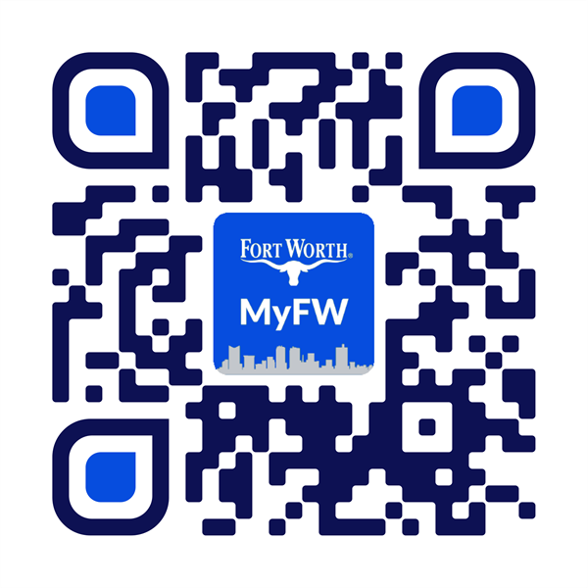
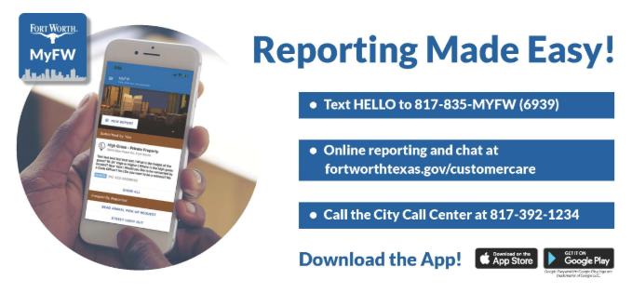
Reporting Camps
MyFW app > “Police” >“Homeless Camps”

Slide 18
Questions

Slide 19
