Slide 1
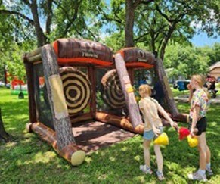
Make it a Can’t-Miss Event
+
Promotion Strategies that Work

Slide 2
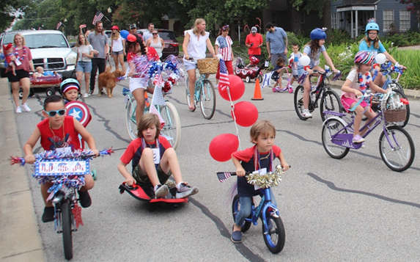
Why Neighborhood Events Matter
Turn strangers into neighbors
Increase safety and trust
Create pride in your community
Make it easier to solve problems together
Strengthen your neighborhood association
THE ARE FUN!

Slide 3
What does successful really mean?
Success isn’t about:
Huge crowds
Fancy decorations
Big budgets
Success is about:
People connecting
Positive energy
New faces showing up
Neighbors talking to each other

Slide 4
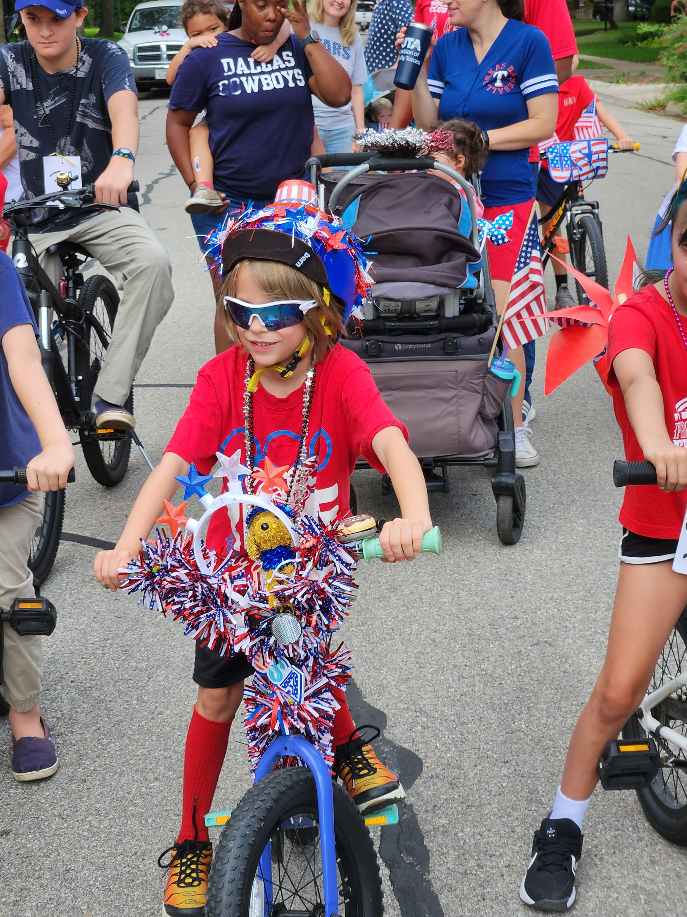
Types of Neighborhood Events
Block party
Potluck
Holiday decorating contest
Movie night in the park
Ice cream social
Community garage sale
Cleanup day
National Night Out

Slide 5
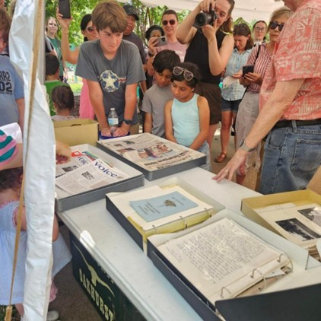
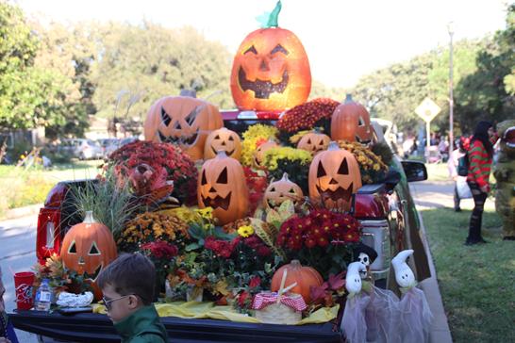
Before you plan…Ask why?
What is your goal?
Meet new neighbors?
Welcome new residents?
Celebrate the neighborhood?
Raise funds?
Share information?
Build volunteer support?

Slide 6
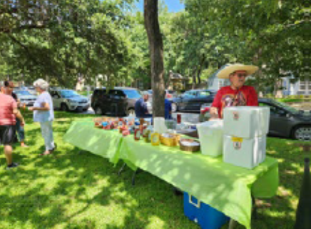
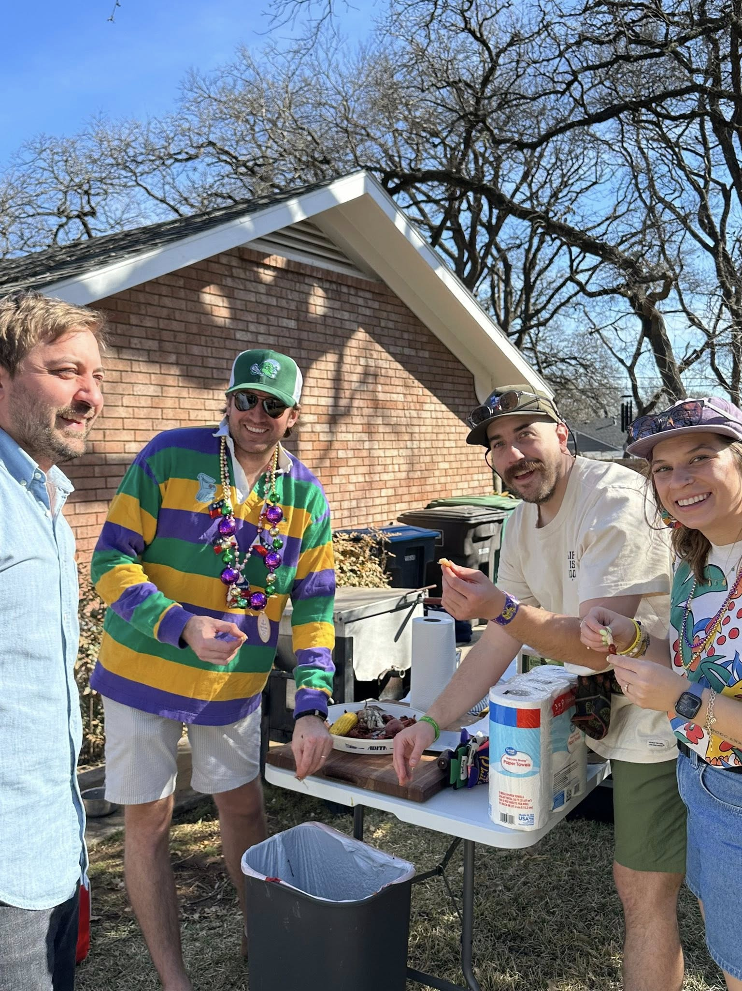
What can you do …and do well?
How many volunteers do we really have?
What’s our realistic budget?
How much time can we commit?

Slide 7
Planning for Success

Slide 8
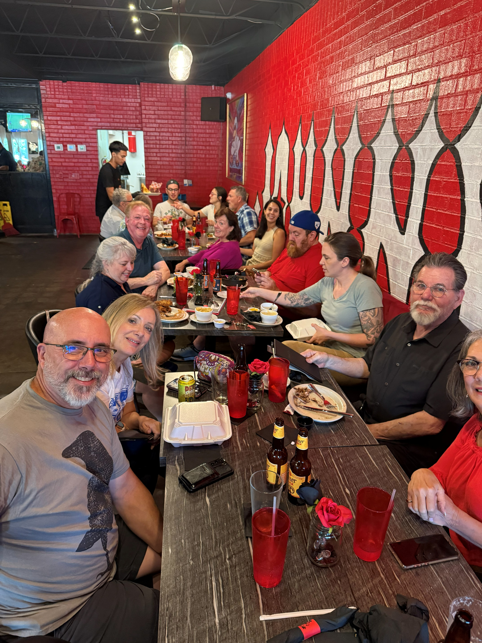
Choose the Right Date & Time
Consider:
Weather
School schedules
Major holidays
Local competing events
Daylight hours
Work schedules

Slide 9
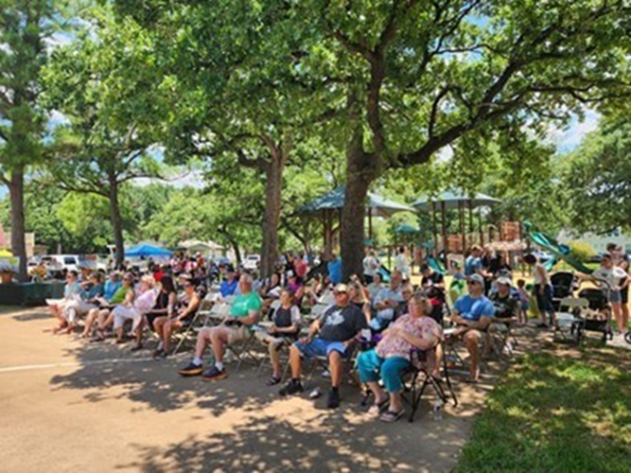
Where should you host it?
A cul-de-sac
A neighborhood park
Community pool area
School playground
HOA clubhouse
A neighbor’s large yard

Slide 10
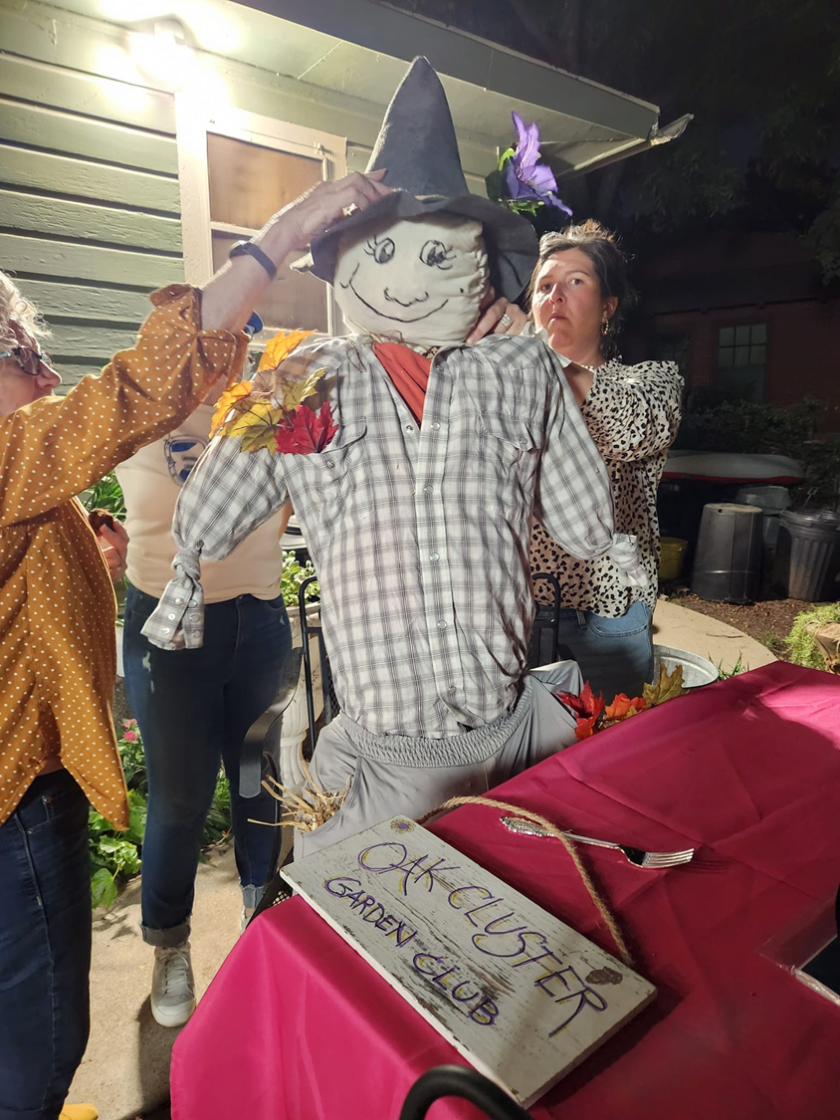
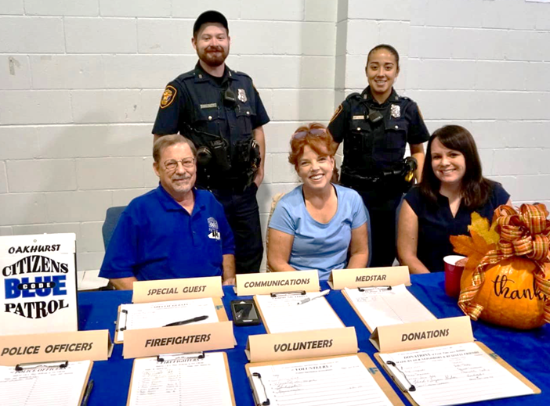
What is your budget?
Ways to reduce expenses:
Potluck instead of catered food
Borrow tables/chairs
Ask local businesses to donate small prizes
Simple decorations
Use digital invites

Slide 11
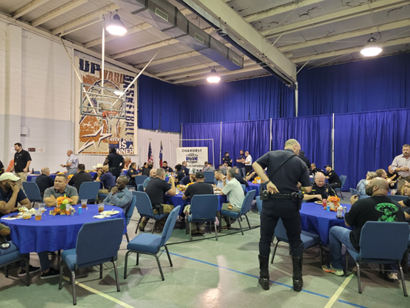
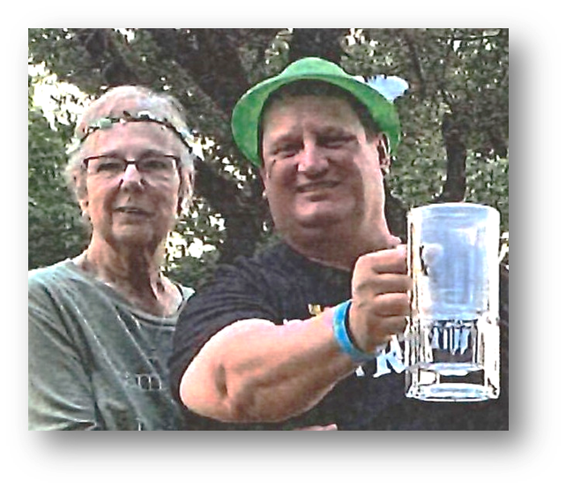
Who is your audience?
Families
Seniors
Children
Adults

Slide 12
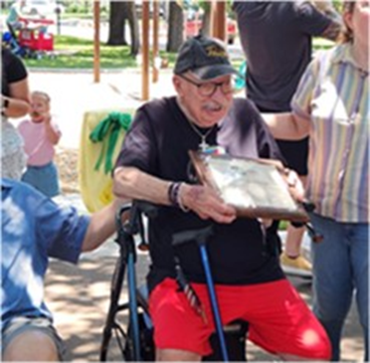
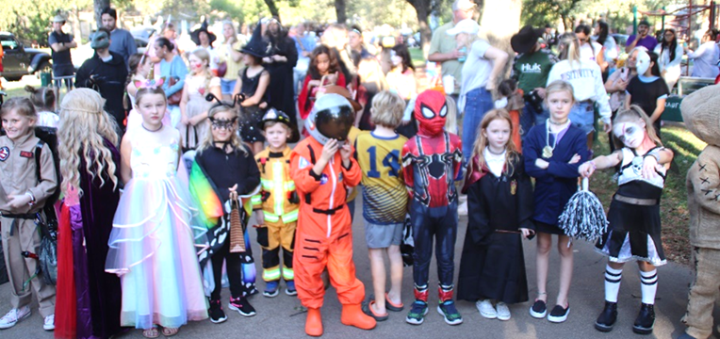
Remove Barriers
Think about
Shade in summer
Seating for seniors
Kid-friendly activities
Food and water
Translations

Slide 13
Promoting Your Event

Slide 14
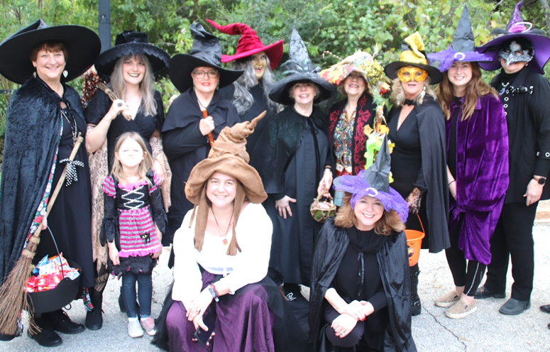
Start Early and Repeat
Develop a Timeline
4 Weeks – Announcement
2 Weeks – Reminder
1 Week – Push
2 Days – See you there
Day of – Happening tonight

Slide 15
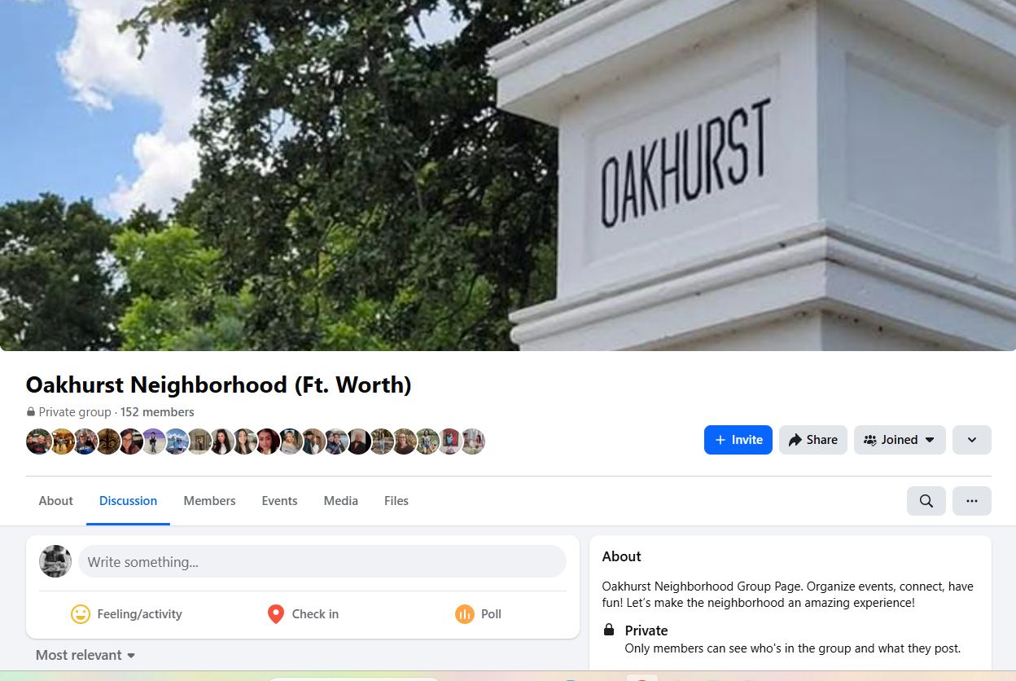
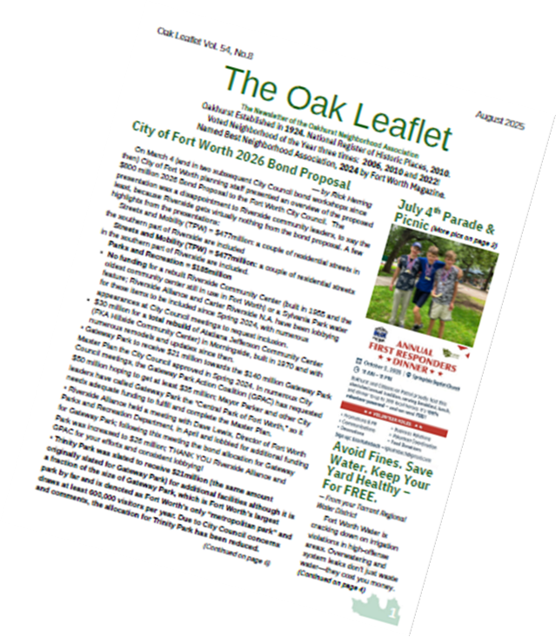
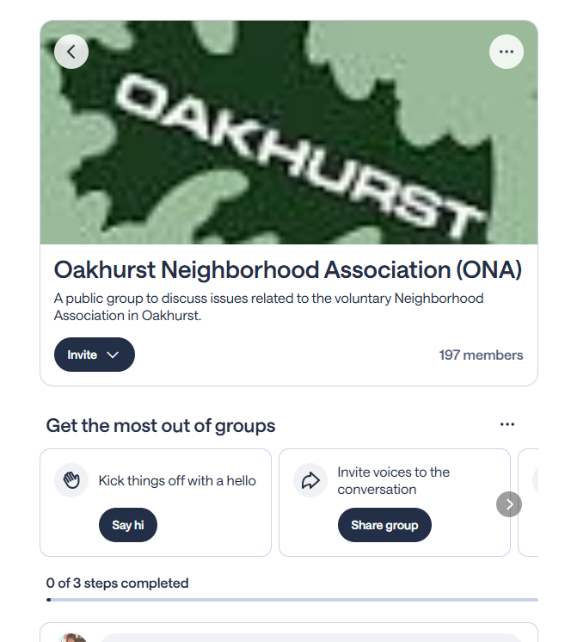
Multiple Channels
Newsletter and Calendar
Neighborhood Facebook Page
Nextdoor
Mailing List/Emails
Group text
Yard signs
Flyers
Word of Mouth

Slide 16
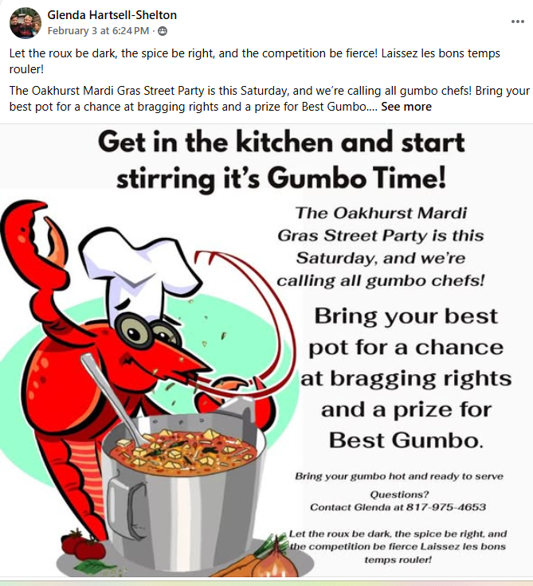
Make the message about them
Instead of:
“Neighborhood Association Meeting”
Try:
“Come Meet Your Neighbors & Enjoy Ice Cream!”
Focus on:
Fun
Food
Family
Community pride

Slide 17

Include all the information
Headline:
“Join Us for a Neighborhood Block Party!”
Details:
Date
Time
Location
Why Come?
Meet neighbors
Free hot dogs
Kids games
Raffle prizes

Slide 18
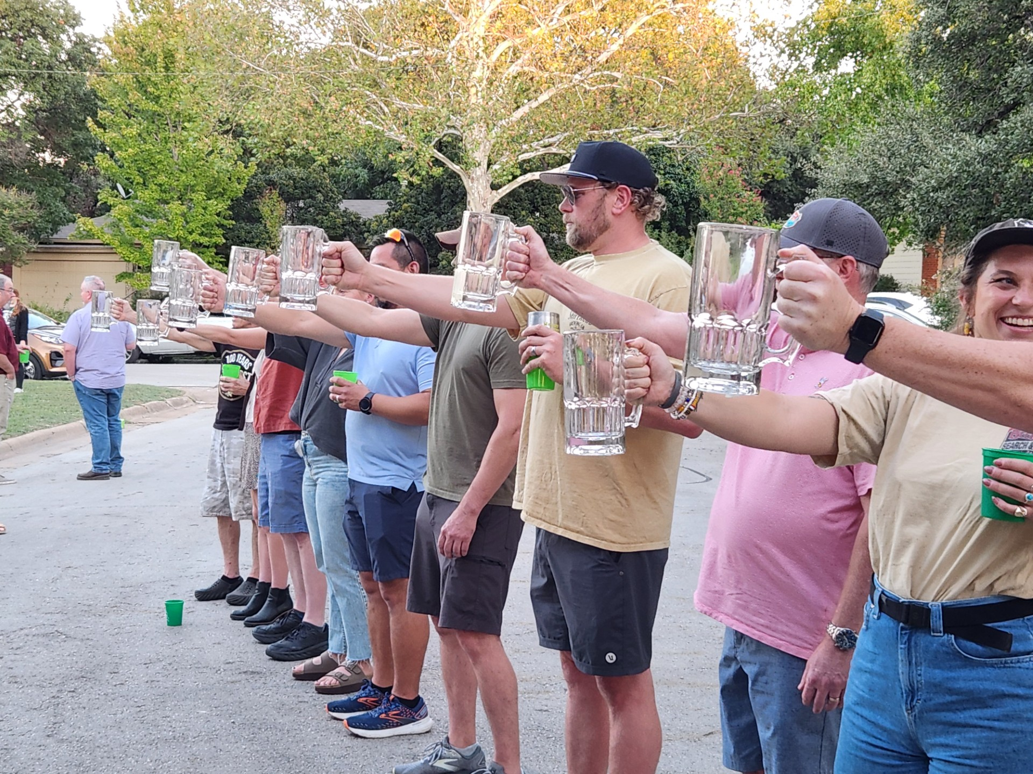
Day of Success
Make a checklist
Arrive early
Set up signs
Play music
Greet every person
Take photos
Collect emails

Slide 19
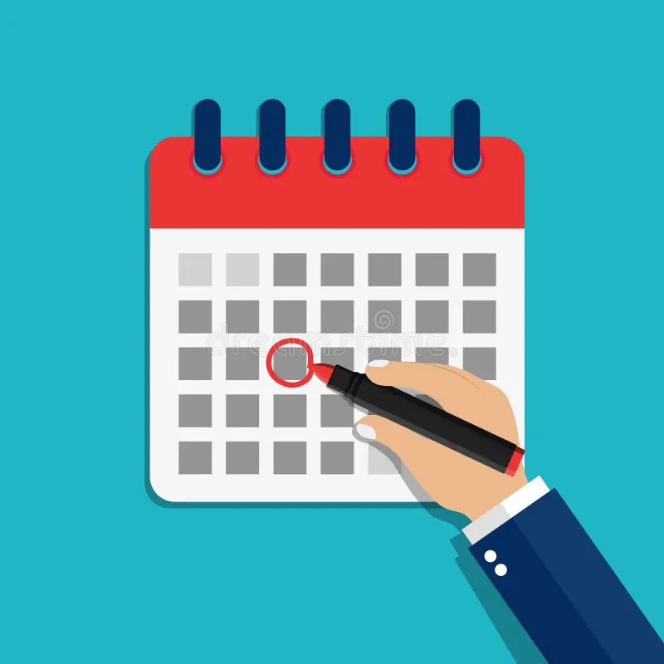
After the Event
Within 2 days:
Post photos
Say thank you – to attendees and volunteers
Share how many attended
Invite people to the next event

Slide 20
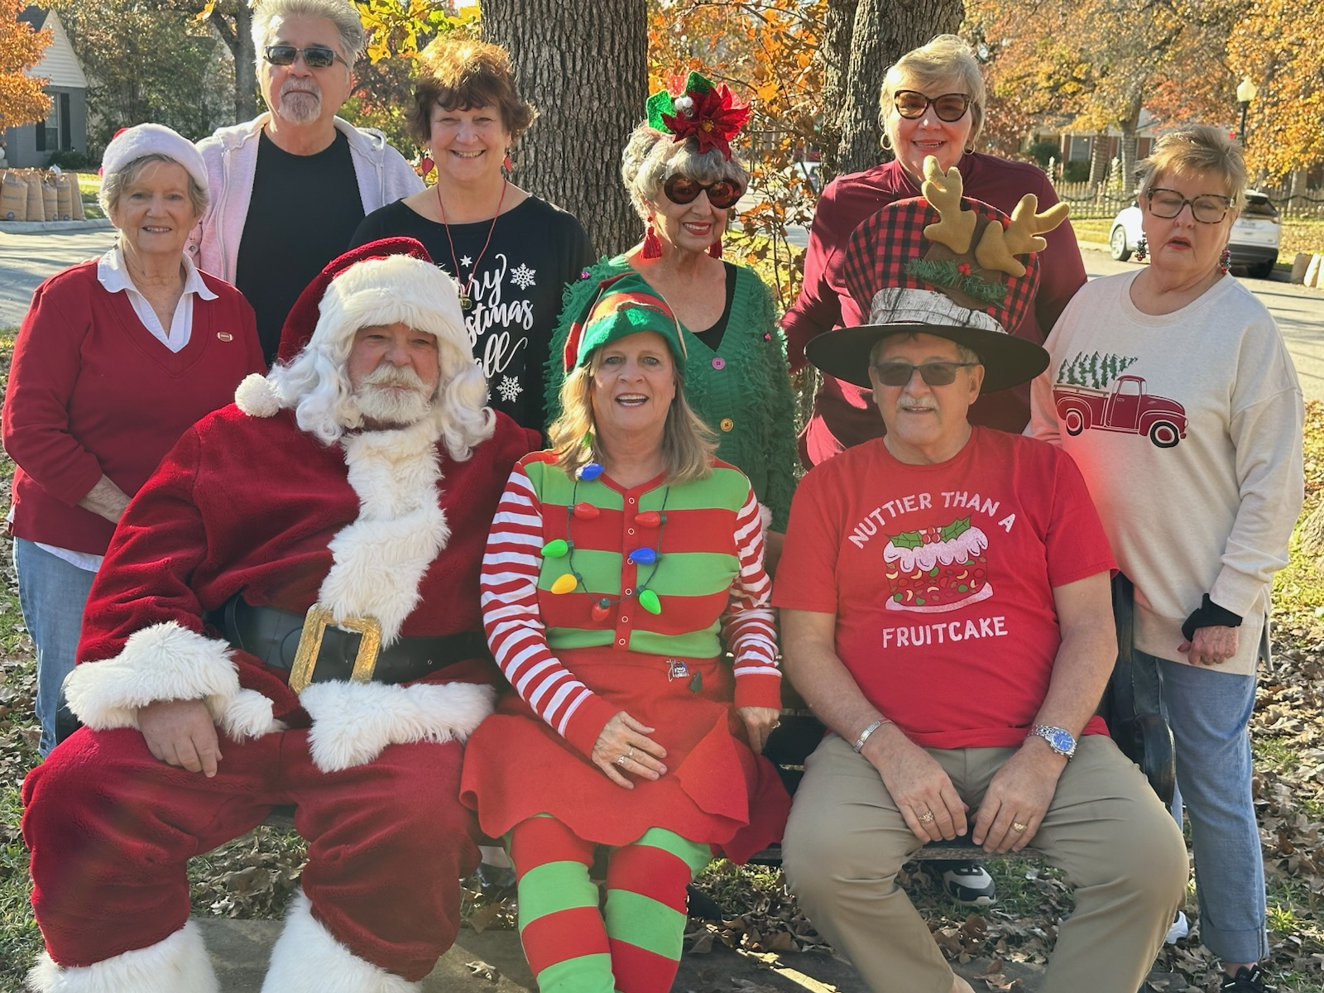
What worked?
Ask your volunteers:
What went well?
What was stressful?
What would we change?
Who stepped up?

Slide 21
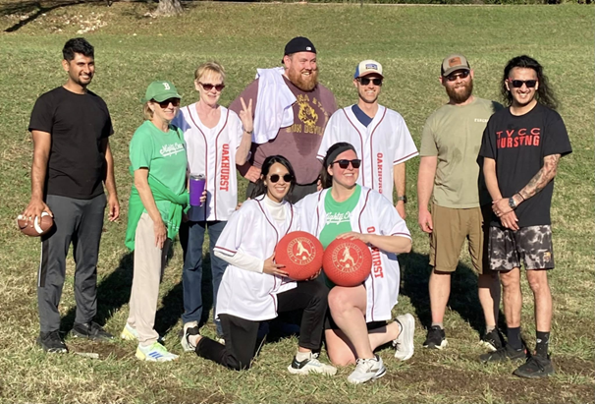
Common Mistakes
Planning too big
Waiting too late to promote
Doing everything yourself
Overcomplicating the agenda
No follow-up

Slide 22
Questions?

