Slide 1
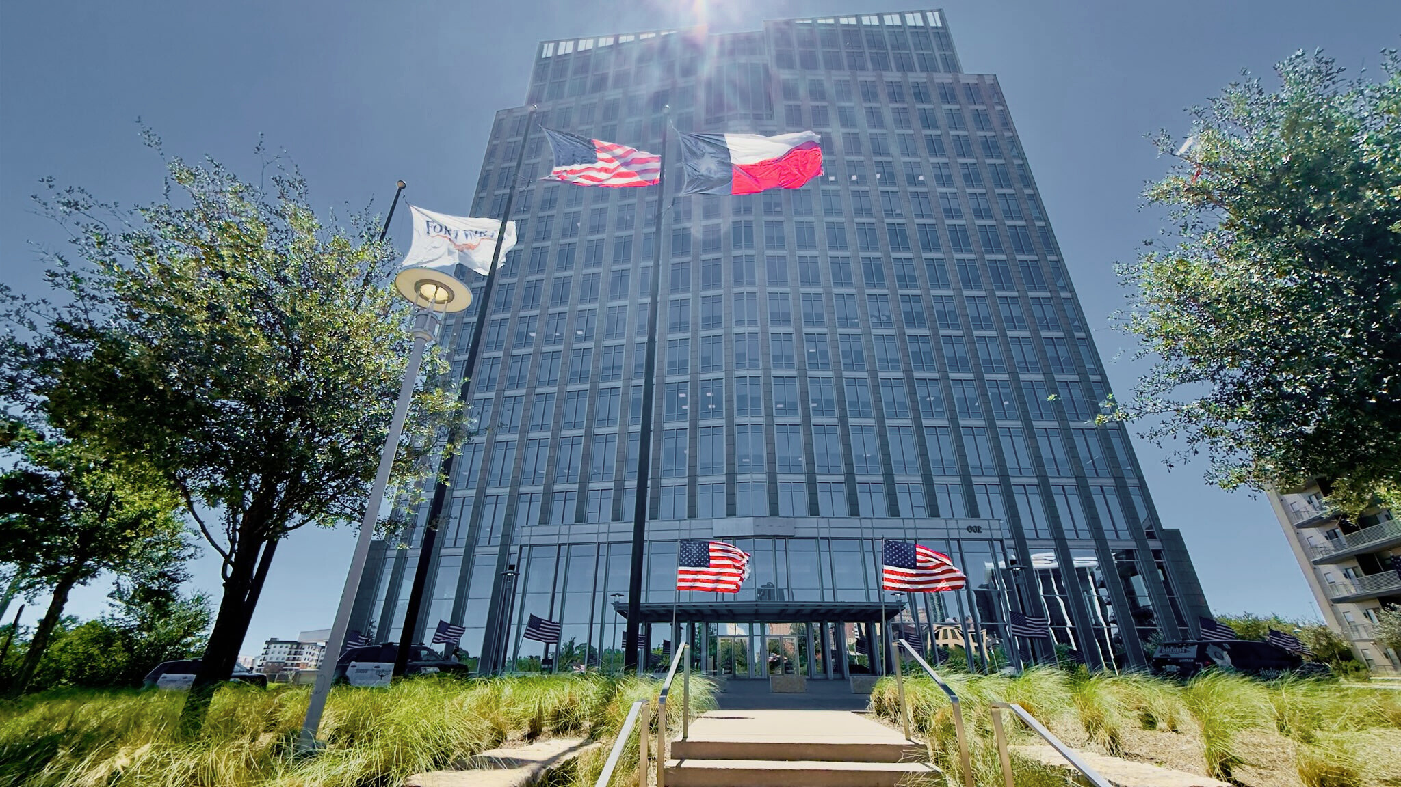


VOLUNTEER STRATEGY
MADE SIMPLE
APRIL 2026
MADALYN MACKEY
Volunteer Services Coordinator
City of Fort Worth
Communications & Public Engagement
1

Slide 2
OVERVIEW
KEY THEME
CLARITY
Purpose, Goals, and Needs
Recruitment
Communication
Training
Recognition
Clarity
CLARITY
Communications & Public Engagement
2

Slide 3
WHAT IS YOUR PURPOSE?
Upcoming event
Beautification
Crime prevention
Community
development
HOA Board
Communications & Public Engagement
3

Slide 4
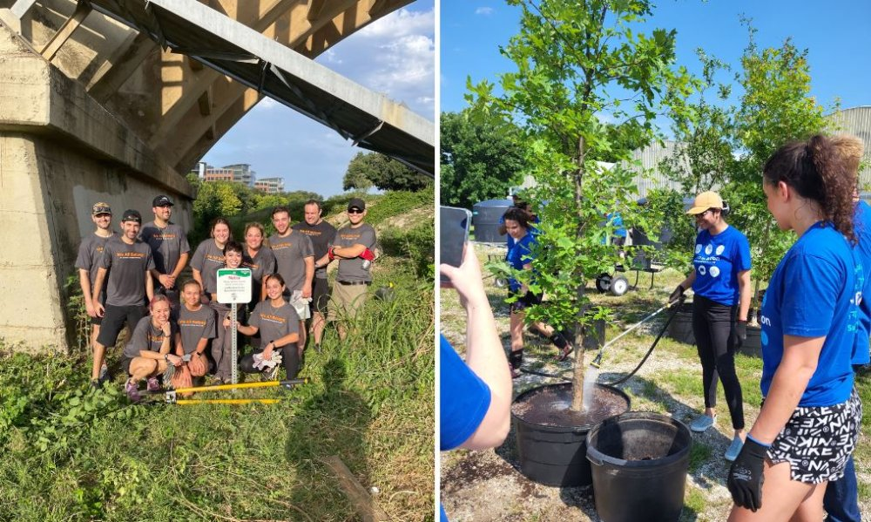
DETERMINING GOALS & NEEDS
What are your desired outcomes?
Examples: welcoming atmosphere, consistently stocked food table, smooth check-in process
What support is needed for your event?
Examples: crowd control, greeters, set-up or tear-down, door prizes, decorations
When is support needed?
Consider pre-event, day-of, and post-event
Communications & Public Engagement
4

Slide 5
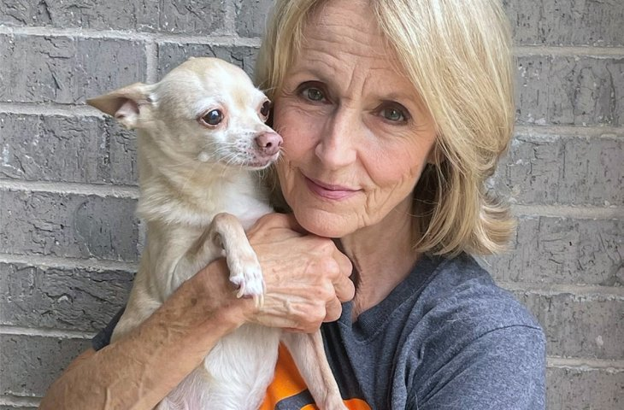
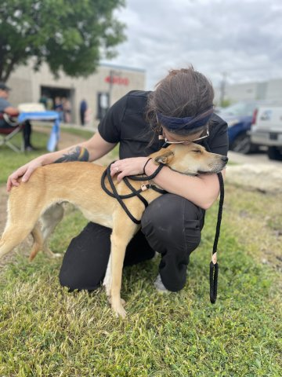
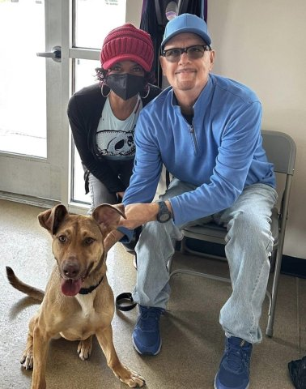
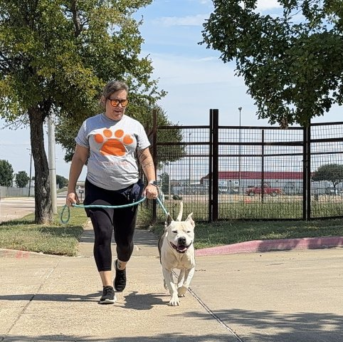
RECRUITING VOLUNTEERS
Who do you ask?
  Local businesses
  Faith-based organizations
  Current/former volunteers
  HOA’s and NA’s
  Community groups
  Schools
How do you ask?
  Targeted request (specific person, specific task)
  General request: asking a specific person (broad audience)
How will they confirm their participation?
Examples: phone call, email, web form
Communications & Public Engagement
5

Slide 6
REQUEST DETAILS
REQUEST LANGUAGE
  When and where are volunteers needed?
  What will volunteers be doing?
  What outcomes will volunteers help bring about? (ex: sense of community, cleaner streets)
  How do they sign up?
Don’t just say “we need volunteers” - language should be inviting!
Instead of...
Use...
We need volunteers...
We want volunteers...
We need your help with...
We can’t do this without you...
Join us in our mission
Use your skills to...
Grow with us...
Share your gift by...
Communications & Public Engagement
6

Slide 7
COMMUNICATION
1
2
Confirmation Email
Reminder Email
  Send after a volunteer confirms their participation
  Date, time, and location
  Identify main point of contact for pre-event questions
  Send 5-7 days prior to event
  Include all previous details
  Parking
  Where to meet
  Dress code
  Supplies
3
Event Communication
Remember...
  Unexpected changes (ex: weather delay)
  On-site contact
Clear communication is a show of respect to your volunteers and helps ensure a smooth experience for all.
Communications & Public Engagement
7

Slide 8
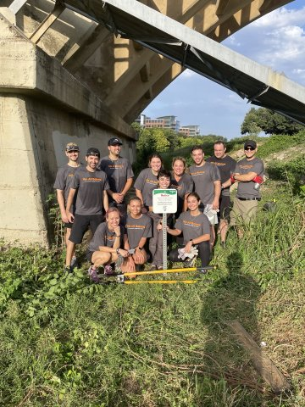
TRAINING
Determine needs
  What do volunteers need to know to fulfill their responsibilities effectively?
  Do volunteer tasks require special training?
(ex: equipment, specific processes)
  Are vulnerable populations involved?
(ex: minors, animals, unhoused individuals)
Instruction to volunteers
  Clear expectations and responsibilities
  Timeline
  Point of contact
  Reference sheet
  Specialized training as needed
Communications & Public Engagement
8

Slide 9
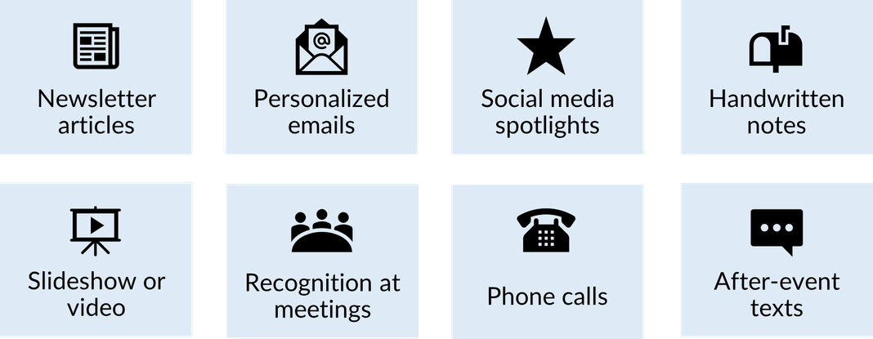
RECOGNITION
A small gesture goes a long way...
Think outside the box...
•Invite them to present at a meeting
•Write letters of recommendation
•Enjoy a cup of coffee together
•Apply for a neighborhood award
•Library book dedication
•Yard sign recognition
•Charity donation
•Bake a treat
Communications & Public Engagement
9

Slide 10
Not sure where to start?
Communications & Public Engagement
10

Slide 11









City of Fort Worth Volunteer Programs
50+ coordinators
45 programs
10k+ volunteers
Community Centers
Animal Welfare
Environment/Sustainability
Community Safety
Litter/Beautification
Athletics
Library
Municipal Court
History
Communications & Public Engagement
11

Slide 12
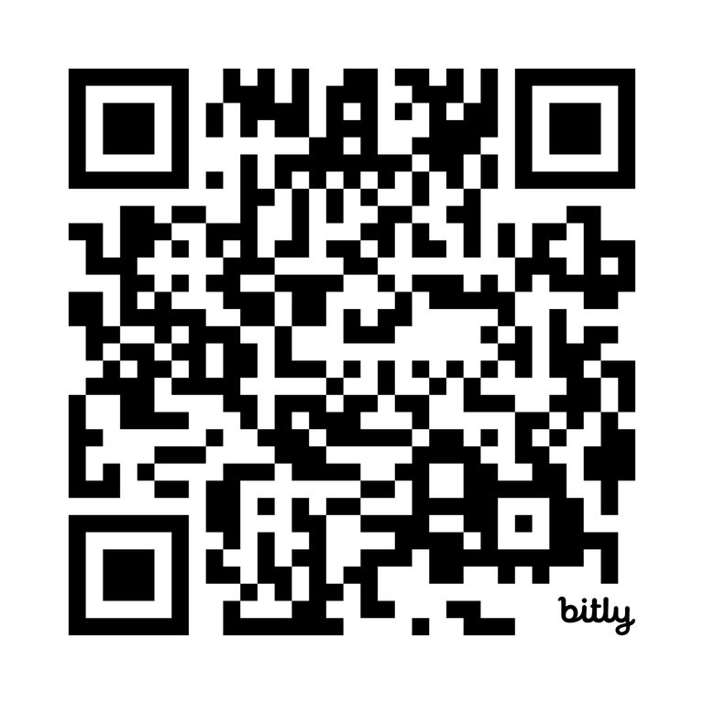
Explore Our Opportunities
FortWorthTexas.gov/volunteer
Communications & Public Engagement
12

Slide 13

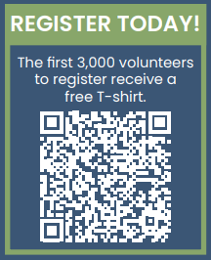
Last chance to register for the 41st Annual Cowtown Great American Cleanup, happening Saturday, March 28, from 8-11 a.m. Keep Fort Worth Beautiful invites residents to join in this citywide effort to pick up litter and care for our community.
The Cowtown Cleanup is for everyone! Individuals, families, neighbors, schools, churches, and businesses are all welcome to participate. Get involved and make it meaningful. Select any public area, like your neighborhoods and streets, parks, and
school campuses, or choose from pre-selected hub locations around the city.
Register early – the first 3,000 people to sign up will receive a free event T-shirt! All registered volunteers will also receive free litter cleanup supplies.
Communications & Public Engagement
13

Slide 14
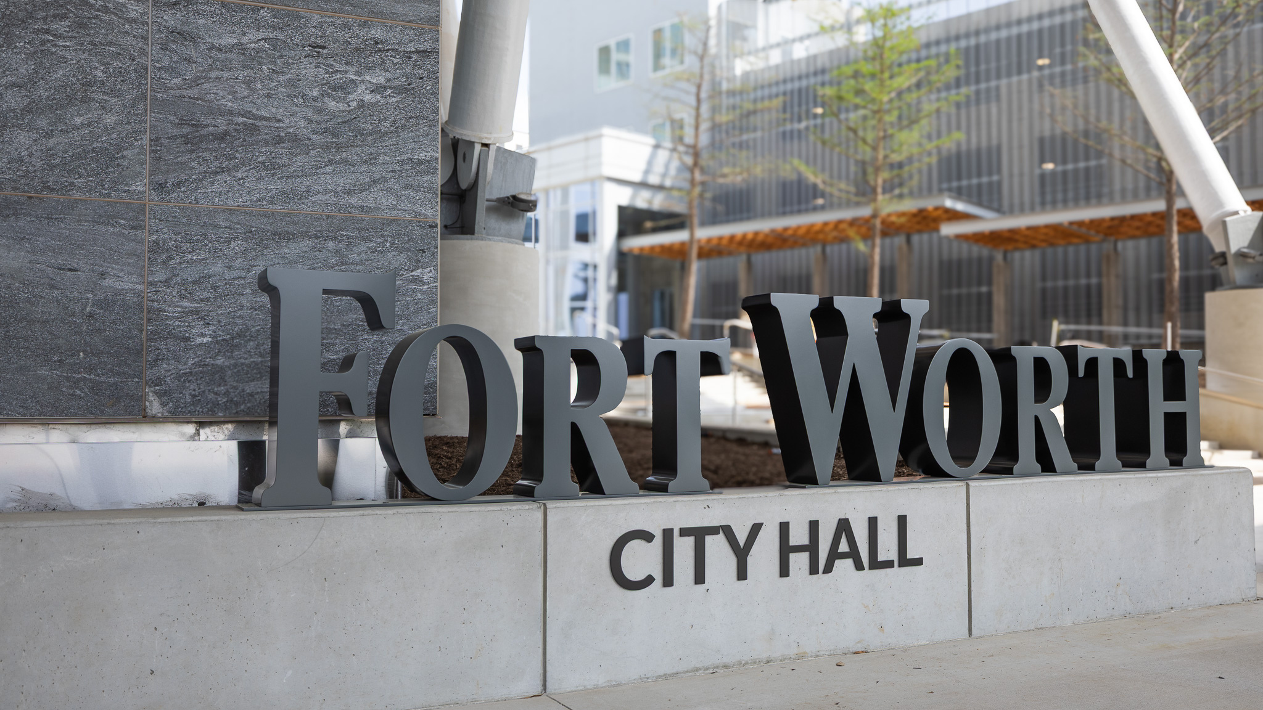

PHONE:
ADDRESS:
+(817) 392-2045
100 Fort Worth Trail, Fort Worth, TX 76102
EMAIL:
WEBSITE:
Madalyn.Mackey@fortworthtexas.gov
www.fortworthtexas.gov/volunteer
14

