Slide 1
Fort worth Main Street America Pilot program
Request for Applications: Informational Presentation
Fort Worth, Texas

Slide 2
Presentation Purpose
This is an informational presentation for individuals from local organizations interested in applying for the Main Street America Pilot Program in the City of Fort Worth.
It is a way to get to know Main Street America and learn more about this exciting partnership!
Click here to find the application form in Submittable

Slide 3
About Main Street America (MSA)
  The Main Street program was created by the National Trust for Historic Preservation in 1980 to combat the harmful impacts of sprawl and the changing nature of retail on the physical character and economies of communities.
  Today’s Main Street programs serve both rural and urban communities, more than 80% of which are in low-to-moderate income census tracts.
  Main Street programs are currently in more than 1,300 communities across 45 states.
  Main Street America is headquartered in Chicago. It is a 501(c)3 corporation with an independent board composed of leaders in community revitalization.
Notes:
Our Vision: Everyone has access to an inclusive and resilient Main Street – a place that has a thriving local economy, is distinctive and rich in character, and features welcoming spaces and diverse businesses for residents and visitors alike.
MSA is a proven leader in the commercial district revitalization field. Their approach to helping to transform local economies, known as the Main Street Approach®, is a time-tested methodology that focuses comprehensively on the key factors that build shared prosperity and community wealth in commercial districts

Slide 4
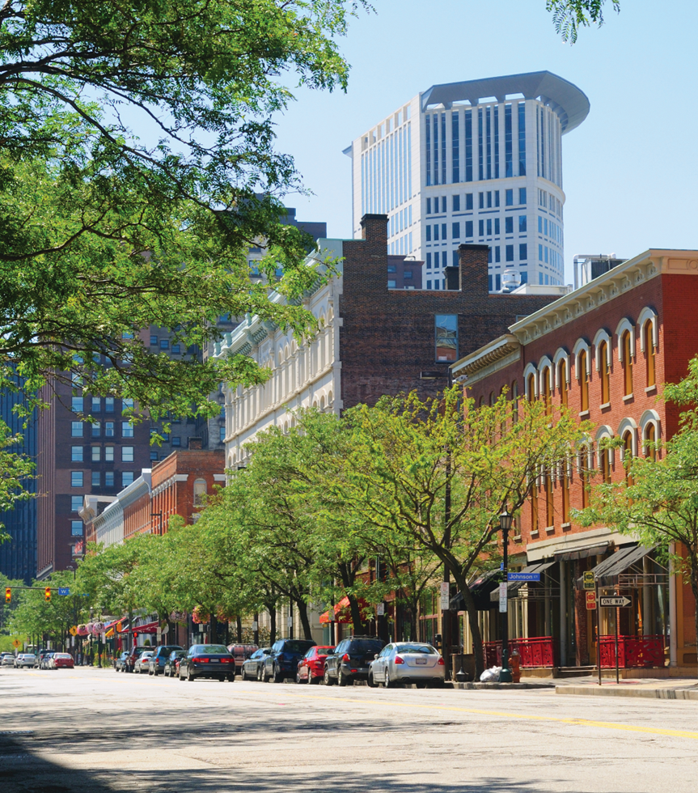
Main Street America - Impact
Since 1980, over 2,000 programs have used the Main Street Approach, resulting in:
$79.2 Billion Reinvested in Communities
  $4.39 Billion Reinvested in 2018
640,017 Net New Jobs
  25,301 Net New Jobs in 2018
143,613 Net Gain in Businesses
  5,300 Net New Businesses in 2018
284,936 Buildings Rehabilitated
  8,146 Buildings Rehabilitated in 2018

Slide 5
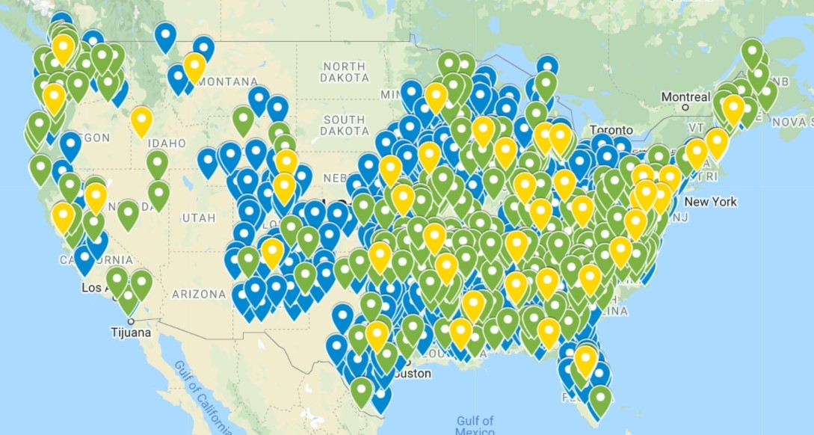
A network with national reach
A national network of 1,000+ local affiliate organizations and 45 State, City, or County Coordinating Programs.

Slide 6
A network with national reach
National Newsletter: Neighborhood News
Research and Insights in a member-only portal
Peer-to-peer learning opportunities
The Point, online community portal
National network, Ambassador program
Access to grants

Slide 7
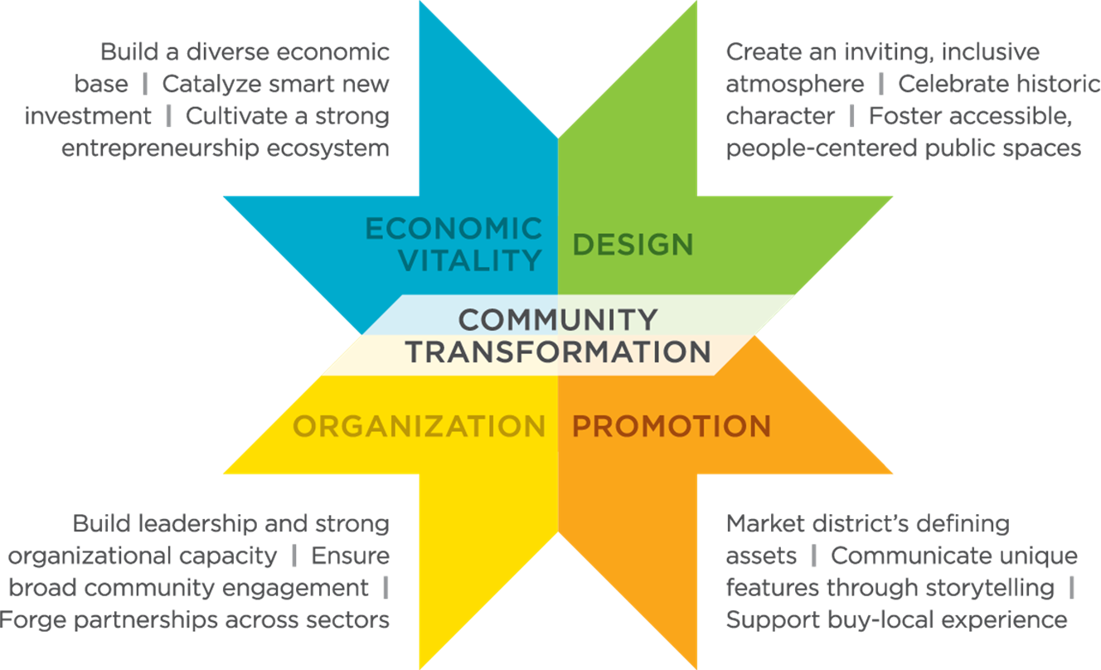
The Main Street Approach

Slide 8
An adaptable Approach
If you have plans and strategies already, the Main Street Approach can help you organize the information and create actionable steps.
It helps bring the different stakeholders from the community come together to prioritize actionable steps and work together to accomplish them.
It reflects the priorities of the stakeholders while offering tools, training, and a network of people who have done it before to help execute.

Slide 9
EXAMPLE outcomes of the Approach
Small business technical support classes like how to get your business on e-commerce
Preserving historical buildings and community assets, or creating assets that preserve history like murals, digital tours, etc.
Preserving the community through strategies providing residents and business small-scale development training or community land trusts
Community building events like shop local days, community movie nights, etc.
Farmers markets and/or food co-ops
Training residents to do their own small-scale development to build wealth & promote local ownership
Development of storytelling materials to brand the district
Workforce training programs in partnership with foundations or large employers
Promoting entrepreneurship through programs or market data & research
Engaging youth in volunteer opportunities

Slide 10
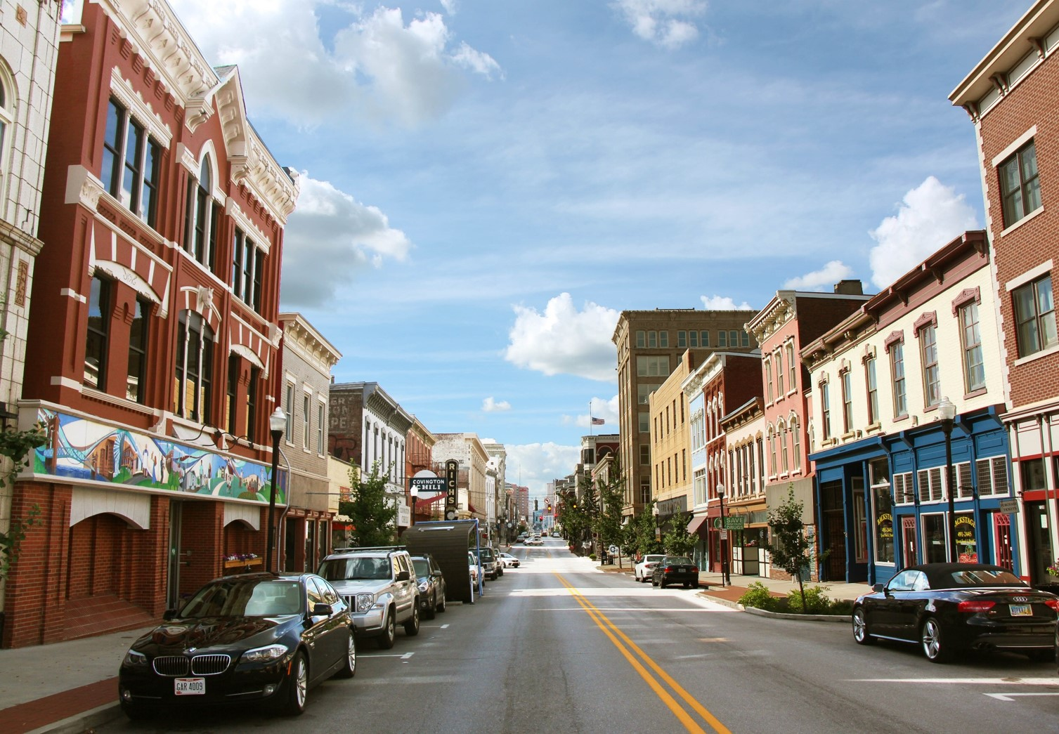
Our work in
Big cities

Slide 11
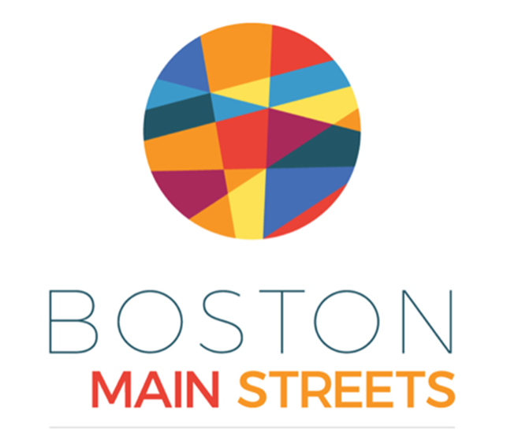
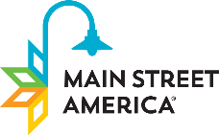
Boston Main streets impact (2013 – 2019)
20 Commercial Districts
$ 217,312,475.00 of private dollars invested in 606 new businesses launched; 3,354 new jobs.
Over 179,614 hours of volunteer time invested (value of $5.9 million)
450+ buildings have been rehabbed

Slide 12
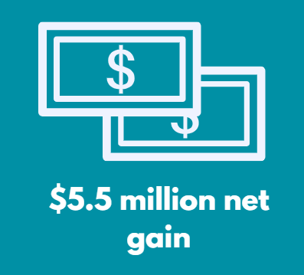
Boston main streets impact, continued
The city of Boston allocates approximately $1.8 million to the Main Street program annually.
Between 2015 and 2016, the program generated nearly $7.3 million more city tax revenue than would have been expected without the presence of a Main Street program –a $5.5 million net fiscal gain for the city.
Stated another way, for every $1 in tax revenue invested in Main Street, there is a $4 return on investment.
  Jon Stover and Associates. (2017). Fiscal Impact Analysis of Public Sector Spending on Four Main Street Programs

Slide 13

District of Columbia main streets impact (2013 – 2020)
28 commercial districts
$3,253,893.93 of private dollars have been reinvested into the Main Streets.
369 new businesses launched with a total of 7,431 new jobs.
Over 18,692 hours of volunteer time has been invested with a value of $825,064.
Over 325 buildings have been rehabbed.

Slide 14
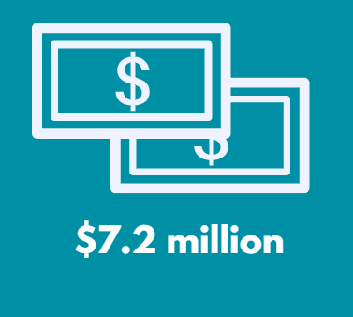
District of Columbia main streets impact, continued
Between 2003 and 2014, the Barracks Row Main Street (BRMS) and H Street Main Street (HSMS) outperformed benchmark commercial corridors in business growth, revenue growth, and employment growth.
Return on City Investment
Since 2003, these programs have netted the District over $7.2 million.
Source: Jon Stover and Associates. (2014). The Value of H Street Main Street and Barracks Row Main Street: Return on Investment of District of Columbia Funding for Barracks Row Main Street and H Street Main Street

Slide 15
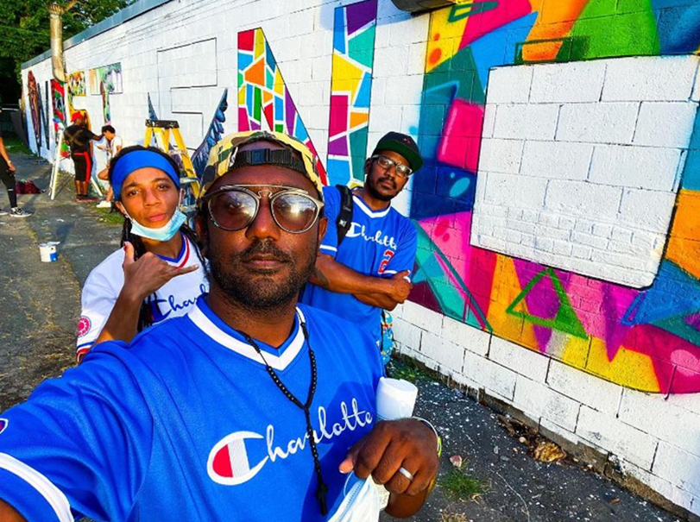

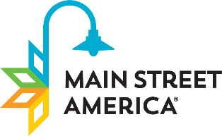

Beatties Rd / Lasalle corridor – Charlotte, NC
In 2018, UrbanMain kicked off programming in Charlotte, working in partnership with the Knight Foundation and the City of Charlotte.
Main Street is executing Urban Main programming in one commercial corridors in Charlotte:
  Beatties Ford / Lasalle Corridor
The community received support and in-person technical services including:
    Community engagement outreach
    Capacity building in commercial corridor revitalization
    Organizational development (if applicable)
    Economic transformation strategy development

Slide 16
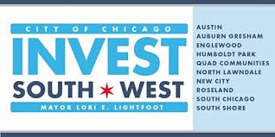
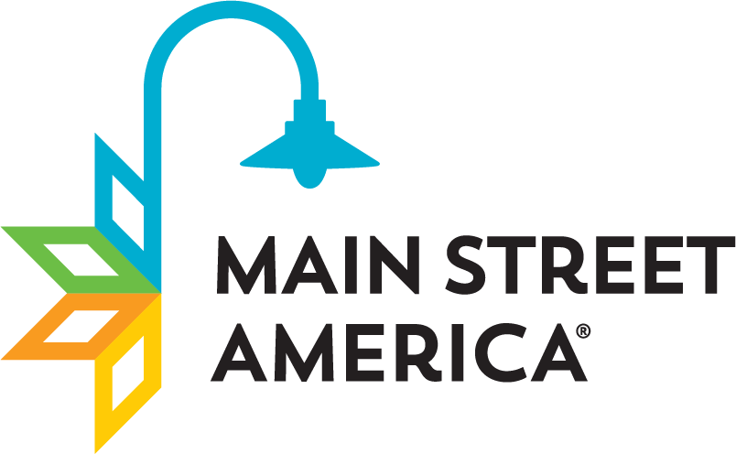
Invest South/West– Chicago, IL
Main Street 101
Community Asset Mapping, Engagement and Partnership building
Organization board training
(roles & responsibilities)
Volunteer Recruitment and Retention
Resource Development (fundraising)
Business Recruitment/Retention Strategies

Slide 17
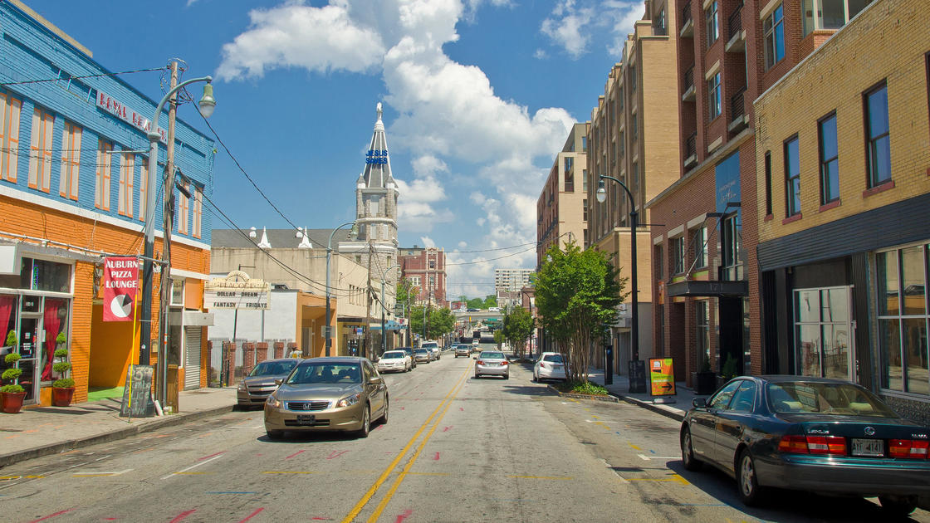
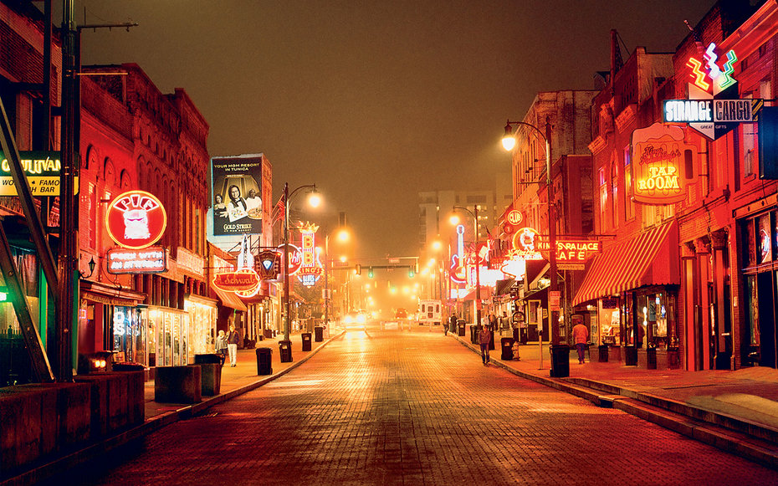
UrbanMain services: ATlanta, GA AND Memphis, TN
UM Services: 12-month engagement.
Services include:
Resiliency Study:
  Atlanta four commercial districts
  Memphis (South Memphis)
Organizational Development
  Fundamentals of the Main Street approach
Staff capacity analysis including structural and operation recommendations
Transformation Strategy Development
Credit: Michael Turek

Slide 18

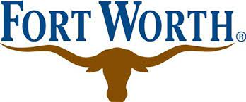
City of Fort Worth Pilot Program
The City of Fort Worth is pleased to announce its partnership with Main Street America (MSA) to support community economic development and commercial district revitalization efforts in two of Fort Worth’s Central City commercial districts. This program is the first of its kind in a major city in Texas.
Applications due: Monday, June 6th, 2022 at 8pm

Slide 19
Pilot Program Goals
Meaningful neighborhood commercial corridor revitalization –build community capacity, enhance quality of life & place, preservation of unique assets, focus on small businesses & entrepreneurship, set the groundwork for new investment & development, etc.
Provide community stakeholders the proven tools with Main Street training and to understand and guide the districts future in a positive way.
Aid in catalyzing an organization and “community quarterback” to help advance revitalization goals.

Slide 20
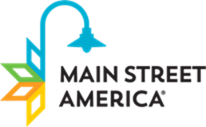

Program support and services
Training & technical support from Main Street America
Main Street courses
Transformation Strategy (including work plan & metrics)
Operational support grants for managing organization to aid in funding for a full-time
Year 1: $45,000
Year 2: Up to $45,000
Year 3: Up to $30,000
Project Implementation Grants to support projects identified in Main Street programming
Year 1: Up to $20,000
Year 2: Up to $80,000
Year 3: Up to $50,000 as a matching grant

Slide 21
MSA support & Training(s)
Training and technical support from the Main Street America’s team for the chosen managing entity, community, its board and partners to help build a robust revitalization knowledgebase and develop a sustainable and equitable strategy to spur economic vitality. Services will include the following:
Main Street 101 Fundamentals training
Community Asset Mapping, Engagement and Partnership Building
Board Roles/Responsibilities
Volunteer recruitment and retention
Business mix and Trade Area analysis
Neighborhood attitude survey
Business Recruitment and Retention
Yearly program assessments
Free 2-year Main Street America Membership
Free registration to attend the Main Street Now Conference for a staff member

Slide 22

Applicant Eligibility Requirements
Applicants must be a “managing organization” (501c3, c4, c6) or become one.
The managing organization should be based in the applicable neighborhood or have a significant presence and support with the intention of locating an office there
Have a proven ability to convene small businesses, property owners, residents, institutions and local stakeholders.
Have track record of achieving measurable community outcomes.
Must have sufficient staffing and sound financials to sustain economic development work in the neighborhood or demonstrate that there is significant support from organizations or individuals who will aid in fulfilling this objective.

Slide 23
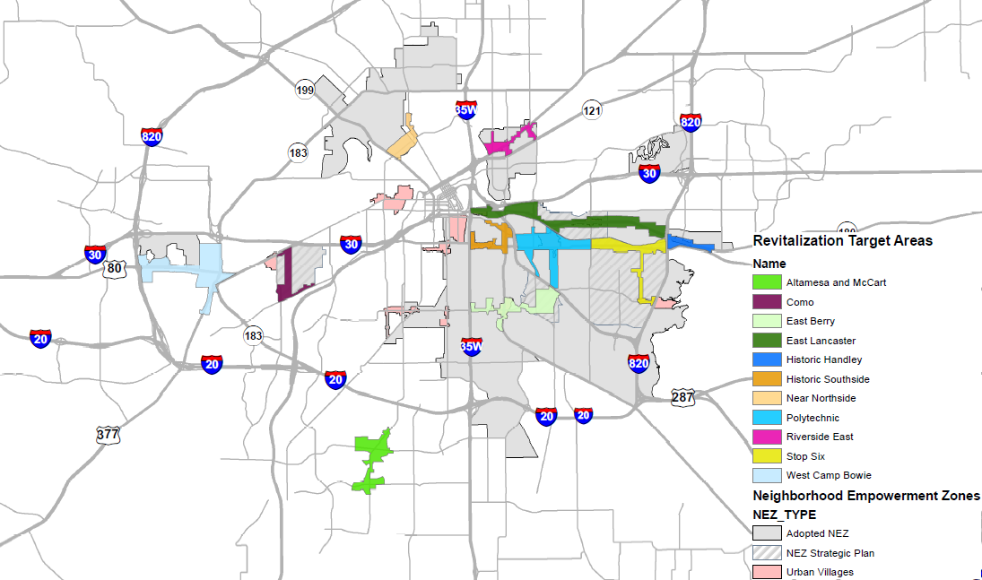
City of Fort Worth Revitalization target areas
Notes:
Some of our priority corridor

Slide 24
Successful applicants ideally will have:
Distinct areas with a significant cultural and/or historic aspects that are desired to be preserved,
Demonstrate a need for community capacity building and a district only focused community and economic development organization and full-time staff person to advance their mission – “community quarterback”,
At least one year of audited financial statements (strongly preferred), 990s, CPA reviewed, fiscal agent agreement
Letters of support from council members, and/or other local stakeholders, MOU between organizations, etc.
Submit a letter of intent that expresses commitment to this program
A designated staff or board member responsible for leading change on behalf of their organization around commercial revitalization and serve as the MSA’s on-the-ground point person.

Slide 25
Managing organization will:
Maintain relationships and build collaborations among organizations to achieve results.
Demonstrate ability to fundraise by providing a $6,000 match to support work and demonstrate a commitment to fundraise to access matching funds provided through the program.
  Fifty percent of the required program match or up to $3,000 may be provided by the managing organization’s contribution of staff time to support the project. Match fund and timesheets will be collected over a 24-month period.
Establish a Launch Committee that will be tasked with standing up and implementing the program until a new, official board and committee structure is established.
Work in collaboration with Main Street America and City to convene local stakeholders, small business owners, and property owners for focus groups, community-wide meetings and program assessment at Year 3.
Monitor and report to MSA and City in an annual report on the Main Street Approach implementation
  Status on efforts, new projects implemented, and progress made towards the Main Street Approach and strategy / work plan (once work plan and strategy are completed). Examples: neighborhood festivals, placemaking, programs, additional trainings beyond Main Street, small business supported, redevelopment projects supported, promotion and marketing efforts, etc.)

Slide 26
A day in the life…
As a local Main Street Program your daily, weekly and monthly routine may include:
Connecting with other organizations and key stakeholders in your community to support a unified place-based economic development goal
Fundraising with public, private, and non-profit organizations to secure funds for the implementation and investment included in your transformation strategy and annual work plans
Constant communication and follow-up with your Main Street Committee chairs on the execution of their action plans
Communication and coordination with business owners in your commercial corridor providing training, technical assistance, and supporting business promotion initiatives
Marketing, promotion and event planning and execution to increase visitors and spending in your commercial corridor
A local Main Street manager wears many hats! But the long-term goals set by the community in the transformation strategy provide the vision and direction

Slide 27
BEYOND REQUIREMENTS WE’RE LOOKING FOR:
Commitment & Sustainability

Slide 28
SAMPLE Program Measure(s) of Success
 | ORGANIZATION Build leadership and strong organizational capacity| Ensure broad community engagement| Forge partnerships across sectors | PROMOTION Market district’s defining assets| Communicate unique features through storytelling| Support buy-local experience | DESIGN Create an inviting, inclusive atmosphere| Celebrate culture, historic character| Foster accessible people-centered public spaces | ECONOMIC VITALITY Build a diverse economic base |Catalyze smart new investment| Cultivate strong entrepreneurship eco-system
Indicators of Program Success | Launch Committee (first year) and Board established– diverse representation of members (both organizationally, and in reference to stakeholder perspectives and skillsets) Number of participants in the trainings, both new and returning, and how they are tied to area – i.e., business owner, property owner, neighbor, community partner Number of volunteers serving on boards and committees Hours volunteered Number of new and existing partnerships Value seen by stakeholders – through surveys, quotes, statements collected by participants, etc | Summary of promotional/marketing efforts and reach # of attendees to Festivals/Events hosted in the local community # of listens to digital Historic tour Increase in visits to district | Number of facades rehabilitated Beautification projects established/wins New built environment accomplishments – streetscape, community places, art, etc. $ dollars secured to do historic preservation through art project | Public/private dollars invested in district Number of new businesses established in district Number of businesses/entrepreneurs supported in district New net jobs created in district Number of vacancies filled or new leases Dollar amount of new development/redevelopment projects worked with in district Dollars fundraised Mix of commercial vs non-commercial Increase in Property Values Increase in revenue to businesses that received technical assistance

Slide 29
Timeline:
Program Launch | Tuesday, April 19, 2022
In-person workshop | May 10th
MSA Office Hours | May 23rd – June 3rd
Application Due! | June 6th, 2022
Site Visits | June 14th – 17th
Announcement of Selected Districts! | Week of June 27th
Program Launch (Administrative details and fundamentals training) | Q3/Q4 of 2022
Local Staff Onboarded Leading Main Street Programming | Q4 2022/Q1 2023
Notes:
July – September:
Signing of grant contracts for year 1 (City)
Establish Launch Committee (Managing Entity / Community)
Main Street 101 Basic Training (Main Street)
Community Asset Mapping, Engagement and Partnerships Training? (Main Street)
October 2022- September 2023 (Yr 1)
Board and Community Volunteer Recruitment & Retention Training
Board Training (Roles and Responsibilities) Training
Market Analysis Training
Transformation Strategy Development
Work Plan and Metrics Development
At least one project / program created
Year-end program assessment
New grant contracts
We can slow this down over two years if need be but will go at each community’s pace

Slide 30
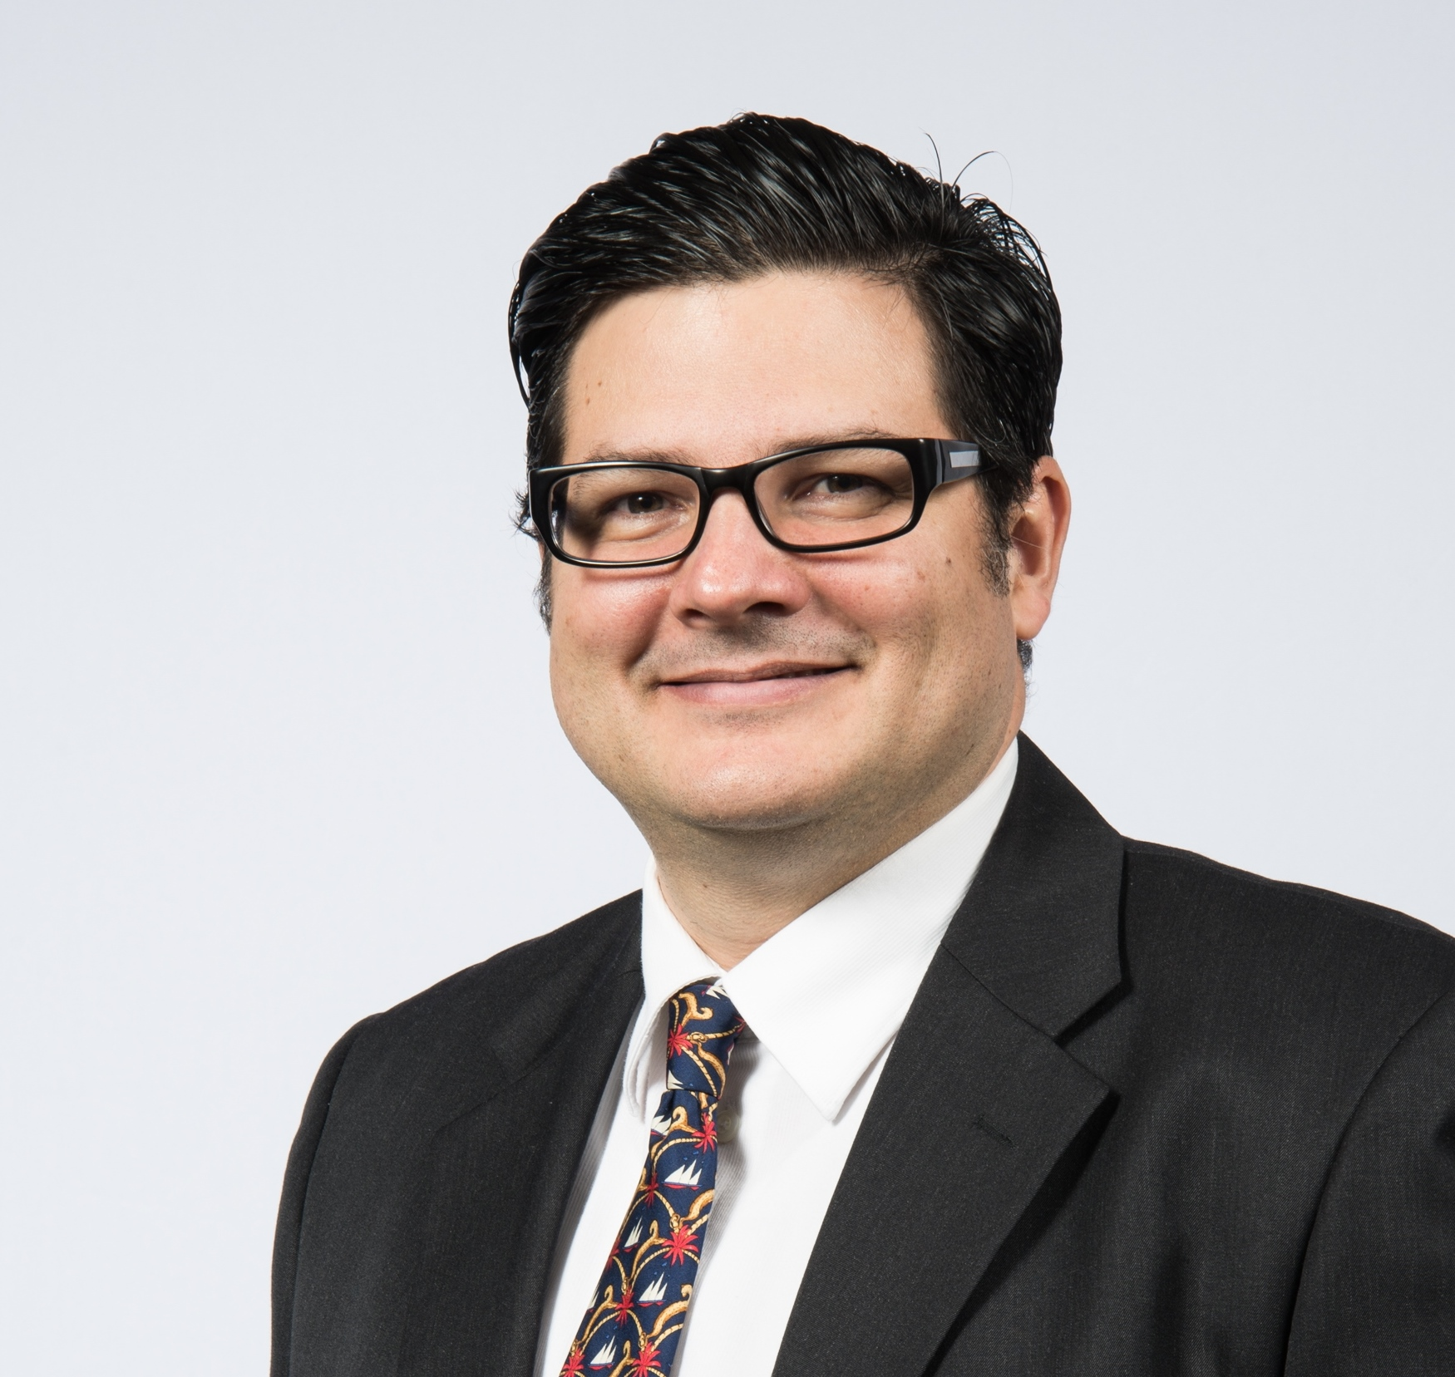
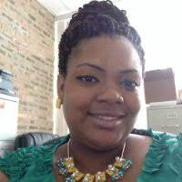
Main Street America team
Dionne Baux
Vice President, Urban Development
dbaux@savingplaces.org
Gustavo Ustariz
Sr. Manager of Marketing and Outreach gustariz@saviingplaces.org
Frankye A. Payne
Director of Chicago Main Streets

