Slide 1
REDISTRICTING 101
January 4, 2021

Slide 2

Topics
Brief history of redistricting in Fort Worth
Task Force membership and charge
Why we’re redistricting
Recommended goals and practices
Draft criteria and procedures
Schedule of redistricting activities
Questions from audience

Slide 3
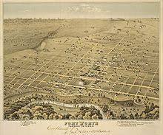
Brief History
  1849 U.S. Army establishes Fort Worth on Trinity River.
Community incorporates as City of Fort Worth.
City adopts council-manager form of government.
1965 U.S. Congress passes Voting Rights Act.
1975 Voters amend charter to create single-member districts.
1981
1991
2001
2011
Redistricting: City Council redraws district lines
after release of census results.

Slide 4
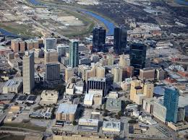
Brief History
(continued)
2013 U.S. Supreme Court invalidates coverage provisions of Voting Rights Act.
Voters amend City Charter to increase number of single-member districts from eight to ten.
Task Force on Race and Culture recommends appointment of charter review task force to study desirability of amending City Charter for purpose of creating independent redistricting commission.
City Council declines to appoint charter review task force but expresses support for goal “to create districts that, when drawn, provide the best opportunities to elect City Council members who reflect the diverse population of the City.”
2020 COVID-19 strikes United States, causing seven-month delay in census and subsequent redistricting.
2020 City Council appoints Redistricting Task Force.

Slide 5

Redistricting Task Force
Members
Place 1: Lorraine Miller (Chair)
Place 2: Salvador Espino
Place 3: Graham Norris
Place 4: Craig Allen
Place 5: Bert Williams
Place 6: Linda Kennedy
Place 7: Tony DeVito
Place 8: Tracy Scott
Place 9: Kent Bradshaw
Place 10: Bill Schur
Place 11: Teresa Ayala
Staff
City Manager’s Office
City Secretary’s Office
Law
Planning and Data Analytics
Information Technology Solutions
Communications and Public Engagement
Diversity and Inclusion

Slide 6
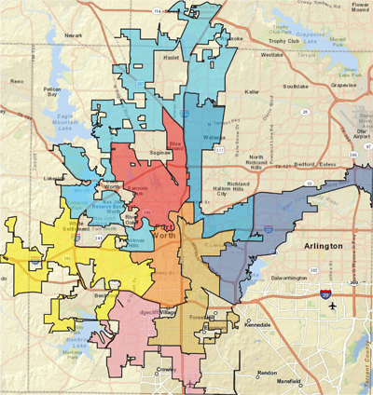
Resolution No. 5259-08-2020, Appointing a Redistricting Task Force Adopted August 4, 2020
“The Redistricting Task Force is charged with…advising the City Council about redistricting criteria and procedures…”
Note: The resolution contemplates that the City Council, rather than an independent redistricting commission, will redraw Council district boundaries.

Slide 7

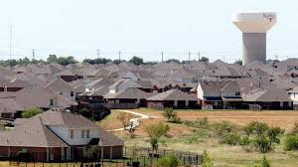
Why are we redistricting?
To ensure that districts contain roughly equal populations as required by federal law.
To create two new districts, as required by the City Charter, in view of Fort Worth’s rapid growth.

Slide 8















2018 Population
Rank | City | 2018 Population | Percent Change, 2010-2018 | Population per Square Mile
1 | New York | 8,398,748 | 2.7% | 27,961
2 | Los Angeles | 3,990,456 | 5.2% | 8,515
3 | Chicago | 2,705,994 | 0.4% | 11,901
4 | Houston | 2,325,502 | 10.8% | 3,651
5 | Phoenix | 1,660,272 | 14.8% | 3,207
6 | Philadelphia | 1,584,138 | 3.8% | 11,801
7 | San Antonio | 1,532,233 | 15.4% | 3,162
8 | San Diego | 1,425,976 | 9.1% | 4,380
9 | Dallas | 1,345,047 | 12.3% | 3,960
10 | San Jose | 1,030,119 | 8.9% | 5,817
11 | Austin | 964,254 | 22.0% | 3,237
12 | Jacksonville | 903,889 | 10.0% | 1,210
13 | Fort Worth | 895,008 | 20.8% | 2,517
14 | Columbus | 892,533 | 13.4% | 4,110
15 | San Francisco | 883,305 | 9.7% | 18,846
16 | Charlotte | 872,498 | 19.3% | 2,931
17 | Indianapolis | 867,125 | 5.7% | 2,399
18 | Seattle | 744,955 | 22.4% | 8,875
19 | Denver | 716,492 | 19.4% | 4,683
20 | Washington, DC | 702,455 | 16.7% | 11,506
Fort Worth ranks…
3rd in growth rate
13th in population
40th in density out of top 50 cities
Sources: U.S. Census Bureau, 7/1/2018 estimate; Fort Worth Planning & Data Analytics, 2020
Notes:
18th lowest density out of top 20 cities.
Out of the top 50 cities, Fort Worth ranks #40 in terms of population density. The remaining cities’ land area is based on 2010 Census data, and as such has likely changed since.

Slide 9
Population Growth, 1950-2045:
Fort Worth, Dallas, and Arlington
1,316,000
1,125,000
909,585
Sources: U.S. Census Bureau estimate for July 1, 2019; NCTCOG

Slide 10
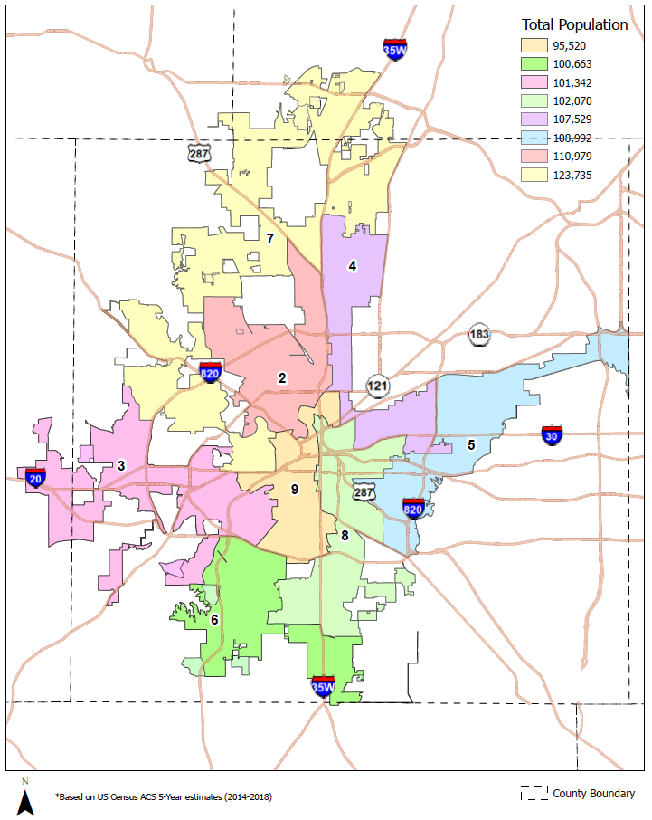
Population by Council District, 2018
Total = 850,830
Average = 106,354
District 7 = 123,735 (16% above average)
District 9 = 95,520 (10% below average)
Source: U.S. Census ACS 5-Year Estimates (2014-2018)

Slide 11
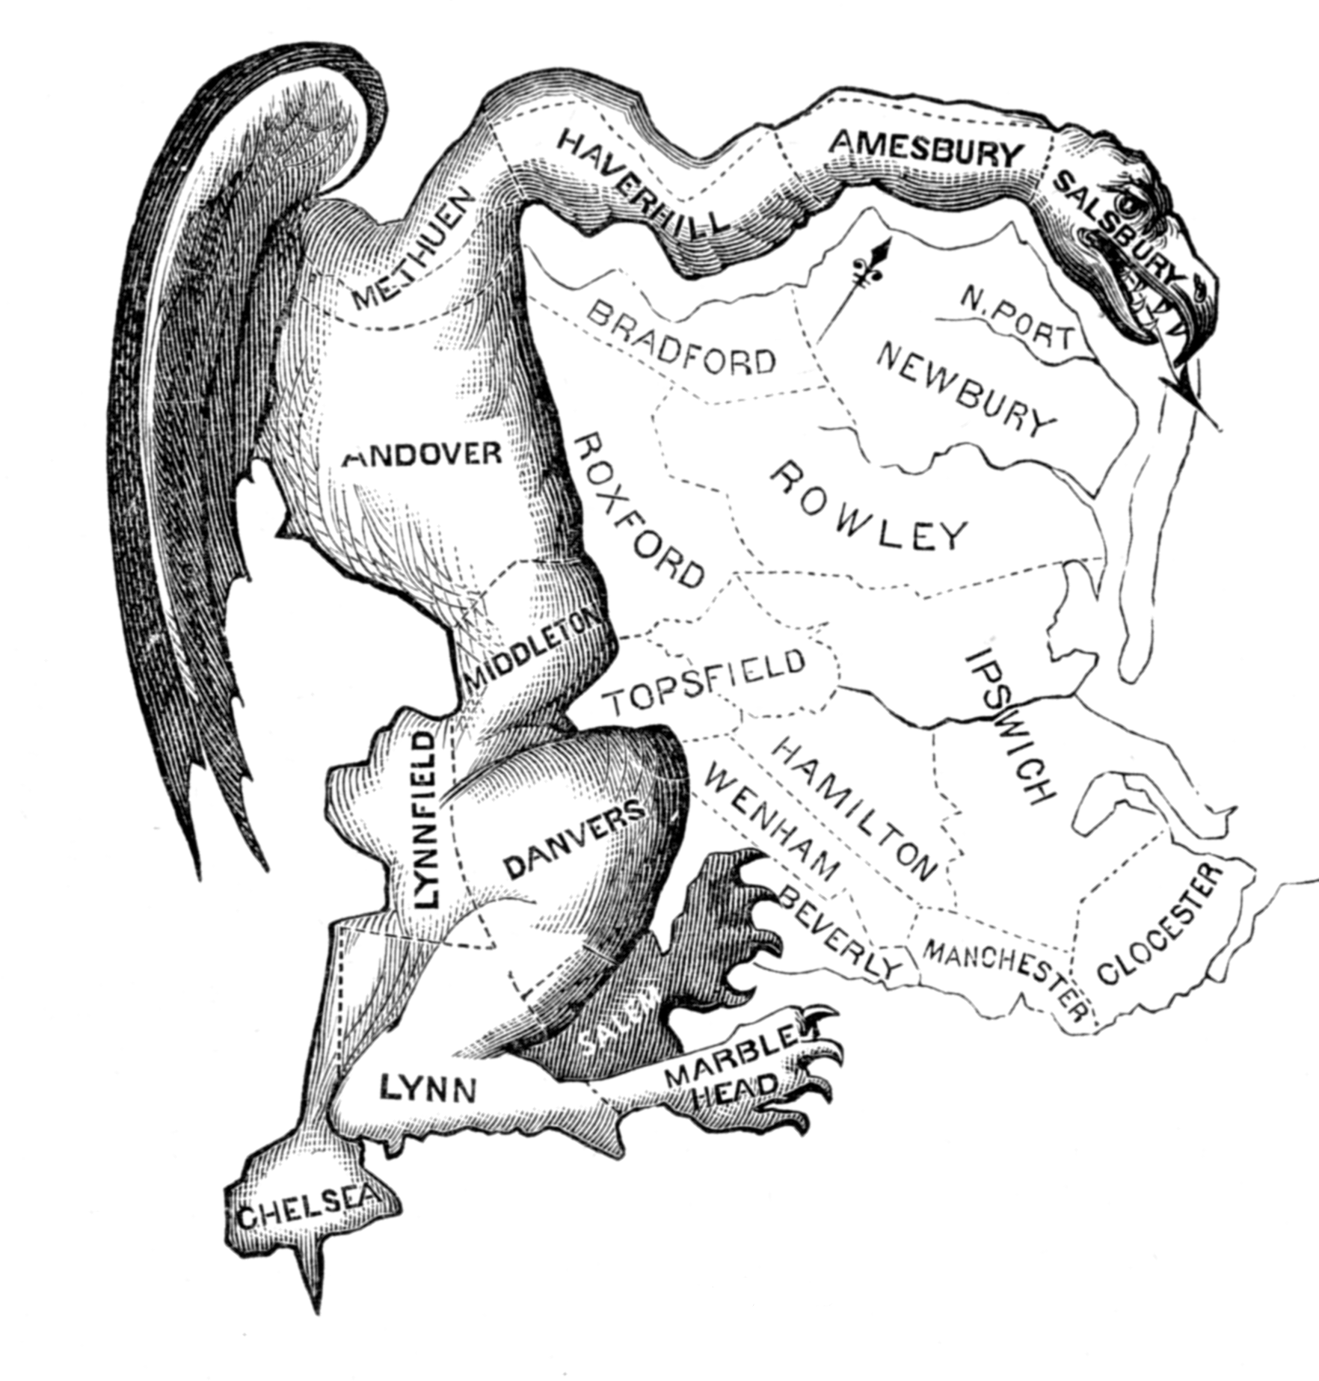
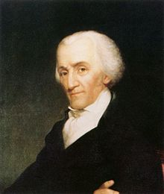
Two Broad Goals
1. Prevent Gerrymandering
2. Provide Best Opportunities to Elect Council Members Who Reflect Fort Worth’s Diverse Population
Elbridge Gerry
1744-1814
Signer, Declaration of Independence, 1776
Governor of Massachusetts, 1810-1812
Vice President of United States, 1813-1814
Race/Ethnicity, 2010 Census

Slide 12


Practices to Prevent Gerrymandering and Promote Diversity
Avoid packing of minority voters.
Avoid fragmentation or “cracking” of minority communities.
Create minority opportunity districts.
Promote compactness.

Slide 13
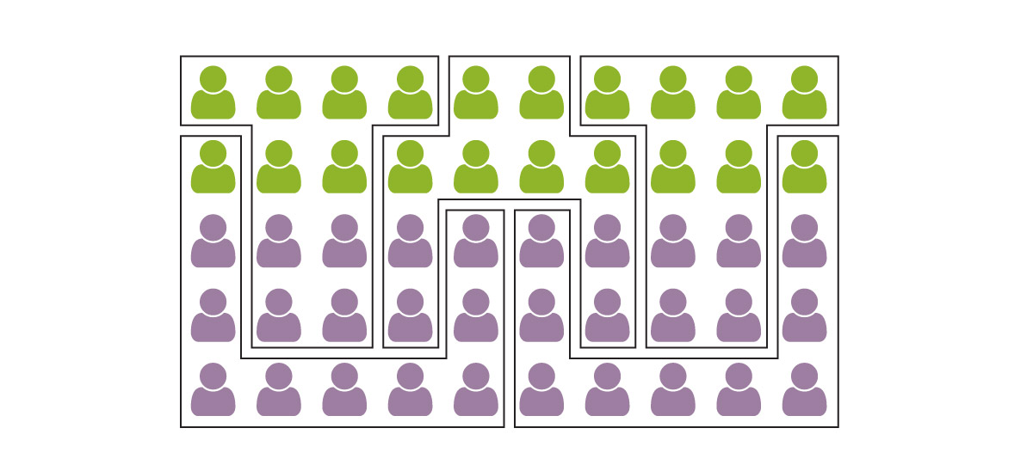
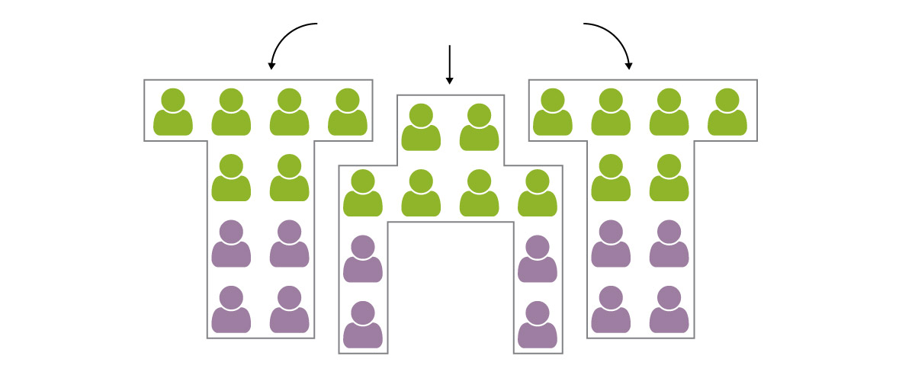
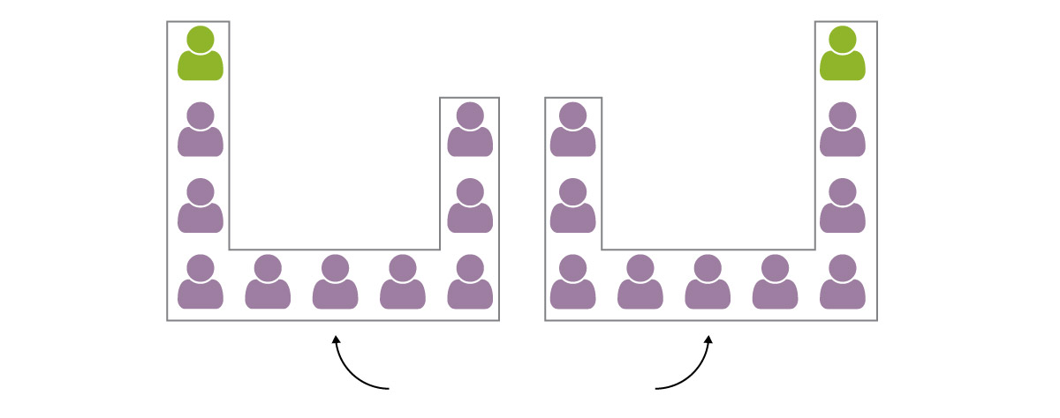
No Packing or Cracking
In this example, purple people comprise 60 percent of voters across five districts.
If voting patterns follow color lines, however, then purple people are likely to elect only two of five representatives.
3 Cracked Districts
2 Packed Districts
Graphics from WashingtonPost.com

Slide 14
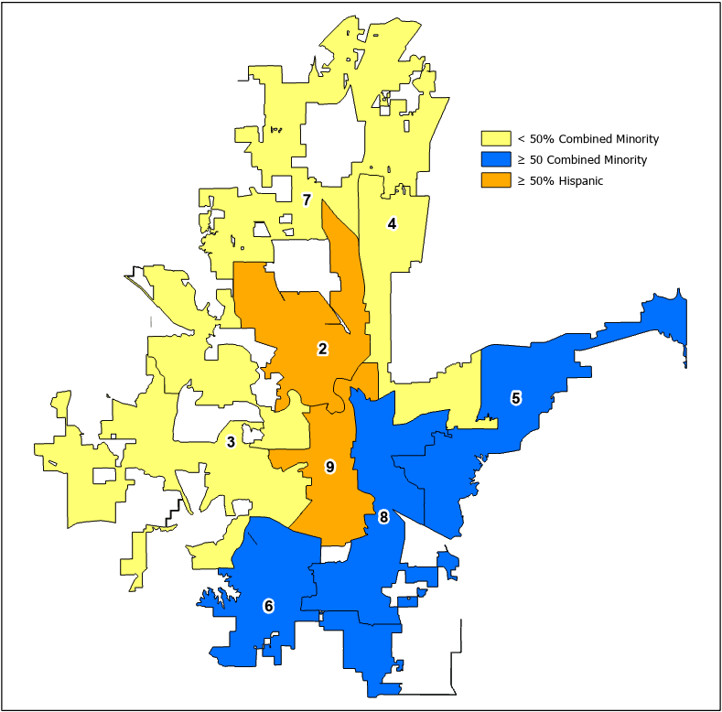
Five of eight current districts are minority opportunity districts, including two majority-Hispanic districts.
< 50% combined minority: Districts 3, 4, and 7
> 50% combined minority: Districts 5, 6, and 8
> 50% Hispanic: Districts 2 and 9
Proportion of minority voters by Council district based upon 2010 population

Slide 15

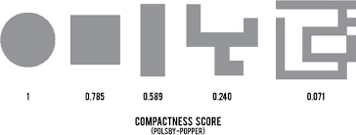
Compactness
Goal: Create districts with compactness scores > 0.050.

Slide 16
Compactness Scores of Current Council Districts
Districts 3 and 7 scores < 0.050.

Slide 17
Draft Redistricting Criteria
High Priority: Not in any order of priority
1. Approximately equal size: Population of largest district < 10 percent more than population of smallest district
2. Compliance with U.S. Constitution, Voting Rights Act, Texas Constitution, and other applicable laws, with no packing of minority voters, no fragmentation of minority communities, and no retrogression in ability of minorities to participate in electoral process
3. Create minority opportunity districts, in compliance with federal law, to further reflect growing diversity of City
4. Contain communities of interest in single districts, with community of interest defined as “a local population with shared socio-economic characteristics and political institutions that would benefit from unified representation”
5. Contiguous territory
Lower Priority: Not in any order of priority
6. Compact districts, with goal of Polsby-Popper ratio > 0.050
7. Identifiable geographic boundaries
8. Contain whole voting precincts
9. Contain whole census blocks or block groups
10. Do not consider place of residence of incumbents or potential candidates

Slide 18

Comments on Redistricting Procedures
Continue to…
  Provide software training for interested residents.
  Analyze redistricting plans submitted by residents and brief City Council.
  Provide greater transparency in redistricting.

Slide 19
Task Force Schedule, August – December 2020
Month | Activity
August | City Council adopts resolution appointing Redistricting Task Force.
September | Staff presents informational briefings. Task force charge Open Meetings Act training Redistricting history and schedule Legal basis for redistricting Demonstration of redistricting software
October | Task force interviews representatives from Austin and San Antonio. Staff presents additional informational briefings. Voting Rights Act Local demographic trends
November | Staff provides task force with additional demographic data. Task force discusses preliminary findings. Task force discusses arrangements for Redistricting 101 seminar and public hearings.
December | Task force presents interim report to City Council.

Slide 20
Task Force Schedule, January – March 2021
Month | Activity
January | Monday, January 4, 6:00 p.m.: Task force chair and staff present virtual Redistricting 101 seminar. January 11-21: Task force conducts series of virtual public hearings. All hearings begin at 6:00 p.m. Monday, January 11 Tuesday, January 19 – in Spanish only Thursday, January 21
February | Thursday, February 4, 3:00 p.m.: Task force discusses comments from public meetings, agrees on final recommendations.
March | Tuesday, March 2, 3:00 p.m.: Task force presents final report to City Council. Tuesday, March 16, 7:00 p.m.: City Council adopts resolution accepting final report.

Slide 21
Redistricting Schedule, April 2021 – May 2023
Month | Activity
April 2021 | City begins to provide training on redistricting software for interested residents.
May | City conducts 2021 election.
End of July | Census Bureau releases block-level population data for state and local redistricting.
August | City Council and Redistricting Task Force members hold joint work session.
August to December (or later, if Tarrant County reprints voter registration cards or adjusts printing schedule) | City Council conducts redistricting process in accordance with approved criteria and procedures.
December | Tarrant County Voter Registrar prints voter registration cards with information about new Council districts.
Mid-July 2022: 180 days before qualifying begins for May 2023 municipal election | Deadline for candidates to establish residency within Council districts that they wish to represent.
Mid-January to mid-February 2023 | Candidates file for places on 2023 municipal election ballot.
May 2023 | City conducts 2023 election.

Slide 22
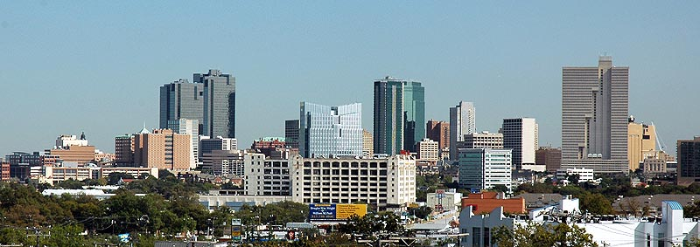
Questions?

