Slide 1


OCTOBER 7 – OCTOBER 25, 2024
OPEN ENROLLMENT FOR PLAN YEAR 2025
Presented By Human Resources Department

Slide 2
OE FAST FACTS
Online Access To Enroll via our online system cfwbenefits.com Starts October 7th
Open Enrollment Deadline for ALL Plans is October 25, 2024, 11:59 pm
Changes Are Effective January 1, 2025

Slide 3
INSURANCE TERMS
Copayment
Deductible
A payment made by a beneficiary
(especially for health services) in addition to that made by an insurer.
A specified amount of money that the insured must pay before an insurance company will pay a claim.
Total Out of Pocket Maximum
Coinsurance
A type of insurance in which the insured pays a share of the payment made against a claim.
The most you have to pay for covered services in a plan year. After you spend this amount on deductibles, copayments, and coinsurance, your health plan pays 100% of the costs of covered benefits.

Slide 4
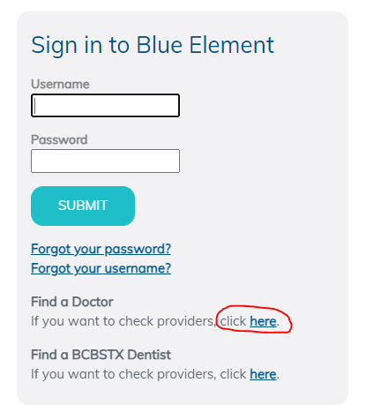


Medical- BCBSTX
(BlueCross BlueShield of TX)
Medical Carrier is BlueCross BlueShield of TX
National Network- Blue Choice PPO
Provider Search: myblueelementtx.com
OptumRx will provide prescription benefits

Slide 5
SAME Two Medical Plan Options
Health Center Plan
Consumer Choice Plan
Free primary physician (PCP) care at City Designated health centers
Copays for Specialists, Non-Health Center PCPs, OBGYN, Pediatricians and Prescriptions
Lower deductibles and out of pocket costs
Health Savings Account (HSA)
High-deductible
Members will be able to use the health centers at a discounted rate
Deductible & Coinsurance for complex imaging & surgery
ALL Services apply to deductible except preventive care
All preventive care, including mammograms and colonoscopies, are free to members on both the
Health Center Plan and the Consumer Choice Plan

Slide 6


Medical- BCBSTX
(BlueCross BlueShield of TX)
Health Center Plan:
Primary Care (Family Medicine, Internists, OB/Gyn, Pediatricians)
  All Health Center services are FREE
  All other Primary Care Providers = $30 co-pay
Specialists (All other physicians) = $50 co-pay
No Coverage for Out-of-Network Providers
  Except emergencies and certain surgery situations

Slide 7
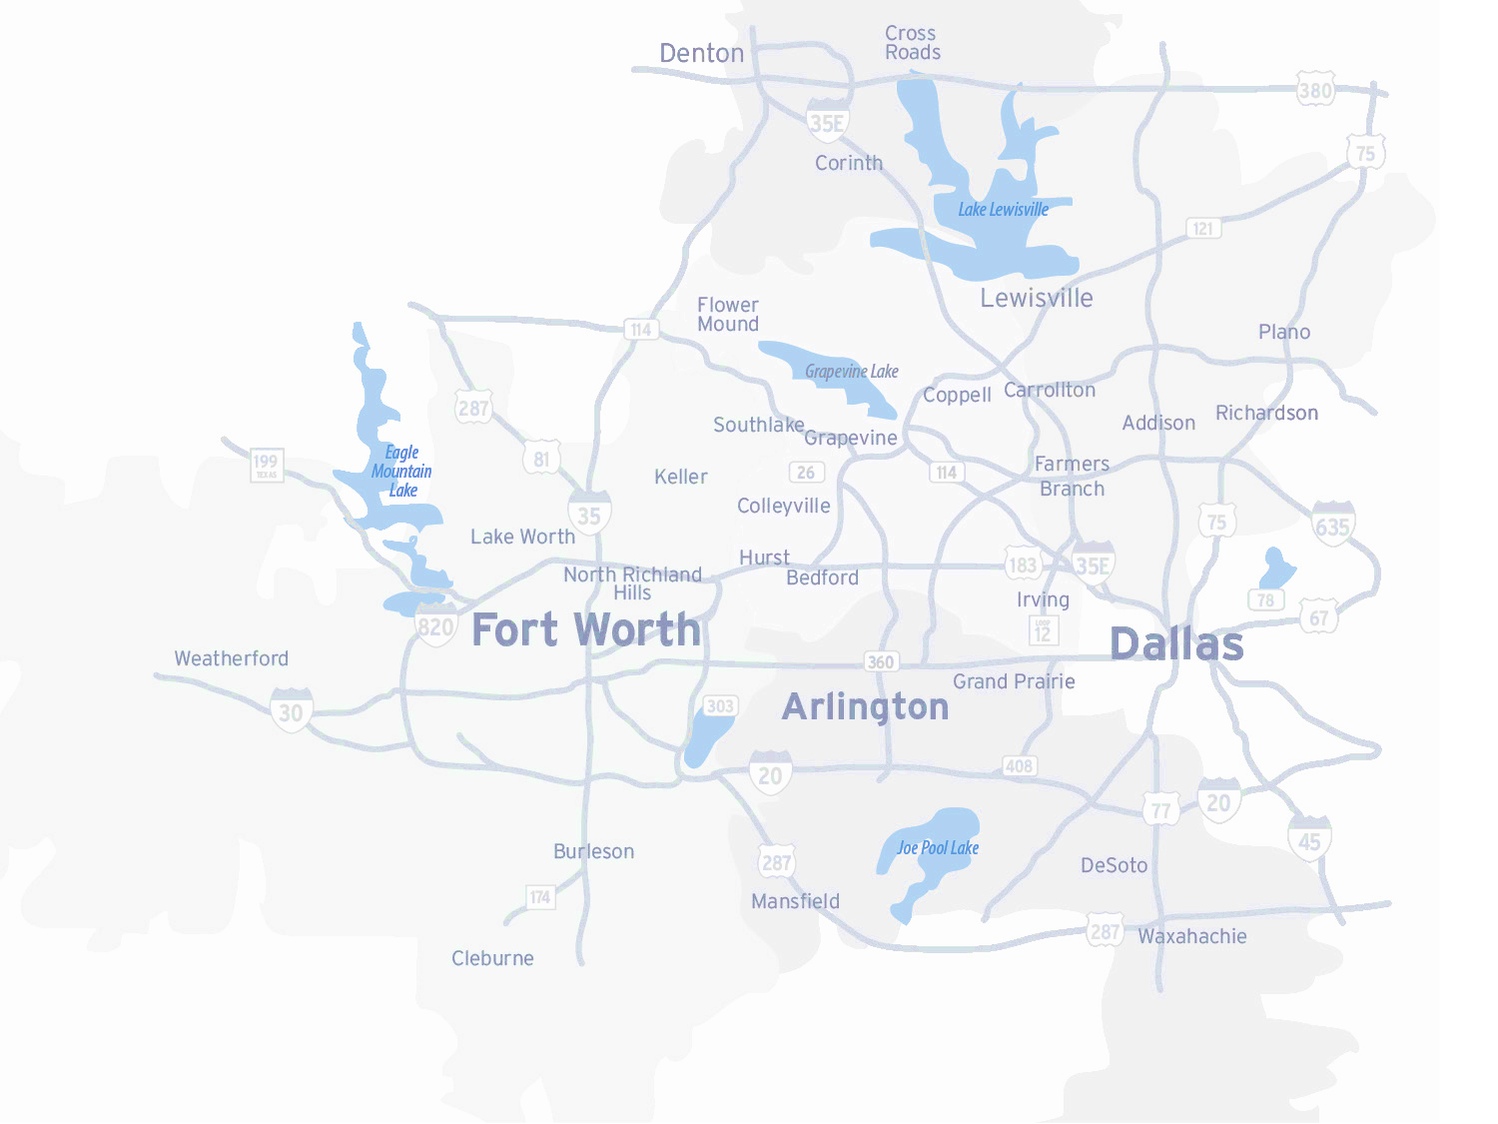
Dedicated/ Primary Health Centers
Four (4) Dedicated Health Centers
  Texas Health Resource Physicians at each location
  Only available for Employees and Retiree enrolled in Health plans
  Same or next day appointments for sick visits
  Short wait times when patients make an appointment and arrive on time
  Hours Monday – Friday
  8:00 AM – 5:00 PM
  Call Care Coordinators to set an appointment
  800-574-0606
  Unlimited Visits
  Health Center Plan $0 Copay
  www.FortWorthEmployeeHealthCenter.com

Slide 8
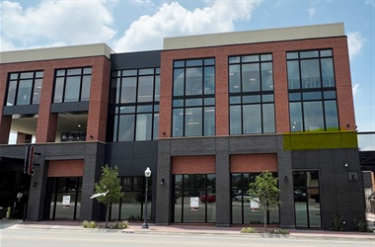
Health Center Locations
Magnolia
  1320 Hemphill St. Ste 350
  Bilingual physician- Dr. Campbell
Riverside
  Police Officer’s Association Building:
  100 N. Forest Park Blvd, Ste 120
  Bilingual physician- Dr. Mejia
Lake Worth
  4701 Boat Club Road, Ste 325
Huguley
  12001 South Freeway, Ste 208
  Medical Office Building 5
Satellite Locations:
Bedford: 3024 State Hwy 121
Burleson: 2730 SW Wilshire Blvd
SW Fort Worth: 7001 Granbury Rd
Willow Park: 101 Crown Pointe Blvd, Ste 200
Keller: 100 Bourland Rd, Ste170

Slide 9
Consumer Choice Plan
Physicians Network
Full access to Blue Choice PPO
No referrals needed for specialists
Co-pay/Co-insurance
Deductible increased to $3,300 individual/$5,400 family
Contributions
City contributes $610/$1,000
Premiums lower than Health Center Plan
Pharmacy – deductible, then 20% co-insurance up to Out-of-Pocket maximum
Can still use the Health Center at a reduced cost
Out of pocket maximums remains at $6,550 individual/$13,000 family

Slide 10






Special Programs included with enrollment in either medical plan option
Telemedicine (Virtual Visits)
Mental Health Services available
Virtual Physical Therapy
REBRANDED TO
Musculoskeletal Rehabilitation- relief in about 3 visits
Total Heart Health- Blood Pressure and Cholesterol management program
Same previous services just a new name
Bundled billing for savings nonemergency surgeries.
Cancer Care
Type 2 diabetes management program

Slide 11
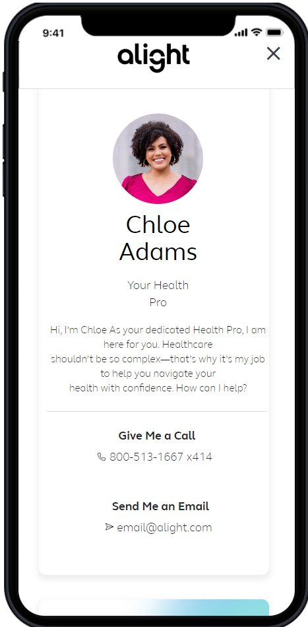


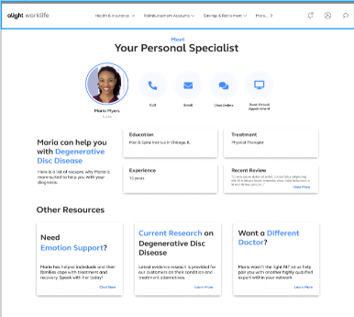
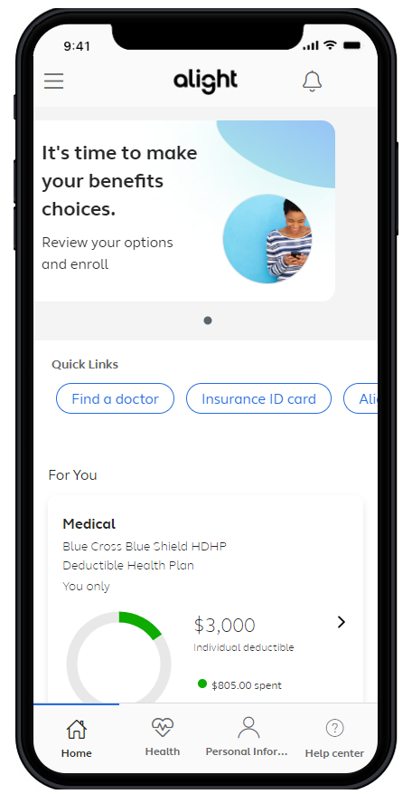
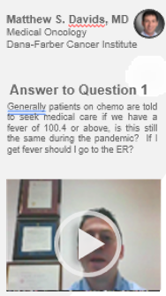
A connected experience – right time, right resource
Diagnosis
Doctor
Treatment
Facility
Coping
Comprehensive Benefits Navigation
--General benefits questions --Provider recommendations -Procedure cost estimates -Program referrals | -Coordination of care -Prescription reviews -Bill reviews
Clinical Decision Support
-Support for any health condition and treatment options -Curated content -Comprehensive clinical intake | -Physician conference calls -Pre-appointment prep -Emotional support for participants and caregivers
Expert Medical Opinions (EMO)
-Virtual second opinions with leading experts -Confirm a diagnosis and treatment options | -Multi-disciplinary consults for complex cases -Referrals to high-quality physicians for in-person care
Surgery Decision Support
-Understand the risks and benefits of any surgery -Alternative treatment options | -Pain management techniques -Incentives tied to elective surgeries for lower back, hip or knee replacement, weight loss, or hysterectomy

Slide 12


Pharmacy Benefits - OptumRx
Health Center Plan
$100 Deductible, then Coinsurance
Maintenance Medications through Walgreens (retail) or
Consumer Choice Plan
Deductible, then Coinsurance
Medications through Walgreens (retail)
Mail Order
OptumRx Mail Order
90 day supply
Select90 Program for Maintenance Medications
Select90 Program for Maintenance Medications

Slide 13
Health Center Pharmacy Plan
 | Retail | Mail Order/Select 90
Generic | 20% coinsurance, $10 min/$20 max | 20% coinsurance, $25 min/$50 max
Brand Formulary | 20% coinsurance, $30 min/$50 max | 20% coinsurance, $75 min/$125 max
Brand Non-Formulary | 20% coinsurance, $50 min/$70 max | 20% coinsurance, $125 min/$175 max
Specialty | 20% coinsurance, $200 max | 20% coinsurance, $200 max
$100 deductible
Maintenance medications still obtained through mail order or Walgreens

Slide 14
2025 Medical Rates
 | Health Center Plan |  | Consumer Choice Plan
 | Per Paycheck | Month | Per Paycheck | Month
Employee Only | $52.64 | $114.06 | $0 | $0
Employee + Spouse | $260.47 | $564.36 | $176.65 | $382.75
Employee + Child(ren) | $194.34 | $421.07 | $126.50 | $274.08
Employee + Family | $364.39 | $789.52 | $264.98 | $574.13
*Participants in the Consumer Choice Plan could contribute that premium difference in their Health Savings Account pre-tax to save for future medical expenses.
Assumes all three wellness requirements have been met

Slide 15
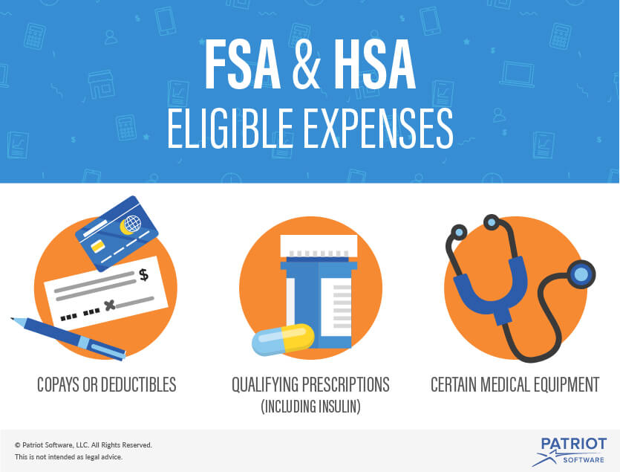
Flexible Spending Accounts
MUST RE-ELECT EACH YEAR
ENROLLMENT DOES NOT CARRY OVER
  Contribute funds tax free
  Do not have to be enrolled in Medical
  Pay for out-of-pocket expenses
HealthCare FSA
  Max Contribution: $3,200
  Rollover up to $610
Dependent Care FSA
  Max Contribution: $5,000
  ZERO rollover

Slide 16
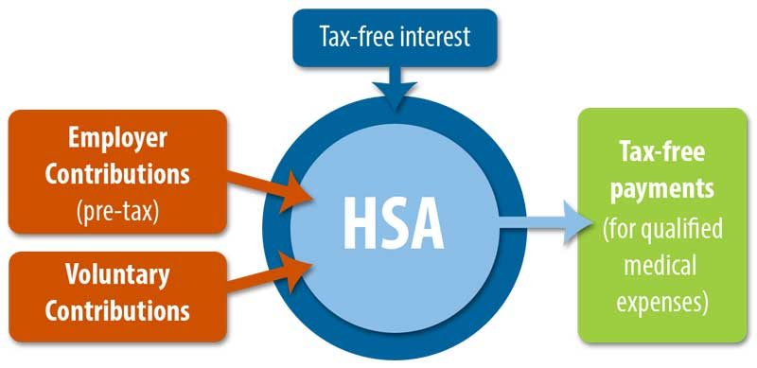
Health Savings Accounts
  Must be enrolled in
  Consumer Choice plan
  Pre-tax dollars to pay for out-of-pocket health care expenses
    You own the account
    No documentation needed
    Grow your account through investments
  Funds rollover from
  year to year
Doubles as a retirement account
  Withdrawal funds without a penalty at age 65 for non-medical expenses (taxes apply)
City Contribution deposited at the End of January
$610 Employee Only & $1,000 Family
Max Contributions for 2025:
  $4,300 individual / $8,550 Family

Slide 17


Dental- MetLife
Dental Carrier is MetLife
3 plan options: DPPO High, DPPO Low, DHMO
PPO Network: PDP Plus
DHMO Network: Dental HMO/Managed Care
Metlife.com/insurance/dental-insurance

Slide 18
Dental Plan Comparison
 | DPPO High Option | DPPO Low Option | Delta Care DHMO Option
Deductible | $50 per person $150 per family | $50 per person $150 per family | None
Annual Maximum | $2,250 per person | $1,250 per person | None
Preventive & Diagnostic Care | 100% Deductible Waived (4 Cleanings per year) | 100% Deductible Waived (4 Cleanings per year) | Fixed schedule of copays
Basic Restorative Care | Plan pays 80% After Deductible | Plan pays 50% After Deductible | Fixed schedule of copays. Specialist referral is REQUIRED
Major Restorative Care | Plan pays 50% After deductible | Plan pays 50% After Deductible
Orthodontia | Plan pays 50% Lifetime Maximum $1,500 | Plan pays 50% Lifetime Maximum $1,000
Implants | Plan Pays 50% After Deductible | Plan pays 50% After Deductible | Limited Coverage

Slide 19
2025 Dental Rates
Bi-Weekly (per paycheck)
New
LOWER
Rates
 | DPPO High | DPPO Low | DHMO
Employee Only | $15.51 | $10.44 | $5.31
Employee + Spouse | $31.79 | $19.84 | $10.08
Employee + Child(ren) | $41.10 | $22.98 | $10.62
Employee + Family | $51.94 | $32.38 | $16.46

Slide 20


Vision- MetLife
Vision Carrier is MetLife
2 plan options- High & Low
Network: Superior Vision
Metlife.com/insurance/vision-insurance

Slide 21
Vision Plan Comparison
 | High | Low
Exam (once every calendar year) | $0 copay | $0 copay
Standard Contact Lens Fit & Follow up | $10 copay | $10 copay
Contact Lenses Allowance | $150 | $125
Frames Allowance | $200 Every Calendar Year | $180 Every Other Calendar Year
Lenses – Single, Bifocal, Trifocal | $10 copay | $20 copay
Lenses – Progressive I, II, III, IV | $55, $110, $150, $225 copay | $55, $110, $150, $225 copay

Slide 22
2025 Vision Rates
Bi-Weekly (per paycheck)
New
LOWER
Rates
 | High | Low
Employee Only | $5.38 | $2.35
Employee + Spouse | $10.20 | $4.47
Employee + Child(ren) | $10.74 | $4.70
Employee + Family | $15.78 | $6.91

Slide 23

Life and AD&D Insurance - Securian
The City of Fort Worth provides one time your base salary for Life and Accidental Death and Dismemberment (AD&D)
Open Enrollment (Plan Year 2025)
  Currently enrolled, can increase up to one (1) time your base salary without Evidence of Insurability (EOI)
  Can decrease coverage online without EOI
Employee maximum eight (8) times salary, max of $600,000
Spousal life up to $150,000 in $25,000 increments
Dependent child life $10,000 or $20,000

Slide 24
Disability Insurance
Income replacement if you can’t work due to your own illness or injury
Evidence of Insurability Required if enrolling for the first time or increasing coverage
 | Short Term Disability |  | Long Term Disability*
 | Low Option | High Option | Low Option | High Option
Elimination Period | 30 Days | 14 Days | 90 or 180 Days | 90 or 180 Days
Maximum Benefit Period | 9 or 22 Weeks | 11 or 24 Weeks | Until able to work again or age 65 | Until able to work again or age 65
Income Replacement | 40% | 60% | 40% | 60%
* Long Term Disability has a 6/12 Pre-existing Condition Limitation

Slide 25

457 Deferred Compensation Plan TIAA
Set aside pre-tax or post-tax (ROTH) money for retirement
Minimum contribution $10.00/pay period or 1% of salary
Enroll online anytime through TIAA’s website
www.tiaa.org/fortworth
Investment in a variety of funds available
2024 catch-up contribution
  $7,500 over age 50
  Special catch-up contribution within 3 years of retirement
  Contact Benefits or TIAA
2024 contribution limit is $23,000

Slide 26

Beneplace
Discount Site:
Tickets
Car rental
Vacation
Big Ticket Items
Voluntary Benefits:
  Legal Protection
  Home, Auto and Pet Insurance
www.beneplace.com/cofw

Slide 27
MetLife
Critical Illness Plan
Two benefit tiers $15,000 or $30,000
Initial benefit pays when diagnosed with a critical illness such as
Accident Plan
Two tiers – Low and High Option
Pays when an injury/accident occurs including accidental death and dismemberment
Hospital Indemnity Plan
Two tiers – Low and High Option
Pays flat dollar amount if admitted to the hospital
Cancer
Heart Attack
Stroke
Health Screening Benefit $100
Pre-existing condition limits
Flat amount for various medical situations such as:
Fracture/dislocations
Burns
Concussions
ER Visit
Additional benefit if admitted to the Intensive Care Unit
Initial hospitalization limit to 1x per year
Confinement benefit limited to 31 days per year
Enrollment made easier! Now available online at cfwbenefits.com

Slide 28
Legal Plans
MetLife Legal
Access to an attorney for frequently used legal matters
Allstate Identity Protection
Check Identity Health Status
Monitor TransUnion Credit Score for fraud
Estate planning
Identity theft
Family and personal issues
Traffic
Civil lawsuits
Receive alerts for withdrawals, balance transfers and large purchases
Reimbursement in the event of fraud
Enrollment made easier! Now available online at cfwbenefits.com

Slide 29
Wellness Update

Slide 30

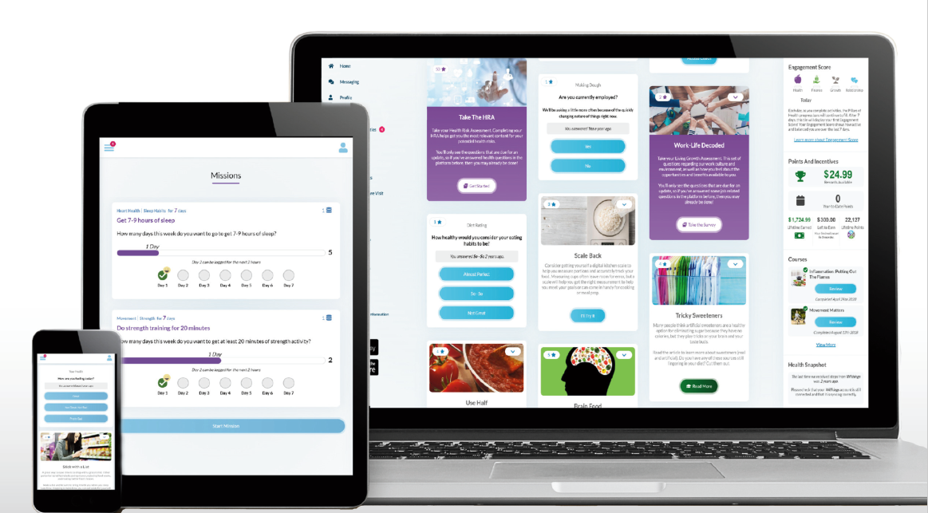
Wellness- Ramp Health
NEW! Wellness Vendor
Same deadlines – August 31, 2025
Same requirements for Premium Incentive and Cash Payout
Easy-to-use, engaging platform available on desktop and mobile
Health and Wellness Coaching
Online Challenges
And more!

Slide 31

Health, Safety & Benefits Fair
Wednesday October 16th
9:00 AM – 2:00 PM
Will Rogers, 3401 W. Lancaster
Representatives from safety, health, local non-profits will be in attendance
Flu Shots will be available
Door prizes
Earn points towards Healthy Challenge Cash Payout
Online Enrollment Support
Register Now

Slide 32

Where can you find more information?
On the city’s webpage you can
learn more about:
Plan Comparisons
Plan Design
Open Enrollment Meeting Dates
Healthcare Vendors
Frequently Asked Questions (FAQs)
https://www.fortworthtexas.gov/departments/hr/employees/openenrollment

Slide 33


Online Enrollment
At home
Enroll from any desktop or laptop: www.cfwbenefits.com
Upload proof documents online – birth certificates, marriage license, etc.
Online enrollment help:
    HR Benefits Office: M-F 8:00 AM – 5:00 PM
    Your Department Human Resources Coordinator (HRC)
Or at work
**ALL elections MUST be completed & submitted online by October 25th**
FSA elections will not roll over to next year you must re-elect

Slide 34
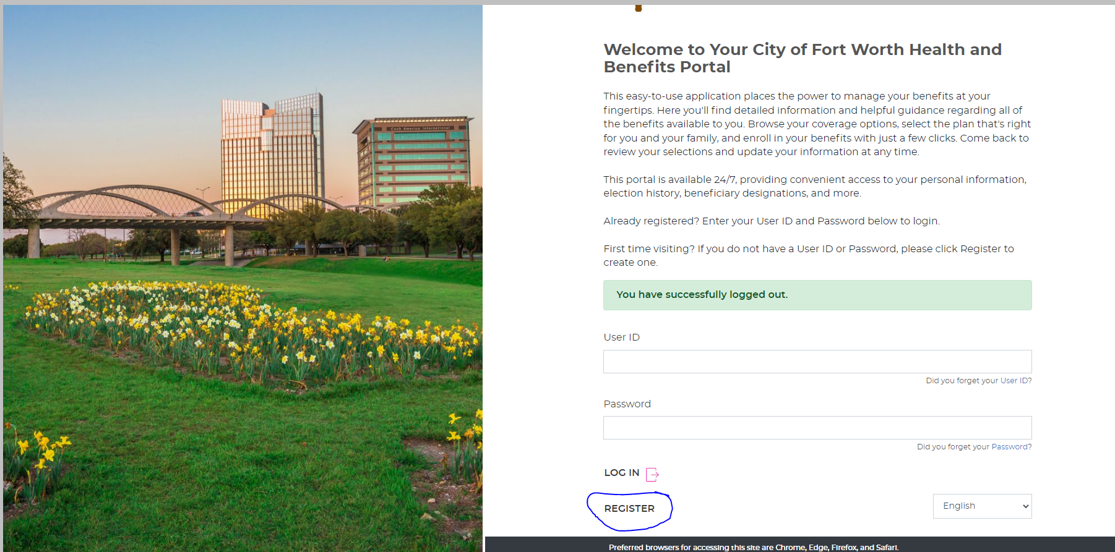
Member Portal Welcome Page

Slide 35
City of Fort Worth HR Benefits Office
100 Fort Worth Trail, Fort Worth, TX 76102
New City Hall- 15th floor
817-392-7782 phone
Alight at 866-307-8835
benefits@fortworthtexas.gov
We MOVED!

