Slide 1



OCTOBER 13 – OCTOBER 31, 2025
OPEN ENROLLMENT FOR PLAN YEAR 2026
Presented By Human Resources Department

Slide 2
OE FAST FACTS
Online Access To Enroll via our online system cfwbenefits.com Starts October 13th
Open Enrollment Deadline for ALL Plans is October 31, 2025, 11:59 pm
Changes Are Effective January 1, 2026

Slide 3
What’s Changing?
Medical
Health Savings Account
Increase individual contribution limit to $4,400
Increase family contribution limit to $8,750
Pharmacy
New vendor! Rightway
Same 2 plan designs, but increase in individual deductible on Consumer Choice to $3,400
Slight increase to premiums (27 paychecks in 2026)
Copay for weight loss medication
Separate ID card
City will still contribute $610 for individual & $1,000 for family
Employee Assistance Program (EAP)
  New Vendor! Acentra Health

Slide 4

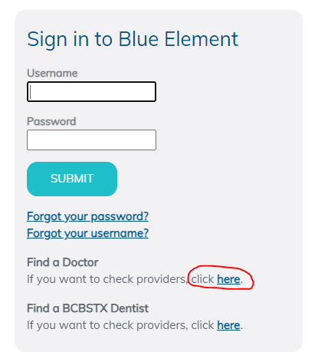
Medical- BCBSTX
(BlueCross BlueShield of TX)
National Network- Blue Choice PPO
Provider Search: myblueelementtx.com
New ID card for 2026

Slide 5
SAME Two Medical Plan Options
Health Center Plan
Consumer Choice Plan
Free primary physician (PCP) care at City Designated health centers
Copays for Specialists, Non-Health Center PCPs, OBGYN, Pediatricians and Prescriptions
Lower deductibles and out of pocket costs
Health Savings Account (HSA)
High-deductible
Members will be able to use the health centers at a discounted rate
Deductible & Coinsurance for complex imaging & surgery
ALL Services apply to deductible except preventive care
All preventive care, including mammograms and colonoscopies, are free to members on both the
Health Center Plan and the Consumer Choice Plan

Slide 6
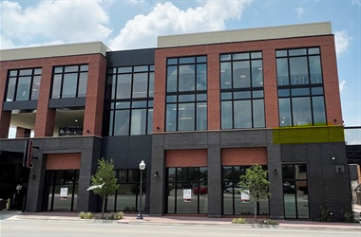
Health Center Locations
Magnolia
  1320 Hemphill St. Ste 350
  Bilingual physician- Dr. Campbell
Riverside
  Police Officer’s Association Building:
  100 N. Forest Park Blvd, Ste 120
  Bilingual physician- Dr. Mejia
Lake Worth
  4701 Boat Club Road, Ste 325
Huguley
  12001 South Freeway, Ste 208
  Medical Office Building 5
Satellite Locations:
Bedford: 3024 State Hwy 121
Burleson: 2730 SW Wilshire Blvd
SW Fort Worth: 7001 Granbury Rd
Willow Park: 101 Crown Pointe Blvd, Ste 200
Keller: 100 Bourland Rd, Ste170

Slide 7
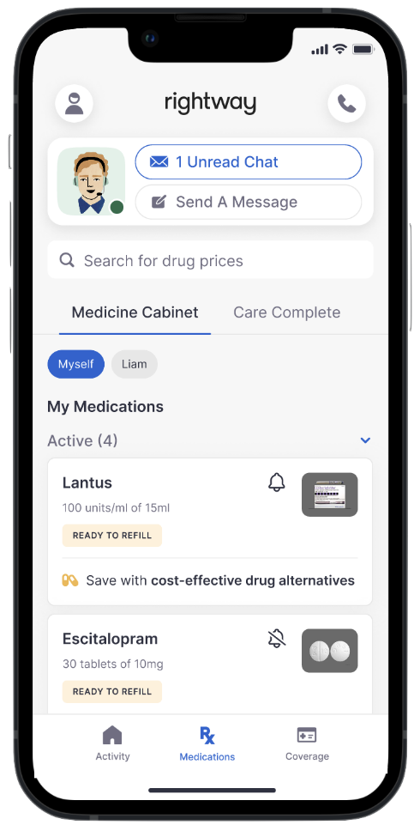


Pharmacy- Rightway
Separate ID card
Copay for weight loss medication effective January 1, 2026
No mandatory pharmacy for your 90-day maintenance medication
Walgreens mail order and specialty
Mark Cuban, Cost Plus Drugs
Download the app today!
Rightway Health Guides ready to assist
Member Services: 833-502-9052
Website: joinrightway.com/rx

Slide 8
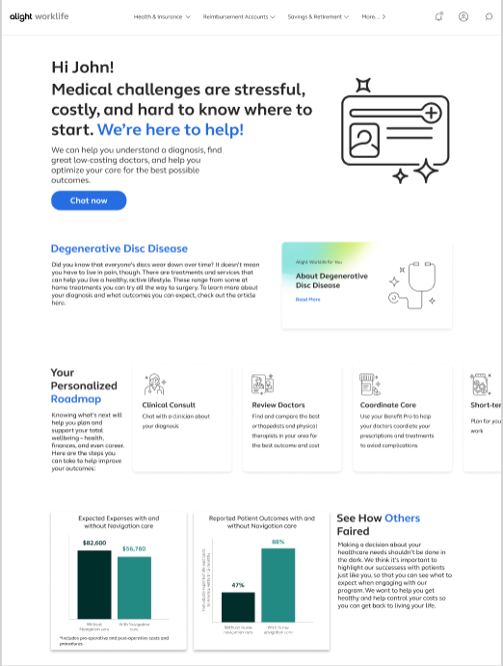

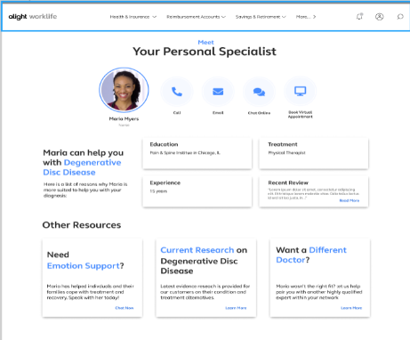
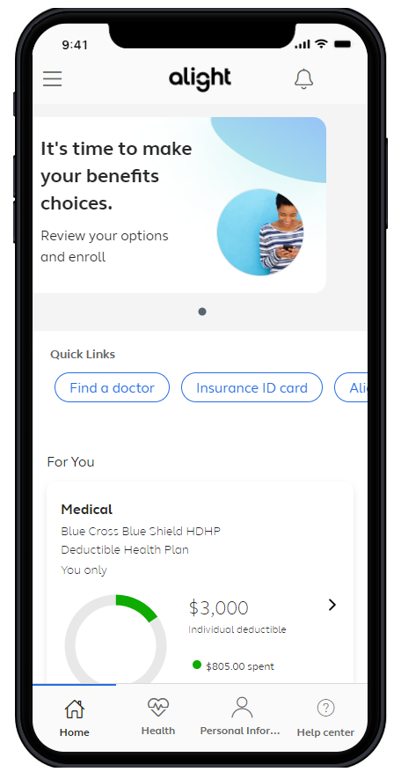
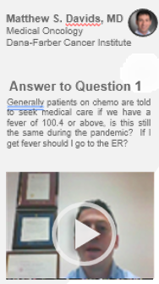
Alight – Healthcare Concierge
A connected experience – right time, right resource
Comprehensive Benefits Navigation
--General benefits questions --Provider recommendations -Procedure cost estimates -Program referrals | -Coordination of care -Prescription reviews -Bill reviews
Clinical & Surgery Decision Support
-Support for any health condition and treatment options -Curated content -Comprehensive clinical intake | -Physician conference calls -Pre-appointment prep -Emotional support for participants and caregivers
Expert Medical Opinions (EMO)
-Virtual second opinions with leading experts -Confirm a diagnosis and treatment options | -Multi-disciplinary consults for complex cases -Referrals to high-quality physicians for in-person care
Diagnosis
Doctor
Treatment
Facility
Coping

Slide 9





Additional Programs included with enrollment in either medical plan option
Telemedicine (Virtual Visits)
Mental Health Services available
Virtual Physical Therapy
Musculoskeletal Rehabilitation- relief in about 3 visits
Total Heart Health-
Blood Pressure Management
Cholesterol Management
Bundled billing for savings on nonemergency surgeries
Cancer Care
Weight Management Programs
Form Health
Digbi Health
Noom
Type 2 diabetes management program

Slide 10
Weight Management Programs
Zero cost to the member! Viewed as preventative services on both plans
Form Health
Work one-on-one with a dedicated care team who will develop a personalized science-based plan to address behavioral health, nutrition, physical activity and if needed medication.
Digbi Health
Personalized program that identifies each member’s unique biological triggers through at home testing. This data-driven approach allows Digbi to create a highly personalized treatment plan that addresses specific biological factors.
Noom
Psychology-based program that offers a holistic approach to healthy living. Addressing the “why” behind their habits and how to change them.

Slide 11
2026 Medical Rates
27 paychecks in 2026
 | Health Center Plan |  | Consumer Choice Plan
 | Per Paycheck | Month | Per Paycheck | Month
Employee Only | $52.22 | $117.48 | $0 | $0
Employee + Spouse | $258.35 | $581.29 | $175.21 | $394.23
Employee + Child(ren) | $192.76 | $433.71 | $125.47 | $282.31
Employee + Family | $361.42 | $813.20 | $262.83 | $591.36
*Participants in the Consumer Choice Plan could contribute that premium difference in their Health Savings Account pre-tax to save for future medical expenses.
Assumes all three wellness requirements have been met

Slide 12
FSA & HSA Reminders
Flexible Spending Account (FSA)
HealthCare FSA
Health Savings Account (HSA)
City will contribute (end of Jan. 2026)
Max contribution: $3,300
$610 for Employee only
$1,000 for Family
Full Balance Rolls over from Year to Year
Must be enrolled in Consumer Choice Plan for medical coverage
Rollover up to $660
Max Contribution: $7,500
ZERO Rollover
Must RE-ELECT each year
Dependent Care FSA
Max Contributions for 2026:
$4,400 individual / $8,750 Family
HealthCare FSA and HSA can be used for Medical, RX, Dental and Vision Expenses

Slide 13

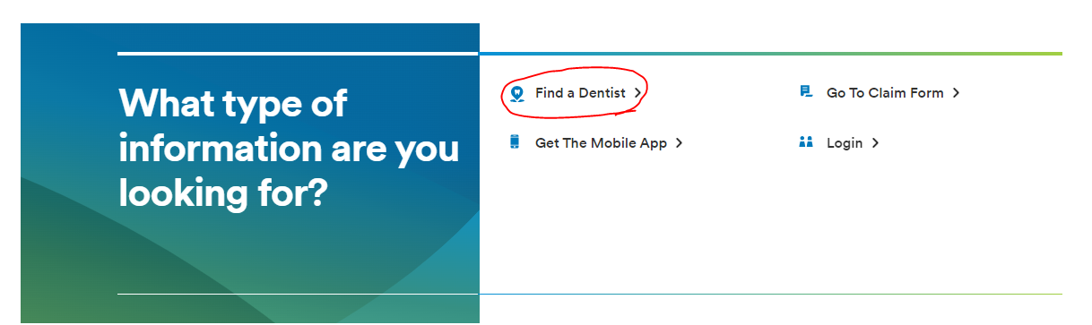
Dental- MetLife
3 plan options: DPPO High, DPPO Low, DHMO
PPO Network: PDP Plus
DHMO Network: Dental HMO/Managed Care
Metlife.com/insurance/dental-insurance
No ID cards

Slide 14
Dental Plan Comparison
 | DPPO High Option | DPPO Low Option | Delta Care DHMO Option
Deductible | $50 per person $150 per family | $50 per person $150 per family | None
Annual Maximum | $2,250 per person | $1,250 per person | None
Preventive & Diagnostic Care | 100% Deductible Waived (4 Cleanings per year) | 100% Deductible Waived (4 Cleanings per year) | Fixed schedule of copays
Basic Restorative Care | Plan pays 80% After Deductible | Plan pays 50% After Deductible | Fixed schedule of copays. Specialist referral is REQUIRED
Major Restorative Care | Plan pays 50% After deductible | Plan pays 50% After Deductible
Orthodontia | Plan pays 50% Lifetime Maximum $1,500 | Plan pays 50% Lifetime Maximum $1,000
Implants | Plan Pays 50% After Deductible | Plan pays 50% After Deductible | Limited Coverage

Slide 15
2026 Dental Rates
Bi-Weekly (27 paychecks in 2026)
 | DPPO High | DPPO Low | DHMO
Employee Only | $14.93 | $10.05 | $5.11
Employee + Spouse | $30.61 | $19.10 | $9.71
Employee + Child(ren) | $39.57 | $22.12 | $10.22
Employee + Family | $50.02 | $31.18 | $15.85

Slide 16


Vision- MetLife
2 plan options- High & Low
Network: Superior Vision
Metlife.com/insurance/vision-insurance
No ID cards

Slide 17
Vision Plan Comparison
 | High | Low
Exam (once every calendar year) | $0 copay | $0 copay
Standard Contact Lens Fit & Follow up | $10 copay | $10 copay
Contact Lenses Allowance | $150 | $125
Frames Allowance | $200 Every Calendar Year | $180 Every Other Calendar Year
Lenses – Single, Bifocal, Trifocal | $10 copay | $20 copay
Lenses – Progressive I, II, III, IV | $55, $110, $150, $225 copay | $55, $110, $150, $225 copay

Slide 18
2026 Vision Rates
Bi-Weekly (27 paychecks in 2026)
 | High | Low
Employee Only | $5.18 | $2.27
Employee + Spouse | $9.83 | $4.30
Employee + Child(ren) | $10.34 | $4.53
Employee + Family | $15.20 | $6.65

Slide 19
Wellness Update

Slide 20

Employee Assistance Program
(EAP)
New EAP Provider - January 1, 2026
Counseling Services
Legal and Financial Consultations
Caregiver Resources
Work life/Convenience Services
Website Tools and Resources
Critical Incident On-site Counseling Services
Contact starting January 1
888-703-9003
eap.acentra.com

Slide 21
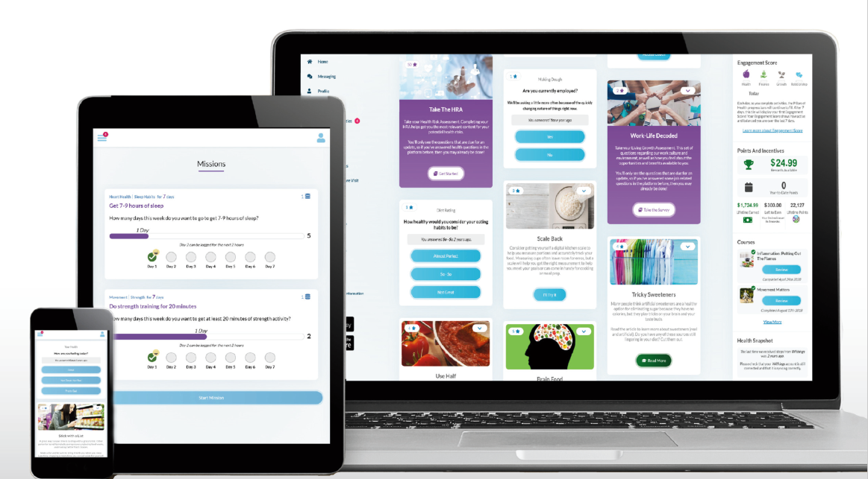
Wellness – Ramp Health
Wellness Website and App
On-site and Virtual Health Coaching
On-site and Virtual Wellness Seminars
Premium Incentive Deadline – August 31, 2026
Cash Payout Deadline - December 15, 2026
Registration ID for Employees and Retirees:
Use your City Employee ID.
Registration ID for For Spouses on the Health Plan:
Use the Employee ID with an “S” at the end. Example: Employee John Smith, ID 123456;
Spouse Jane Smith, ID 123456S.

Slide 22
Wellness – Cash Payout
Can now receive wellness time off instead of cash
  Time will be use or lose
Look for email after points deadline of December 15th to make selection between cash or hours
  Default election will be cash if no action is taken
Points Earned | Cash Amount | Wellness Time Off
2,500 | $150 | 5 hours
3,000 | $200 | 10 hours
3,500 | $250 | 16 hours
*Payout of cash or time will be on the 3rd paycheck of 2026 - January 30th*

Slide 23
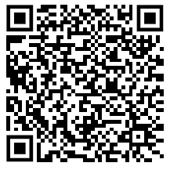
Health, Safety & Benefits Fair
Wednesday October 29th
9:00 AM – 2:00 PM
Will Rogers, 3401 W. Lancaster
Representatives from safety, health, local non-profits will be in attendance
Flu Shots will be available
Door prizes
Earn points towards Healthy Challenge Cash Payout
Online Enrollment Support
Register Here!

Slide 24

Where can you find more information?
On the city’s webpage you can
learn more about:
Plan Comparisons
Plan Design
Open Enrollment Meeting Dates
Healthcare Vendors
Frequently Asked Questions (FAQs)
https://www.fortworthtexas.gov/departments/hr/employees/openenrollment

Slide 25


Online Enrollment
At home
Enroll from any desktop or laptop: www.cfwbenefits.com
Upload proof documents online – birth certificates, marriage license, etc.
Online enrollment help:
    HR Benefits Office: M-F 8:00 AM – 5:00 PM
    Your Department Human Resources Coordinator (HRC)
Or at work
**ALL elections MUST be completed & submitted online by October 31st **
FSA elections will not roll over to next year you must re-elect

Slide 26
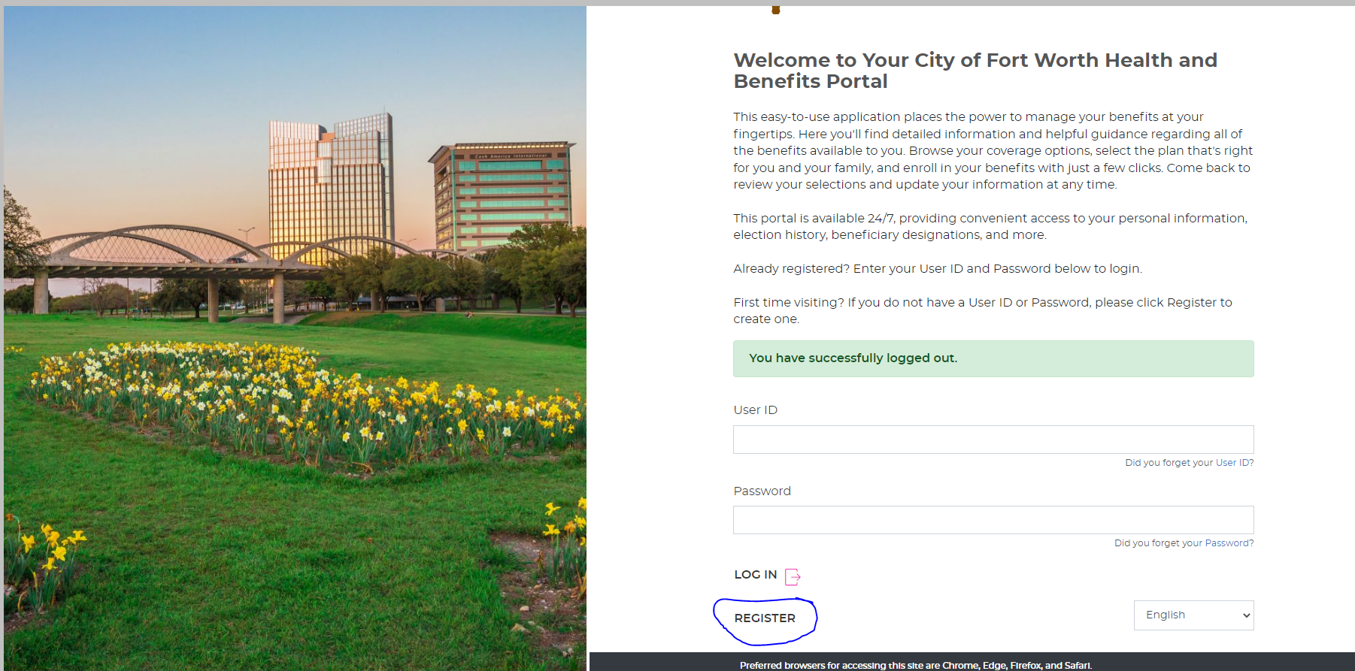
Member Portal Welcome Page

Slide 27
City of Fort Worth HR Benefits Office
100 Fort Worth Trail, Fort Worth, TX 76102
New City Hall- 15th floor
817-392-7782 phone
Alight at 866-307-8835
benefits@fortworthtexas.gov

