Slide 1


OCTOBER 13 – October 31, 2025
OPEN ENROLLMENT FOR PLAN YEAR 2026
Presented By Human Resources Department

Slide 2

If you are not making changes for 2026,
you do not have to do anything.
Your coverage will automatically carry over to the new Pharmacy carrier for 2026.
You will receive updated BCBS cards
and a separate RX ID card.

Slide 3
OE FAST FACTS
Online Access To Enroll via our online system cfwbenefits.com Starts October 13, 2025
Open Enrollment Deadline for ALL Plans is October 31, 2025, 11:59 pm
Changes Are Effective January 1, 2026

Slide 4

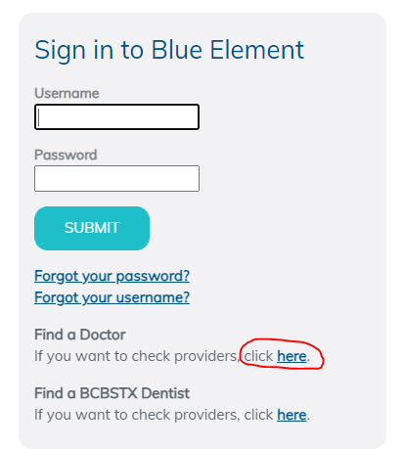
Medical- BCBSTX
(BlueCross BlueShield of TX)
National Network- Blue Choice PPO
Provider Search: myblueelementtx.com
New ID cards for 2026

Slide 5
SAME Two Medical Plan Options
Health Center Plan
Consumer Choice Plan
Free primary physician (PCP) care at City Designated health centers
Copays for Specialists, Non-Health Center PCPs, OBGYN, Pediatricians and Prescriptions
Lower deductibles and out of pocket costs
Health Savings Account (HSA)
High-deductible
Members will be able to use the health centers at a discounted rate
Deductible & Coinsurance for complex imaging & surgery
ALL Services apply to deductible except preventive care
All preventive care, including mammograms and colonoscopies, are free to members on both the
Health Center Plan and the Consumer Choice Plan

Slide 6


Health Center Plan
Primary Care (Family Medicine, Internists, OB/Gyn, Pediatricians)
  All Health Center services are FREE
  All other Primary Care Providers = $30 co-pay
Specialists (All other physicians) = $50 co-pay
Find a provider = myblueelementtx.com
  National Network- Blue Choice PPO
No Coverage for Out-of-Network Providers
  Except emergencies and certain surgery situations

Slide 7
Consumer Choice Plan
Physicians Network
Full access to Blue Choice PPO
No referrals needed for specialists
Co-pay/Co-insurance
Deductible increased to $3,400 individual/$5,400 family
Health Savings Account
City contributes $610/$1,000
Premiums lower than Health Center Plan
Pharmacy – deductible, then 20% co-insurance up to Out-of-Pocket maximum
Can still use the Health Center at a reduced cost
Out of pocket maximums remains at $6,550 individual/$13,000 family

Slide 8
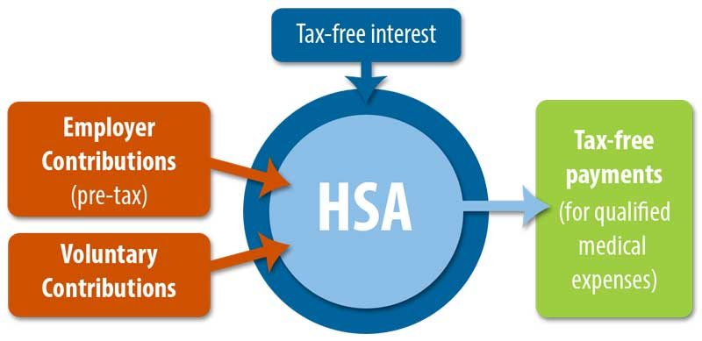
Health Savings Account
  Must be enrolled in the Consumer Choice Plan
  Pre-tax dollars to pay for out-of-pocket health care expenses
    You own the account
    No documentation needed
    Grow your account through investments
  Funds rollover from year to year
Doubles as a retirement account
  Withdrawal funds without a penalty at age 65 for non-medical expenses (taxes apply)
City Contribution deposited beginning of February
$610 Retiree only & $1,000 Family

Slide 9
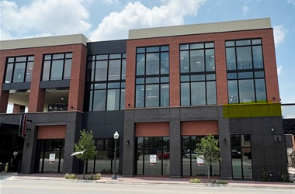
Health Center Locations
Magnolia
  1320 Hemphill St. Ste 350
  Bilingual physician- Dr. Campbell
Riverside
  Police Officer’s Association Building:
  100 N. Forest Park Blvd, Ste 120
  Bilingual physician- Dr. Mejia
Lake Worth
  4701 Boat Club Road, Ste 325
Huguley
  12001 South Freeway, Ste 208
  Medical Office Building 5
Satellite Locations:
Bedford: 3024 State Hwy 121
Burleson: 2730 SW Wilshire Blvd
SW Fort Worth: 7001 Granbury Rd
Willow Park: 101 Crown Pointe Blvd, Ste 200
Keller: 100 Bourland Rd, Ste170

Slide 10
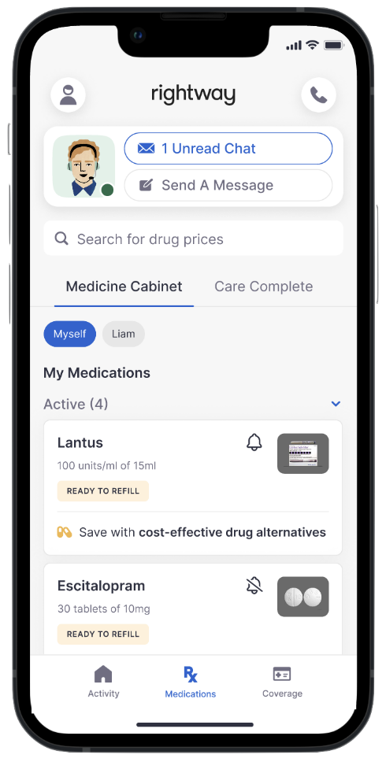


Pharmacy- Rightway
Separate ID card
Copay for weight loss medication effective January 1, 2026
No mandatory pharmacy for your 90-day maintenance medication
Walgreens mail order and specialty
Mark Cuban, Cost Plus Drugs
Download the app today!
Rightway Health Guides ready to assist
Member Services: 833-502-9052
Website: joinrightway.com/rx

Slide 11
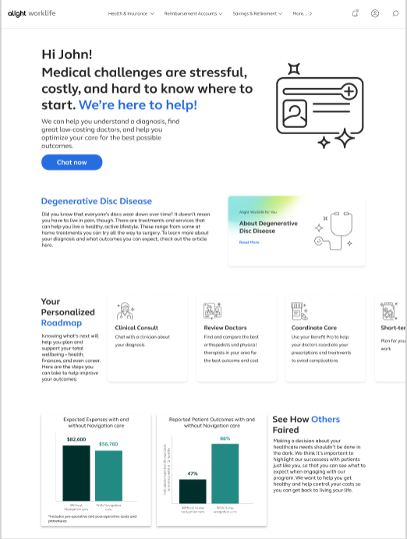

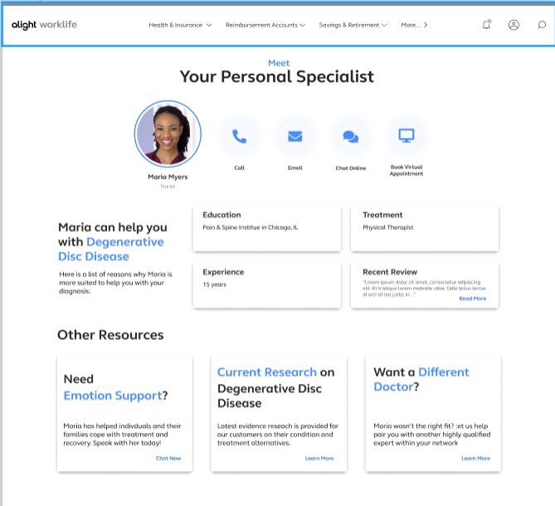
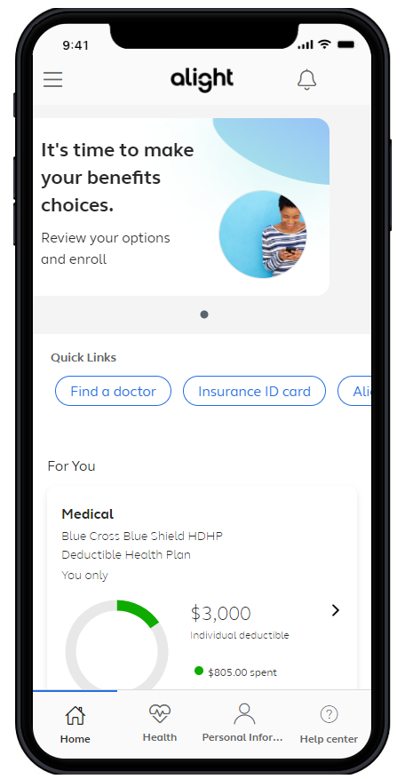
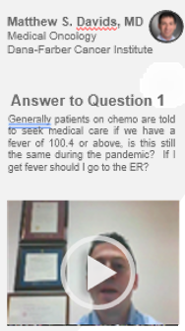
Alight – Healthcare Concierge
A connected experience – right time, right resource
Comprehensive Benefits Navigation
--General benefits questions --Provider recommendations -Procedure cost estimates -Program referrals | -Coordination of care -Prescription reviews -Bill reviews
Clinical & Surgery Decision Support
-Support for any health condition and treatment options -Curated content -Comprehensive clinical intake | -Physician conference calls -Pre-appointment prep -Emotional support for participants and caregivers
Expert Medical Opinions (EMO)
-Virtual second opinions with leading experts -Confirm a diagnosis and treatment options | -Multi-disciplinary consults for complex cases -Referrals to high-quality physicians for in-person care
Diagnosis
Doctor
Treatment
Facility
Coping

Slide 12





Additional Programs included with enrollment in either medical plan option
Telemedicine (Virtual Visits)
Mental Health Services available
Virtual Physical Therapy
Musculoskeletal Rehabilitation- relief in about 3 visits
Total Heart Health-
Blood Pressure Management
Cholesterol Management
Bundled billing for savings on nonemergency surgeries
Cancer Care
Weight Management Programs
Form Health
Digbi Health
Noom
Type 2 diabetes management program

Slide 13
Weight Management Programs
Zero cost to the member! Viewed as preventative services on both plans
Form Health
Work one-on-one with a dedicated care team who will develop a personalized science-based plan to address behavioral health, nutrition, physical activity and if needed medication.
Digbi Health
Personalized program that identifies each member’s unique biological triggers through at home testing. This data-driven approach allows Digbi to create a highly personalized treatment plan that addresses specific biological factors.
Noom
Psychology-based program that offers a holistic approach to healthy living. Addressing the “why” behind their habits and how to change them.

Slide 14
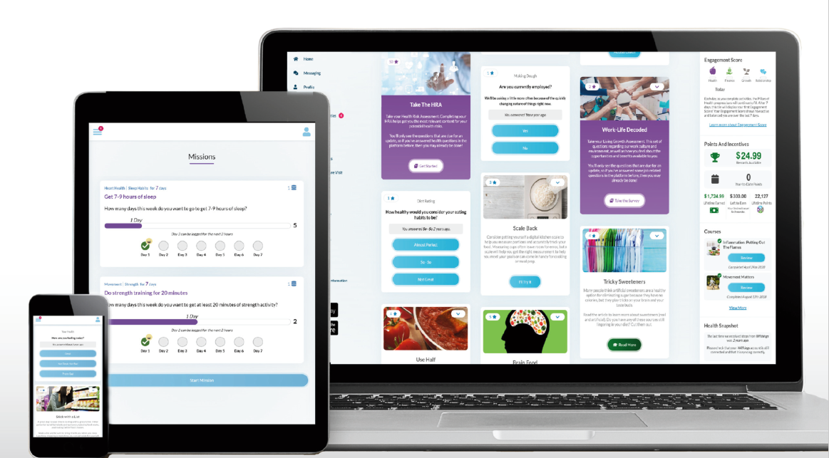
Wellness- Ramp Health
Premium Incentive Program
  Complete a Member Health Assessment (MHA)
  Complete Tobacco Affidavit or Alternative
  Obtain and submit biometric screening form
Deadline – August 31, 2025
Save up to $100/Month on Premium
Registration ID for Employees and Retirees:
Use your City Employee ID.
Registration ID for For Spouses on the Health Plan:
Use the Employee ID with an “S” at the end. Example: Employee John Smith, ID 123456;
Spouse Jane Smith, ID 123456S.
Purpose of the Program
Know your numbers
Have a relationship with a health care provider who knows you
Better ensure that gaps in care are addressed

Slide 15
Classes
Fit Camp
Lunch N Learns
Seminars/Webinars
Special Challenges & Events
Airrosti – Musculoskeletal
Healthy Challenge Stress Management
Right Step – Opioids in the Workplace
TIAA – Financial Wellness
Blood Drives
Total Body Blast
Health, Safety & Benefits (HSBF)
Heart Walk
Free Form Chiropractic
Lantern (formerly SurgeryPlus)
https://www.signupgenius.com/go/10C0F4DACAA2FA6FBC25-healthy3#/

Slide 16

Dental- MetLife
3 plan options: DPPO High, DPPO Low, DHMO
PPO Network: PDP Plus
DHMO Network: Dental HMO/Managed Care
Metlife.com/insurance/dental-insurance
No ID cards

Slide 17
Dental Plan Comparison
 | DPPO High Option | DPPO Low Option | Delta Care DHMO Option
Deductible | $50 per person $150 per family | $50 per person $150 per family | None
Annual Maximum | $2,250 per person | $1,250 per person | None
Preventive & Diagnostic Care | 100% Deductible Waived (4 Cleanings per year) | 100% Deductible Waived (4 Cleanings per year) | Fixed schedule of copays
Basic Restorative Care | Plan pays 80% After Deductible | Plan pays 50% After Deductible | Fixed schedule of copays. Specialist referral is REQUIRED
Major Restorative Care | Plan pays 50% After deductible | Plan pays 50% After Deductible
Orthodontia | Plan pays 50% Lifetime Maximum $1,500 | Plan pays 50% Lifetime Maximum $1,000
Implants | Plan Pays 50% After Deductible | Plan pays 50% After Deductible | Limited Coverage

Slide 18
2026 Dental Rates
Monthly (per paycheck)
 | DPPO High | DPPO Low | DHMO
Retiree Only | $33.60 | $22.62 | $11.50
Retiree + Spouse | $68.87 | $42.98 | $21.85
Retiree + Child(ren) | $89.04 | $49.78 | $23.00
Retiree + Family | $112.54 | $70.15 | $35.66

Slide 19


Vision- MetLife
2 plan options- High & Low
Network: Superior Vision
Metlife.com/insurance/vision-insurance
No ID cards

Slide 20
Vision Plan Comparison
 | High | Low
Exam (once every calendar year) | $0 copay | $0 copay
Standard Contact Lens Fit & Follow up | $10 copay | $10 copay
Contact Lenses Allowance | $150 | $125
Frames Allowance | $200 Every Calendar Year | $180 Every Other Calendar Year
Lenses – Single, Bifocal, Trifocal | $10 copay | $20 copay
Lenses – Progressive I, II, III, IV | $55, $110, $150, $225 copay | $55, $110, $150, $225 copay

Slide 21
2026 Vision Rates
Monthly (per paycheck)
 | High | Low
Retiree Only | $11.65 | $5.10
Retiree + Spouse | $22.11 | $9.68
Retiree + Child(ren) | $23.27 | $10.19
Retiree + Family | $34.20 | $14.97

Slide 22
Turning 65 in 2026?
If you are turning 65 and are eligible for Medicare (have earned your 40 credits), please call Social Security at 800-772-1213 or visit www.socialsecurity.gov three months prior to your birthday month to enroll in Part A & B. When you receive your card call 817-392-7782 or send a copy to benefits@fortworthtexas.gov to enroll in the City’s Medicare Advantage Plan.
If you turn 65 and will never be eligible for Medicare, please call 817-392-7782 to schedule a session to discuss your options.
If you do not enroll into Part B when you reach age 65, you will be charged a 10% penalty by Social Security for every 12 month period you did not enroll and your enrollment will be delayed until July 1. In order to be on the City’s Medicare Advantage Plan you must enroll in Medicare Part A and B
Notes:
Laurie
Your Health Assistants & Front Line Care Team have a huge impact on savings - by helping members understand how to use their benefits and coordinating needs. members receive more preventive services– immunizations, well visits for children and adults at their PCP, recommended screenings - All increase as a result of Health Assistants providing the exact education and resource each member needs, and always with a lens toward any clinical need that a nurse or BH specialist can support. . All while providing benefits education, claims support, logistics and more, for the whole family.
A 2015 study into Health Care Advocacy concluded that the most important principle to engaging consumers is supporting their ability understand and act on health information. Accolade is built on the principle of putting the member at the center of care, which is why the role of the Health Assistant is so broad & so vital
Your Accolade platform provides a comprehensive view of each member by first ingesting, then integrating data that typically is not brought together, to build member profiles. Accolade’s front line care team review data on conditions, medications the member is taking, self service provider searches to name a few. We view claims so we understand how the member is using healthcare. And all this data is refreshed on a nightly basis & up to date. We use this data in really smart ways – creating a series of triggers and alerts to draw the Health Assistant’s attention to a variety of opportunities to personalize interactions. Answering transactional questions and needs but with the ability to probe and assist further all for the purpose of creating a simpler healthcare experience for your members.

Slide 23
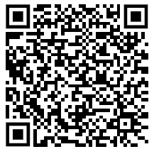
Health, Safety & Benefits Fair
Wednesday October 29th
9:00 AM – 2:00 PM
Will Rogers, 3401 W. Lancaster
Representatives from safety, health, local non-profits will be in attendance
Flu Shots will be available
Door prizes
Earn points towards Healthy Challenge Cash Payout
Online Enrollment Support
Register Here!

Slide 24


Go online to the
Open Enrollment page
On the city’s webpage you can
learn more about:
Plan Comparisons
Plan Design
Open Enrollment Meeting Dates
Healthcare Vendors
Frequently Asked Questions (FAQs)
https://www.fortworthtexas.gov/departments/hr/employees/openenrollment

Slide 25


Online Enrollment
At home
Enroll from any desktop or laptop: www.cfwbenefits.com
Online enrollment help available:
    Kiosk in HR Benefits Office:
    Monday -Friday 8:00 AM – 5:00 PM
Or at work
**ALL changes MUST be completed & submitted online by October 31st **

Slide 26
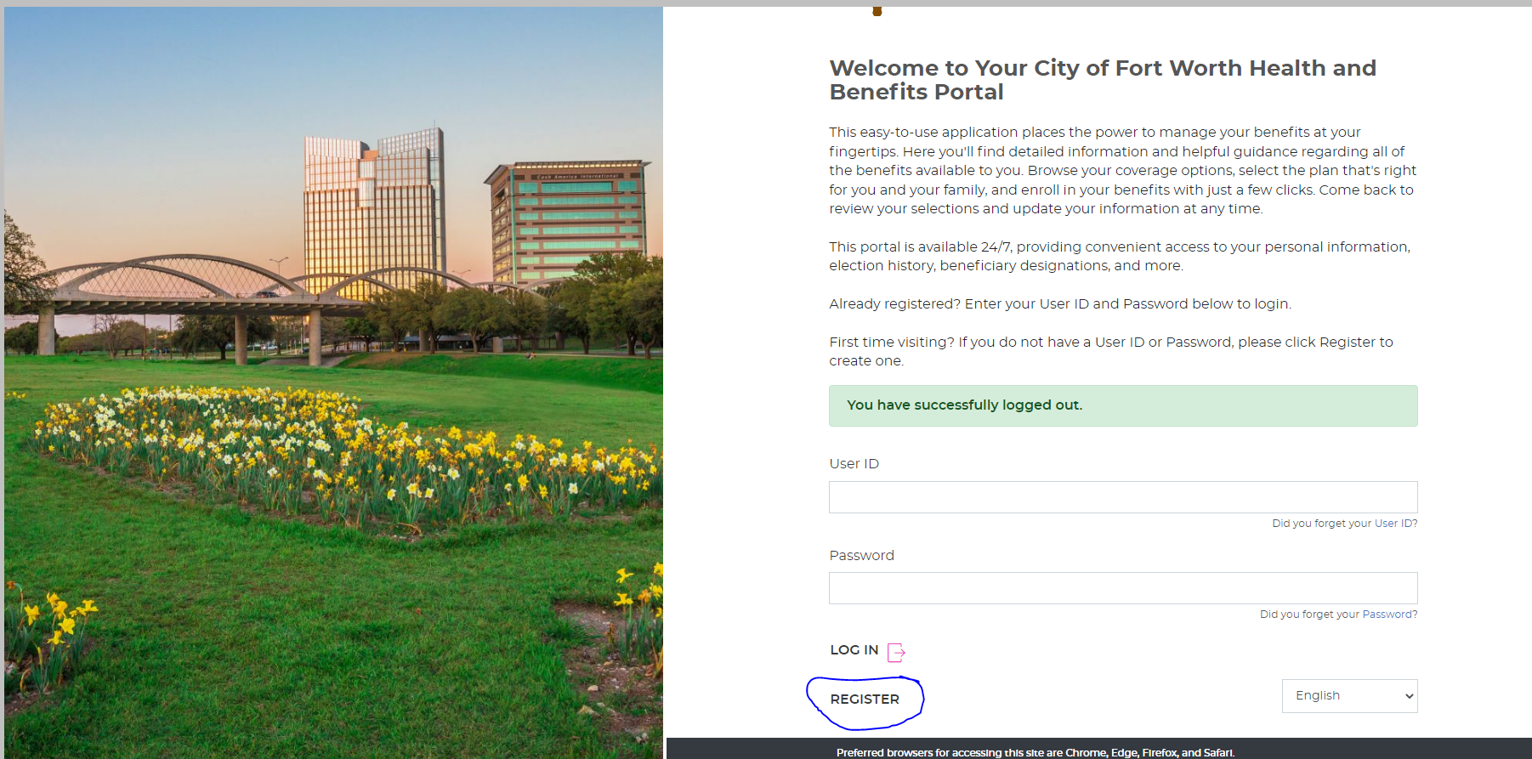
Member Portal Welcome Page

Slide 27
City of Fort Worth HR Benefits Office
100 Fort Worth Trail, Fort Worth, TX 76102
New City Hall- 15th floor
817-392-7782 phone
Alight at 866-307-8835
benefits@fortworthtexas.gov

