Slide 1
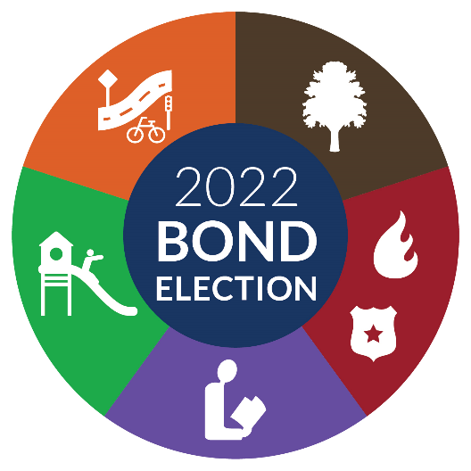

Slide 2

Presentation Overview
Program Goals
Program Strategy and Highlights
Project Selection Process
City Council approved Projects and Summary of Propositions
Bond Program Schedule

Slide 3
2022 Bond Program Goals
Maintain/Improve Existing Infrastructure and Address Equity
Provide Mobility & City Services in Growth Areas
Enhance Active Transportation and Recreational Corridors
Allow for Flexibility and Partnership Opportunities
Achieving Balance and Fiscal Stewardship

Slide 4
Program Strategy and Highlights
Strategy
Capital Delivery
  $29.8 million in advance funding to accelerate Capital Delivery through early design of transportation and park projects
Resources
  Reserve Debt Capacity for grant match opportunities, public-private partnerships, emergency repairs and renovations.
Program Highlights
$365,563,000 in 2022 Bond Funds, $71,660,000 of Tarrant County Bond funds, and $59,857,000 of other City funding sources, in total $497,808,000 for streets and mobility projects.
$121,525,000 in 2022 bond funds, $13,200,000 of partnership funds and $3,986,955 of other City funding sources, in total $138,711,955 for park and recreation improvements and natural area and open space conservation
No Tax Rate Increase
Notes:
Accelerate Capital Delivery – Funding separate from Bond Program
TPW - $10.4 from Future Improvement Agreements (FIA) and $18.5M Transportation Impact
Plans development to 60% for arterial projects under consideration
PARD - $900K
Design for proposed Forest Park Pool Replacement
MMAs
PARD (Non Vertical) $47,150,000
Facilities CC $29,072,000
Right of Way Acquisition Phase
Begin ROW acquisition at 30% design phase
Incorporate 2018 actual timelines for ROW acquisition into future schedules
Address ROW risk management in project selection criteria
Utility Relocation Phase
Begin utility coordination at 30% design phase
Incorporate utility relocation coordination and verification into consultant contracts
Current debt capacity - approximately $655M

Slide 5
Project Development
Data Collection and Analysis
Master Plans and Strategic Goals
Neighborhood Meetings
Development Activity
PROJECT
Boards and Commissions
City Council
Public Meetings
Waitlisted Projects from 2018 Bond Program
Service Demand
Notes:
Prioritization Criteria
Leverage Opportunities – Project has committed funds outside organizations or public agencies
Capital Replacement - Project replaces existing asset or facility that is beyond economic useful life with increasing risk of failure.
Project Collaboration - Project connects with existing or proposed projects, and/or will share resources with other departments.
Service Deficiencies – Project improves and/or increases the level of service provided to the City
Infrastructure - Project improves the City's existing infrastructure.
Project Consistent with Approved Master Plan or Strategic Goals
Federal, State, or other Legal Requirement - Project satisfies federal, state or local mandate, grant or court order, as well as contractual obligation.
Public Health and Safety - Project eliminates or prevents existing health, environmental, or safety concerns. (0 - 15 max pts)
Economic Development - Project stimulates significant job creation through business expansion, corporate relocation, or the development of walkable urban places
*Equity – Project located within, or adjacent to, and serves a Super Majority Minority Area. Does the project address and help reduce or eliminate racial and cultural disparities consistent with recommendations from the Fort Worth Task Force on Race and Culture?

Slide 6
Project Selection Process
Department Project Development
Projects developed and prioritized by departments with defined criteria using quantitative data and qualitative factors
Project Prioritization Committee
Committee reviewed department submissions and prioritized using general ranking criteria
Management Review and Input of Proposed Projects
CMO reviewed initial list of prioritized projects
City Council Review and Input
Public Meetings
Final Projects List Developed
Notes:
MMA Stats
(4) Arterials: Trinity Blvd; Cromwell Marine Creek, WJ Boaz, Keller Hicks, Meacham Blvd Phase 2 are located in an MMA or SMMA for a Proposed Bond funding of $36,465,000 and estimated total project cost of $106,900,000.
(1) Grade Separated Railroad Crossing: Everman Parkway from Rosedale Springs to Cameron Hills, proposed bond funding of $30M, estimated total project cost of $60M.
(9) Intersections: 3 projects, for approximately $7.2M in a SMMA; 6 projects for approximately $16M in a MMA.
(7) New Traffic Signals (Bucket): 5 projects identified in the SMMA, 2 projects identified in the MMA for an approximate value of $3M.
(110) Neighborhood Streets: All streets planned for design and construction in Year 1-3 are in the MMA or SMMA, for an approximate value of $58.3M and 47 total lane miles.
Total: $167,165,000 or 69% of total categories listed on Legend.
Citywide – MMAs represent 49% of total area (177 sq. mi.)

Slide 7
Public Input - Program Changes
Streets and Mobility Infrastructure Improvements - $45.5 million
Additional funding for arterials, neighborhood streets, and intersections
Park and Recreation Improvements – $8.1 million
Increased funding for Forest Park Pool replacement and Stop Six Aquatic facility
Increased funding for Botanic Gardens infrastructure improvements
Add Oak Grove Park development with partial funding reallocated from Sycamore Park development
Facilities - $3.6 million
Increased funding for land acquisition - Fire Stations 16 and 37
Notes:
Streets and Mobility-
Based on public input 5 arterial projects added to the original 9 proposed during the public engagement meetings last fall.
Since Tarrant County did not approve participation in the City’s intersection program as part of the bond program funding, the City increased funding to ensure no reduction in the number of planned intersection projects.

Slide 8
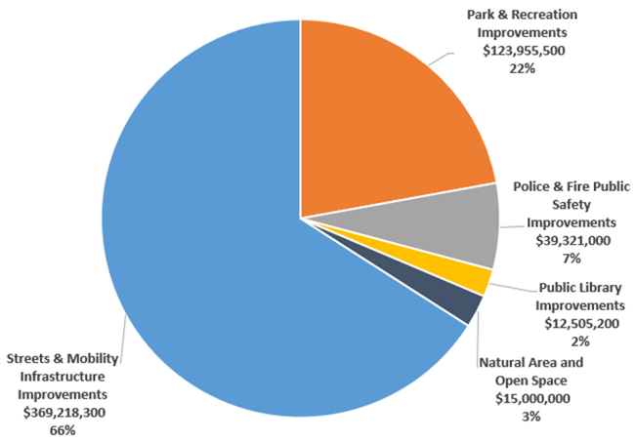
Projects Distribution by Proposition
Proposed $560,000,000
* Includes Public Art Funding – 1% for Streets & Pedestrian Mobility Infrastructure and 2% for all others except Open Space Conservation
Notes:
2/3 of the program is dedicated to Streets and Mobility improvements.

Slide 9
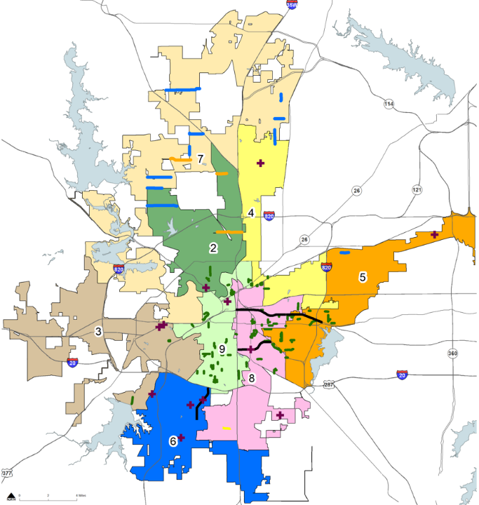
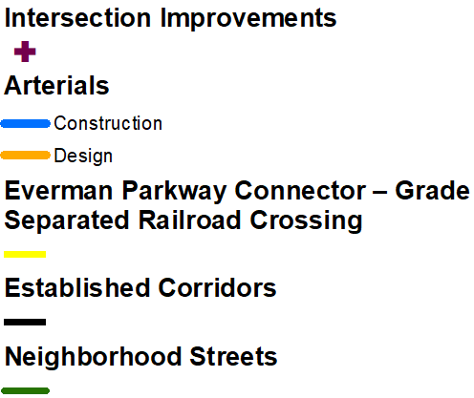
Fort Worth Proposition A
Streets and Mobility Infrastructure Improvements - $369,218,300*
*Includes 1% public art funding
Notes:
EQUITY
Arterials: Trinity Blvd; Cromwell Marine Creek, WJ Boaz, Keller Hicks, Meacham Blvd Phase 2 are located in an MMA or SMMA for a Proposed Bond funding of $36,465,000 and estimated total project cost of $106,900,000.
Grade Separated Railroad Crossing: Everman Parkway from Rosedale Springs to Cameron Hills, proposed bond funding of $30M, estimated total project cost of $60M.
Intersections: 3 projects, for approximately $7.2M in a SMMA; 6 projects for approximately $16M in a MMA.
New Traffic Signals (Bucket): 5 projects identified in the SMMA, 2 projects identified in the MMA for an approximate value of $3M.
Neighborhood Streets: All streets planned for design and construction in Year 1-3 are in the MMA or SMMA, for an approximate value of $58.3M and 37 total lane miles. Year 4 streets, 23 out of the 28 streets recommended for design only are in the MMA or SMMA for an approximate value of $2.2M and 9.5 lane miles.

Slide 10
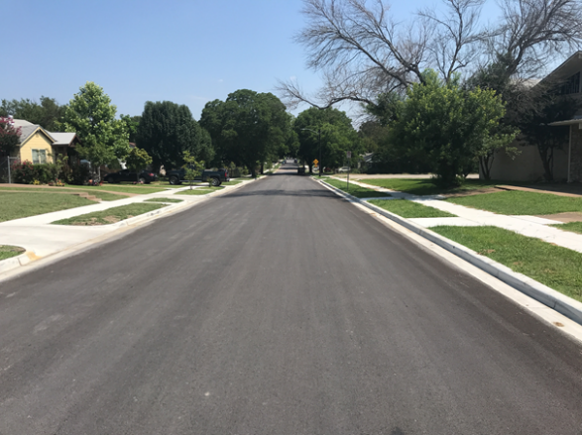
Streets and Mobility
Added Network Capacity
Arterials
Intersections
Sidewalks/Bicycle Facilities
Safety Improvements
Neighborhood/School Safety
High Injury Network Focus – Vision Zero Program
Bridges
Streetlights
Maintain/Improve Network
Established Corridors
Traffic Signals
Neighborhood Streets Rehabilitation

Slide 11
Fort Worth Proposition A
Streets and Mobility Infrastructure Improvements

Slide 12
Arterials – Added Capacity
Added Arterials
Notes:
Wagley Robertson - $4.5M of TOD (Transit Oriented Development) funds from 2014 Bond to be reprogrammed to support the project.
Bailey Boswell Road– FM156 to Horseman Road – we will also seek federal funds for construction.
Recently passed Bipartisan Infrastructure Bill would likely go toward regional projects. Potentially, Heritage Trace Bridge project.
2018 Bond Funds used for:
Avondale Haslet Road
Cromwell Marine Creek Blvd
Originally funded in 2018 was programmed for intersection only improvements to increase capacity. With Tarrant County funds and 2022 Bond funds, we can widen and improve the entire segment to the MTP.
TrIF Funds programmed for ten(10) arterials
Cromwell Marine Creek – $3.0M
Bailey Boswell – FM156 to Horseman- $2M
Ray While Road South - $500K
Meacham - $1M
Keller Hicks Road - $500K
Bonds Ranch - $2.5M
Trinity Blvd - $1.3M
Park Vista – $1.2M
WJ Boaz - $4M
Heritage Trace- $1M

Slide 13
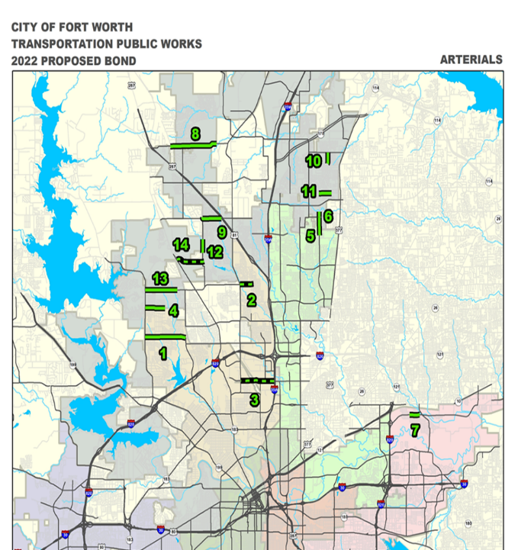
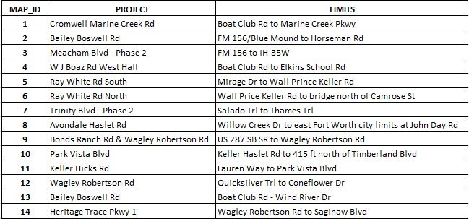
Arterials

Slide 14
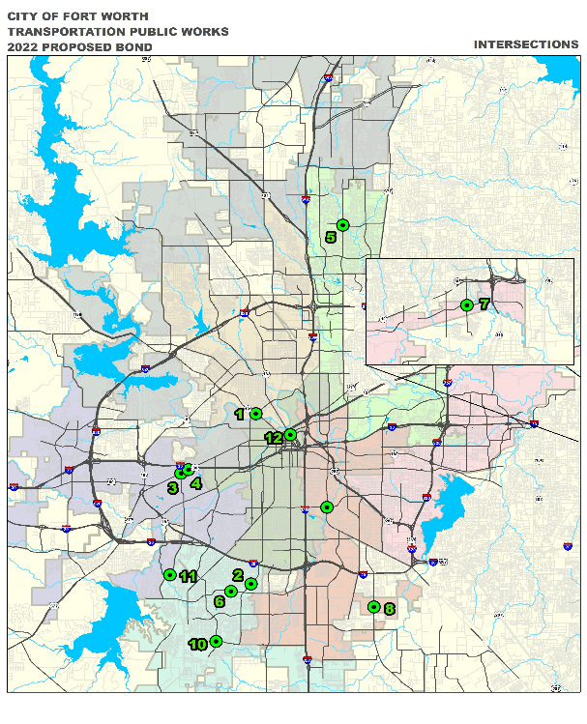
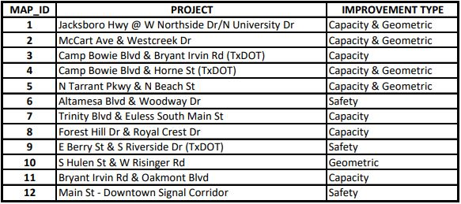
Intersections

Slide 15
Established Corridors Supporting Transit
Notes:
$10M available for local match opportunities to support transit.

Slide 16
Safety/Mobility
Vision Zero Program – High Injury Network
$5,000,000 for the installation of multi-model transportation improvement projects that reduce traffic- related fatalities and severe injuries.
All modes – vehicle, pedestrian, and bicycle
From 2015 to 2019:
25% (772) of the City’s traffic fatalities and serious injuries (3,126) occurred on only 3.2% of the City’s roadway network.
79% of High Injury Network (HIN) fall within or are adjacent to Super Majority Minority Areas (SMMA).
100% of pedestrian (47) and bicycle (2) fatalities occurred within a SMMA.
Notes:
The projects in this category will specifically address the High Injury Network corridors. It will consist of a comprehensive approach that may include components from various categories, such as a project that includes sidewalks, crosswalk and ADA modifications, access management, new streetlights, pavement markings, signs and minor geometric improvements, etc. The goal is to do a quick build project through this program.
Pedestrian and Bicycle treatments:
Improve pedestrian crossing by installing new crosswalks, ADA curb ramps, and installing Rapid Rectangular Rapid Flashing Beacon (RRFB) at specific locations
Mid-block pedestrian crossing with RRFB
Curb extensions to reduce pedestrian crossing distance and to reduce right-turning vehicle speed
Address sidewalk gaps
Review bus stops and recommends improvements
All modes treatments
Refresh Pavement markings in the corridor
Replace and install new signs in the corridor
Install street lights as needed to improve visibility at the night
Improve access management by restricting a particular movement either by signage or by delineators

Slide 17
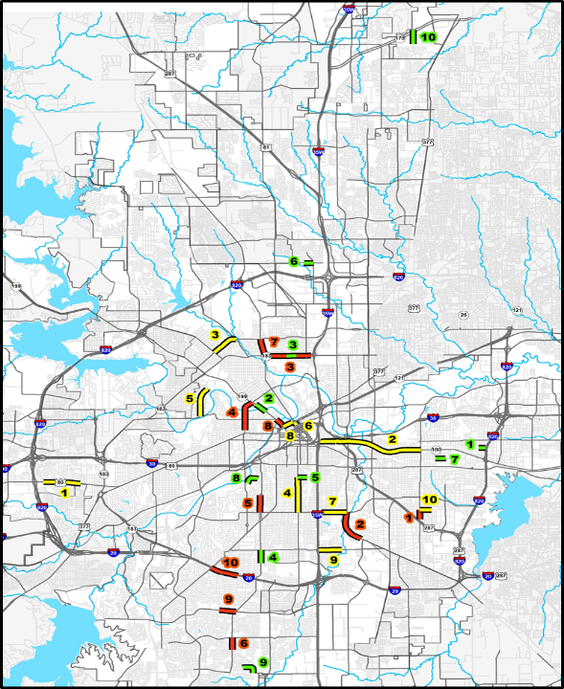
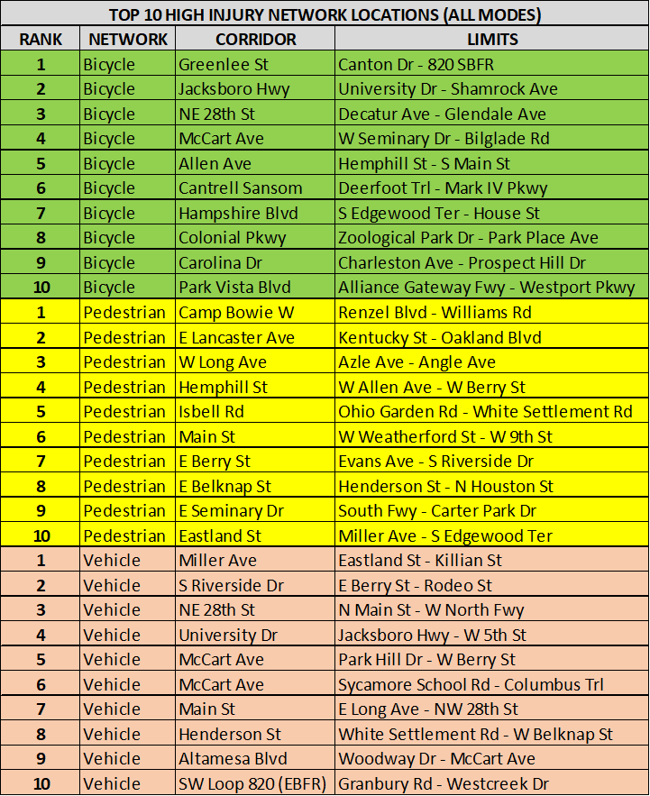
High Injury Network - Locations
Notes:
We’re currently working with a consultant to evaluate the Top 10 corridors for each mode and will determine the scope and cost of potential projects. We will then select projects up to the $5m proposed Bond allocation.
Project types:
Crossing beacons
Geometric realignment at intersection
Altamesa Blvd & Woodway
McCart Sycamore

Slide 18
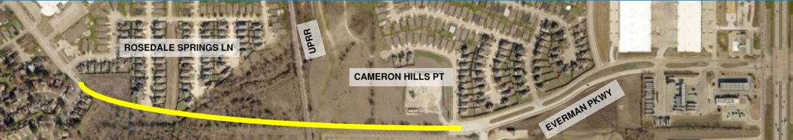

Everman Parkway Connector - Grade Separated Railroad Crossing Rosedale Springs to Cameron Hills Point
Design and construction of 4-lane divided thoroughfare
New east – west road segment linking Everman to IH-35
New bridge at Union Pacific Railroad and Sycamore Creek
Notes:
The Everman Pkwy Connector Is a new east west road segment linking Everman to I-35, potentially taking traffic off Sycamore School Rd
There is existing industrial at the east end, access to this property would allow for potential economic development opportunities in CD8.
The project grade separated crossing would go over Sycamore Creek and Union Pacific Railroad.
Leverages $15,350,000 of Tarrant County Bond funds.

Slide 19
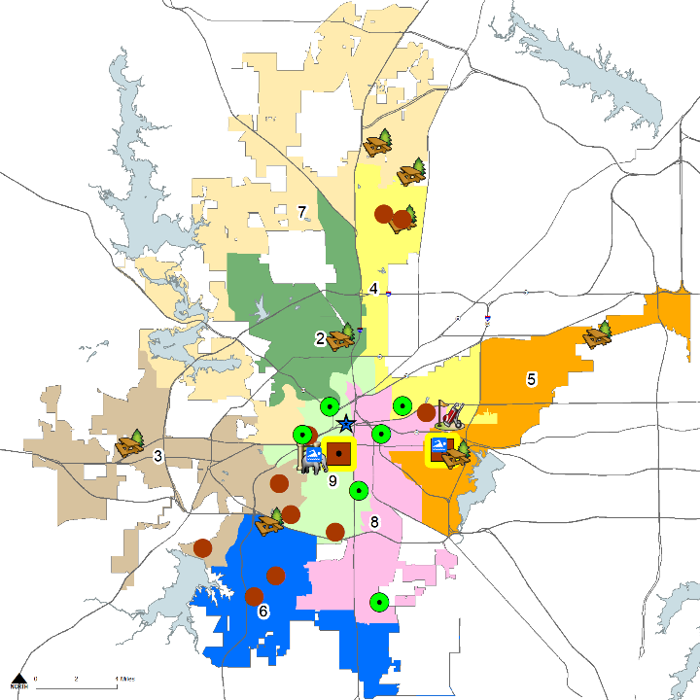
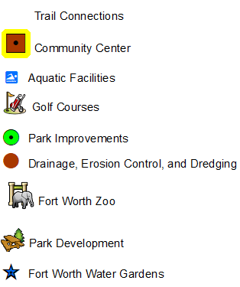

Fort Worth Proposition B
Park and Recreation Improvements $123,955,500 *
*Includes 2% public art funding
Notes:
.

Slide 20
Fort Worth Proposition B
Park and Recreation Improvements
Other Funds – Include park dedication fees, gas well revenue, and 2014 Bond funds
Notes:
Equity
Neighborhood Parks – 3 of 8 located in MMA or SMMA
Community Centers – Stop Six Hub and Aquatic Facility in SMMA
Drainage, Dredging, and Dam Repair 6 of 13
*26 of the 35 park projects are located within the MMAs (8), SMMAs (18) Includes Stop Six Hub and Fire Station Community Centers

Slide 21
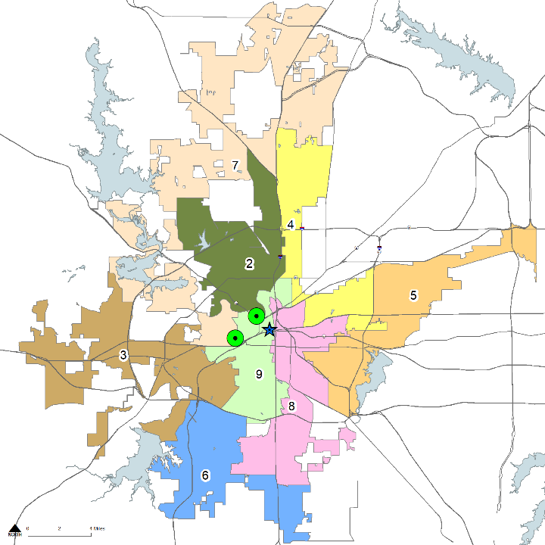
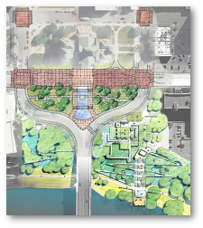
Park and Recreation
Botanic Garden Infrastructure
Improvements – $7,000,000
Development of new facilities; and restoration,
renovation and replacement of existing facilities.
Heritage and Paddock Parks Renovation and Site Improvements
Heritage and Paddock Parks Renovation and Site Improvements – $13,500,000
Design and construction of improvements to Heritage and Paddock Parks, and associated streetscape to improve pedestrian and vehicular safety.
Fort Worth Water Gardens – $6,500,000
Renovation and replacement of degrading infrastructure, which include pump and pipes, paving, lighting, and electrical system.
Fort Worth Water Gardens
Fort Worth Botanic Garden Infrastructure Improvements
Notes:
Heritage Park - $1.5M from 2014 Bond Program and $8.3M from NCTCOG, Foundations, individuals, and other entities in addition to 2022 Bond funds of $13.5M.
Fundraising Partners
Private Funds to be raised - $6M
Tarrant County - $1M
Texas Parks and Wildlife - $1M
Total Construction Cost - $23.3M
Renovation of the historic Heritage Plaza
Realignment of Main Street in order to expand the park space and improve pedestrian interface with Main Street.
Botanic Gardens -Letter received from BRIT requesting the City increase the 2022 Bond funding for the Garden from 4.6M to $7M. Increase request resulting from est. const. cost increases related to greenhouse, Teaching Gardens, Japanese Garden, Utility and Infrastructure Repair, Children’s Garden. $3,575,000 contribution from the BRIT
Fort Worth Water Gardens – constructed in 1971, limited renovations over of the years.
April 25, 2019 Freeze and Nichols Report- Highlighted several areas in need of repair and replacement Bald Cypress roots at quiet pool have compromised the plumbing for the Quiet pool, water loss, filtration system and drains have been taken over by tree roots. There is no compromise to the health, safety and welfare of park visitors.

Slide 22
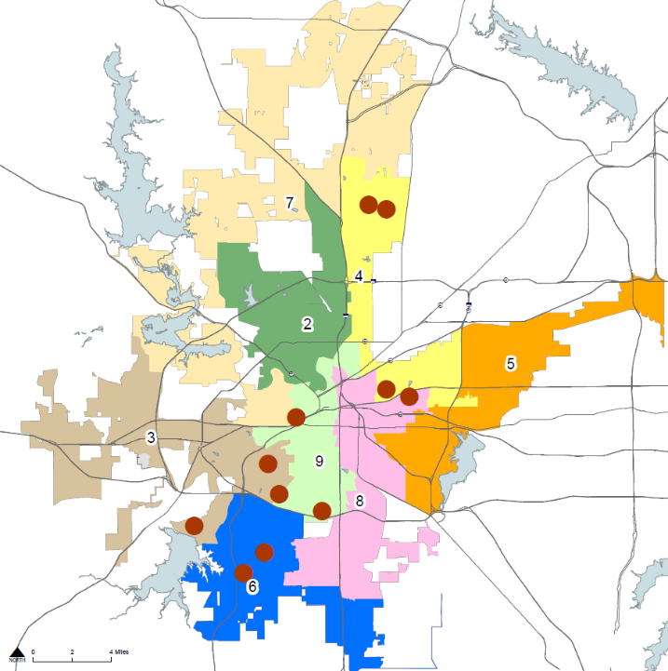
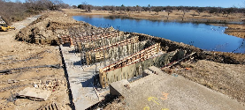
Park and Recreation
Arcadia Park
Coventry Hills Park
Drainage and Erosion Control, and Pond Dredging Projects – $7,150,000
Design and construction of drainage improvements to address erosion, dam restoration, and streambank failures, as well as, dredging of ponds and lakes to increase storm water holding capacity and improve habitat quality for aquatic life.
Gateway Park
Trinity Park
Oakland Lake Park
Overton Park
Foster Park
Pecan Valley Park
Greenbriar Park
C.P. Hadley Park
Candleridge Park /French Lake Dam

Slide 23
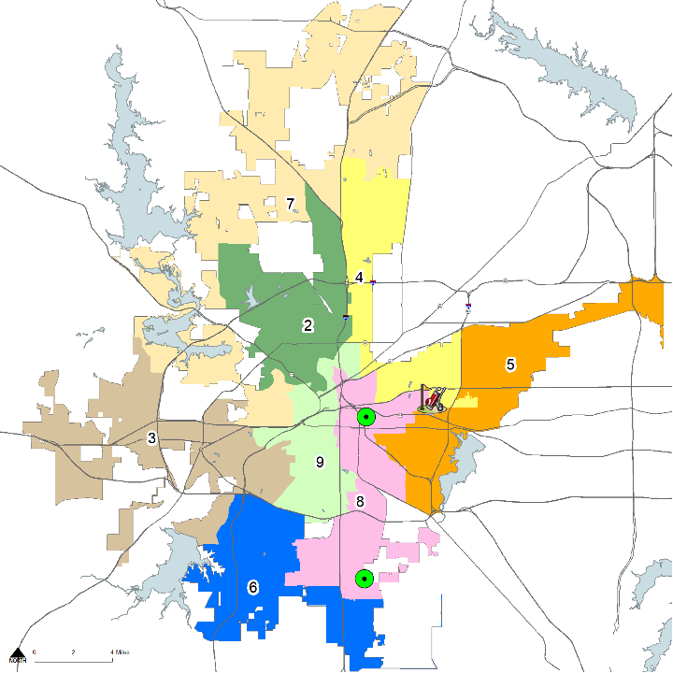
Park and Recreation
Meadowbrook Golf Course Renovation - $7,000,000
Design and construction of improvements to upgrade course playability which may include reconfiguring tees, fairways, greens, irrigation, cart trails and other golf course amenities.
Sycamore Park Improvements - $2,000,000
Design and construction of master planned park
improvements including trails, picnic facilities, security lighting,
and supporting infrastructure and equipment.
Oak Grove Park Improvements - $3,000,000
Master Planning, design and construction of park amenities
that may include, but not limited to, playgrounds, picnic
shelters and site furnishings, walking trails, security lighting,
and supporting Infrastructure.
Meadowbrook Golf Course Renovation
Sycamore Park Improvements
Oak Grove Park Improvements
Notes:
Sycamore Park Improvements:
66 acres (former golf course) north of Vickery and east of US 287
Implementation of Park Master Plan - endorsed by Park Board in February 2020. Demo of existing clubhouse, pedestrian bridge renovations, trail connection along Sycamore creek and construct iconic overlook pavilion. In addition to $2M of bond funds, the City is allocating $2M from Gas Well Lease Revenue – Bringing total project funding to $4M.
Oak Grove Community Park – 67 acres of park land acquired in 2015 from PlainsCapital Bank. Located at the northeast corner of Shelby Road and Oak Grove Road. CD 8 Added after public and City Council input. $3M reallocated to project from Sycamore Park development which was initially $5M. In addition to $3M of bond funds, Park Dedication fees in the amount of $486,955 will be allocated for this project – Bringing total project funding to $3,486,955.

Slide 24
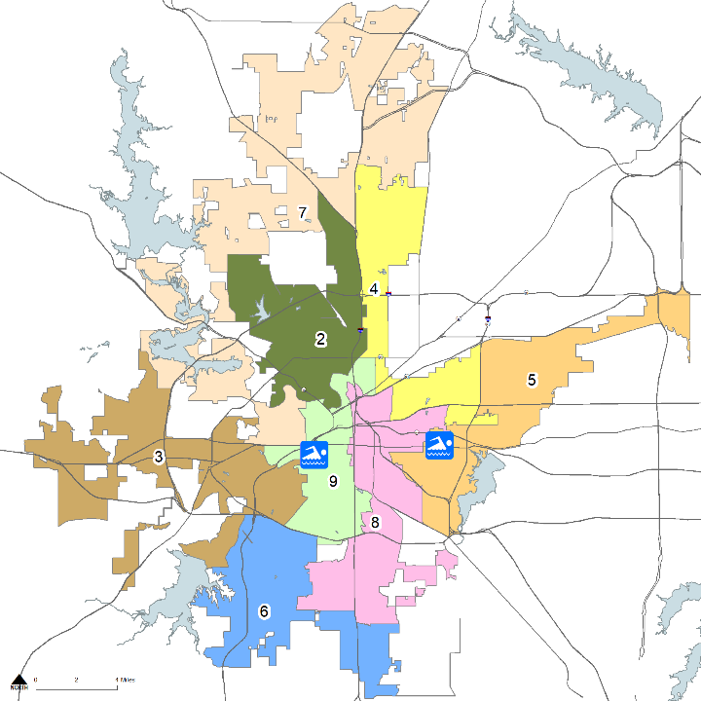
Park and Recreation
Stop Six Aquatic Facility - $8,200,000
Design and construction of outdoor aquatic and associated amenities, including, but not limited to eight (8) lane, twenty-five (25) yard lap pool, interactive water play area with large water slide and supporting infrastructure adjacent to proposed Stop Six Hub Community Center.
Stop Six Aquatic Facility
Forest Park Pool Replacement – $11,000,000
Demolition of existing facilities, design and construction of new aquatic and associated amenities, including, but not limited to eight (8) lane, fifty (50) meter lap pool, interactive water play elements with large water slide, changing rooms, renovation and expansion of parking area and associated infrastructure.
Forest Park Pool Replacement
Notes:
$900K in advance design funding approved for Forest Park pool replacement (2850 Park Place Ave)
. Citywide deficiency of 2 facilities
Location at Stop 6 HUB
Department’s second priority after Forest Park.
How often has the pool been unusable or closed for repairs? We have had to shut it down for equipment failure over last few years.
Forest Park Swimming Pool was originally built in 1922, as a fill and drain pool, without a filtration system. A major renovation took place in 1967 which reconfigured the pool to its current shape, added a new bathhouse, new piping and a filtration system. Another renovation completed in 1992 consisted of the reconstruction of the pool resulting in the addition of a zero depth entry, PVC liner, vacuum sand filtration system, and stainless steel gutters.
Subsequent to public input - Increase lap lane portion of pool from 4 to 8 lanes, 50 meters in length- with active play elements, including zero depth entry, tube slide
In July 2010, the City was forced to close the pool due to the failure of the 18 year old pool liner that was installed in 1992
Attendance 20,464 in 2019
Summer Music Series 2019
Arctic Dip 2020
Hosted 162 swim team practices 2019
Hosts swim lessons and drowning prevention events

Slide 25
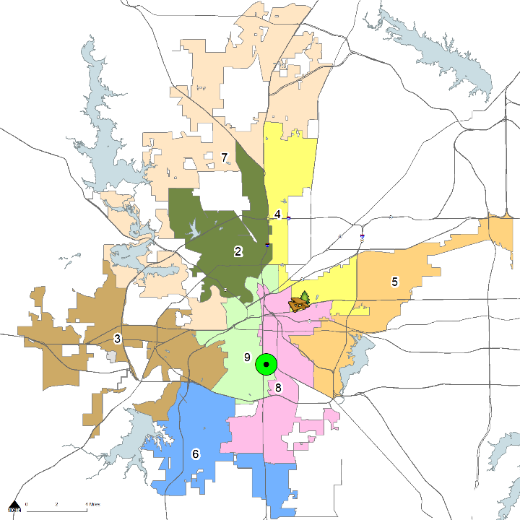
Park and Recreation
Echo Lake Park Improvements - $5,000,000
Master planning, design, and construction of park amenities, including, but not limited to playgrounds, picnic shelters, site furnishings, walking trails security lighting and athletic fields.
Gateway Park
Gateway Park Development - $8,000,000
Master plan update, design and construction of park amenities, including, but not limited to athletic fields, trails, skate park, parking lots, security lighting and supporting infrastructure and equipment.
Echo Lake Park
Notes:
Echo Lake Park
The City received the property (approx. 41 acres) from Tarrant County on 5/10/2017.
The property sits adjacent to Worth Heights Community Center. Tarrant County conveyed the property the CC sits in 1975.
Demolition and replacement of existing facilities required. Not ADA approved, poor condition.
Gateway Park Development – Master plan update of park – needs assessment for athletic fields. Focus is east of Beach Street.
785 acres
Master Plan development including athletic fields, trails and other recreational facilities

Slide 26
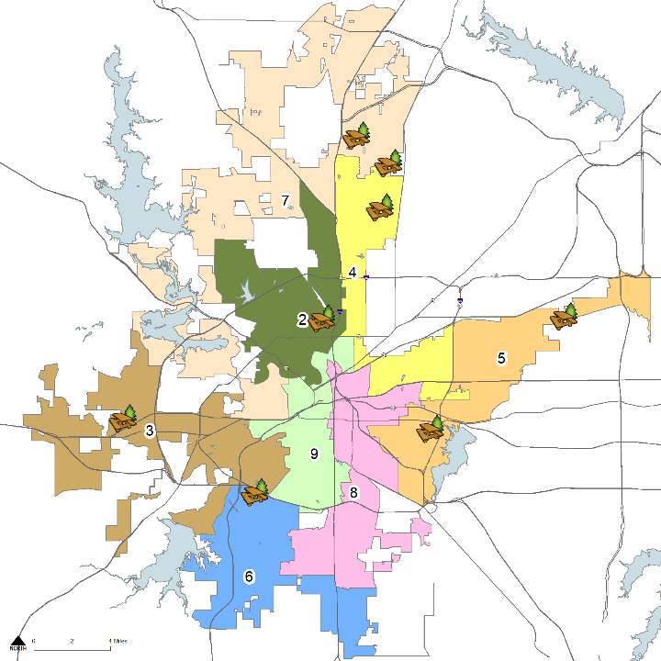
Park and Recreation
Timberland Park
Kingsridge Park
Coventry Hills Park
Neighborhood Park Improvements – $5,500,000
Master planning, design and construction of park amenities associated with eight (8) neighborhood parks that may include playgrounds, picnic shelters, walking/biking trails, security lighting and practice fields.
Chuck Silcox Park
Lebow Park
Mosier Valley Park
Martin Luther King Park
Westhaven Park
Notes:
Master Plan development and improvements to approximately 81 acres of neighborhood parkland
Westhaven Park (CD 6) was acquired on 4/24/2020 from the YMCA. 4.6 Acres Formerly Van Zandt YMCA

Slide 27
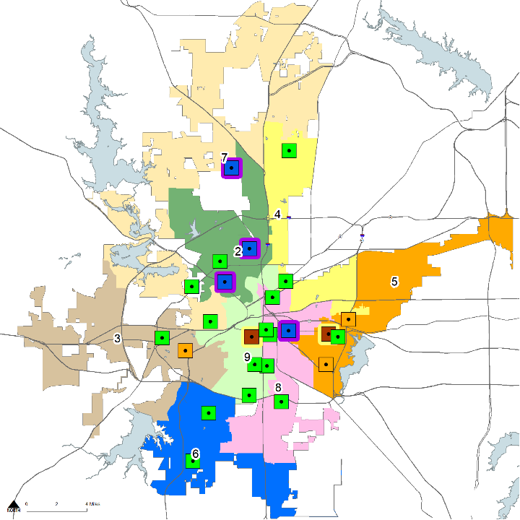

Park and Recreation
Planned Northwest Community Center
(2018 Bond)
Northside CC Renovation (2018 Bond)
Stop Six Hub Community Center – $17,500,000
Design and construction of new 28,000 SF community center to replace existing Martin Luther King, Jr. Community Center. Community center will include library, gym, and programmed space for social service providers.
Sycamore CC Renovation
(2018 Bond)
Diamond Hill CC Replacement (2018 Bond)
Como Community Center
(2014 Bond)
Fire Station Community Center
Replacement - $11,575,000
Design and construction of approximately 20,000 SF of facility improvements, including gym, and renovation of 1920’s historical fire station.
Fire Station Community Center
Stop Six Hub Community Center
2014 Bond Program Projects
2018 Bond Program Projects
Existing Community Centers
Notes:
The Stop Six Choice Neighborhood Initiative includes modern, multi-family, mixed-income design, community resources, public amenities and neighborhood services. Visitors at the EnVision center can get information on federal programs and issues they’re facing, from social security to affordable housing. So rather than visiting or calling different agencies, the EnVision Center consolidates all the services at one place. Programmed areas to accommodate the HUD approved Envision Center, public library, Community Action Partners, counseling services, etc. To be located on approximately 5 acres across from Rosedale Park. A new Enhanced Family Aquatics facility will be located adjacent to the new CC. Fort Worth is home to only 17 Envision Centers nationwide which helps to serve economically disadvantaged individuals, families and the elderly, at the community center. . Programs will include an expanded EnVision Center, a YMCA, a Head Start Center, a public library, family case management services and a host of other programs aligned to resident needs
Existing MLK is 23,500 SF built in 1973 located at 5565 Truman
Fire Station Community Center – faces significant incurable functional obsolescence as the 2nd floor is unusable for programming. Facility suffers from poor sight lines within the facility and inaccessible areas. An additional $3M from park dedication fees will be used to masterplan and develop the previously acquired adjoining acreage. Based on a 2017 evaluation of 11 Community Centers, this facility ranked #2 on the replacement list. The #1 facility, Diamond Hill CC, is scheduled for replacement with use of 2018 Bond Funds.

Slide 28
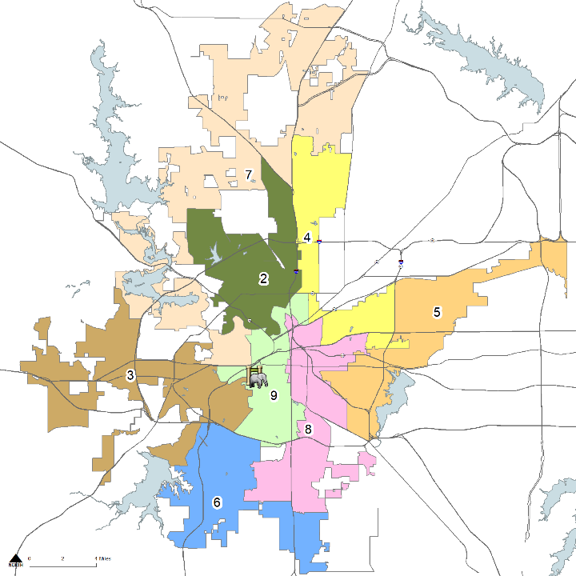

Park and Recreation
Fort Worth Zoo - $3,500,000
Design and construction of utility infrastructure to support new zoo facilities.
Trail Gap Connections - $5,500,000
Design and construction of trails citywide to address gaps between trail sections within the trail system, including locations where city funds can be leveraged through grants and partnerships with other organizations and agencies to create expanded recreational and accessible trail opportunities.
Sycamore Creek Trail
Bomber Spur Phase 1
Mistletoe Bridge to Forest Park
Notes:
Trail Gap Connections will focus on gaps identified in the Park & Recreation Department’s Trail Gap Study completed in April 2019. Use Trail Gap Funding to
leverage Federal or NCTCOG Funding. – Bomber Spur Trail- $4.9M.
The $5.5M would cover three trail projects: The $1M local match requirement on Bomber Spur Phase 1 (Calmont to Camp Bowie Blvd), Sycamore Creek Trail connection and the Mistletoe Bridge to Forest Park Trail connection. We will continue to pursue federal funding throughNCTCOG and partnerships with TRWD, Tarrant County and Streams and Valleys on all of these projects in order to maximize the amount of trail we can build.

Slide 29
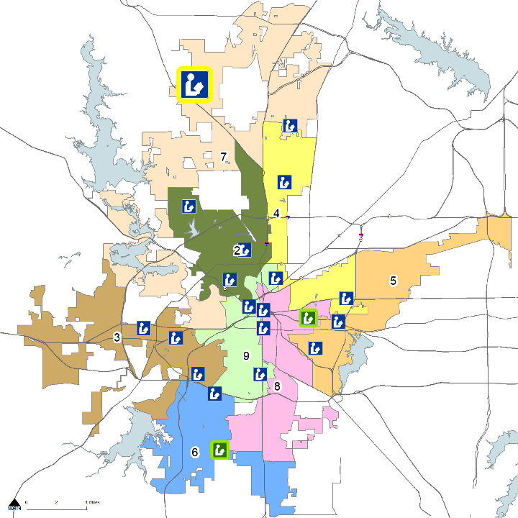
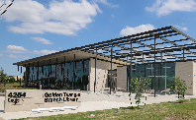

Fort Worth Proposition C
Public Library Improvements -
$12,505,200*
Proposed Far Northwest Library
Golden Triangle Library (2014 Bond)
Far Northwest Library – $12,260,000
Land acquisition, design, and construction
of approximately 18,000 SF Library
facility in far northwest Fort Worth.
Reby Cary Youth Library (2014 Bond)
Far South Library (2018 Bond)
Existing Library Locations
*Includes 2% public art
Notes:
High growth rate – Total population within 3 mile radius 19,050 as of April 2021. Population added since 2016 - 8,745. In 2020, the year of a pandemic, added 3,260 residents.
According to 2020 census, northwest FTW grew by 76%.

Slide 30



Fort Worth Proposition D Police and Fire Public Safety Improvements - $39,221,000*
*Includes 2% public art funding

Slide 31

Fort Worth Proposition D
Police and Fire Public Safety Improvements -
Station #37 Replacement
Police Northwest Patrol Division
Fire Station #37 Replacement – $9,500,000
Land acquisition, design, and construction of 3 Bay, double-company fire station to replace existing temporary station.
Station #16 Replacement
Fire Station #16 Replacement – $10,450,000
Land acquisition, design, and construction of 3-Bay, double-company fire station to replace existing station.
Police Northwest Patrol Division – $18,600,000
Design and construction of approximately 32,000 SF facility to consolidate operations and eliminate lease expenses.
Notes:
Fire Station 37 – 4721 Ray White Road – 5,190 SF constructed in 1998 as a temporary fire station in a modular building. Funding included to relocate the station. 3 bay- double company station. Station is half the size of FS we build today.
Fire Station 16 – 5933 Geddes - Our 7th busiest station – 4,640 calls (2020) constructed in 1964 (57 years old), is 5,010 SF versus, 10,000 SF for new stations. Current configuration does not accommodate female firefighters, nor is it adequately sized for a double company station. The height of the apparatus bays will not accommodate current fire apparatus. Suspension must be lowered on reserve apparatus to fit into bay doors. Captain’s office and living quarters are located in the apparatus bay. 2 urinals and 2 showers. Cramped conditions.
NW Patrol Division –– Construct Approx. 32K SF Facility – Move from N. Main leased facility at Airport, Hemphill personnel, and stockyards to 60 acre tract of land located at 3900 Angle Ave recently purchased by the City in 2021. Balance of property to be used to relocate Auto Pound Vehicle Storage facility from Brennen Ave. 5,300 SF facility for 25+ people, employee visitor/wrecker parking area and 4,800 Sf building for secure bays for crime scene evidence processing. 40 acres of vehicle storage. Reduces PD’s annual lease expense of $151K.

Slide 32
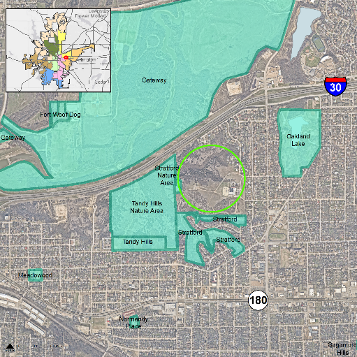
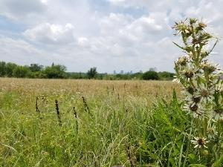
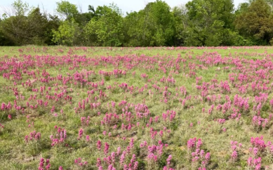
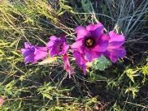
Fort Worth Proposition E
Natural Area and Open Space
Gateway
Oakland Lake
Acquisition and improvements of land citywide to enhance air and water quality, facilitate other environmental benefits, control erosion, mitigate flooding concerns, provide passive recreational opportunities, and facilitate future economic development - $15,000,000
Tandy Hills Nature Area
Tandy Hills
Stratford
Broadcast Hill
June 2020 - First open space acquisition
~50 acres of native prairie
Notes:
49 acres a vacant land is being developed each day in Fort Worth. The program is intended to preserve natural areas which helps enhance air and water quality, control erosion, mitigate flood concerns, passive recreational spaces.

Slide 33
Summary of Propositions
 |  | Funding Amount
Streets and Mobility Infrastructure | Fort Worth Proposition A | $369,218,300
Parks and Recreation Improvements | Fort Worth Proposition B | $123,955,500
Public Library Improvements | Fort Worth Proposition C | $12,505,200
Police and Fire Public Safety Improvements | Fort Worth Proposition D | $39,321,000
Natural Area and Open Space | Fort Worth Proposition E | $15,000,000
 | Total | $560,000,000

Slide 34
2022 Bond Program Schedule
March – May 2022 – Public information meetings
April 25, 2022 – Early voting begins
May 7, 2022 – Election Day

Slide 35
Questions
For more information visit: www.fortworthtexas.gov/departments/planning-data-analytics/budget/2022bond

