Slide 1
Community Meeting for Sidewalk Improvements for Cleckler Avenue From E Belknap Street to Clary Avenue Council District: 11 CPN: 104759
Project Manager: Chad Allen
Project Engineers: CRIADO and Associates
April 15, 2024

Slide 2
Agenda
Project Background and Location Map
Project Schedule
Frequently Asked Questions
Project Contact Information

Slide 3
Project Background
Objectives include:
Improve pedestrian mobility, connectivity, and safety by constructing sidewalks, and ADA compliant pedestrian curb ramps on the east and west side of Cleckler Avenue between E Belknap Street and Clary Avenue.
Project improvements will provide safe access too surrounding schools and park.
Project funded by 2022 Bond Program funds

Slide 4
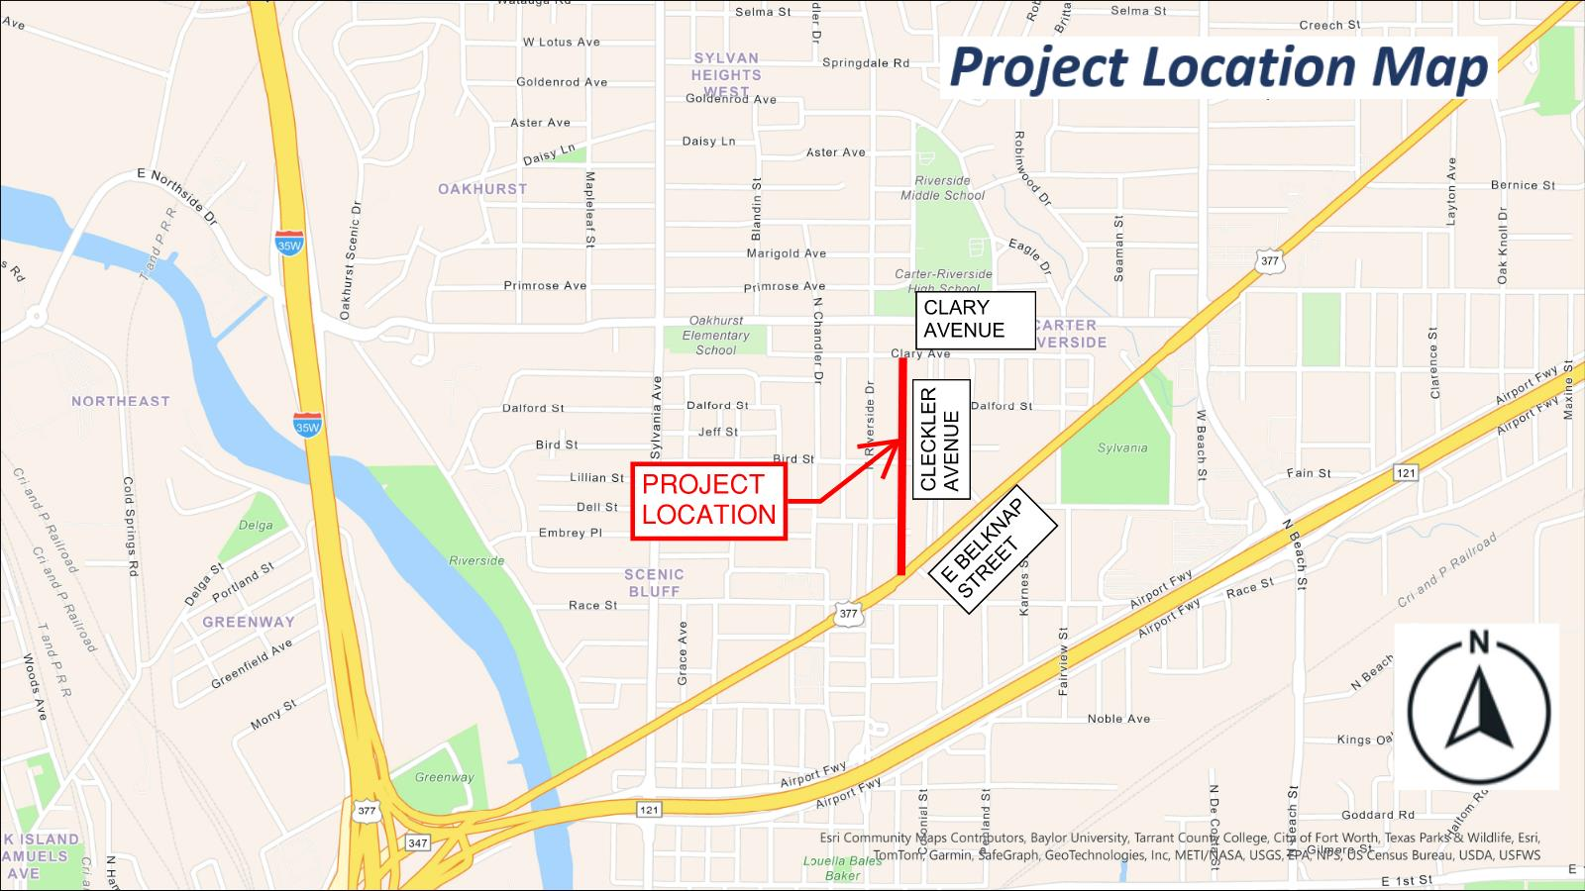

Slide 5
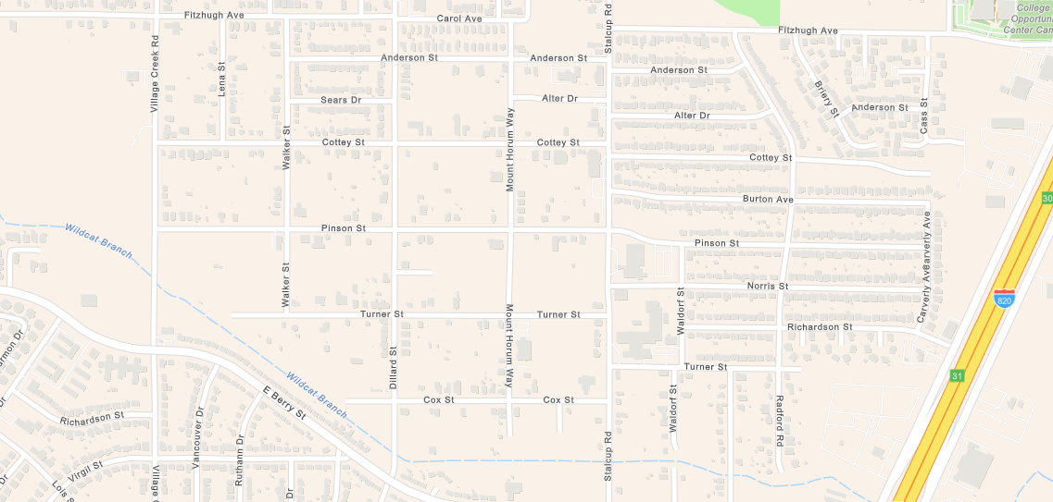
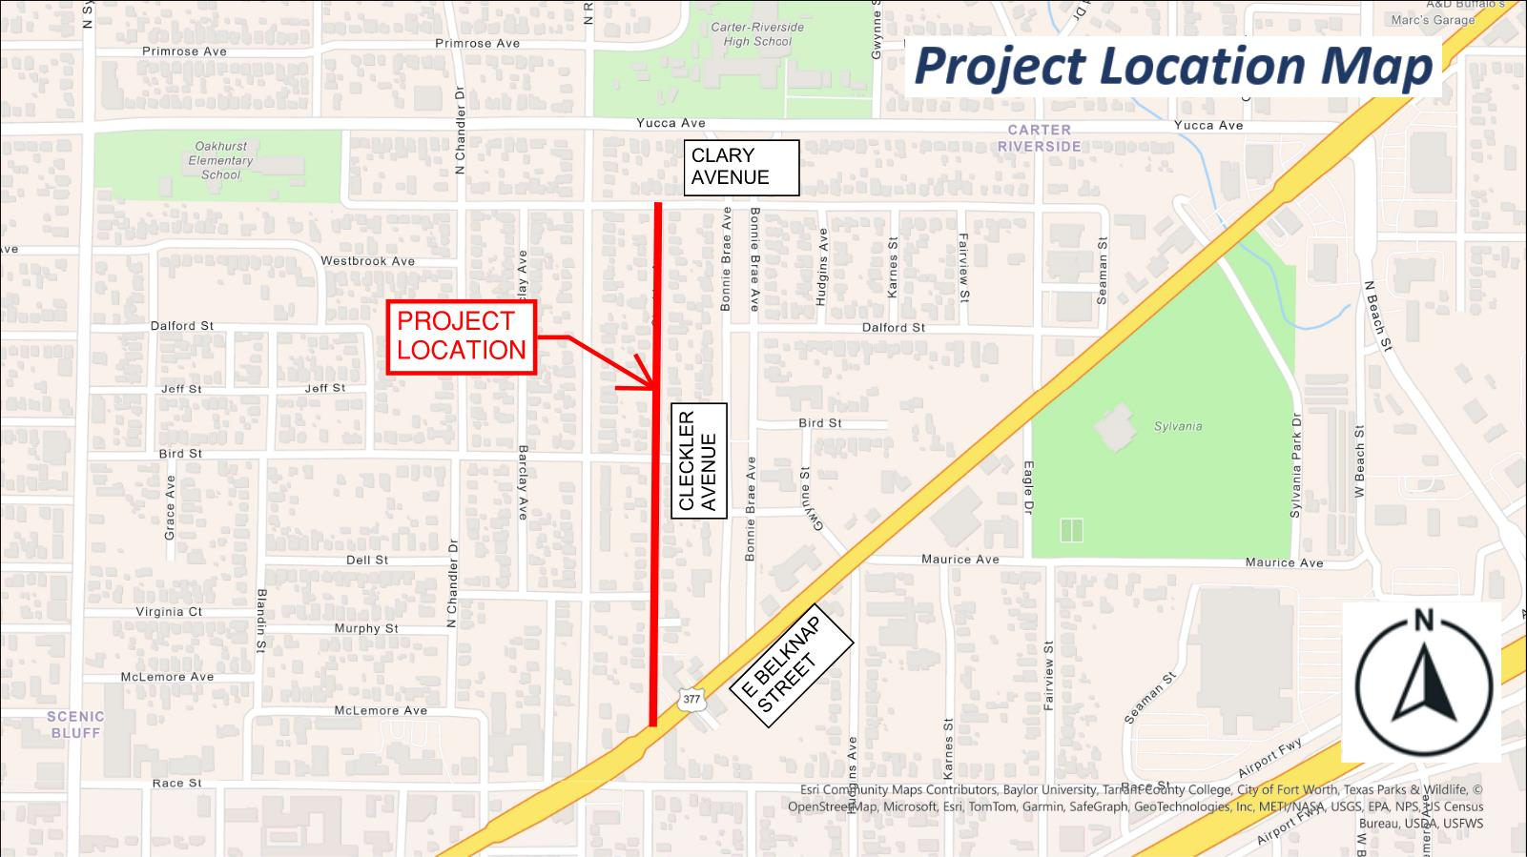
Project Location Map
Village Creek Road
Stalcup Road
Carverly Avenue
Pinson Street
JPS Clinic
Project Location
Sunrise McMillan Elementary School
Approximately 5,100 Feet
of Sidewalk Improvements on South Side of Pinson Street

Slide 6
Project Schedule
Currently in design phase
Estimated construction start – Spring 2025
Estimated construction duration – 4 months
Estimated construction cost - $580K

Slide 7
Frequently Asked Questions
Q: What is the typical width of the proposed sidewalk?
A: The typical width of the sidewalk will be 5’ when detached from the roadway curb and 6’ when attached to the roadway curb. Where existing trees are located, the width of the sidewalk maybe reduced to 4’ to preserve the tree and reduce impacts to the base or roots of the tree.
Q: Are we impacting driveways in the project? If so, will there be any access to the property during driveway construction?
A: There will be multiple driveway reconstructions with this project. We will be replacing one panel at a time and will provide continuous access to the property at all times.

Slide 8
Frequently Asked Questions
Q: Will existing tree and landscaping removals be necessary?
A: There will be trees being removed to accommodate the proposed concrete sidewalk. City and contractor to coordinate with property owner in regards to existing landscaping.
Q: Will traffic lanes be temporary closed or detoured?
A: We do not anticipate any street closures or detoured streets associated with this project.

Slide 9
Frequently Asked Questions
Q: Will existing irrigation systems or grass be impacted with this project?
A: If an existing irrigation system or grass parkway is impacted by the construction, the contractor will be required to repair the site to pre-construction conditions. If an irrigation system is within the limits of the proposed improvements, the system will be adjusted by the contractor.
Q: Will the construction materials and equipment be left on-site during construction?
A: Yes, the contractor will keep materials and equipment on-site during construction. However, the travel lanes will be re-opened when the contractor is not on-site. In addition, the contractor will clean the work site every day prior to leaving for the day.

Slide 10
Project Contact Information
City of Fort Worth Project Manager:
Chad Allen, PE, CFM
Engineering Manager, Transportation Public Works
817-392-8021
chad.allen@fortworthtexas.gov
Consultant Project Manager:
Dakota B. Partain, PE
CRIADO and Associates
817-727-9166
dpartain@criadoassociates.com

Slide 11
Service Requests (MyFortWorth)
MyFW App for Apple:
https://apps.apple.com/us/app/myfw/id1463082731
MyFW App for Google:
https://play.google.com/store/apps/details?id=gov.fortworthtexas.service&hl=en_US
Text HELLO to 817-835-MYFW (6939).
City Call Center: 817-392-1234
Chat Box on City of Fort Worth Website

Slide 12
Thank you!

