Slide 1
Community Meeting for
Camp Bowie Blvd at Bryant Irvin Rd
&
Camp Bowie Blvd at Horne St
Intersection Improvements
CPN: 103305 & 103313
Project Manager: Chad Allen, PE, CFM Project Engineer: Kimley-Horn and Associates, Inc.
April 18, 2024

Slide 2
Agenda
Project Background
Camp Bowie Boulevard & Bryant Irvin Road Existing Condition and Proposed Improvements
Camp Bowie Boulevard & Horne Street Existing Condition and Proposed Improvements
Schedule
Adjacent Projects
Questions

Slide 3
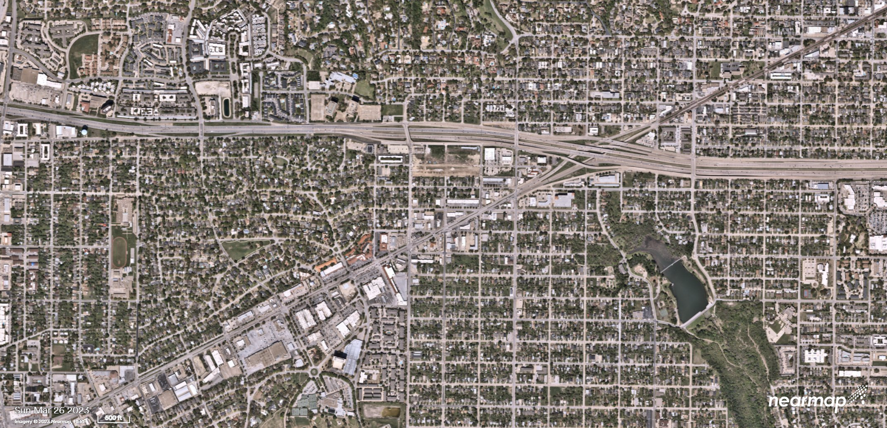
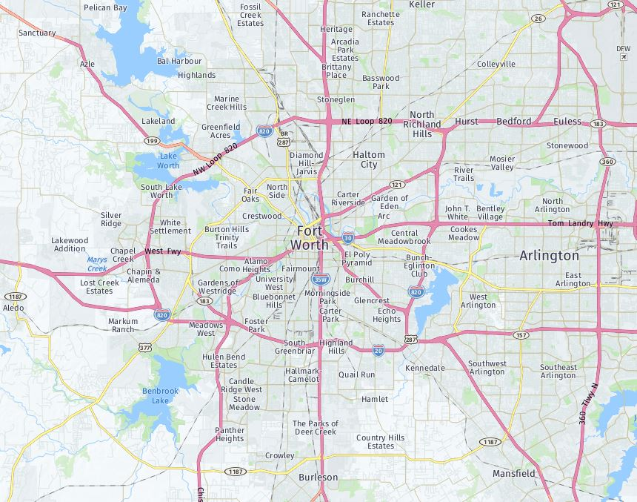
Project Background
N
Interstate 30
Horne St
Camp Bowie Blvd
Bryant Irvin Rd

Slide 4
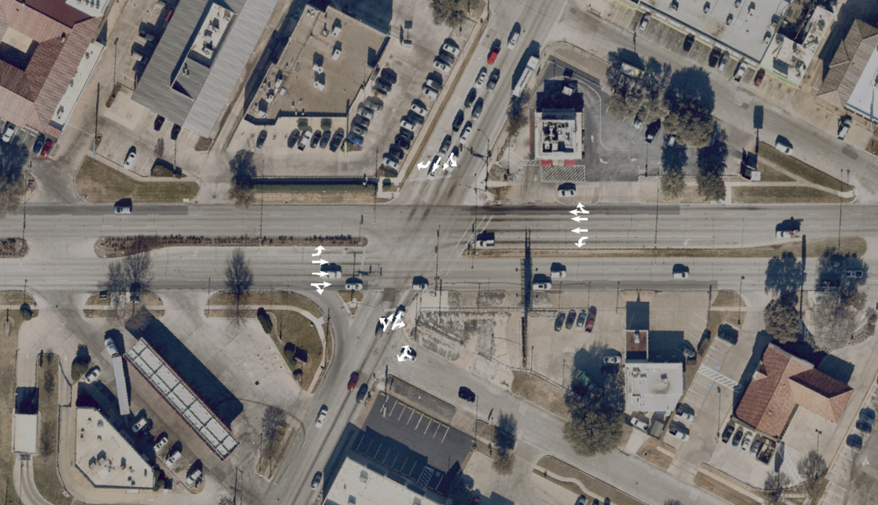
Existing Configuration at Bryant Irvin
Curzon Ave
Camp Bowie Blvd
Bryant Irvin Rd
Donnelly Ave

Slide 5
Existing Conditions at Bryant Irvin

Slide 6
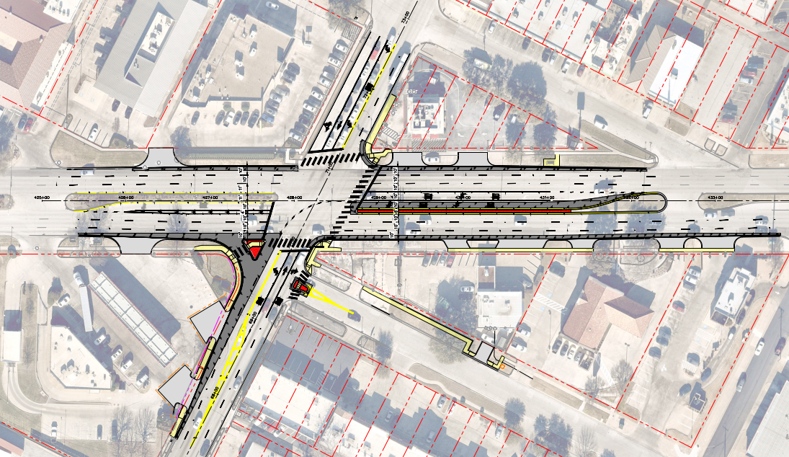
CURZON AVENUE
CAMP BOWIE BOULEVARD
DONNELLY AVENUE
Proposed Improvements Include:
Westbound dual left-turn lane
Splitter island on Donnelly Ave
Dedicated Northbound left-turn lane
BRYANT IRVIN ROAD

Slide 7
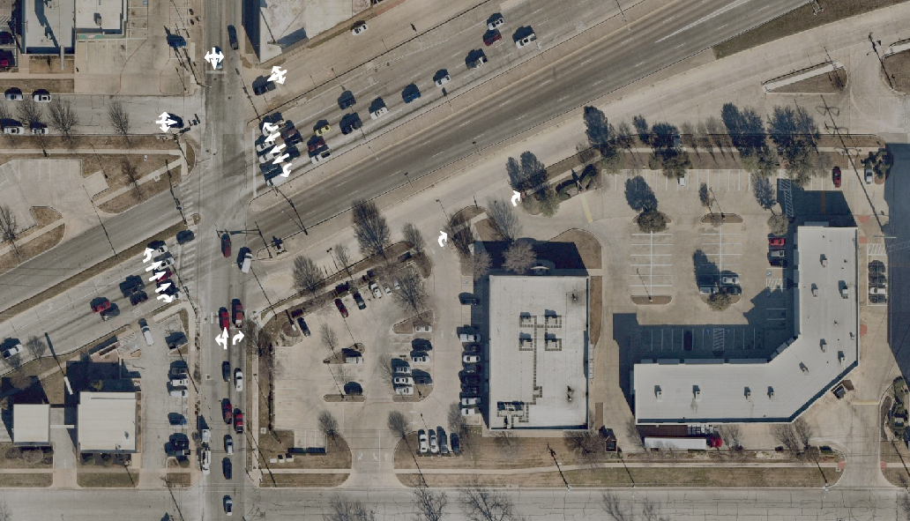
Existing Configuration at Horne Street
SERVICE ROAD
ROSEDALE STREET
FARON STREET
LOCKE AVE
LOCKE AVE
CAMP BOWIE BOULEVARD
HORNE STREET
CAMP BOWIE BOULEVARD
LOVELL AVE

Slide 8
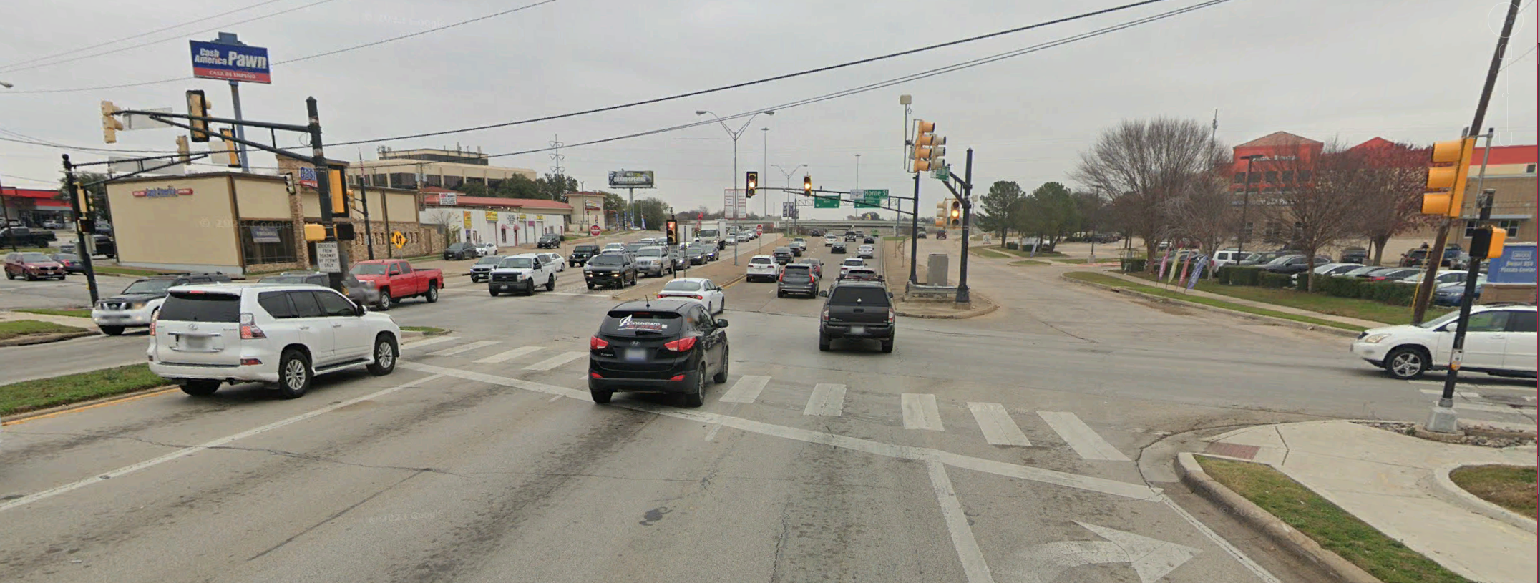
Existing Conditions at Horne Street

Slide 9
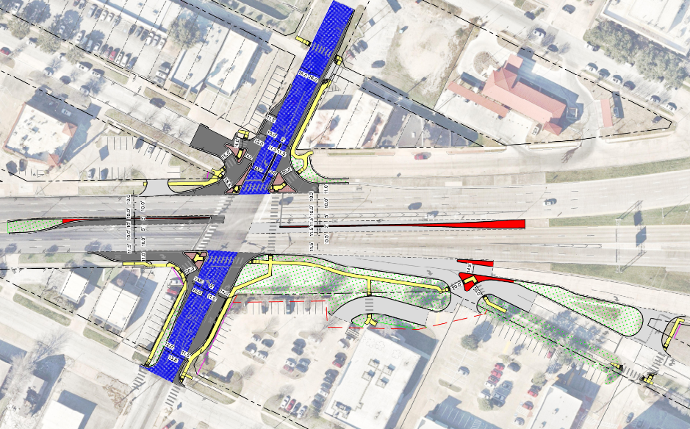
Proposed Improvements Include:
Modify Camp Bowie Blvd medians to add left-turn lanes
Close Camp Bowie Blvd Service Rd at Horne St
Modify Rosedale St entrances to SE properties
Median opening between Rosedale and Locke to be shifted to align with Faron St.
Mill and Overlay Horne St
HORNE STREET
LOCKE AVE
CAMP BOWIE BOULEVARD SERVICE ROAD
LOCKE AVE
CAMP BOWIE BOULEVARD
CAMP BOWIE BOULEVARD
ROSEDALE STREET
LOVELL AVE
FARON STREET
HORNE STREET

Slide 10
Schedule
Camp Bowie Blvd at Bryant Irvin Rd
90% design Submittal – April 2024
Design Complete – July 2024
Bid and award – April 2025
Contractor Notice to Proceed – September 2025
Substantial Completion – June 2026
Camp Bowie Blvd at Horne St
60% design Submittal – March 2024
Design Complete – September 2024
Bid and award – April 2025
Contractor Notice to Proceed – September 2025
Substantial Completion – September 2026

Slide 11
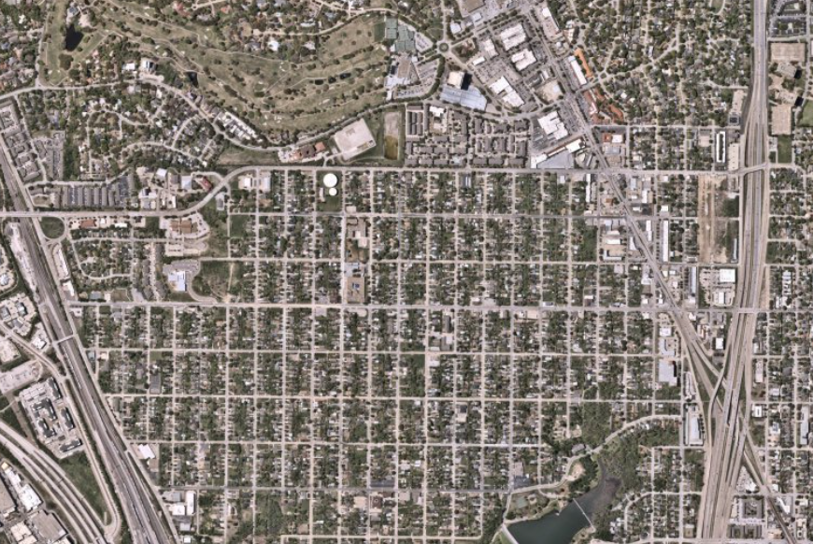
Adjacent Project – Horne Street
N
BRYANT IRVIN RD N
INTERSTATE 30
CAMP BOWIE BLVD
HORNE ST
W VICKERY BLVD

Slide 12
Contact Information:
Chad Allen, PE, CFM
City Project Manager
Chad.Allen@fortworthtexas.gov Office Phone: 817-392-8021
Trenton Tidwell, PE Abhishek Acharya, PE
Project Manager (CB @ Bryant Irvin) Project Manager (CB @ Horne)
Trenton.Tidwell@kimley-horn.com Abhishek.Acharya@kimley-horn.com

Slide 13
Thank you!

