Slide 1
Stormwater Strategic Planning
Mobility: Infrastructure & Transportation Committee
August 13, 2024
Jennifer Dyke, TPW Assistant Director, Stormwater Management Program
Matt Giglio, Freese & Nichols, Project Manager
Introduce Strategic Planning Initiative
Collaborate with MITC

Slide 2
Agenda
Introductions 2 min
Stormwater Program History 3 min
Strategic Planning 10 min
Current Program Characterization
Purpose
Assumptions
Drivers & Outcomes
Other Considerations
Questions 15 min

Slide 3
2006
2012
2020
2024
Utility Fee Created
5-year Ramp Up
Reactive Maintenance
Limited Improvements
FY 20 Increase
Hazardous Roadway Mitigation
Pipe Rehabilitation
Channel Restoration
Lebow Flood Mitigation Phase
Central City Projects
Begin Project Development for 3 Large Flood Mitigation Projects
FY 24 Increase
Initial Phases of 3 Large Flood Mitigation Projects
Maintenance Service Level Improvements
26.7%
13.7%
6.5%
15%
10.3%
17.2%

Slide 4
Stormwater vs. Water/Wastewater Utility Fees
Water/Wastewater Utility Fee
Stormwater Utility Fee
Heavily Regulated Standards
Cost to Deliver
Rate Structure
Minimal Regulatory Standards
Rate Structure
Service Depends on Resources

Slide 5
Current Program Characterization
Established and Functional
Asset Inventory
Programmed Maintenance
Customer Response and Reactive Projects
Hazard Warning
Development Review and Permitting
Moderate Capital Program

Slide 6
Current Program Characterization
Emerging Challenges
Awareness of Infrastructure Deterioration
Mitigating Large Scale Chronic Flooding
Competing for Grant Funding
Keeping Pace with Inflation

Slide 7
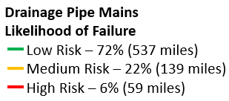
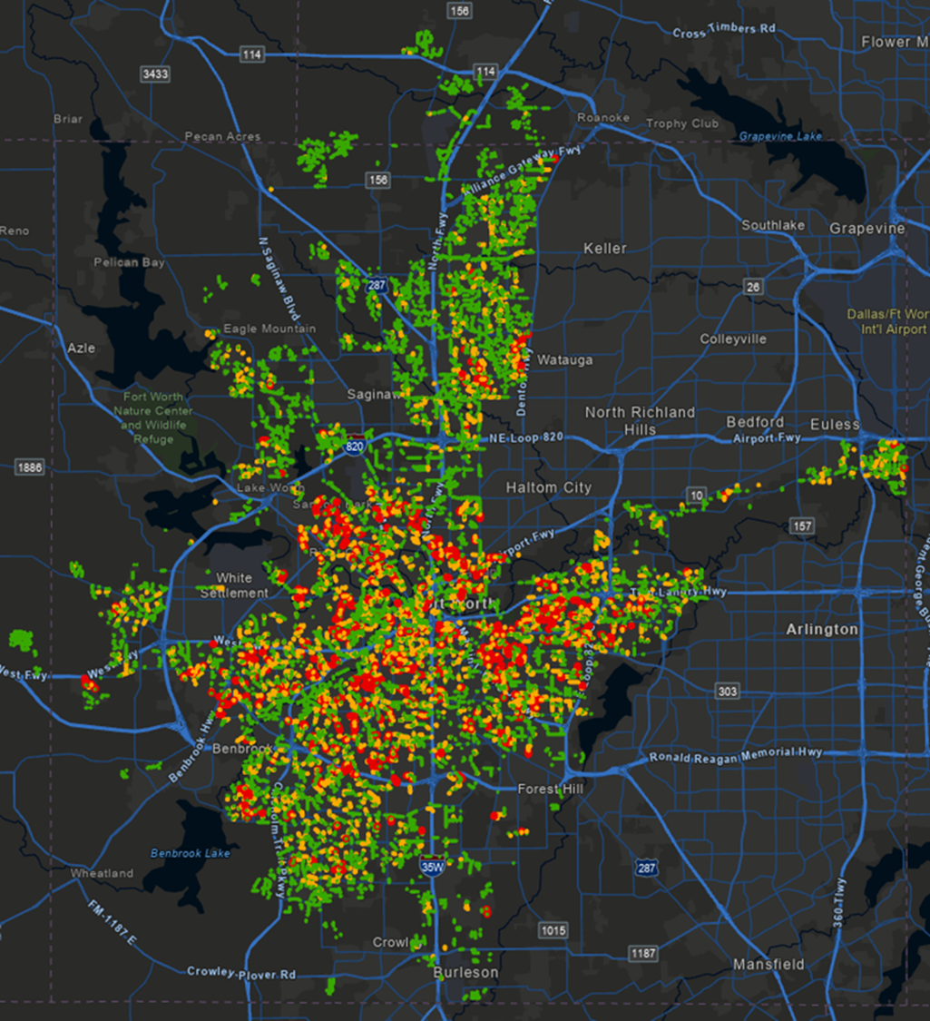
Emerging Challenges
Awareness of Infrastructure Deterioration
1,059 miles of storm drain
Assessed condition - 160 miles
Assess rate - 40 miles/year
59 miles at high risk (projected)

Slide 8
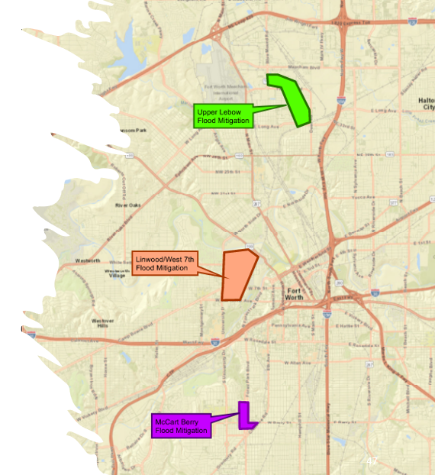
Emerging Challenges
Upper Lebow
~$90M
Mitigating Large Scale Chronic Flooding
Upper Lebow, Linwood/W 7th, McCart/Berry
Partially funded phased approach
Other large-scale needs also exist
Linwood/ W 7th
~$110M
McCart/Berry
~$40M
Cost estimates are 2023 dollars and will be refined during current Project Development efforts

Slide 9
Grant/Loan
Objectives & Requirements
Fort Worth
Objectives & Needs
Emerging Challenges
Competing for Grant Funding
Competitive
Must understand objectives of each
To compete, objectives must align
Potential project scope changes
May require project information not yet determined
Not Competitive

Slide 10
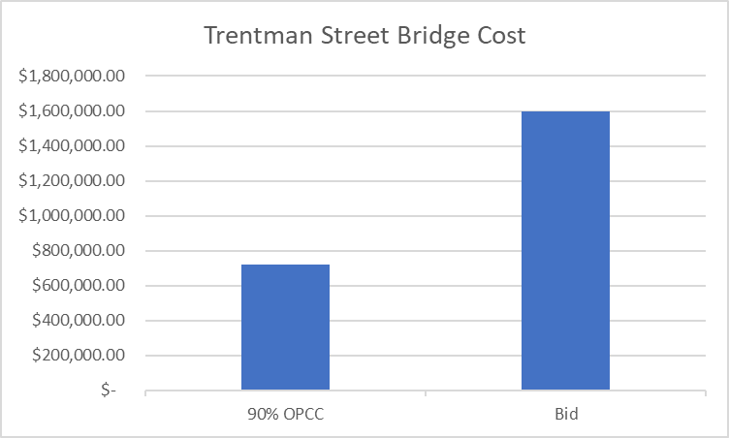
Emerging Challenges
Keeping Pace with Inflation
Trentman Street Bridge Costs
Randol Mill Hazardous Roadway Overtopping Mitigation Costs
90% OPCC
Bid
25% OPCC
90% OPCC
Inflation
Material & Labor Cost Increases
Supply Chain Issues
Overall Supply & Demand – Too Many Projects & Not Enough Contractors

Slide 11
Current Program Characterization
Emerging Challenges
Awareness of Infrastructure Deterioration
Mitigating Large Scale Chronic Flooding
Competing for Grant Funding
Keeping Pace with Inflation

Slide 12
Purpose
The Stormwater Strategic Plan will determine the best way to accomplish the Stormwater Program’s mission in a way that aligns with City Council Strategic Goals and is in the best interest of the community. It will optimize use of available resources and determine future resource needs.
Stormwater Program Mission
To Protect People and Property from Harmful Stormwater Runoff

Slide 13
Planning Assumptions & Constraints
Don't Make Things Worse- Appropriate Regulations
Make Things Better
Maintain Current Maintenance and Capital Service Levels
Community Support
Realistic Resource Expectations
Continuous Optimization
Long Term Measurable Goals
Future Fee Increases in Small Increments

Slide 14
Program Drivers and Outcomes
DRIVER | PROPOSED OUTCOME
Deteriorating Infrastructure | Based on an analysis of available data, forecast repair and replacement rates, and quantify resource needs to minimize the need for emergency response to failure.
Flood Mitigation | Complete implementation of the current 3 major projects, begin work on additional large-scale projects.
Financing Opportunities | Invest in the development of a grant/loan strategy that leverages existing resources to implement more projects.
Inflation | Project future inflation impact and establish an internal process to periodically assess cost index changes and adjust stormwater utility fee to maintain current level of service.

Slide 15
Other Considerations
New Assets vs. Revenue Growth
Cost of Service
Extraterritorial Jurisdiction (ETJ)
Rate of Growth Changes
Water Quality
Impact of Emerging Technologies
Feedback on Priorities

Slide 16
Engagement
Fort Worth Lab
Other Departments
Stormwater Stakeholder Group
City Council
Public Engagement

Slide 17
Supporting Data
Maintenance/Repair Records
Privately Constructed Public Infrastructure
Revenue Growth vs Asset Inventory Growth
Outside Financing Requirements
Future Cost Index Projections

Slide 18
Feedback and Questions
We would appreciate any suggestions you might have for us to make our Strategic Plan effort more effective

