Slide 1
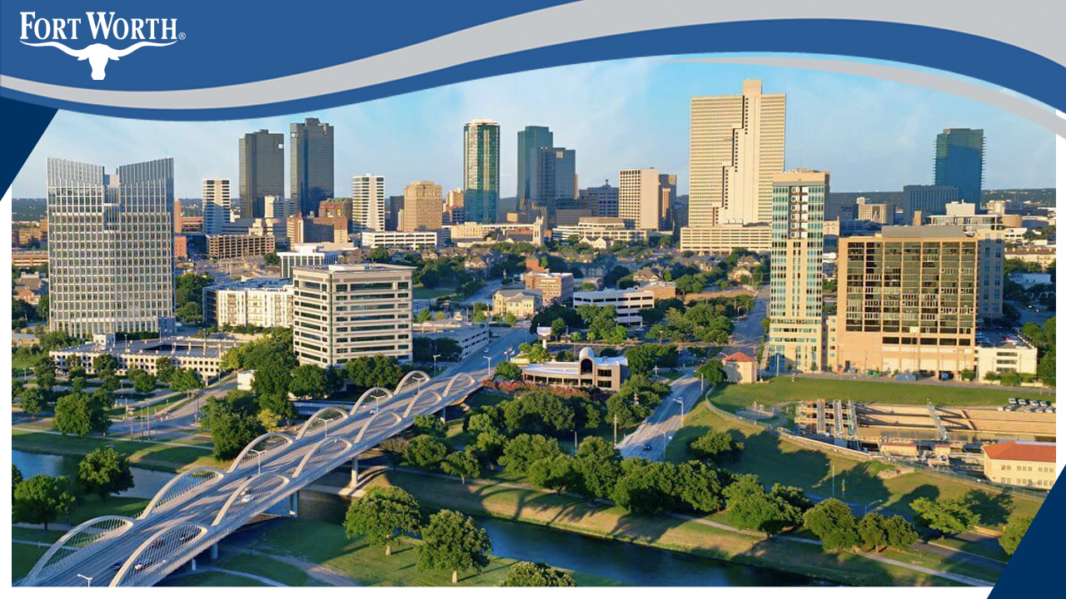
Evans & Rosedale

Slide 2
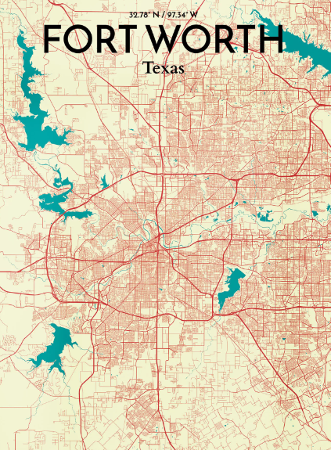
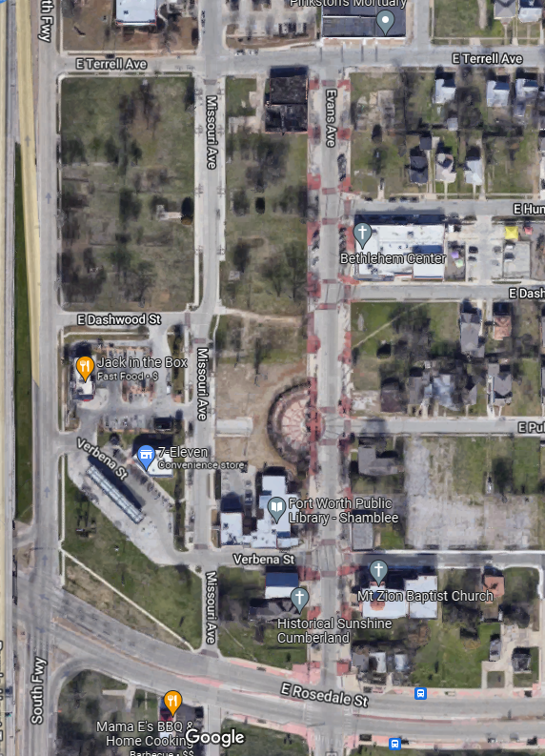

Slide 3
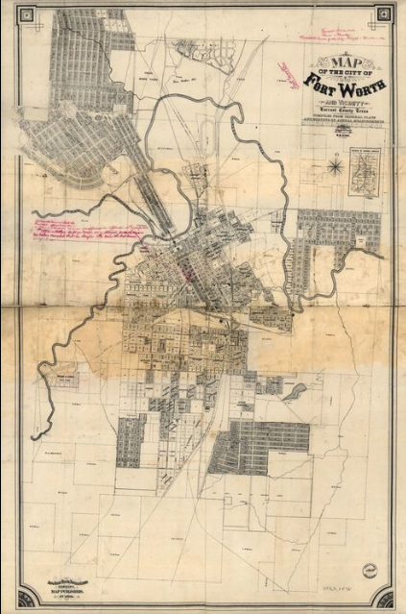
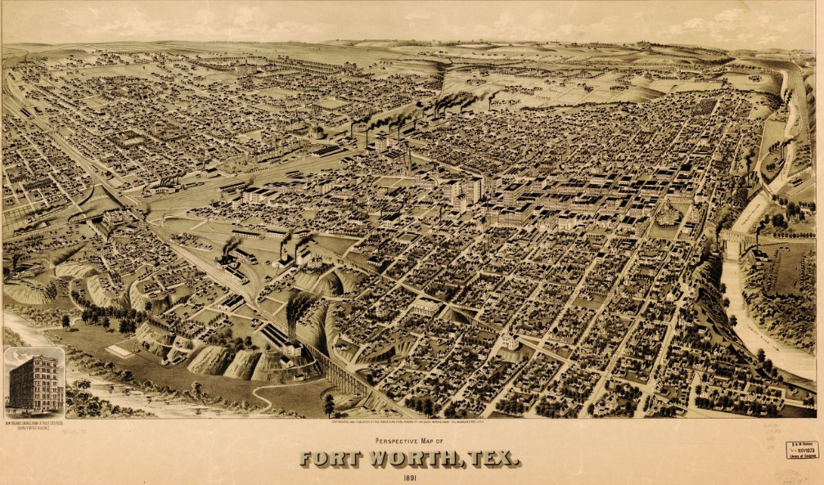

Slide 4
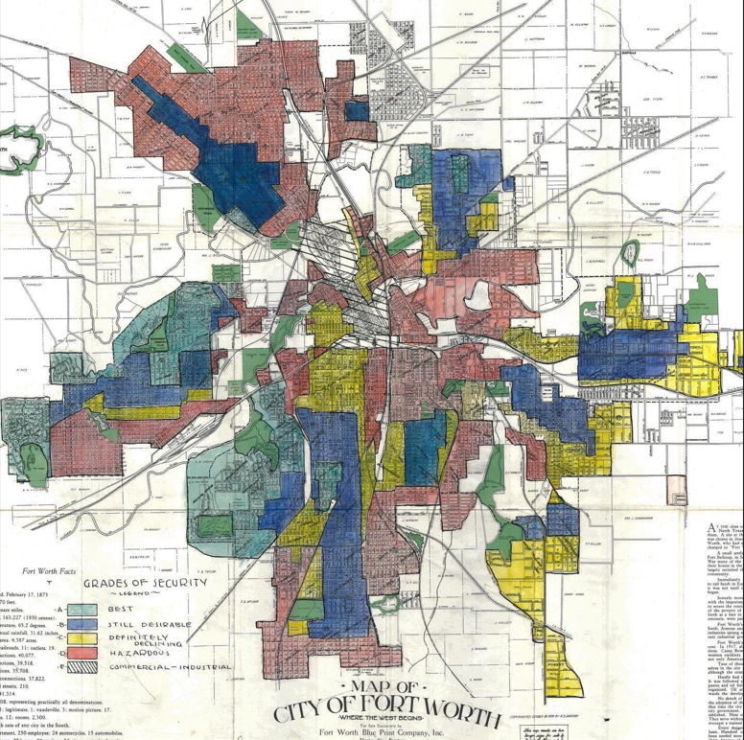
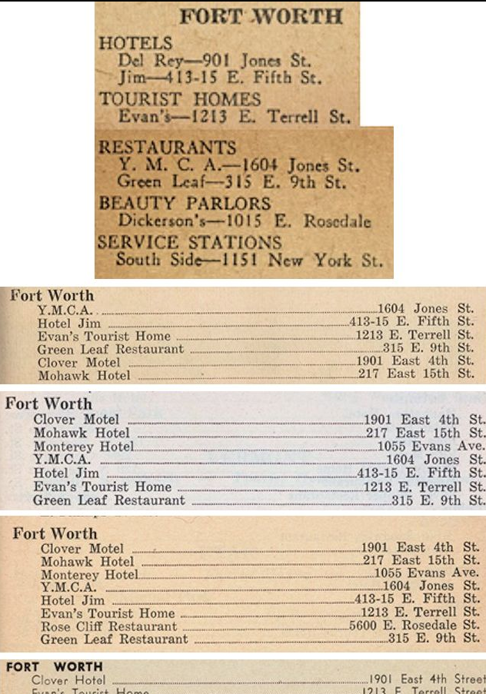

Slide 5
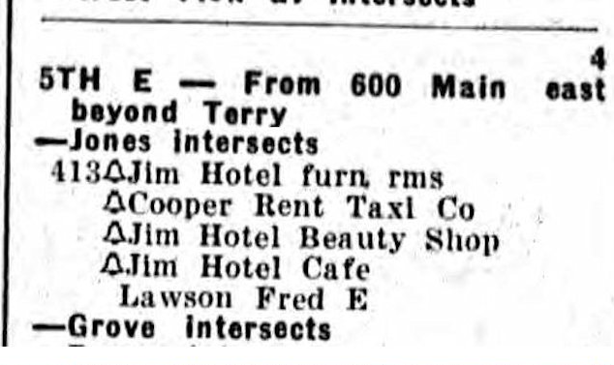
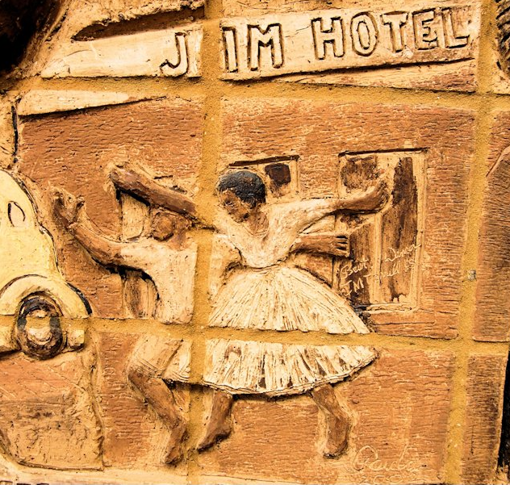
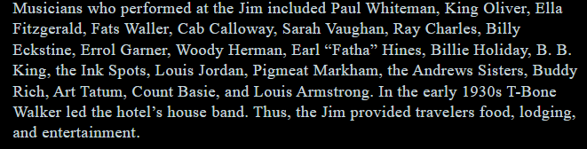

Slide 6
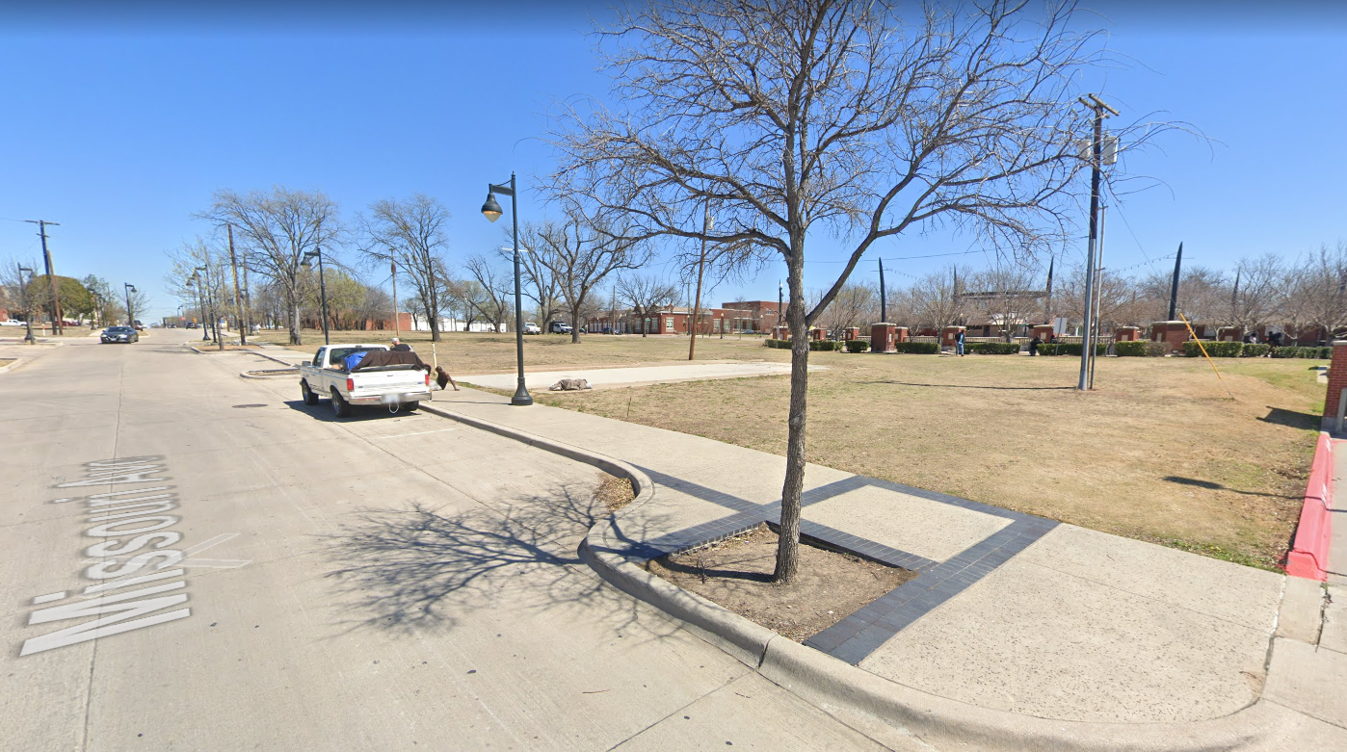

Slide 7
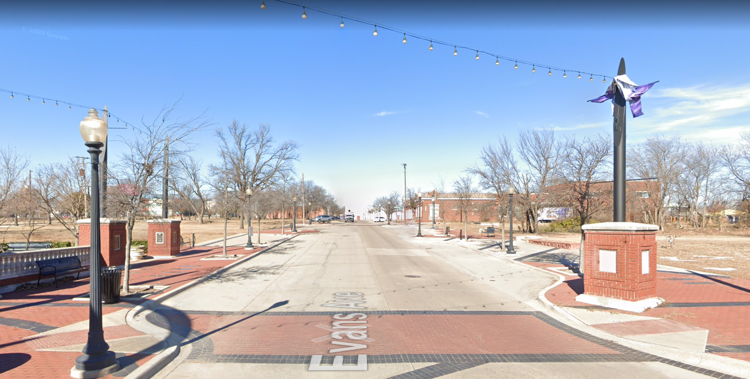

Slide 8
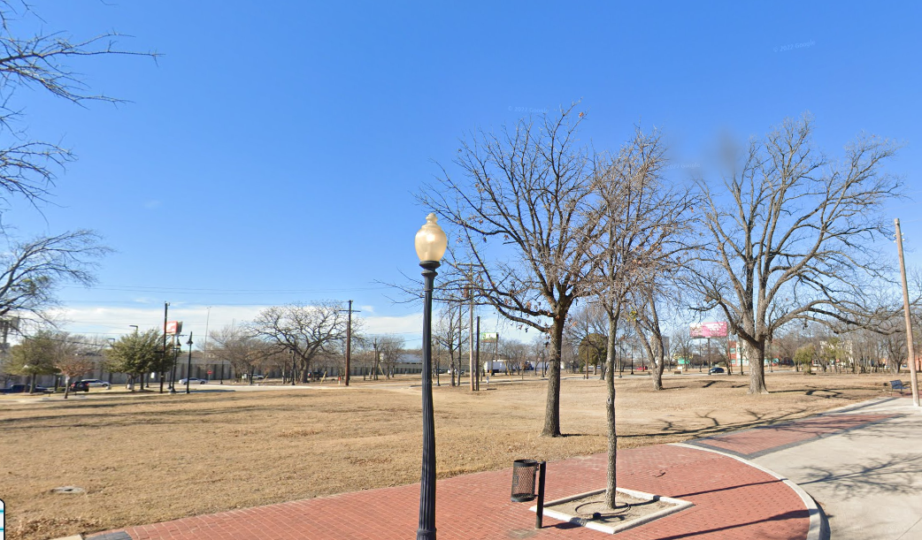

Slide 9
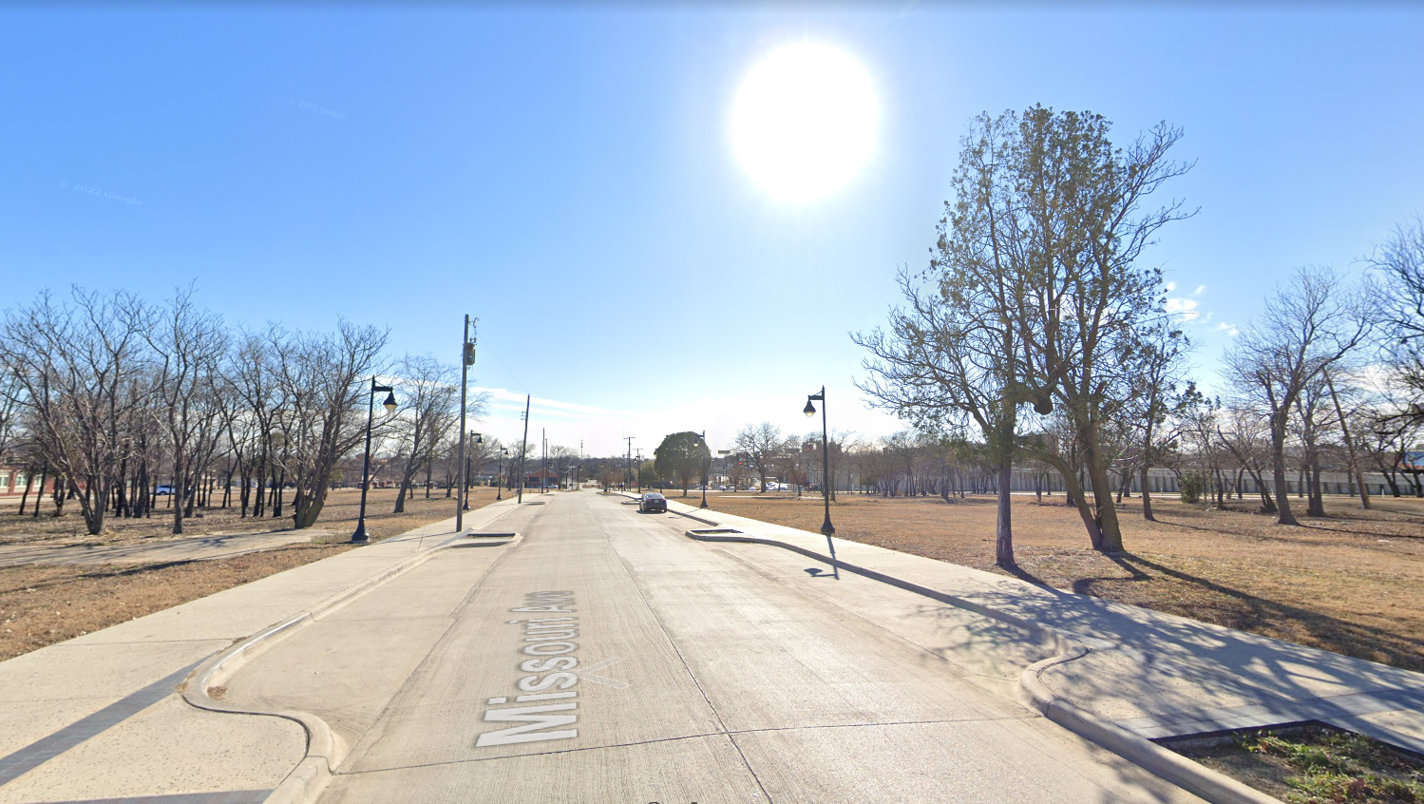

Slide 10
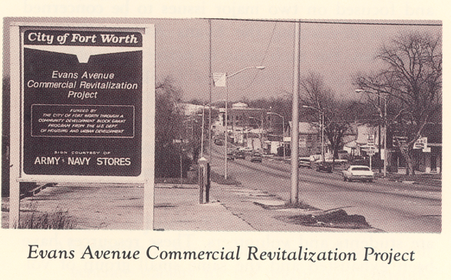

Slide 11
Year | Development History
1997 | Near Southside CDC issues a planning document showing need for economic development
1997 | Fort Worth TIF #4 Established
1999 | Fort Worth South, Inc. issues urban design guidelines
2000 | Fort Worth Metropolitan Black Chamber of Commerce issues Economic Development Action Plan
2000 | Vision Plan for Evans & Rosedale adopted & endorsed by Evans & Rosedale Advisory Committee
2000 | City receives $1.5M EDI grant and $7.5M in Section 108 loans to redevelop
2000-2002 | Property acquisition
2002-2003 | Streetscape Project
2005-2006 | Shamblee Library Constructed
2009 | Hazel Harvey Peace Center for Neighborhoods Constructed
2011 | Jack in the Box & Bethlehem Center constructed
2012 | 7 Eleven Constructed
2016-2017 | Hotel development considered
2018 | Request for Economic Interest - 8 Responses
2019 | Hoque Global selected as Master Developer

Slide 12
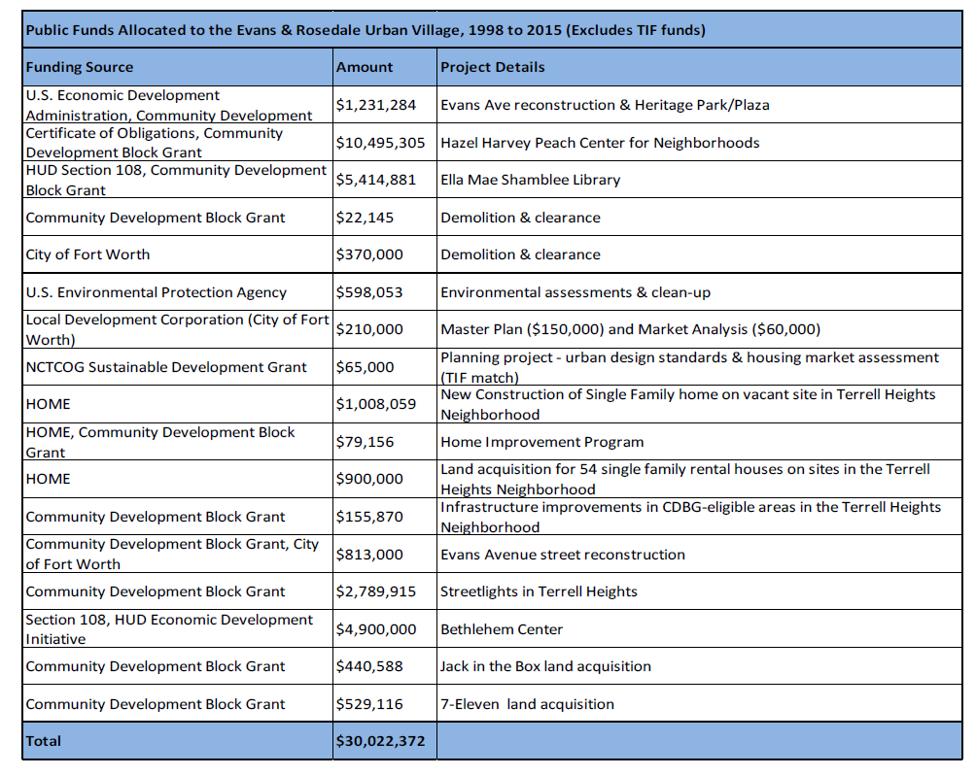

Slide 13
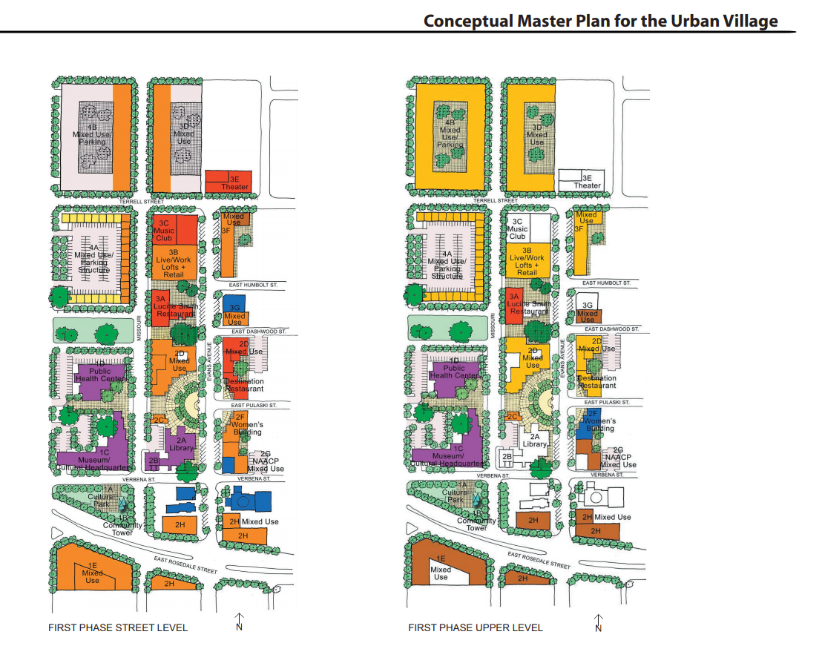
2005 Urban Village Master Plan

Slide 14
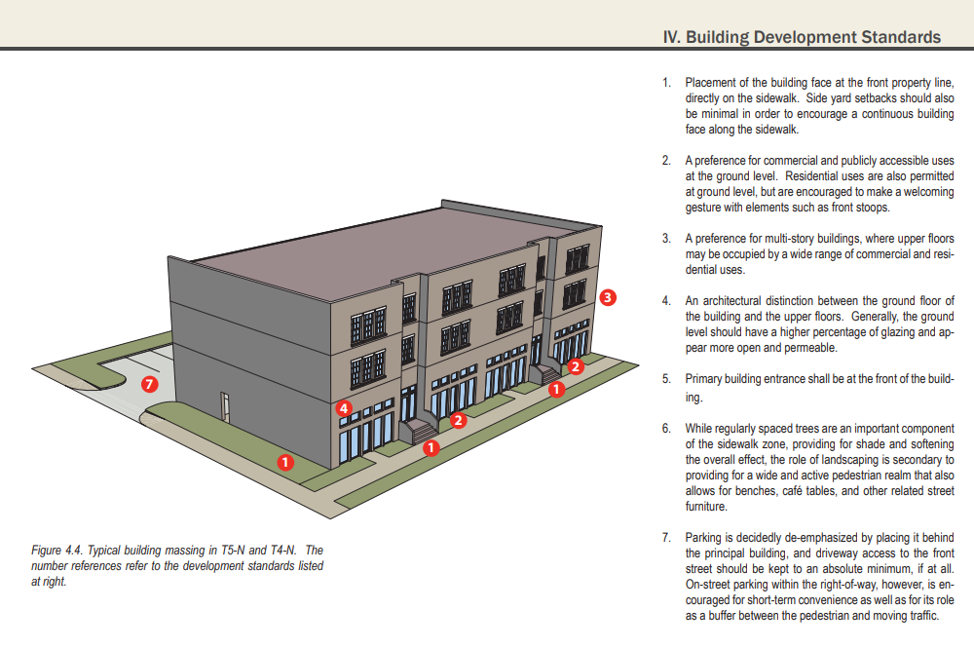
2009
Evans & Rosedale Area
Design Standards
And Guidelines

Slide 15
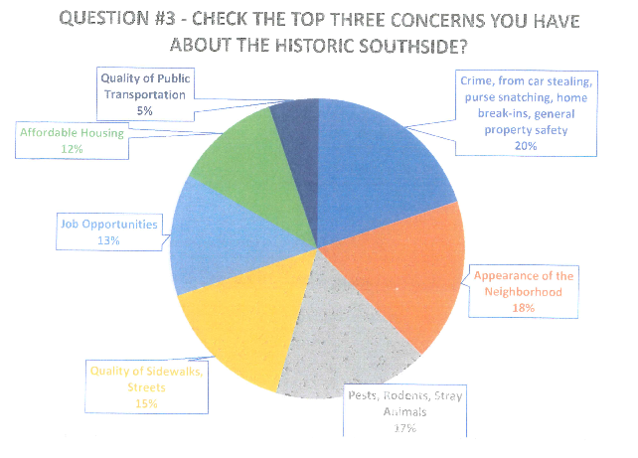
2018
Historic Southside Neighborhood Poll

Slide 16
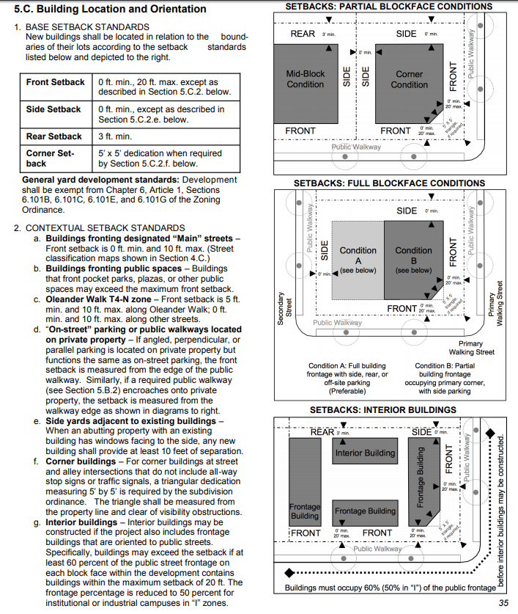
2019
Near Southside
Form Based Code

Slide 17

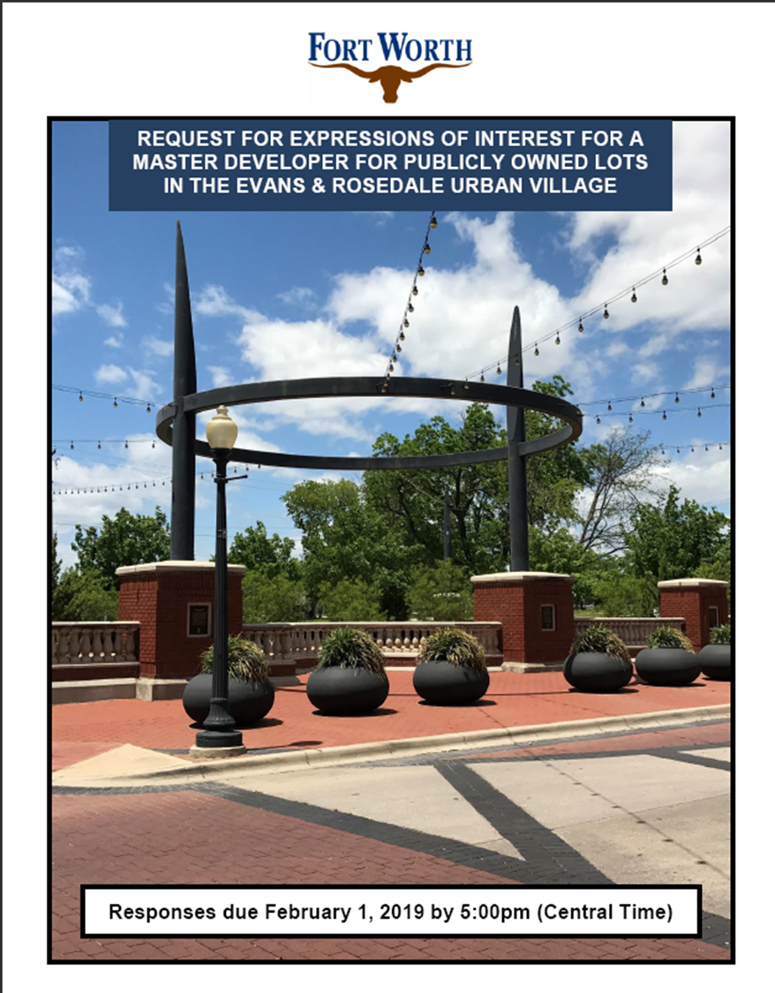
RFEI
“Request for Expression of Interest”
Neighborhood Meeting Held November 28, 2018 for RFEI Input and Feedback
HFC, LDC, and City Council Briefing December 4, 2018
Request for Expression of Interest (RFEI) issued December 6, 2018
The RFEI emphasized a partnership “with a developer who can respect the history while maximizing the use of the property for the current market.”
Responses Due February 1, 2019
Community Input Workshop, facilitated by University of Texas at Arlington, February 9, 2019

Slide 18

Specific Sites
Fort Worth Housing Finance Corporation (HFC), Fort Worth Local Development Corporation (LDC), and the City of Fort Worth sought a Master Developer arrangement in and near the historic Evans & Rosedale Urban Village located minutes from downtown Fort Worth, for properties owned by these three entities.

Slide 19
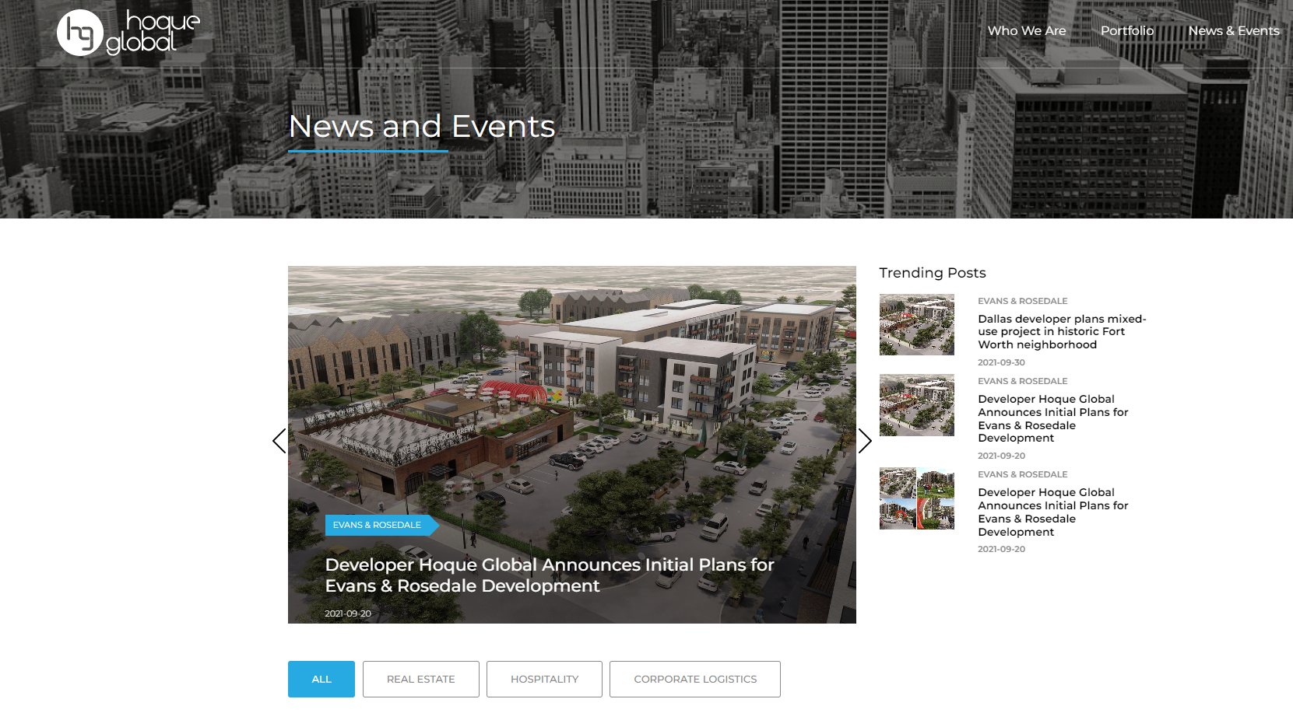

Slide 20
Proposed Project Overview
Developer: Hoque Global Properties LLC
Phase I - $60 Million Capital Investment
  292 multifamily units and 28 live/work units
  27,000 square feet of retail or office space
      15,000 SF of the retail space will be marketed to an urban grocer for up to 12 months past receipt of the Certificate of Occupancy
  339 parking space parking garage
  Enhancements to include the cultural square, linear parks, interactive square, and other public spaces
Phase II – Additional $10 Million Capital Investment
  20 townhomes

Slide 21

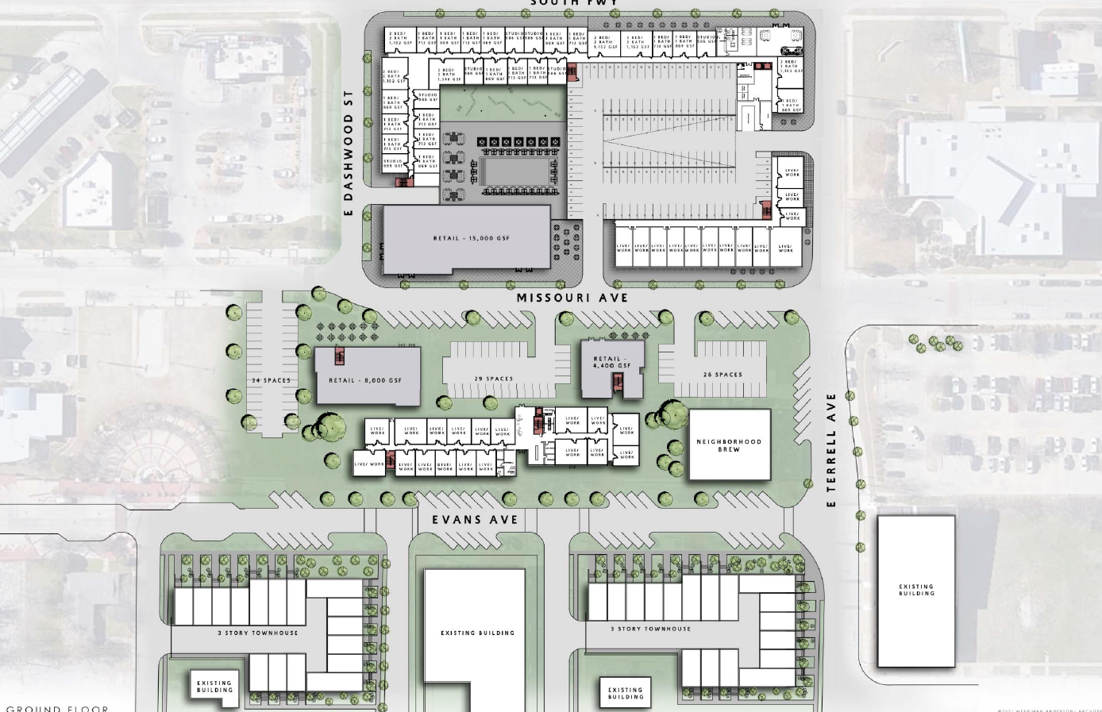
Proposed
Development
Phase I - $60M
  292 multifamily units and 28 live/work units
  27,000 square feet of retail or office space
  15,000 SF of the retail space will be marketed to an urban grocer for up to 12 months past receipt of the Certificate of Occupancy
  339 parking space parking garage
  enhancements to include the cultural square, linear parks, interactive square, and other public spaces
Phase II - $10M
  20 townhomes
Phase I
Phase II

Slide 22
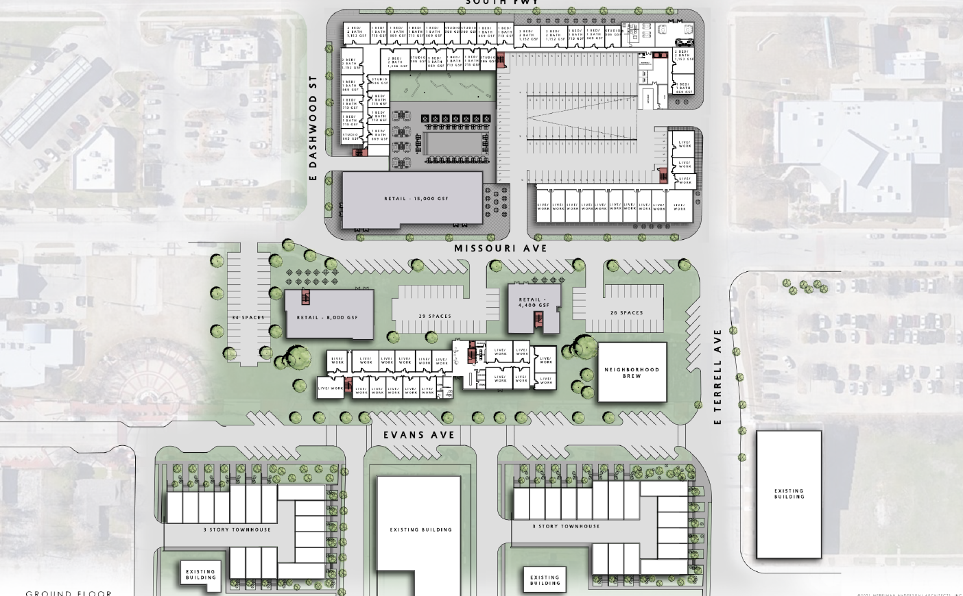

Slide 23
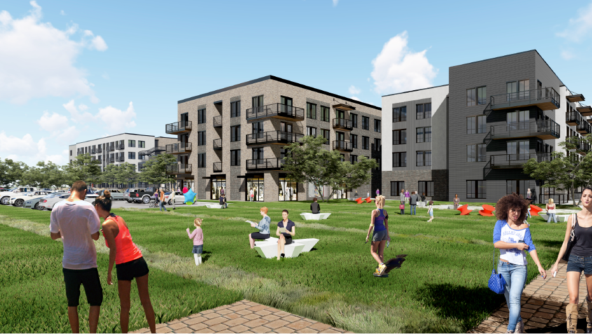

Slide 24
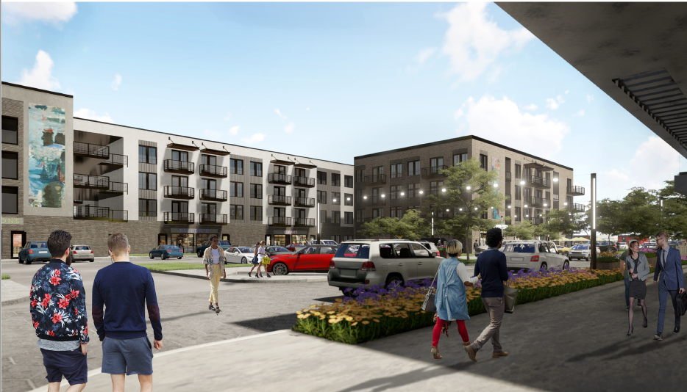

Slide 25
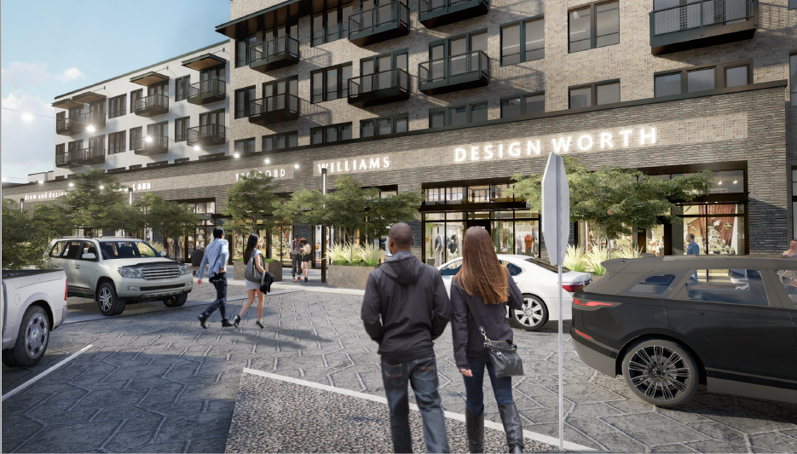

Slide 26
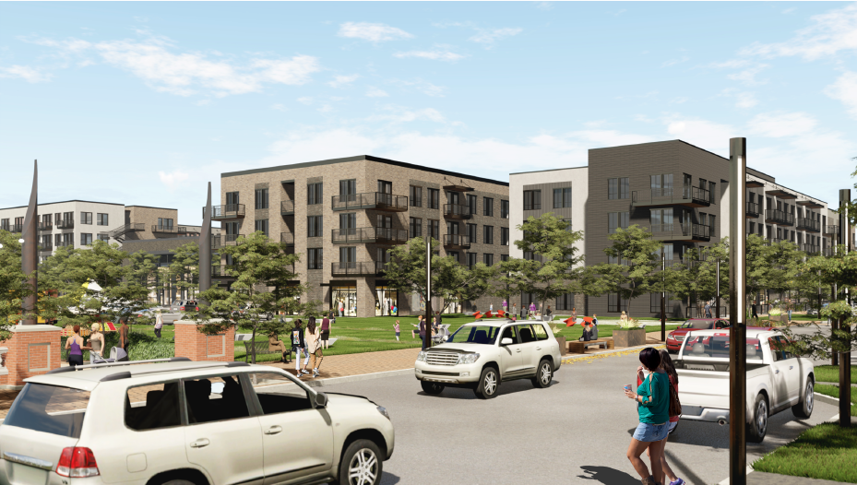

Slide 27
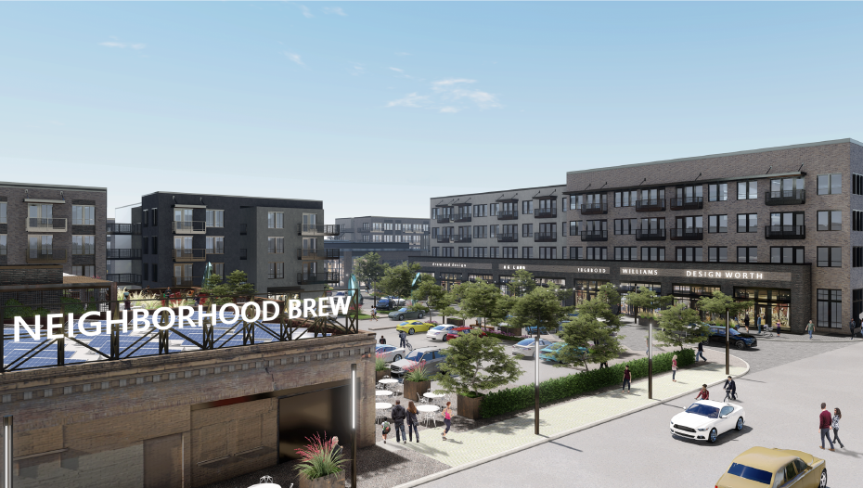

Slide 28
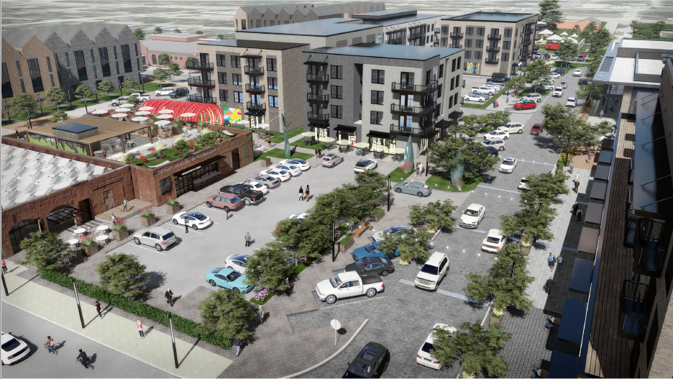

Slide 29
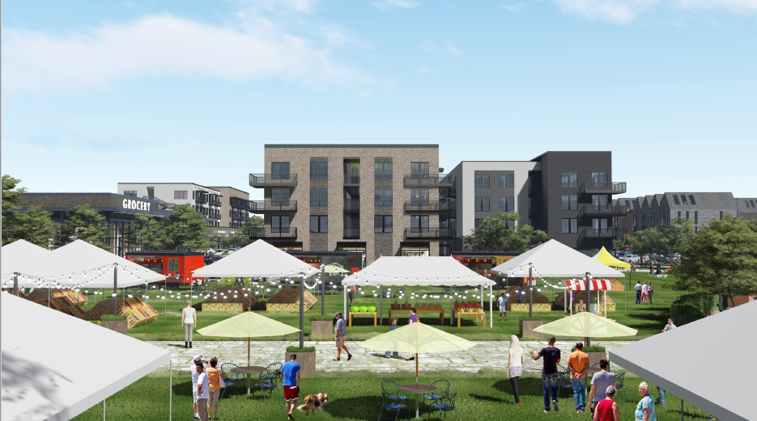

Slide 30
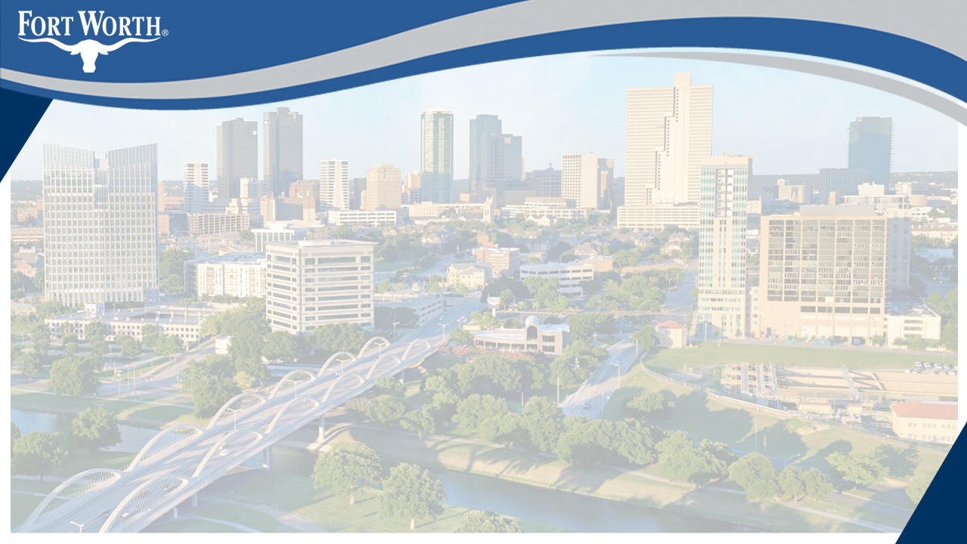
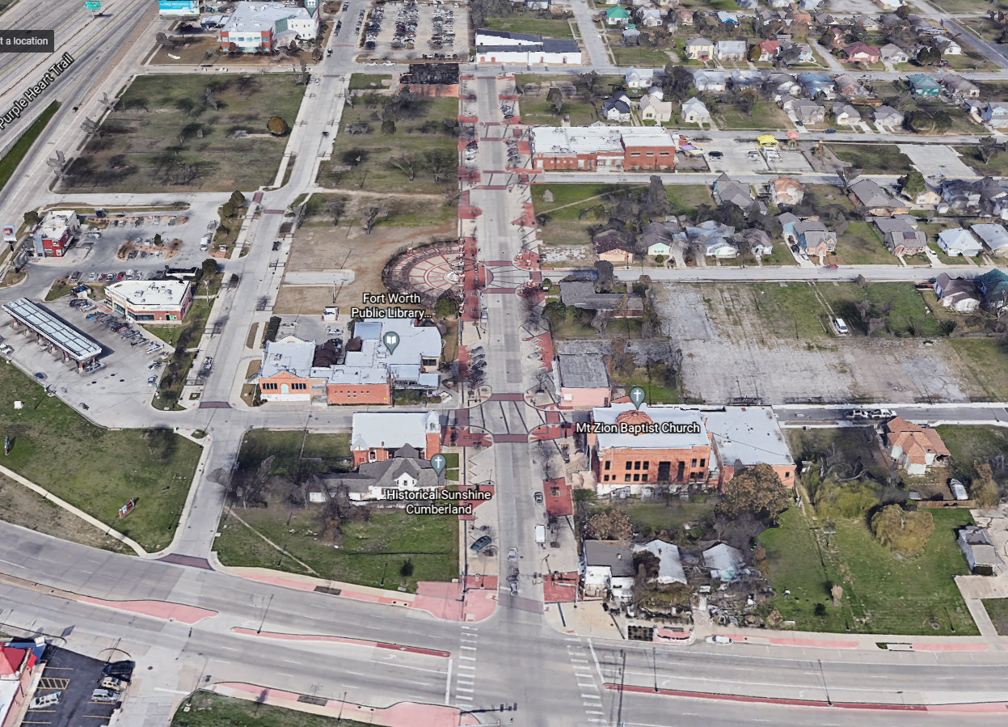
Where are we in the Redevelopment Timeline?

Slide 31
Redevelopment Timeline
Request for Economic Interest
Nov ’18 – Apr ‘19
Community Workshops
Apr ‘19; May ‘19; Jun ‘19
Term Sheet Negotiations
July ‘19 – Aug ‘21
City Approvals
Sep –Nov ‘21
Permitting & Financing
Jan – Dec ’22
NOW March ‘23
Construction
July ’22 – Dec ’23
NOW
April ‘23-Dec ‘24
Phase I Completion
2024
Pandemic
Phase II Completion
2025

Slide 32
What financial incentives are committed?

Slide 33
Developer Commitments
Invest a minimum of $60 Million – Phase I
  Min. $56 million Hard Costs
  Construction to begin within 18 months; Completion within 36 months of signing of Definitive Agreements
  Min. 15% Total Development Costs to Business Equity Firms
Invest an additional $10 Million – Phase II
Affordable Housing: Rent no fewer than 20% of all rental residential units as affordable housing
  10% of all residential units leased to individuals or families earning at or below 80% of the Area Median Income for the Fort Worth-Arlington region in a given year as established by the U.S. Department of Housing and Urban Development
  10% of all residential units leased to individuals or families earning at or below 60% of the Area Median Income.
Notes:
Total Development Costs means the aggregate of Hard Construction Costs and the following costs directly expended for the Development: engineering fees; architectural and design fees; real estate commissions; costs of third party consultants, including attorneys and environmental consultants; developer fees; zoning fees; insurance and taxes directly related to the construction of the Development; and financing costs, including capitalized interest and FF&E.
Hard Construction Costs means the aggregate of the following costs expended by Developer for the Development: actual site development and construction costs, contractor fees, and the costs of supplies and materials, but excludes land acquisition costs paid by Developer for the various parcels that make up the Development Property.

Slide 34
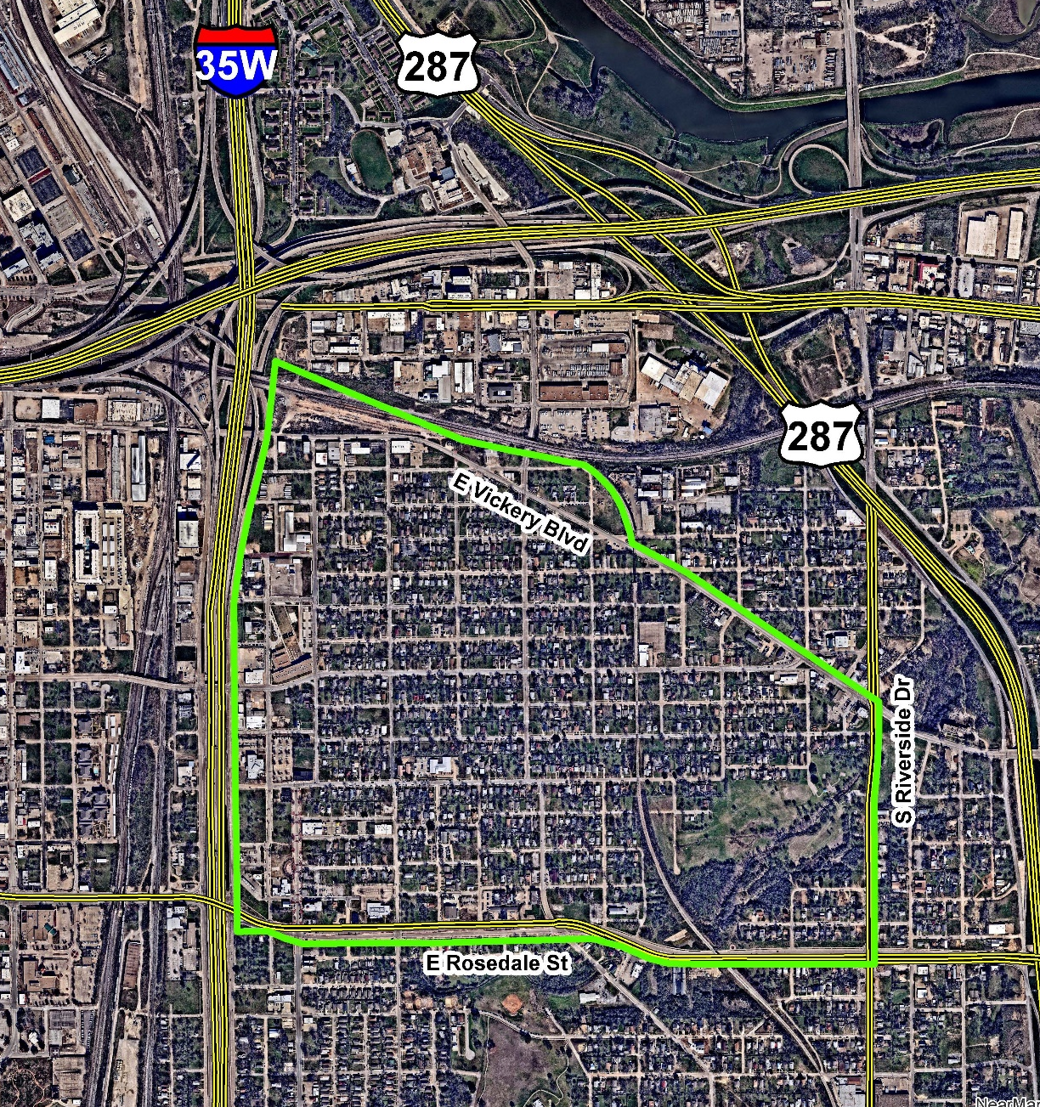
Additional Developer Commitments
Demonstrates the financial capacity and commitments to complete the project prior to any land transactions and no later than 6 months after signing of the Definitive Agreements;
Employ or cause to employ a minimum 30 Full-Time Employees on the Property by December 31, 2024, using good faith efforts to hire from the neighborhood;
Community Engagement:
  Initial Public Meeting
  Continued Public Meetings at least once every 6 months
  Quarterly project status updates to City and made available via website
Is responsive to and specifically informed by historic and cultural context in designing the buildings and public spaces; and
Developer will also work with the City of Fort Worth to make best efforts to attract a grocer to the Development.
The Developer will pursue a waiver of certain permit and impact fees related to the Development through the Neighborhood Empowerment Zone application process.
The Developer will make best efforts to acquire the property located at 912 Missouri Avenue, Fort Worth, TX 76104 from the private property owner with a conclusion to such efforts no later than December 31, 2021, provided that if significant progress is being made toward acquisition but acquisition is not yet complete, this deadline may be extended by the City.
Notes:
Neighborhood boundaries for targeted employment are I-35 on the west, Vickery on the north, Riverside Drive on the east, and E. Rosedale on the south.

Slide 35
Proposed City Commitments
15 year Chapter 380 Economic Development Program Agreement at 80% of Real Property, Business Personal Property, and Sales Tax ad valorem taxes up to an overall incentive cap of $9 million (gross).
    The Chapter 380 incentive cap shall be $8 million upon completion of the Phase I commitments.
    If Phase II commitments are achieved, the Chapter 380 incentive cap shall increase to $9 million.
Notes:
Note that City will be reimbursed for the price of the lot with ARPA funds.

Slide 36
Sale of Properties
36 lots identified as required for this development
  1 owned by City of Fort Worth
  5 owned by the Local Development Corporation
  30 owned by the Housing Finance Corporation
35 Lots will be sold “as is” to City & then to Developer
Sale price to developer is $1;
City to reimburse HFC, LDC, and itself with ARPA Funds for 36 lots at fair market value;
City lien will be placed on properties to assure performance by the developer of the public purpose of development & maintenance of low-to-moderate income housing
Developer must maintain ownership of the properties throughout the term of the lien unless the City approves the subsequent purchaser to assume the same performance requirements
Notes:
ARPA Funds
The City purchases the property from HFC and LDC with ARPA funds under the General Governmental category of eligible expenses.
HFC Property = $4,126,861.57
LDC Property = $537,076.29
City Parcel - $112,500
Total: $4,776,437.86
The City enters into a 380 Agreement with the Developer to pay the Developer back over the 15 years for the FMV paid.
The City also takes a lien in the form Deed of Trust to Secure Performance over all the property to ensure the project is actually built.

Slide 37
Performance Requirements
Phase I
  320 total housing units: 292 multifamily units and 28 live/work units
  Minimum of 64 apartments (20% of total units) set-aside as affordable pursuant to standard City of Fort Worth economic incentive agreements
  Affordability (80% AMI or less on 10% of units and 60% AMI or less on 10% of units) starts upon certificate of occupancy and is maintained for a minimum of 15 years;
  Payment of fair market value of the properties in the amount of $4,126,861.57(or $21.27/s.f.) will be required in the event that developer fails to meet the performance requirements for the duration of the lien or in the event that developer sells or otherwise no longer retains ownership over all properties, except as allowed by City.
  Construction must start within 18 months of closing and completed within an additional 36 months
Phase II
20 townhomes
Minimum of 6 townhomes (20% of total units) set-aside as affordable pursuant to standard City of Fort Worth economic incentive agreements
Affordability (80% AMI or less on 10% of units and 60% AMI or less on 10% of units) starts upon certificate of occupancy and is maintained for a minimum of 15 years;
Payment of fair market value of the properties in the amount of $649,575 (or $21.27/s.f.; $112,500 City parcel; $537,075 LDC parcels) will be required in the event that developer fails to meet the performance requirements for the duration of the lien or in the event that developer sells or otherwise no longer retains ownership over all properties, except as allowed by City.
Construction of the Phase II Housing must start within 60 months of closing and completed within an additional 18 months
Notes:
ARPA Funds
The City purchases the property from HFC and LDC with ARPA funds under the General Governmental category of eligible expenses.
HFC Property = $4,126,861.57
LDC Property = $537,076.29
City Parcel - $112,500
Total: $4,776,437.85
The City enters into a 380 Agreement with the Developer to pay the Developer back over the 15 years for the FMV paid.
The City also takes a lien in the form Deed of Trust to Secure Performance over all the property to ensure the project is actually built.

Slide 38
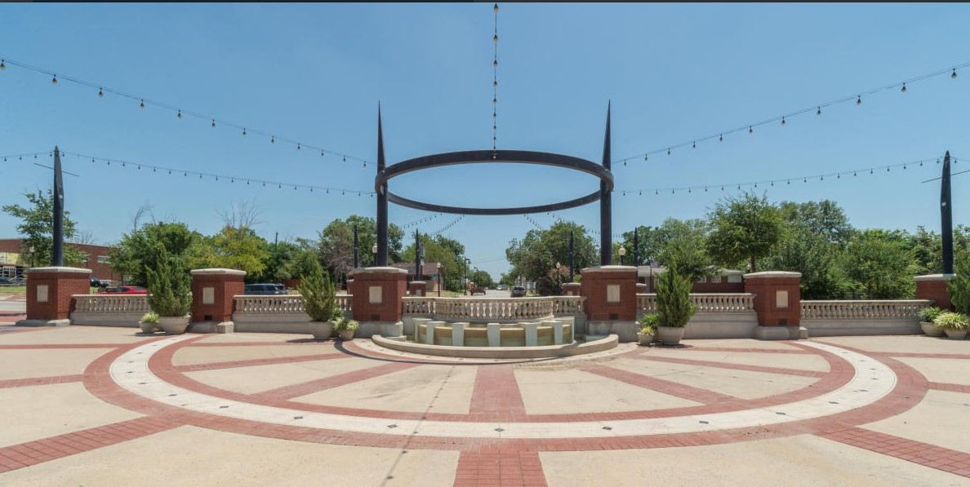
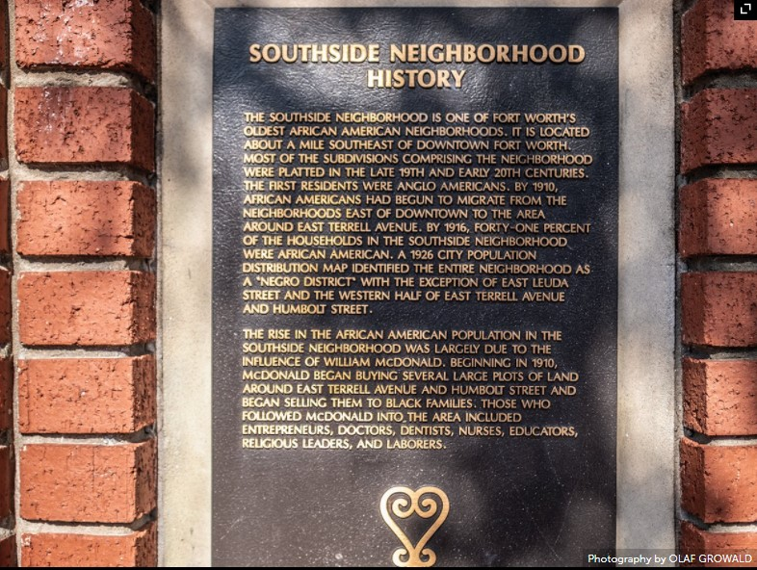
Tax Increment Reinvestment Zone Number Four
Reimburse up to $7 million upon completion of the parking garage and enhancements to the cultural square, linear parks, interactive square, and other public spaces

Slide 39
Development Summary
Private Investment
  Minimum $70 Million in Real property
  Minimum $56 Million in Hard Costs
Other Commitments
  20% of Units Affordable
  30 Full-Time Employees, best efforts to hire from neighborhood
  Community Engagement
  Cultural and Heritage considered throughout Development
  Efforts to Attract a Grocer
Incentive Summary
  $9 Million Chapter 380 EDPA
  $7 Million in TIF 4 Funds
  $4,126,862 in FWHFC Property
  $537,076 in LDC Property
  $112,500 in City Property
  Total Incentive Proposed = $20,776,438
Private/Public Ratio – Chapter 380
(based on max. estimate / cap)
  NPV Benefit $4,557,859
  City Participation (NPV) 6.0%
  Est. Ratio (Gross) 8.4:1
  Est. Ratio (NPV) 16.6:1
Payback 3.85 years
CFW Tax Revenue (15 yr. projection)
  Net NPV New Tax Generated $ 6,648,619
Private/Public Ratio – “All In”
(Includes use of ARPA funds)
  City Participation (NPV) 21.7%
  Est. Ratio (Gross) 3.6:1
  Est. Ratio (NPV) 4.6:1
  Payback 10.45 years

Slide 40
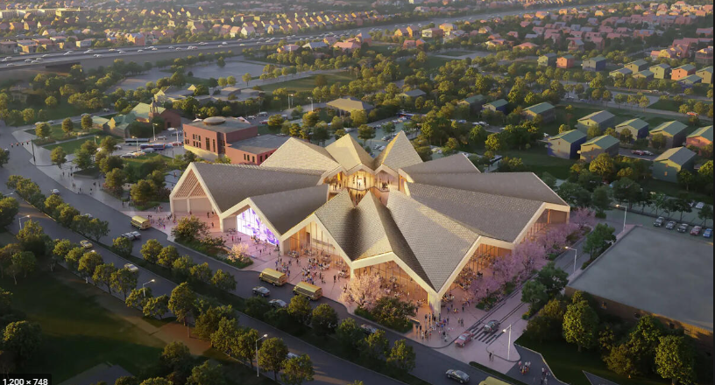
Notes:
National Juneteenth Museum -- $70M investment with $15M coming from City of Fort Worth – includes a business incubator to promote Black entrepreneurship, a food hall, and performance space and theater. Developer is Jarred Howard of Sable Brands. Construction in 2023. Opens 2025.

Slide 41
Thank you
Amy Connolly
Assistant Neighborhood Services Director
Amy.Connolly@fortworthtexas.gov
fortworthtexas.gov

