Slide 1
Presentation To Redistricting Task Force On Citizen Participation
September 17, 2020

Slide 2
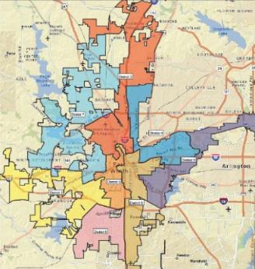
Fort Worth Council Districts
2003-2013 Council Districts
Current Council Districts

Slide 3
2011-12 Redistricting Process
City staff held citywide public meetings to solicit inputs and train citizens in use of mapping software
Citizens submitted written comments and formal plans
Formal citizen involvement ended there
Staff incorporated citizen and council inputs into a single integrated plan
Final district plan submitted to DOJ for review

Slide 4
Citizens Submitted Plans in 2012
Citizen input solicited in 2012-13 Redistricting Cycle
First time that citizen-drawn plans were used
Maps drawn using commercial software used by City
9 plans submitted by individuals and area groups
1 plan from member of City Engineering Staff
2 plans from Eastside residents serving on Zoning Commission
3 plans from United Hispanic Council
1 plan from Alliance Texas real estate executive
1 plan from North Fort Worth Alliance NA
1 plan from Stop Six Sunrise Edition NA

Slide 5
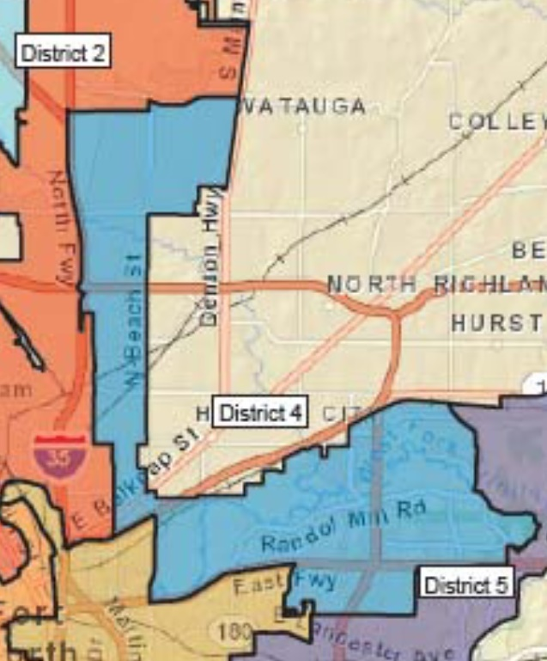
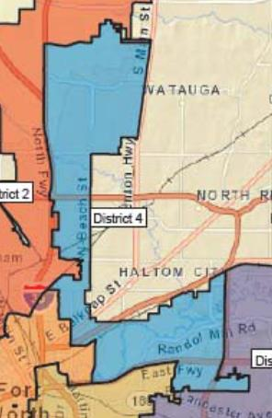
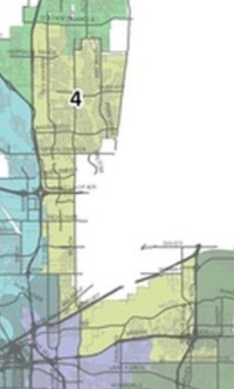
District 4 Based On Citizen Plan
Previous District 4 (2003-13)
Citizen Input Plan (2012)
Current District 4
Staff Adjustments

Slide 6
Lessons Learned From Last Cycle
Some citizen plans received more weight than others
Citizen plans represented many neighborhoods and communities of interest but not comprehensively
No participation by Westside or Southside residents
Need more proactive effort to broaden representation
Citizen involvement ended with submittal of plans
No opportunity to participate in drafting of integrated plan
Some dissatisfaction was expressed by citizens during public comments to draft plan

Slide 7
How To Improve Citizen Process?
Ensure more inclusive representation of neighborhoods and communities of interest
Give more weight to residents of a district (avoid districts drawn by non-residents)
Let citizens to work out their differences as participants in drafting the integrated plan
Broaden participation, not limited to residents who submit complete plans
City staff to oversee and facilitate citizen discussions
Invite voting rights attorney to counsel redistricting team

Slide 8
BACKGROUND CHARTS

Slide 9
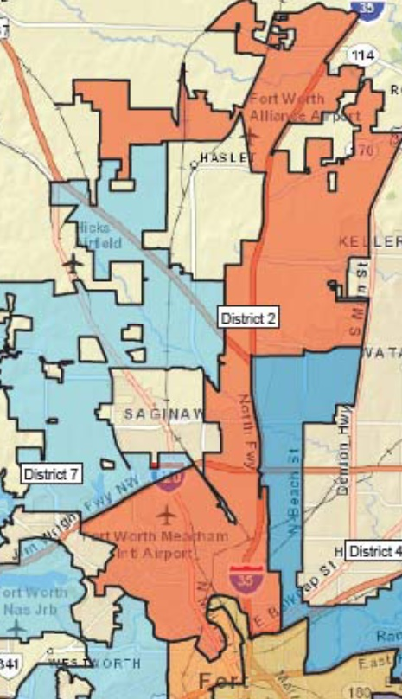
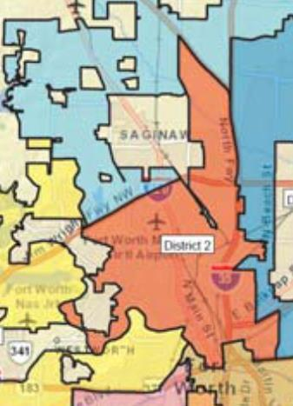
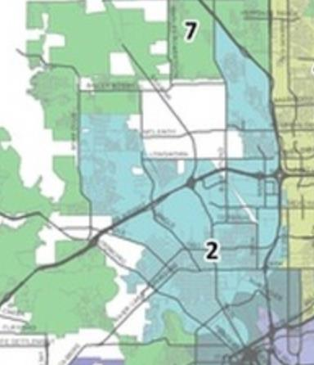
District 2 Roughly Followed United Hispanic Council
Previous District 2 (2003-2013)
Note: All 9 citizen plans incorporated
Jim Wright Fwy boundary
(eliminated to include more
Hispanic areas in District 2)
United Hispanic Council Plan 12C
Current District 2
Boundary
Similarities

Slide 10
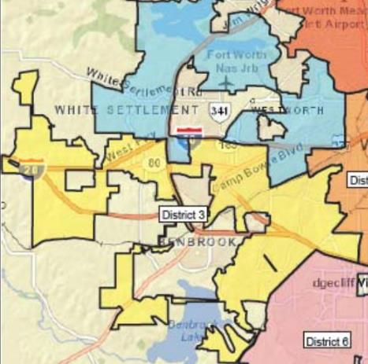
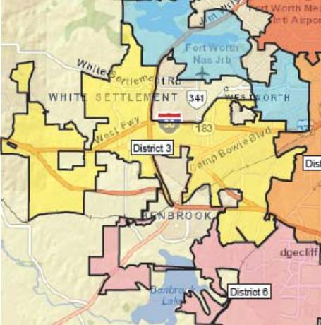
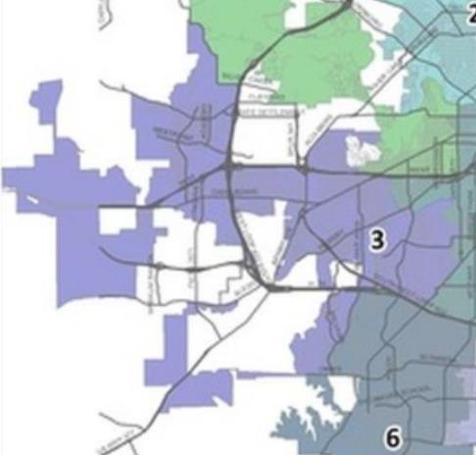
District 3 Based On Citizen Plan
Previous District 3 (2003-2013)
Citizen Input Plan (2012)
Current District 3
Staff Adjustments

Slide 11
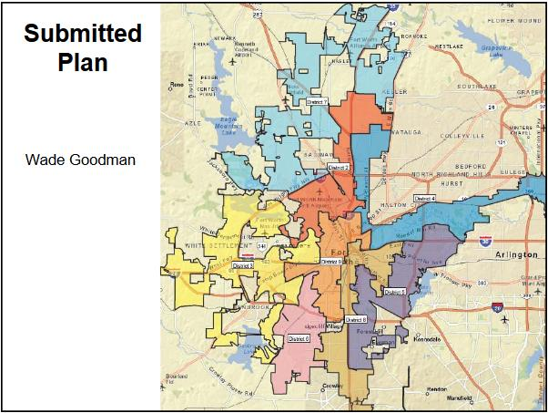
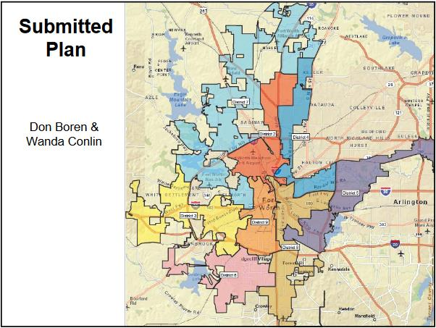
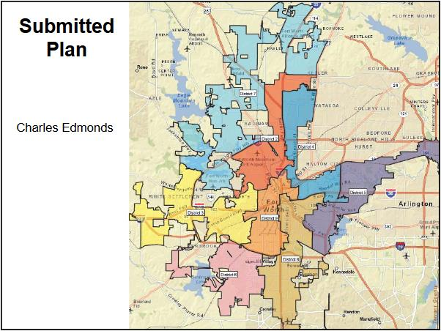
Plans Submitted By Citizens (2012)

Slide 12
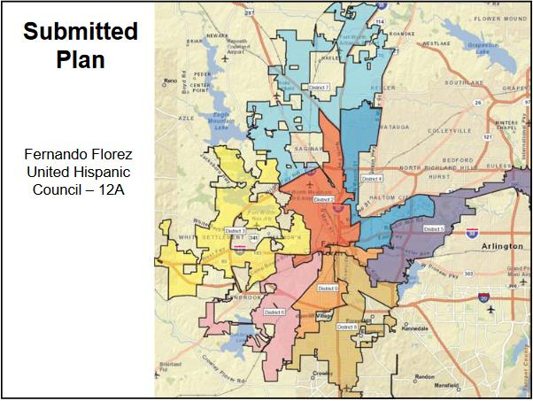
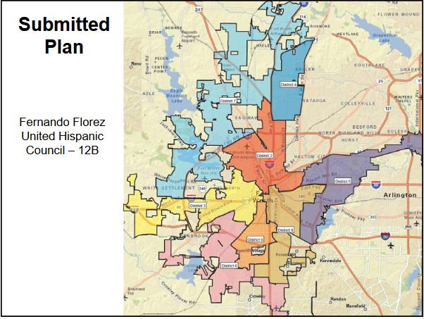
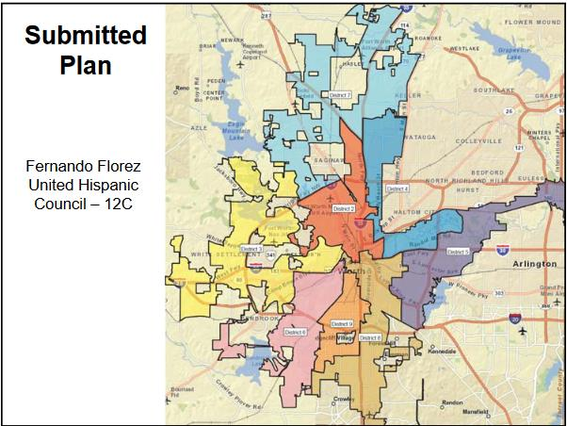
Plans Submitted By Citizens (2012)

Slide 13
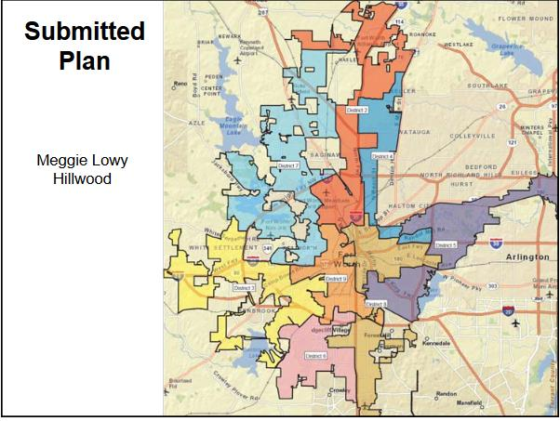
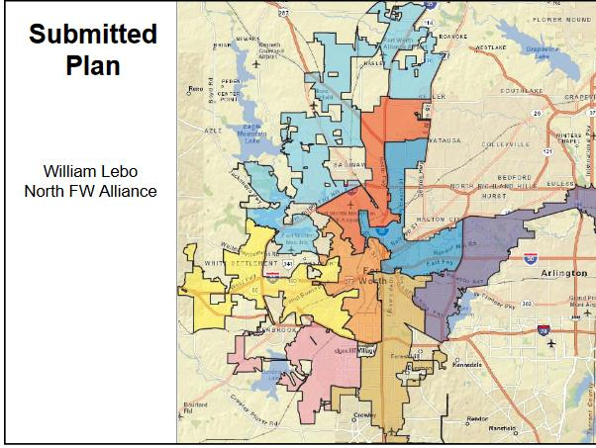
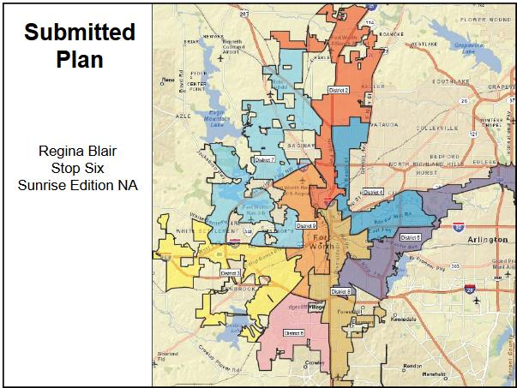
Plans Submitted By Citizens (2012)

