Slide 1
REDISTRICTING TASK FORCE
September 17, 2020

Slide 2
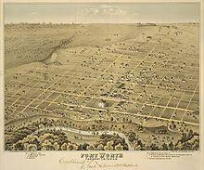
Brief History
1849 U.S. Army establishes Fort Worth on Trinity River.
Community incorporates as City of Fort Worth.
City adopts council-manager form of government.
1965 U.S. Congress passes Voting Rights Act.
1975 Voters amend charter to create single-member districts.
1981
1991
2001
2011
Redistricting: City Council redraws district lines
after release of census results.

Slide 3
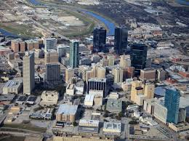
Brief History (continued)
2013 U.S. Supreme Court invalidates coverage provisions of Voting Rights Act.
Voters amend City Charter to increase number of single-member districts from eight to ten.
Task Force on Race and Culture recommends creation of independent redistricting commission.
City Council declines to create independent redistricting commission, deciding instead to create task force on criteria and procedures.
2020 COVID-19 strikes United States, causing seven-month delay in census and subsequent redistricting.
2020 City Council appoints Redistricting Task Force.

Slide 4
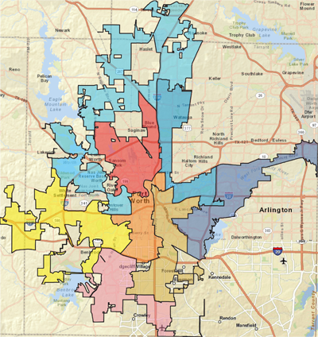
Looking Back: 2011 Redistricting Criteria Per Resolution No. 3998-06-2011, Adopted June 14, 2011
Approximately equal size: Population of largest district < 10 percent more than population of smallest district.
No fragmentation of minority communities or packing of minority voters
No retrogression in ability of minorities to participate in electoral process
Compact and contiguous territory
Identifiable geographic boundaries
Containing communities of interest in single districts
Including areas inside Loop 820 and areas outside Loop 820, if possible, within each Council district
Containing whole voting precincts
Containing whole census blocks or block groups
Preserving incumbent-constituent relations

Slide 5
Looking Back: 2012 Redistricting Procedures
Late January | City notifies public of redistricting plan process.
February | City Council and staff host public workshops including software training.
March 30 | Redistricting plans and other comments due to City Secretary’s Office.
April | Staff prepares analysis of plans submitted and briefs City Council.
May – June | City Council and staff conduct public meetings and City Council conducts work sessions on plan options.
July | City Council conducts public hearing(s), approves plan and submits it to U.S. Department of Justice (DOJ).
August - November | DOJ reviews plan.

Slide 6
Looking Back: 2016 Charter Amendment
Increased the number of Council members from 8+1 to 10+1.
Effective upon redistricting after the 2020 census for the 2023 municipal election.

Slide 7
2018 Task Force on Race and Culture Governance Strategy #1: Redistricting Criteria and Procedures
Goal: Create districts that, when drawn, provide the best opportunities to elect City Council members who reflect the diverse population of the City.

Slide 8
City Manager’s Recommendation Appoint Redistricting Task Force in August 2020
Charge
Develop criteria and procedures to be used to create City Council districts for the 2023 election.
Present recommended criteria and procedures to the City Council.

Slide 9
Composition of Redistricting Task Force
Eleven total members
Eight district members nominated by Council members to ensure geographic diversity
Three at-large members nominated by Mayor to ensure diversity of expertise and interests

Slide 10
Redistricting Task Force
Place 1: Lorraine Miller (Chair)
Place 2: Salvador Espino
Place 3: Graham Norris
Place 4: Craig Allen
Place 5: Bert Williams
Place 6: Linda Kennedy
Place 7: Tony DeVito
Place 8: Tracy Scott
Place 9: Kent Bradshaw
Place 10: Bill Schur
Place 11: Teresa Ayala

Slide 11
Task Force Schedule, August 2020 – March 2021
Month | Activity
August 2020 | City Council adopts resolution appointing Redistricting Task Force.
September | Staff provides task force with informational briefings. Task force charge Legal basis for redistricting Demonstration of redistricting software Texas Open Meetings Act training
October | Task force interviews subject matter experts and representatives of other cities.
November | Task force discusses pros and cons of various options, agrees on preliminary findings.
December | Task force presents interim report to City Council.
January 2021 | Task force conducts series of public meetings, perhaps four for paired Council districts.
February | Task force discusses comments from public meetings, agrees on final recommendations.
March | Task force presents final report to City Council for approval, well before May 2021 election.

Slide 12
Redistricting Schedule, May 2021 – May 2023
Month | Activity
May 2021 | City conducts 2021 election.
End of July | Census Bureau releases block-level census data for state and local redistricting.
August | City Council and Redistricting Task Force hold joint work session.
August to December | City Council conducts redistricting process in accordance with approved criteria and procedures.
December | Tarrant County Voter Registrar prints voter registration cards with information about new Council districts.
Mid-July 2022: 180 days before qualifying begins for May 2023 municipal election | Deadline for candidates to establish residency within Council districts that they wish to represent.
Mid-January to mid-February 2023 | Candidates qualify for 2023 municipal election.
May 2023 | City conducts 2023 election.

Slide 13
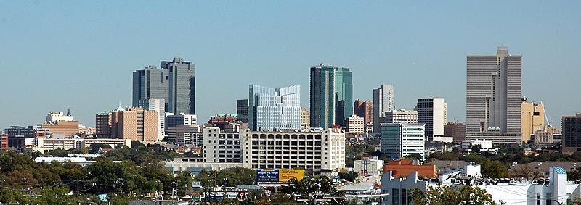
Questions?

