Slide 1
PROPOSED REDISTRICTING MAPS
Presented to the City Council
February 22, 2022

Slide 2
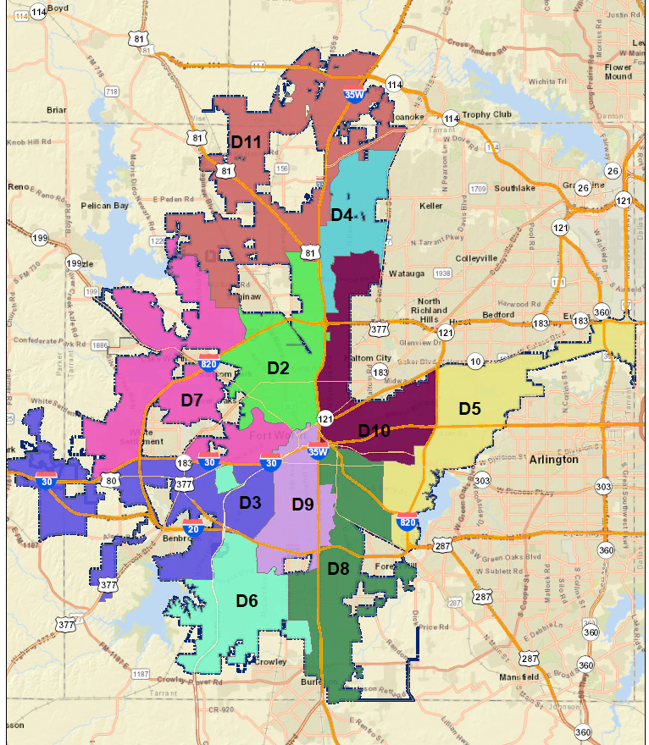
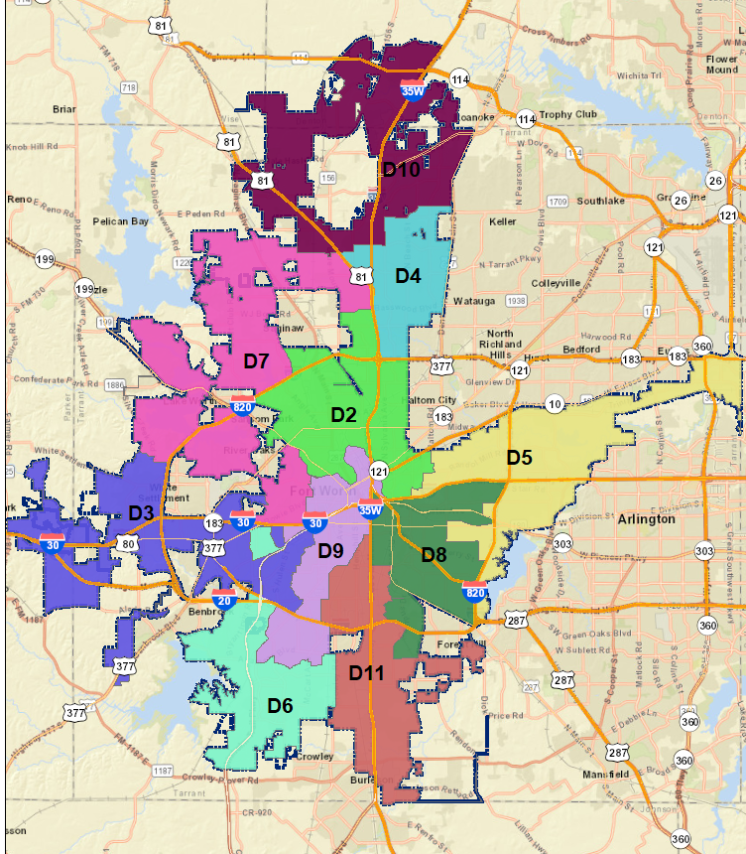
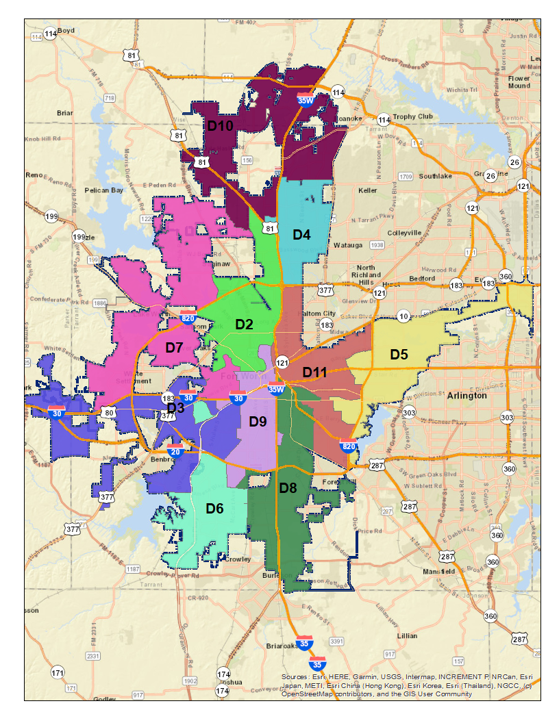
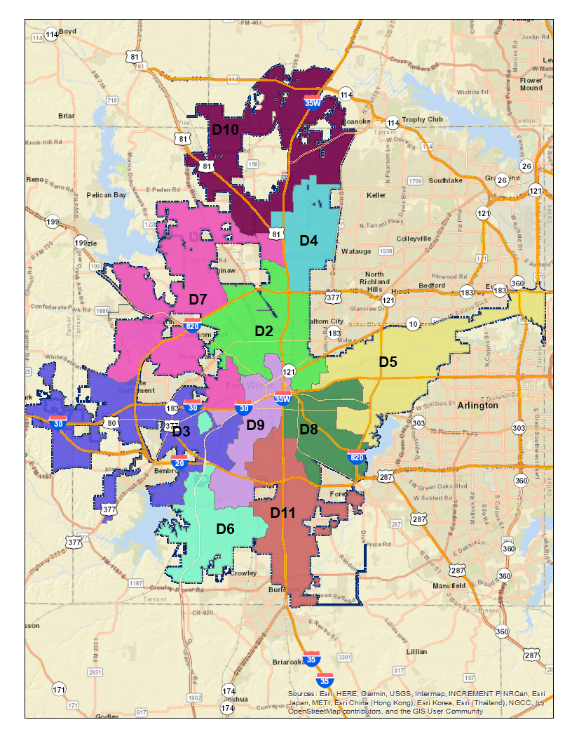
Proposed Redistricting Maps
Map v2
as Amended 2/15/22
Map v4
Map v3
as Amended 2/15/22
Map v2
as Amended 2/19/22
Map v4
as Amended 2/19/22

Slide 3
Map v2 as Amended 2/19/22
Stone Glen in D10
Part of Summerfields in D4 per school attendance zones

Slide 4
Demographic Data for Map v2 as Amended 2/19/22
update
District | Total Population | White | White % | White VAP% | African American | African American % | African American VAP% | Hispanic | Hispanic % | Hispanic VAP% | Asian | Other | Minority Opportunity? | MMA (>50% Combined) SMMA (>75% Combined Minority) | VAP MMA (>50% Combined) VAP SMMA (>75% Combined Minority) | Number of Split Geographic Units | Number of Split Geographic Unit |  | s |  | Compactness Score (Polsby-Popper Ratio)
 |  |  |  |  |  |  |  |  |  |  |  |  |  |  |  | Communities of Interest | Communities of Interest |  | Voting Precincts | Census Block Groups
 |  |  |  |  |  |  |  |  |  |  |  |  |  |  |  | Count | Split | Intact
2 | 89,524 | 17,535 | 19.6% | 22.0% | 8,062 | 9.0% | 8.3% | 57,352 | 64.1% | 62.4% | 4,886 | 1,689 | TBD | SMMA | SMMA | 2 | 29, 40 | 17, 18, 42 | NA | 19 | 0.19
3 | 88,186 | 48,689 | 55.2% | 59.1% | 13,597 | 15.4% | 14.1% | 19,301 | 21.9% | 19.3% | 4,057 | 2,542 | TBD | NO | NO | 4 | 2, 7, 10, 67 | 3, 4, 5, 6, 13, 14, 15, 22, 23, 24, 51, 68 | NA | 32 | 0.05
4 | 87,781 | 48,165 | 54.9% | 57.3% | 9,952 | 11.3% | 10.7% | 16,909 | 19.3% | 17.7% | 9,247 | 3,508 | TBD | NO | NO | 2 | 20, 21 | 8, 9, 33, 35, 36, 38, 39 | NA | 8 | 0.22
5 | 94,929 | 21,063 | 22.2% | 25.1% | 38,790 | 40.9% | 40.9% | 25,750 | 27.1% | 23.9% | 6,696 | 2,630 | TBD | SMMA | SMMA | 2 | 65, 57 | 53, 55, 56 | NA | 7 | 0.12
6 | 96,454 | 28,060 | 29.1% | 33.5% | 33,407 | 34.6% | 33.0% | 27,099 | 28.1% | 25.2% | 5,340 | 2,548 | TBD | MMA | MMA | 4 | 2, 7, 10, 71 | 1, 59, 60, 61, 72, 75, 76 | NA | 19 | 0.09
7 | 88,356 | 52,009 | 58.9% | 62.8% | 8,757 | 9.9% | 8.9% | 20,781 | 23.5% | 20.7% | 3,714 | 3,095 | TBD | NO | NO | 2 | 29, 67 | 16, 27, 28, 30, 52, 62, 77 | NA | 13 | 0.05
8 | 96,293 | 13,600 | 14.1% | 16.9% | 31,723 | 32.9% | 34.0% | 45,827 | 47.6% | 43.9% | 3,275 | 1,868 | TBD | SMMA | SMMA | 3 | 25, 65, 70 | 43, 44, 45, 58, 63, 64, 66, 69, 73 | NA | 25 | 0.08
9 | 95,367 | 28,678 | 30.1% | 34.9% | 11,719 | 12.3% | 12.4% | 50,558 | 53.0% | 48.1% | 2,746 | 1,666 | TBD | MMA | MMA | 4 | 25, 40, 70, 71 | 11, 26, 46, 47, 48, 49, 50, 74 | NA | 22 | 0.32
10 | 94,261 | 31,921 | 33.9% | 38.0% | 17,061 | 18.1% | 17.4% | 36,849 | 39.1% | 35.3% | 5,772 | 2,658 | TBD | MMA | MMA | 3 | 20, 21, 57 | 41, 54 | NA | 15 | 0.19
1/11 | 87,764 | 46,903 | 53.4% | 56.2% | 11,301 | 12.9% | 12.0% | 19,410 | 22.1% | 20.2% | 6,841 | 3,309 | TBD | NO | NO | 1 | 29 | 12, 19, 31, 32, 34, 37 | NA | 12 | 0.04

Slide 5
Opinion of Outside Counsel for Map v2 as Amended 2/15/22
update
One likely Hispanic district (District 2). District 2 has a Hispanic voting age population (VAP) of 59.2 percent and a relatively low White and African American population (19.2 percent and 17.3 percent, respectively). This is likely enough population to elect and candidate of Hispanic choice.
Two districts with Hispanic VAP (but not apparently citizen voting age population) pluralities (Districts 8 and 9).
District 8 has a Hispanic VAP of 45.3 percent and an African American VAP of 33.5 percent. While the Hispanic voting age population outnumbers African Americans by almost 12 percent, District 8 may not necessarily elect a Hispanic candidate. This is due to the younger age of the Hispanic population, lower citizenship levels compared to African Americans, less voter cohesion, and typically less voter registration. While a Hispanic might be elected, it seems more likely that District 8 would elect an African-American.
District 9 has a Hispanic VAP of 45.4 percent and a White VAP of 38.1 percent. For the same reasons as indicated for District 8, it seems more likely that District 9 will elect a White candidate.
One strong African-American district (District 5). District 5 has an African American VAP of 41.1 percent and comparatively low White and Hispanic populations (25.1 percent and 23.7 percent). Therefore, it seems likely that District 5 will elect a candidate of African American choice.
One likely African American district (District 8). As noted above, District 8 has a higher Hispanic VAP than African American or White. However, the African American VAP of 33.5 percent is likely enough to elect an African American candidate.
One toss-up district (District 6). District 6 appears to be a toss-up between African Americans and Anglos because the voting age population is essentially the same between the two groups.

Slide 6
Map v3 as Amended 2/15/22
Fossil Creek in D4
Poly in D11
Old Handley (west of Loop 820) in D11
Chapel Creek in D7
Burton Hill in D3
Bailey Triangle in D9

Slide 7
Demographic Data for Map v3 as Amended 2/15/22
District | Total Population | White | White % | White VAP% | African American | African American % | African American VAP% | Hispanic | Hispanic % | Hispanic VAP% | Asian | Other | Minority Opportunity? | MMA (>50% Combined) SMMA (>75% Combined Minority) | VAP MMA (>50% Combined) VAP SMMA (>75% Combined Minority) | Number of Split Geographic Units | Number of Split Geographic Units |  |  |  | Compactness Score (Polsby-Popper Ratio)
 |  |  |  |  |  |  |  |  |  |  |  |  |  |  |  | Communities of Interest | Communities of Interest |  | Voting Precincts | Census Block Groups
 |  |  |  |  |  |  |  |  |  |  |  |  |  |  |  | Count | Split | Intact
2 | 89,175 | 17,775 | 19.9% | 22.2% | 7,937 | 8.9% | 8.1% | 56,726 | 63.6% | 62.1% | 5,043 | 1,694 | TBD | SMMA | SMMA | 1 | 29 | 17, 18, 42 | NA | 5 | 0.18
3 | 93,745 | 51,907 | 55.4% | 59.3% | 14,704 | 15.7% | 14.3% | 20,114 | 21.5% | 18.9% | 4,236 | 2,784 | TBD | NO | NO | 4 | 3, 7, 10 | 2, 4, 5, 6, 14, 15, 22, 23, 24, 51, 67, 68 | NA | 20 | 0.05
4 | 94,718 | 49,391 | 52.2% | 55.0% | 10,980 | 11.6% | 10.8% | 20,364 | 21.5% | 19.6% | 10,393 | 3,590 | TBD | NO | NO | 0 |  | 8, 9, 20, 21, 36, 38, 39 | NA | 0 | 0.36
5 | 91,727 | 22,592 | 24.6% | 27.8% | 37,351 | 40.7% | 39.9% | 22,107 | 24.1% | 21.5% | 6,938 | 2,739 | TBD | SMMA | MMA | 1 | 57 | 53, 55, 56 | NA | 8 | 0.11
6 | 92,649 | 27,341 | 29.5% | 33.9% | 31,493 | 34.0% | 32.4% | 26,211 | 28.3% | 25.4% | 5,172 | 2,432 | TBD | MMA | MMA | 4 | 7, 10, 71 | 1, 59, 60, 61, 72, 75, 76 | NA | 12 | 0.1
7 | 94,371 | 52,729 | 55.9% | 60.0% | 9,610 | 10.2% | 9.2% | 24,032 | 25.5% | 22.5% | 4,671 | 3,329 | TBD | NO | NO | 1 | 29 | 16, 19, 27, 28, 30, 37, | NA | 12 | 0.04
8 | 90,607 | 14,231 | 15.7% | 18.8% | 32,595 | 36.0% | 36.5% | 38,222 | 42.2% | 38.8% | 3,644 | 1,915 | TBD | SMMA | SMMA | 0 |  | 52 62 25, 43, 44, 45, 58, 64, 66, 69, 70, 73 | NA | 12 | 0.07
9 | 91,161 | 33,309 | 36.5% | 41.6% | 8,403 | 9.2% | 9.3% | 44,603 | 48.9% | 43.8% | 3,047 | 1,799 | TBD | MMA | MMA | 3 | 3, 71, 40 | 11, 13, 26, 46, 47, 48, 49, 50, 74, 77 | NA | 20 | 0.27
10 | 94,945 | 54,441 | 57.3% | 59.9% | 11,088 | 11.7% | 10.8% | 18,003 | 19.0% | 17.4% | 7,623 | 3,790 | TBD | NO | NO | 0 |  | 12, 31, 32, 33, 34, 35 | NA | 1 | 0.05
1/11 | 85,817 | 12,907 | 15.0% | 18.3% | 20,208 | 23.6% | 24.9% | 49,454 | 57.6% | 52.7% | 1,807 | 1,441 | TBD | SMMA | SMMA | 2 | 40, 57 | 41, 54, 63, 65 | NA | 14 | 0.08

Slide 8
Opinion of Outside Counsel for Map v3 as Amended 2/15/22
update
One likely Hispanic district (District 2). District 2 has a Hispanic VAP of 62.2 percent and will likely elect a candidate of Hispanic choice.
Three districts with Hispanic VAP (but not apparently citizen voting age population) pluralities (districts 8, 9, and 1/11).
District 8 might elect a Hispanic candidate, with a Hispanic VAP of 49.1 50.0 percent. However, the African American voting age population of 26.8 23.6 percent is not insignificant and could be enough to elect an African American candidate. Therefore, District 8 appears to be a toss-up. (Confirmed)
District 9 seems most likely to elect a White candidate. This Hispanic VAP is 44.6 percent and the White VAP is 41.1 percent. However, as noted above, Hispanic voting strength is typically lower than indicated by VAP due to several factors that do not necessarily apply to the White VAP, such as citizenship.
District 1/11 appears most likely to elect an African-American. Hispanic VAP is 39.6 percent and African American VAP is 36.1 percent. The White VAP is relatively low at 18.5 percent. This ratio of voters likely favors an African American candidate.
Two likely African-American districts (Districts 5 and 1/11).
District 5 has an African American plurality, with a VAP of 38.9 40.0 percent (as compared to the White VAP of 27.3 27.4 percent and Hispanic of 22.9 22.0 percent). This is likely to result in an African American candidate prevailing.
As noted above, District 1/11 has a Hispanic plurality, but seems likely to elect an African American candidate.
One toss-up district (District 6). District 6 appears to be a toss-up between African Americans and Anglos because the voting age population is essentially the same between the two groups. (Confirmed)

Slide 9
Map v4 as Amended 2/19/22
Camp Bowie District entirely in D3
Colonial Hills, Overton Park, and Tanglewood entirely in D3
Handley entirely in D5
Stop Six entirely in D5

Slide 10
Demographic Data for Map v4 as Amended 2/19/22
update
District | Total Population | White | White % | White VAP% | African American | African American % | African American VAP% | Hispanic | Hispanic % | Hispanic VAP% | Asian | Other | Minority Opportunity? | MMA (>50% Combined) SMMA (>75% Combined Minority) | VAP MMA (>50% Combined) VAP SMMA (>75% Combined Minority) | Number of Split Geographic Units | Number of Split Geographic Units |  |  |  | Compactness Score (Polsby-Popper Ratio)
 |  |  |  |  |  |  |  |  |  |  |  |  |  |  |  | Communities of Interest | Communities of Interest |  | Voting Precincts | Census Block Groups
 |  |  |  |  |  |  |  |  |  |  |  |  |  |  |  | Count | Split | Intact
2 | 95,055 | 16,085 | 16.9% | 19.6% | 7,596 | 8.0% | 7.3% | 65,998 | 69.4% | 67.2% | 3,762 | 1,614 | TBD | SMMA | SMMA | 1 | 29 | 41, 42 | NA | 6 | 0.21
3 | 91,832 | 50,421 | 54.9% | 59.3% | 12,790 | 13.9% | 12.6% | 22,415 | 24.4% | 21.5% | 3,305 | 2,901 | TBD | NO | NO | 3 | 1, 7, 10 | 2, 4, 5, 6, 15, 16, 27, 28, 51, 67 | NA | 15 | 0.04
4 | 94,805 | 48,722 | 51.4% | 54.2% | 11,316 | 11.9% | 11.1% | 20,547 | 21.7% | 19.8% | 10,660 | 3,560 | TBD | NO | NO |  |  | 8, 9, 20, 21, 36, 38, | NA | 1 | 0.36
5 | 91,990 | 23,100 | 25.1% | 28.4% | 36,764 | 40.0% | 39.0% | 22,438 | 24.4% | 21.8% | 6,948 | 2,740 | TBD | SMMA | MMA | 1 | 57 | 39 53, 54, 55, 56 | NA | 7 | 0.1
6 | 87,233 | 25,953 | 29.8% | 34.0% | 31,379 | 36.0% | 34.1% | 22,496 | 25.8% | 23.2% | 5,239 | 2,166 | TBD | MMA | MMA | 3 | 1, 7, 10 | 24, 59, 60, 61, 68, 72, 75 | NA | 12 | 0.09
7 | 95,086 | 49,643 | 52.2% | 56.4% | 10,228 | 10.8% | 9.7% | 25,559 | 26.9% | 24.0% | 6,426 | 3,230 | TBD | NO | NO | 1 | 29 | 17, 18, 19, 30, 37, | NA | 12 | 0.05
8 | 95,633 | 10,712 | 11.2% | 13.9% | 33,035 | 34.5% | 36.5% | 47,597 | 49.8% | 45.3% | 2,741 | 1,548 | TBD | SMMA | SMMA | 2 | 57, 70 | 52 62 43, 44, 45, 63, 64, 65, 66 | NA | 12 | 0.23
9 | 87,986 | 44,872 | 51.0% | 55.0% | 12,829 | 14.6% | 14.0% | 24,048 | 27.3% | 23.9% | 3,827 | 2,410 | TBD | NO | NO | 2 | 48, 74 | 3, 11, 13, 14, 22, 23, 40, 49, 50, 71, 76, 77 | NA | 23 | 0.19
10 | 91,575 | 53,346 | 58.3% | 60.9% | 10,277 | 11.2% | 10.3% | 17,070 | 18.6% | 17.0% | 7,143 | 3,739 | TBD | NO | NO |  |  | 12, 31, 32, 33, 34, 35 | NA | 4 | 0.06
1/11 | 87,720 | 13,769 | 15.7% | 18.5% | 18,155 | 20.7% | 20.7% | 51,668 | 58.9% | 56.2% | 2,523 | 1,605 | TBD | SMMA | SMMA | 3 | 48, 70, 74 | 25, 26, 46, 47, 58, 69, 73 | NA | 10 | 0.08

Slide 11
Opinion of Outside Counsel for Map v4 (before amendments)

Slide 12
Minority Opportunity Districts
Assessment | Map v2 as Amended 2/19/22 | Map v3 as Amended 2/15/22 | Map v4 As Amended 2/19/22
Likely Hispanic
Likely African American
Toss-Up
Total | districts | districts | districts

Slide 13
Communities of Interest
update
COI Group | Map v2 as Amended 2/19/22 | Map v3 as Amended 2/15/22 | Map v4 as Amended 2/19/22
Total COIs: Percentage Split | 35.1% | 20.8% | 20.8%
Key COIs Highlighted at 2/8/22 Public Hearing: Names of Those Split | Fairway Bend in D4 & D9 Morningside in D8 & D9 Oakridge Terrace in D8 & D9 Wedgwood Square in D6 & D9 | Handley in D5 & D11 Wedgwood Square in D6 & D9 | Oakridge Terrace? Rosemont, South Hills in D9 & D11 Westcliff in D9

Slide 14
Next Steps
Day | Date | Time | Location | Activity
Tuesday | February 22 | 9:30 a.m. | City Hall Room 2020 | Produce proposed map for public review and comment.
Thursday | February 24 | 6:00 p.m. | Council Chamber | Conduct public hearing on proposed map.
Tuesday | March 22 | 9:00 a.m. | City Hall Room 2020 | Conduct special work session to produce final map.
Tuesday | March 29 | 10:00 a.m. | Council Chamber | Adopt final map.

Slide 15
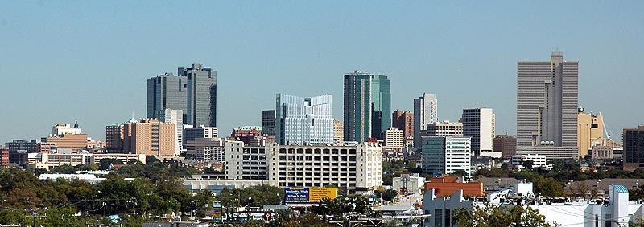
Questions?

