Slide 1
Redistricting Task Force
Communications and Outreach
Michelle Gutt
Communications & Public Engagement

Slide 2
Two Phases
Phase 1 – Education
  What is Redistricting?
  Why is it important?
  What is the process?
Phase 2 – Engagement
  How can I get involved?
  Online and in-person tools
    5 meetings throughout the city

Slide 3
Outreach and Engagement
Waterbill insert – City Times
GovDelivery
    City News
    District newsletters
    Redistricting Topic
Robocalls
Neighborhood outreach

Slide 4

Outreach and Engagement
Social Media Campaign
  Facebook, Twitter, Nextdoor, Instagram
  Posts shared with partners for extended outreach
  Videos
  Hashtag #FWRedistricting

Slide 5
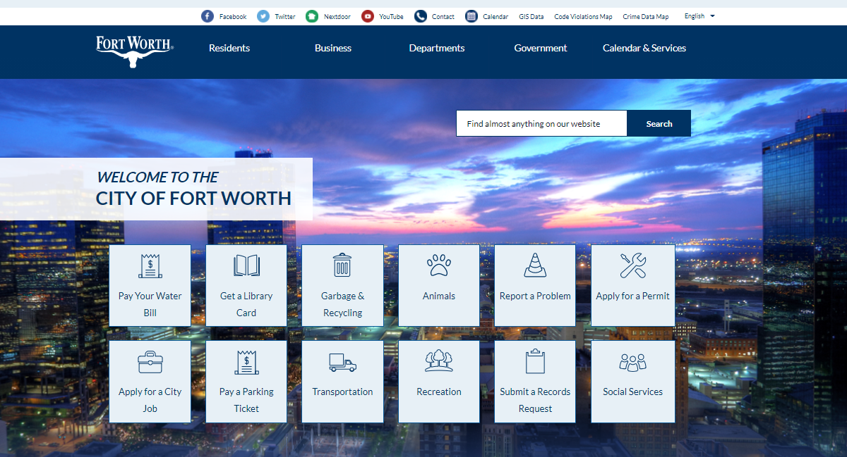
Outreach and Engagement
FortWorthTexas.gov/FWRedistrict – Live December 1
  Task Force information
    Downloadable information
    Informational videos
  Links to mapping

Slide 6

Video Series
Redistricting 101 Video
  Overview of Redistricting process
  Why it is important
    Two new council seats
Redistricting Task Force Video
  Charge from City Council
    Role of the community
    Next Steps
  Interviews Chair and Mayor

Slide 7
Timeline
December – Phase 1
  Redistricting 101 Video
  Website launch
  Public Education Campaign
January – Continue Phase 1 and launch Phase 2
  Public Engagement Campaign
  Task Force Video
  Redistricting 101 Seminar and Public Meetings – virtual
  Online feedback

Slide 8
Questions?

