Slide 1
Redistricting Task Force Minority Packing
Byrwec Ellison
October 22, 2020

Slide 2
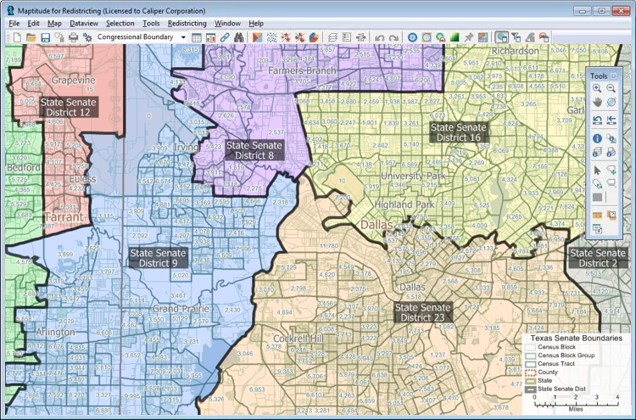
Computing Technology Has Changed The Art Of Redistricting
$

Slide 3
DFW Hispanic Voting Population (2010 Census Data)

Slide 4
DFW Black Voting Population (2010 Census Data)

Slide 5
DFW White Voting Population (2010 Census Data)

Slide 6
Congressional District 33 (Rep. Marc Veasey’s district is 85% minority)

Slide 7
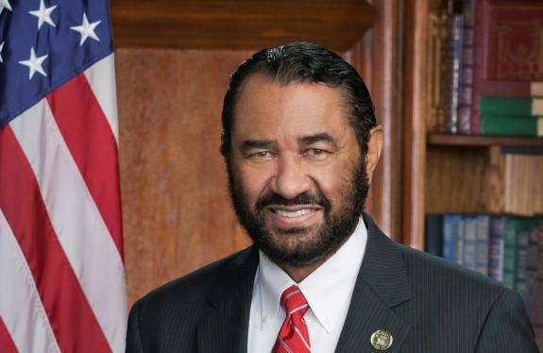
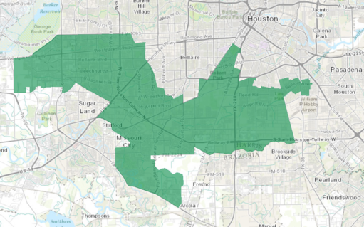
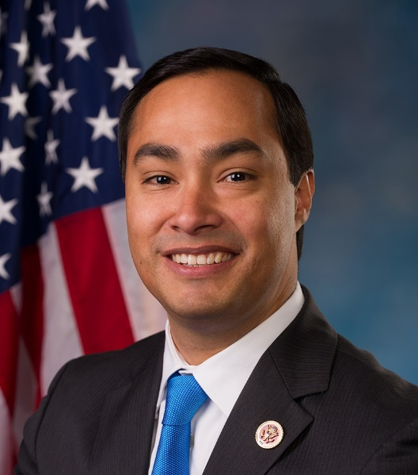
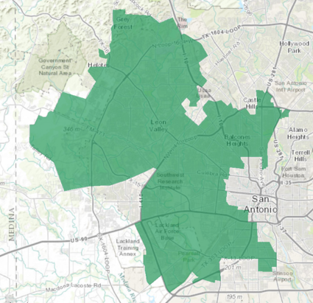
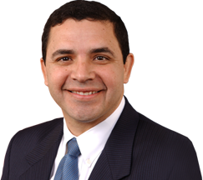
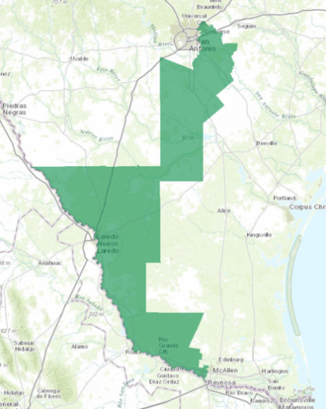
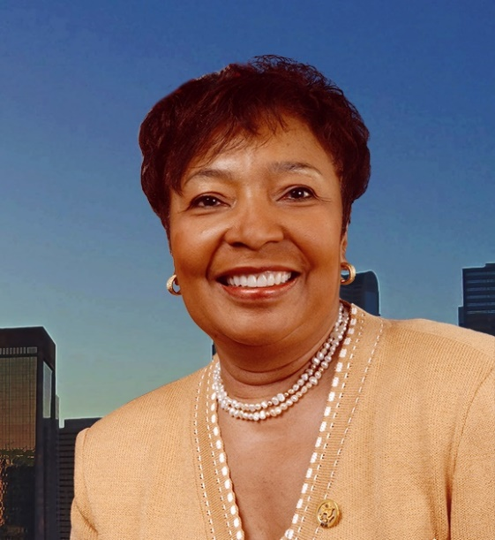
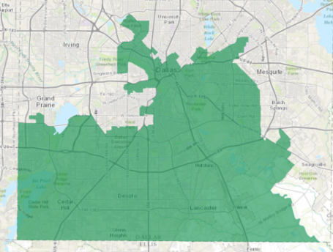
Highest Packed Congressional Districts In Texas Are Minority
Rep. Al Green (D) 89% MOV*
Texas 9th District(Houston) 89% Minority
Rep. Joaquin Castro (D) 81% MOV
Texas 20th District (San Antonio) 79% Minority
Rep. Henry Cuellar (D) 84% MOV
Texas 28th District (San Antonio) 85% Minority
Rep. Eddie Bernice Johnson (D) 91% MOV
Texas 30th District (Dallas) 82% Minority
* Margin of Victory (2018)

Slide 8
Stop 6 Sunrise NA Plan Reduced Minority Opportunity Districts
Fort Worth City Council Plans Submitted By Residents In 2012
Citizen Plan | VRA | Precinct Split < 5 | Neighborhood Split < 5 | Geography | I-820 > 5 | Incumbent | Min. Opp. Districts
Goodman | ✓ | ✓ |  | ✓ | ✓ | ✓ | 4
Boren-Conlin | ✓ | ✓ |  | ✓ | ✓ | ✓ | 4
Edmonds | ✓ | ✓ | ✓ | ✓ | ✓ | ✓ | 4
United Hispanic Council 12A | ✓ | ✓ |  | ✓ | ✓ |  | 4
United Hispanic Council 12B | ✓ | ✓ |  | ✓ | ✓ |  | 4
United Hispanic Council 12C | ✓ | ✓ | ✓ | ✓ | ✓ | ✓ | 4
Lowy-Hillwood | ✓ |  |  |  | ✓ | ✓ | 4
North FW Alliance NA | ✓ | ✓ |  | ✓ | ✓ | ✓ | 4
Stop 6 Sunrise Edition NA | ✓ | ✓ |  | ✓ | ✓ | ✓ | 3
FW City Staff | ✓ | ✓ | ✓ | ✓ | ✓ | ✓ | 4

