Slide 1
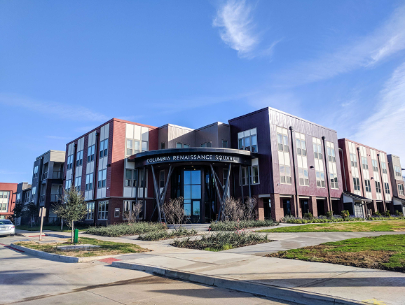
2025 Housing Tax Credit Developer Forum
Wednesday, October 2, 2024
Chad LaRoque, Manager
Neighborhood Services Department

Slide 2
Agenda
Introduction to City Staff
2024 HTC Policy in Review
Proposed Changes to the 2025 HTC Policy Process
Receive Feedback on 2025 Proposed Changes
CDBG-DR Status

Slide 3
Neighborhood Services Development Staff
Kacey Bess
Neighborhood Services Director
Assistant General Manager FWHFC
Chad LaRoque
Housing Development Manager
Dyan Anderson
Coordinator
Tax Credit, Multifamily, Special Projects
Justin McLaughlin
Coordinator
CHDOs, Single Family
Sarah Odle
Coordinator
NEZ, Façade Improvement
Virginia Villalobos
Administrative Assistant

Slide 4
Auxiliary Department Staff
Communication and Public Engagement
Development Services
Fort Worth Lab
Tracy Edwards, Public Education Specialist
Nathaniel Ebers, Budget Analyst
LaShondra Stringfellow, Assistant Director--Zoning and Design Review
Legal
Leslie Hunt, Senior Assistant City Attorney
Denis McElroy, Senior Assistant City Attorney
Francesco Previto, Data Science Analyst
Janira Mejias, Public Education Specialist

Slide 5
What did we hear last year?
Fee waivers
10% set aside for 0-30% AMI (9% HTCs)
Partnerships with FWHFC
Notes:
Review Q&A from last year—highlight 2-3 questions brought up from last year

Slide 6
Proposed Changes in 2025 HTC Policy Process

Slide 7
Requests for hold harmless zoning letters added to the application.
Developer responsible for working with Development Services to obtain letter
Removed quarterly deadlines for the submission of 4% HTC applications
4% HTC applications accepted throughout the year
Community Engagement office to respond within one week, so developer may hold an info session (previously 2 week period)
Added Neighborhood Alliances to required notifications
Neighborhood Associations, Homeowners Associations, Neighborhood Alliances referred to collectively as “Registered Community Organizations” in policy

Slide 8
2025 HTC Resolution Requirements
Requirements | 9% |  | 4% No Objection
 | Support | No Objection
Minimum 10% of total units are 0-30% AMI | X | X
Located in TDHCA-defined high opportunity area, mixed-use growth center, city revitalization area, or CNI Neighborhood | X
Written notifications sent to Councilmember, City Staff, ISD, and Registered NA/HOA | X | X | X
Information session held prior to application deadline | X | X | X
Notes:
Review Policy on this slide and next
Notifications (15) v. Applications (2). How did QAP and CFW Policy impact developing in CFW?

Slide 9
2025 Proposed HTC Timeline
DATE | ACTIVITY
October 2, 2024 | HTC Developer Forum
October 4, 2024 | Developer deadline to submit policy questions/comments
October 11, 2024 | Answers to developer questions posted to the website
November 12, 2024 | Council consideration & approval of Proposed 2025 Policy
December 4, 2024 | Deadline to submit notifications (30 days ahead of submittal)
January 3, 2025 | Deadline to host at least 1 neighborhood information session
January 3, 2025 | Deadline for developers to submit application to Neighborhood Services
February 2025 | Staff recommendations presented at City Council Work Session
February 2025 | City Council consideration & approval of resolutions
Notes:
Review Policy
Notifications (15) v. Applications (2). How did QAP and CFW Policy impact developing in CFW?

Slide 10
Community Engagement Process
Developer notifies Neighborhood Services Department (NSD) staff of intent to submit an HTC application that indicates the address(es) of the proposed development.
NSD staff prepares a map that shows the registered NA/HOA within a ½-mile radius of the proposed development and sends that map to Community Engagement Office (CEO) staff.
CEO staff send an introductory email within one week to both the affected NA/HOAs and the developer. The email will include contact information for all entities notified and the map as noted above. This communication must be attached to the HTC application to provide proof of notification to the affected NA/HOA.
Developers engage with NA/HOA and hold at least 1 information session. The session does NOT have to be held at a NA/HOA meeting but must be held in the area where the proposed development will be located.

Slide 11
FEEDBACK?
Notes:
1 question per slide (no header)

Slide 12
CDBG-DR Multi-Family Briefing
Presented to: HTC Developer Forum
Presented by: Tamara Jones
Date: October 2, 2024

Slide 13
CDBG-DR Overview
What is CDBG-DR?
When the President declares a major disaster, Congress may appropriate funds to the Department of Housing and Urban Development (HUD) when there are significant unmet needs for long-term recovery.
How can CDBG-DR funds be used?
The special appropriation provides funds to the most impacted and distressed
areas for:
Disaster Relief
Long-Term Recovery
Restoration of Infrastructure
Housing
Economic Revitalization
Who is Eligible to Receive Funding?
Members of the public impacted by a disaster cannot receive CDBG-DR funds directly from HUD. Funds are awarded to state and local governments which become grantees. Those who receive grant money include state agencies, non-profit organizations, economic development agencies, citizens and businesses.

Slide 14
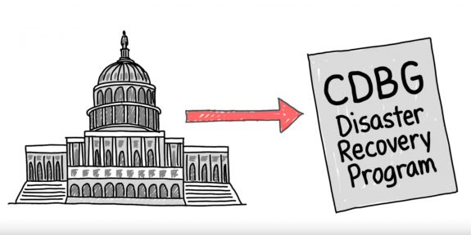
CDBG-DR Overview
Winter Storm Uri
February 11, 2021 – February 21, 2021
Record amount of snow and ice impacted the entire State of Texas
State power grid unable to produce electricity
70% of Texans lost power; 50% had no access to water
Presidential Declaration
President Biden approved a Texas Disaster Declaration (February 20, 2021)
FEMA-4586-DR-TX
Approved assistance for all areas affected by Winter Storm Uri
FEMA Assistance
Federal Emergency Management Agency
Established in April 1979 under President Carter (Executive Order 12127)
Dual mission of emergency management and civil defense
Region VI (Denton, TX)
Provides assistance before, during, and after disasters

Slide 15
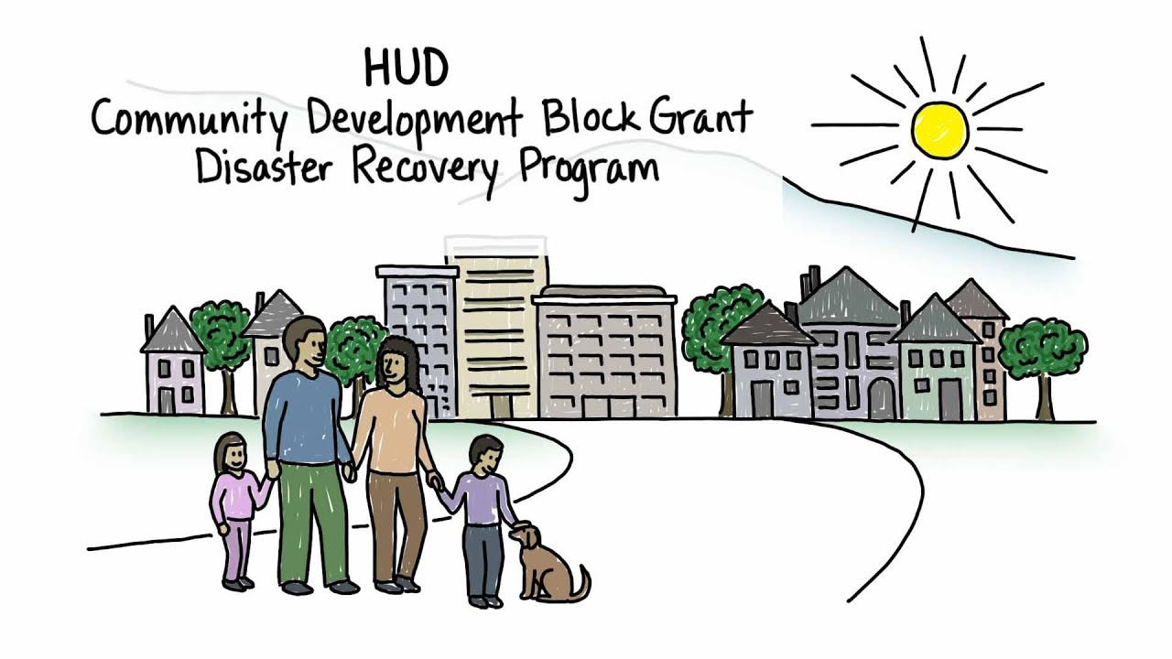
CDBG-DR Overview
Purpose of CDBG-DR Funds
Focuses on long-term recovery efforts
Addresses unmet needs that other federal programs have not addressed yet
Funds SUPPLEMENT and fill remaining gaps
CDBG-DR cannot SUPPLANT other federal funds
Funding Allocation
City of Fort Worth was allocated $16,614,000 in May 2022 (FY21)
Second allocation of $10,858,000 in November 2022 (FY22)
Total Allocation = $27,472,000
Assistance to individuals and entities impacted by Winter Storm Uri
Funding to address needs that remain after all other assistance has been exhausted

Slide 16
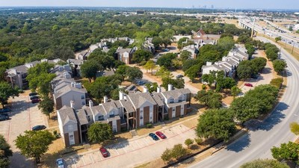
CDBG-DR: Multifamily New Construction $8,140,600
Award Method: Notice of Funding Availability (NOFA)
Maximum Award: $2M
Replacement housing due to the storm
Low-Mod Housing (LMH) Benefit
51% of assisted units must comply with the locally established standards for housing that is “affordable to LMI households”
Eligible applicants must provide
financial documentation
Must meet underwriting guidelines
Financially feasible

Slide 17
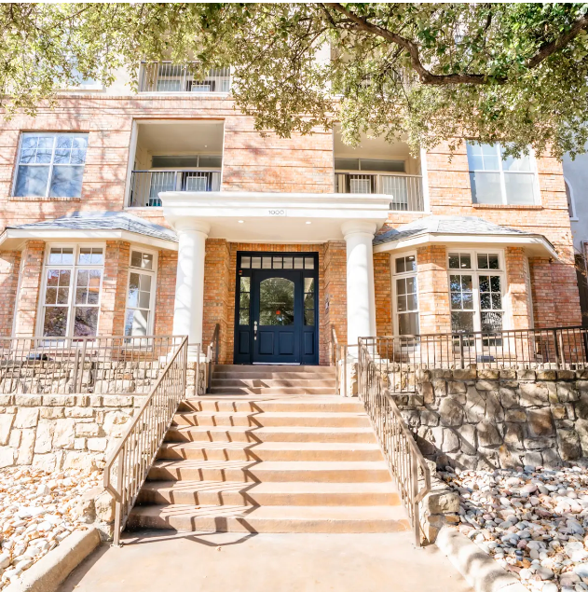
CDBG-DR: Multifamily Rehab $5,835,000
Award Method: Notice of Funding Availability (NOFA)
Maximum Award: $2M
Low-Mod Housing (LMH) Benefit
At least 51% of assisted units must be LMI
Designed to support the preservation of rental units
Eligible applicants must provide
financial documentation
Must meet underwriting guidelines
Financially feasible

Slide 18
TIMELINE
Milestone | Date
Winter Storm Uri | February 11, 2021
Presidential Disaster Declaration | February 20, 2021
HUD Allocation – CDBG-DR | March 20, 2022
Allocation Notice – Federal Register | May 24, 2022
First Public Comment Period Begins | August 22, 2022
First Action Plan Public Hearing | August 31, 2022
First Public Comment Period Ends | September 23, 2022
Draft Action Plan presented to Community Development Council; Public Hearing | October 12, 2022

Slide 19
TIMELINE
Milestone | Date
Additional Funding Allocation | November 3, 2022
Extension #2 Granted to January 31, 2023 | November 18, 2022
Second Public Comment Period Begins | December 19, 2022
Third Action Plan Public Hearing | December 28, 2022
Draft Action Plan presented to Community Development Council | January 11, 2023
Second Public Comment Period Ends | January 18, 2023
City Council Approval Request | January 31, 2023
Action Plan submitted to HUD | February 14, 2023
Action Plan Approval | May 8, 2023

Slide 20
TIMELINE
Milestone | Date
Implementation Plan/Budget/Organizational Chart | August 9, 2023
Community Development Council Board Retreat | September 27, 2023
HUD Grant Agreements Executed | January 18, 2024
Single-Family Program Policies Development | January 2024 – June 2024
DR Documents Creation | May 2024 – Ongoing
Intake Application Creation and Neighborly Implementation | ~June 2024 – September 2024
Action Plan Updates/Revisions | February 2024 – June 2024
Public Comment Period Begins | July 8, 2024
Public Hearing | July 18, 2024
Public Comment Period Ends | August 7, 2024
City Council Approval | November 2024

Slide 21
TIMELINE
Milestone | Date
HUD Review/Approval | ~Nov – Dec 2024
Anticipated Single-Family Program Implementation | Dec 2024 – Jan 2025
Multi-Family Program Policies Development | Aug 2024 – Dec 2024
Anticipated Multi-Family Program Implementation | TBD

Slide 22
Thank you!

Slide 23
MORE FEEDBACK/ QUESTIONS?
Notes:
1 question per slide (no header)

Slide 24
2025 Proposed HTC Timeline
DATE | ACTIVITY
October 2, 2024 | HTC Developer Forum
October 4, 2024 | Developer deadline to submit policy questions/comments
October 11, 2024 | Answers to developer questions posted to the website
November 12, 2024 | Council consideration & approval of Proposed 2025 Policy
December 4, 2024 | Deadline to submit notifications (30 days ahead of submittal)
January 3, 2025 | Deadline to host at least 1 neighborhood information session
January 3, 2025 | Deadline for developers to submit application to Neighborhood Services
February 2025 | Staff recommendations presented at City Council Work Session
February 2025 | City Council consideration & approval of resolutions
Notes:
Review Policy
Notifications (15) v. Applications (2). How did QAP and CFW Policy impact developing in CFW?

Slide 25
Thank you!
Send comments/questions to
HTC@fortworthtexas.gov by Friday, October 4, 2024.
Answers will be posted to the department’s website https://www.fortworthtexas.gov/departments/neighborhoods
by Friday, October 11, 2024.

